Slide 1
ETT Presentation to WMS on CREZ Outage Schedule Changes August 3, 2020

Slide 2
New Substation Cut-in
Change in ETT outages to accommodate new station cut-in:
New substation (Figaro) cut-in on the Clear Crossing to Dermott line.
Outage on Clear Crossing to Dermott planned for 9 days subject to ERCOT recall and 8 hour restoration.
ETT will put Edith Clarke to Clear Crossing line back into service during this time raising the GTC limits while the Clear Crossing to Dermott line is out of service.
Once the Clear Crossing to Dermott line is back in service, ETT will continue with the Edith Clarke to Clear Crossing outage until October as submitted in Outage Scheduler.
This is a joint effort between ONCOR & AEP with ERCOT Operations and Outage Scheduling supporting the effort to make this possible.
Due to CEII restriction we are unable to specify the exact dates until they are posted approved in Outage Scheduler. Please check the ETT website for notice of the outage when authorized.
ETT would like to Thank ONCOR, AEPSC, ERCOT and the Contractors/Staff involved in make this possible.
Notes:
When running analysis it is very difficult to single out specific factors as they all have an impact of the final revenue decision. We can do spefic case studies on any of these specific line items to give a more detail report.
Assumptions:
The base model for this analysis takes the revenue requirement of our last iTCOS in 2018.
Please review to the chart in the lower left hand corner to see the factors used for our Best Case and Worst Case Scenarios
O&M: ETT’s O&M level were carefully reviewed and adjusted based on known information from SWEPCO and AEP Texas rate case outcomes.
Depreciation: Deprecation rates were slightly adjusted higher based on expected changes related to ETT’s current portfolio through 2021.
After further conversation with the PUCT it seems unlikely that a one year extension is an option due to ETT not having filed an initial rate case.

Slide 3
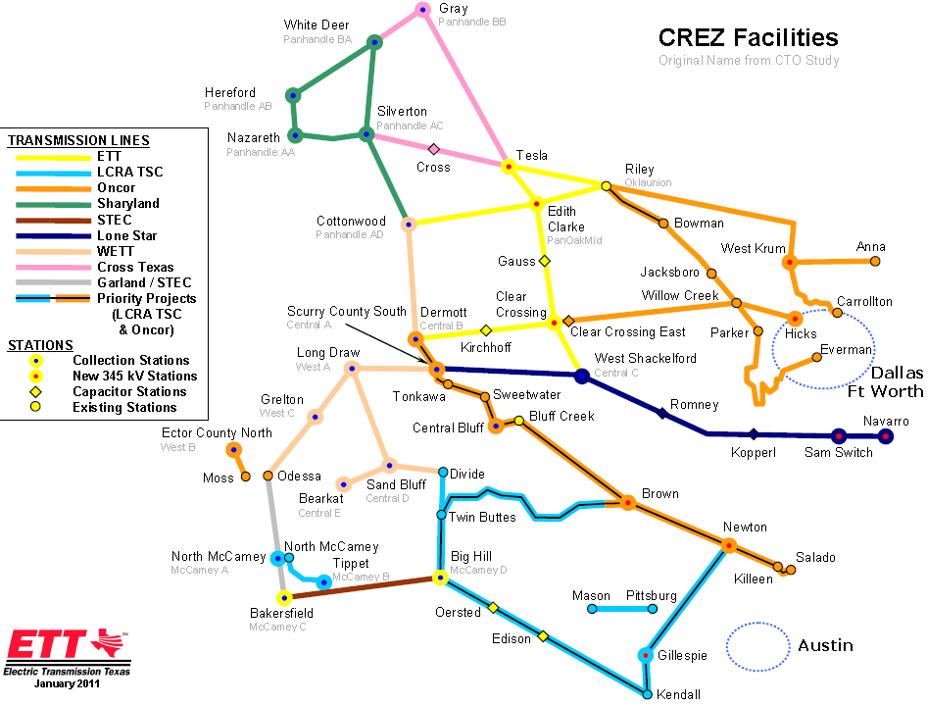
Figaro

