Slide 1
South Zone LMP on 5/11
Jian Chen
Market Analysis and Validation
CMWG
Aug. 3rd, 2020

Slide 2
OD 5/11 LZ_SOUTH LMP

Slide 3
Constraint Shadow Price and Violated MW

Slide 4
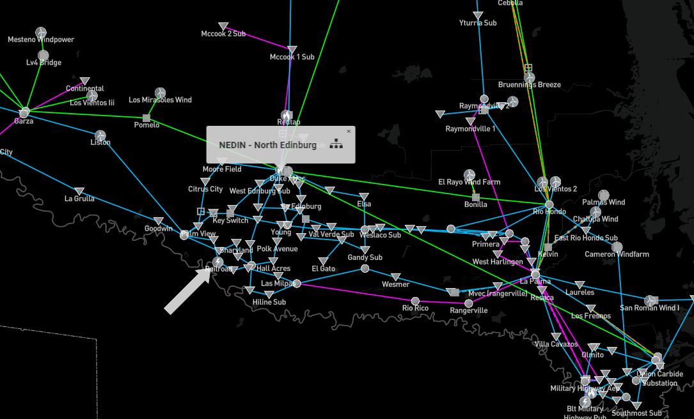
Constraint XNED258: NEDIN_138H
Loss of one 345/138kV transformer at North Edinburg would cause overload on the other 345/138kV transformer at North Edinburg, with flow direction from 345kV to 138kV side.

Slide 5
Factors impacting the constraint
Local loads
Local generations
DC-tie

Slide 6
Local loads

Slide 7
Local Generations

Slide 8
Local Generations (Cont.)

Slide 9
DC-tie

