Slide 1
System Protection Working Group (SPWG) Update to ROS
August 06, 2020
Chair: John Karlik, PE
Vice-Chair: Vincent Roberts, PE

Slide 2
SPWG Meeting
Meeting held on July 22, 2020
Topics Discussed:
Proposed NOGRR to revise OG 6.1.5
Impact of Inverter-Based Resources (IBR) on ERCOT Grid Protection
Proposed RRGRR
2020 Q1 Protection System Misoperations
Next meeting is scheduled November 10-11, 2020

Slide 3
Proposed NOGRR to revise OG 6.1.5

Slide 4
Proposed NOGRR to revise OG 6.1.5
ERCOT presented draft revision of OG 6.1.5
Desire for SPWG to sponsor the NOGRR
Proposed language removes annual reporting of DME
SPWG tentatively supports changes
SPWG is reviewing the draft before submittal

Slide 5
Impact of IBRs on ERCOT Grid Protection

Slide 6
Impact of IBRs on ERCOT Grid Protection
SPWG discussed results of TSP survey:
A common concern is insufficient modeling data collected during interconnection process
Action Items
A SPWG workshop to discuss survey results, determine if further action is required, and summarize results to ROS is scheduled for 8/11/2020

Slide 7
Proposed RRGRR

Slide 8
Proposed RRGRR
SPWG had an action item to revise RARF to add three-winding transformer data
Draft changes have been made to the RRG
SPWG is reviewing the changes before submittal

Slide 9
2020 Q1 Protection System Misoperations

Slide 10
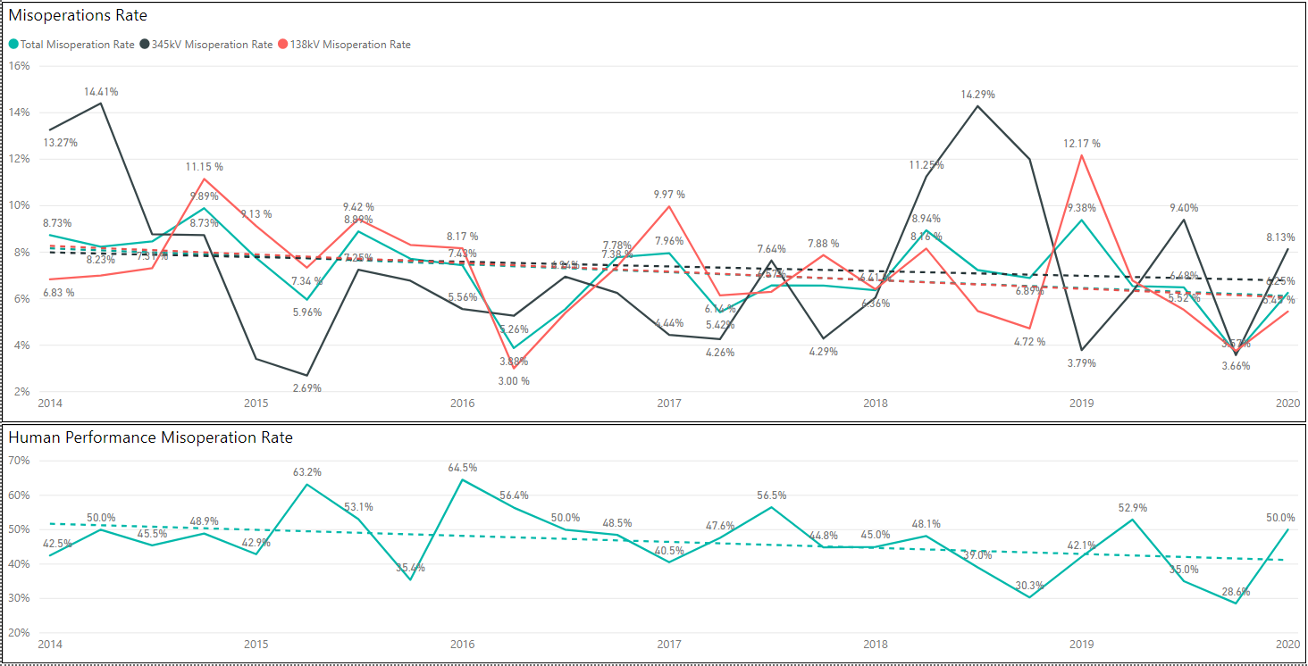
Protection System Misoperations: 2014-2020 Q1

Slide 11
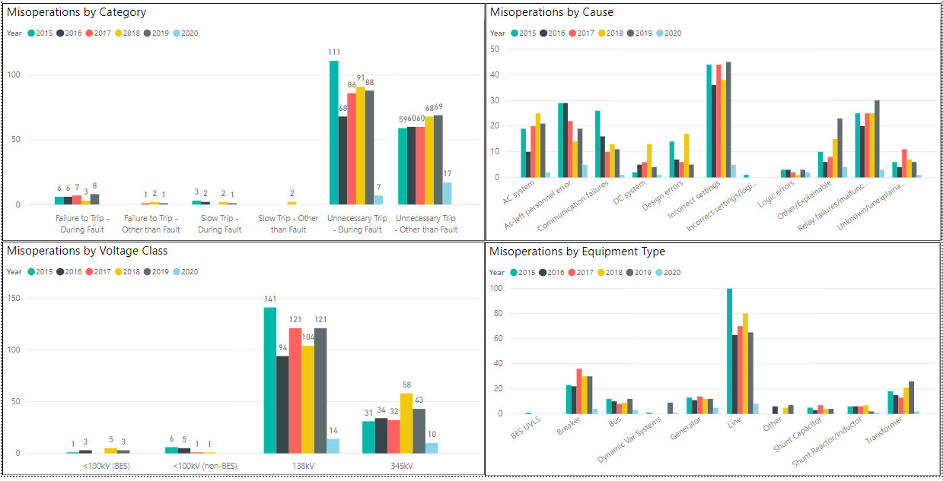
Protection System Misoperations: 2014-2020 Q1

Slide 12
Protection System Misoperations – 2020 Q1
 |  | Q1 | 2020
# of Misoperations | Total | 24 | 24
 | 345 kV | 10 | 10
 | 138 kV | 14 | 14
 | < 100 kV | 0 | 0
By Category | Failure to Trip | 0 | 0
 | Slow Trip | 0 | 0
 | Unnecessary Trip during Fault | 7 | 7
 | Unnecessary Trip – Non Fault | 17 | 17
 | SPS | 0 | 0
By Relay System Type | Electromechanical | 1 | 1
 | Solid State | 0 | 0
 | Microprocessor | 20 | 20
 | Other/ N/A | 3 | 3
By Equipment Protected | Line | 8 | 8
 | Transformer | 2 | 2
 | Generator | 5 | 5
 | Shunt/Series Capacitor | 0 | 0
 | Shunt/Series Reactor | 1 | 1
 | Dynamic VAR system | 1 | 1
 | Bus | 3 | 3
 | Breaker | 4 | 4

Slide 13
Protection System Misoperations – 2020 Q1

Slide 14
Regional Misoperation Rate Comparison

Slide 15
Protection System Misoperations 2020 Q1
Summary of Human Performance Issues noted for 2020 Q1:
A wind plant tripped off-line due to incorrectly wired CTs in a newly replaced 34.5 kV breaker
A wind plant tripped off-line due to incorrectly wired CTs in a capacitor bank
A 138kV bus tripped due to incorrectly wired CTs from a distribution transformer during a construction project
Failure to Trip/Slow Trip Misoperations in 2020 Q1:
None

Slide 16
Definitions
Protection System –
Protective relays which respond to electrical quantities,
Communications systems necessary for correct operation of protective functions
Voltage and current sensing devices providing inputs to protective relays,
Station dc supply associated with protective functions (including station batteries, battery chargers, and non-battery-based dc supply), and
Control circuitry associated with protective functions through the trip coil(s) of the circuit breakers or other interrupting devices

Slide 17
Definitions
Composite Protection System - The total complement of Protection System(s) that function collectively to protect an Element. Backup protection provided by a different Element’s Protection System(s) is excluded.
Misoperation – The failure a Composite Protection System to operate as intended for protection purposes. Any of the following is a Misoperation:
Failure to Trip – During Fault – A failure of a Composite Protection system to operate for a Fault condition for which it is designed.
Failure to Trip – Other than Fault - A failure of a Composite Protection system to operate for a non-Fault condition for which it is designed, such as a power swing, undervoltage, overexcitation, or loss of excitation.

Slide 18
Definitions
Misoperation – The failure a Composite Protection System to operate as intended for protection purposes. Any of the following is a Misoperation:
Slow Trip – During Fault – A Composite Protection system that is slower than required for a Fault condition if the duration of its operating time resulted in the operation of at least one other Element’s Composite Protection System.
Slow Trip – Other than Fault - A Composite Protection system that is slower than required for a non-Fault condition, such as a power swing, undervoltage, overexcitation, or loss of excitation, if the duration of its operating time resulted in the operation of at least one other Element’s Composite Protection System.

Slide 19
Definitions
Misoperation – The failure a Composite Protection System to operate as intended for protection purposes. Any of the following is a Misoperation:
Unnecessary Trip – During Fault – An unnecessary Composite Protection system operation for a Fault condition on another Element.
Unnecessary Trip – Other than Fault - An unnecessary Composite Protection system operation for a non-Fault condition. A Composite Protection System operation that is caused by personnel during on-site maintenance, testing, inspection, construction, or commissioning activities is not a Misoperation.

