Slide 1
Unregistered Distributed Generation Report:
2020 Q2 Update
Resource Adequacy
8/5/2020

Slide 2
2020 Q2 Unregistered Distributed Generation Report
Load Zone | 2020 Q2 Distributed Generation Installed Capacity in MW (AC)
 | SOLAR |  | WIND |  | OTHER RENEWABLE |  | OTHER NON-RENEWABLE |  | TOTAL
 | < 50 kW | ≥ 50 kW | < 50 kW | ≥ 50 kW | < 50 kW | ≥ 50 kW | < 50 kW | ≥ 50 kW | < 50 kW | ≥ 50 kW | Combined
LZ_AEN | 60.26 | 22.21 | - | - | - | - | - | - | 60.26 | 22.21 | 82.47
LZ_CPS | 144.35 | 30.98 | 0.01 | - | 1.11 | - | - | 9.80 | 145.47 | 40.78 | 186.25
LZ_HOUSTON | 49.51 | 2.05 | 0.36 | - | - | 0.11 | 0.05 | 3.70 | 49.92 | 5.86 | 55.78
LZ_LCRA | 49.00 | 13.68 | 0.23 | - | - | - | 0.14 | - | 49.36 | 13.68 | 63.04
LZ_NORTH | 192.88 | 22.92 | 1.83 | 1.01 | - | - | - | 0.63 | 194.71 | 24.55 | 219.26
LZ_RAYBN | 12.41 | 2.97 | 0.25 | 0.05 | - | - | - | - | 12.66 | 3.02 | 15.68
LZ_SOUTH | 61.39 | 15.52 | 0.64 | 0.25 | - | - | - | - | 62.03 | 15.77 | 77.80
LZ_WEST | 17.99 | 4.44 | 0.55 | 0.25 | - | - | - | 0.34 | 18.55 | 5.03 | 23.58
TOTAL | 587.78 | 114.77 | 3.87 | 1.56 | 1.11 | 0.11 | 0.19 | 14.46 | 592.95 | 130.90 | 723.85

Slide 3
2020 Q1 → Q2 Change
Load Zone | 2020 Q1 → Q2 Change in Distributed Generation Installed Capacity in MW (AC)
 | SOLAR |  | WIND |  | OTHER RENEWABLE |  | OTHER NON-RENEWABLE |  | TOTAL
 | < 50 kW | ≥ 50 kW | < 50 kW | ≥ 50 kW | < 50 kW | ≥ 50 kW | < 50 kW | ≥ 50 kW | < 50 kW | ≥ 50 kW | Combined
LZ_AEN | +2.90 | -1.68 | - | - | - | - | - | - | +2.90 | -1.68 | +1.22
LZ_CPS | +7.39 | +1.73 | - | - | +0.27 | - | - | +3.58 | +7.66 | +5.31 | +12.97
LZ_HOUSTON | +0.69 | - | - | - | - | - | - | - | +0.69 | - | +0.69
LZ_LCRA | +5.97 | +0.11 | +0.01 | - | - | - | +0.06 | - | +6.04 | +0.11 | +6.15
LZ_NORTH | +13.08 | +0.78 | - | - | - | - | - | - | +13.09 | +0.78 | +13.87
LZ_RAYBN | +2.99 | +0.99 | -0.01 | - | - | - | - | - | +2.98 | +0.99 | +3.97
LZ_SOUTH | +5.90 | +0.05 | - | - | - | - | - | - | +5.90 | +0.05 | +5.96
LZ_WEST | +3.64 | - | +0.02 | - | - | - | - | - | +3.66 | - | +3.66
TOTAL | +42.57 | +1.99 | +0.02 | - | +0.27 | - | +0.06 | +3.58 | +42.92 | +5.57 | +48.48

Slide 4
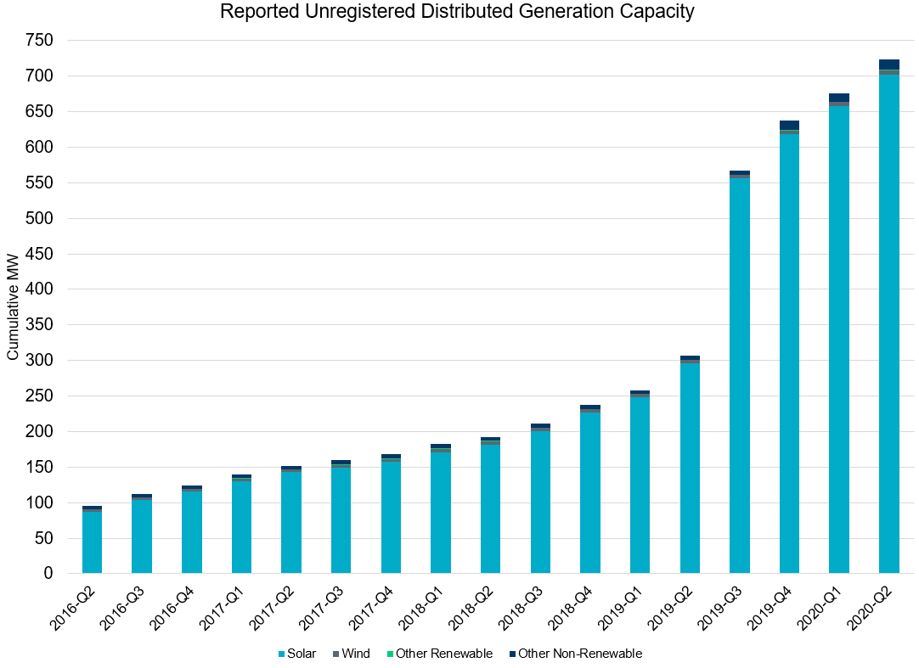
Unregistered DG Growth: 2016-Q2* to 2020-Q2
Large increase due to reporting requirement change**
* 2016-Q2 was the first report published after implementation of report changes per NPRR794/COPMGR044
** 2019-Q3 was the first report published after implementation of report changes per NPRR891

