Slide 1
Factors Influencing Market Clearing Engines Run Times
ERCOT
August 3rd , 2020

Slide 2
CRR
Allotted Time
Long-Term Auction : Two weeks
Short-Term Auction : One week
Factors that can lead to long run times
Large volume of CRR Option Bids
Large number of modeled transmission constraints
Large overall number of CRR Bids/Offers and existing Baseload
Phase Shifter Optimization (potential – upcoming delivery)
Increase in number of Settlement Points can lead to long run times
Potential increase in overall number of CRRs submitted , especially if it causes increase in submitted CRR Option Bids
Potential increase in modeled transmission constraints
Need to factor potential time for:
Delay in start of auction process
Encountering error, fixing it, and then restarting auction process
Results verification
Can sometimes lead to restarting auction process - example Counterparty credit issues from CMM

Slide 3
DAM
Allotted Time
3 ½ Hours (10AM-1:30pm)
Security Constrained Unit Commitment & Dispatch
Iteration between optimization engine (MIP & QP) that commits/dispatches Resources and network analysis that determines transmission feasibility of commitment/dispatch and supplies transmission constrains to the optimization engine
Factors that can lead to long run times
Large volume of variables – both continuous and integer variables
More Integer variables can exponentially increase run-time
Currently experiencing performance issues when volume of PTP submissions exceed 170,000
Large number of modeled transmission constraints.
Large number of Temporal Constraints
Large number of Transmission Outages, typically in shoulder months that can lead to more transmission constraints

Slide 4
DAM
Increase in number of Settlement Points can lead to long run times
Potential increase in overall number of PTP submitted as the available paths increase or increase in DAM Energy Only Offer/Bids
Potential increase in modeled transmission constraints
Need to factor potential time for:
Delay in start of DAM
Encountering error, fixing it, and then restarting DAM

Slide 5
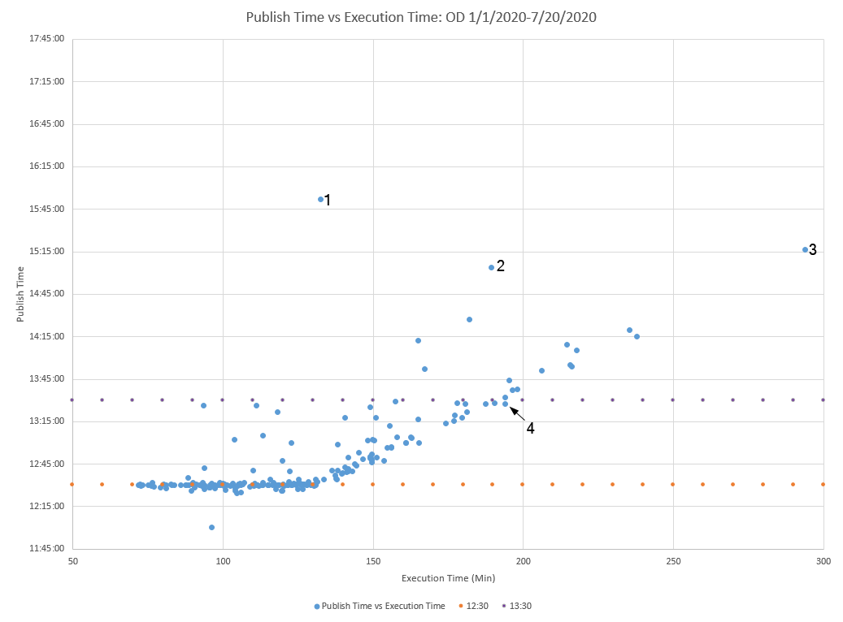
DAM
Key | OD | Description
1 | 3/24/2020 | Numerous variables increased constraints and caused very slow processing. DAM was restarted so that constraints could be added to watchlist. An issue with a NCLR being incorrectly awarded was discovered and fixed. 185,187 PTP/CRR interval records
2 | 7/13/2020 | Numerous constraints caused very slow processing and constraint limit was reached. DAM was restarted so that constraints could be added to watchlist. 189,045 PTP/CRR interval records. $1.1B objective function.
3 | 2/5/2020 | Long solution time. 10 iterations. 170,592 PTP/CRR interval records
4 | 5/1/2020 | Long solution time. 176,200 PTP/CRR interval records

Slide 6
HRUC
Allotted Time
30 minutes maximum. ERCOT Operator needs sufficient time to review HRUC results.
Security Constrained Unit Commitment & Dispatch
Iteration between optimization engine (MIP & QP) that commits/dispatches Resources and network analysis that determines transmission feasibility of commitment/dispatch and supplies transmission constrains to the optimization engine
RUC deals with physical Resources so number of variables less than DAM
Run time allocated, is however, a lot less (30 minutes)
Factors that can lead to long run times
Large volume of variables – both continuous and integer variables
More Integer variables can exponentially increase run-time
Large number of modeled transmission constraints.
Large number of Temporal Constraints
Increase in number of Settlement Points (actually Resources) can lead to long run times if it impacts any of the factors described above

Slide 7
SCED
Allotted Time
20-30 seconds. On the average, end to end is less than 20 seconds
Factors that can lead to long run times
Large volume of variables –here only dealing with continuous variables
Large number of modeled transmission constraints.
Increase in number of Settlement Points (actually Resources) can lead to long run times if it impacts any of the factors described above
As of today, no performance issues

