Slide 1
ERCOT Metering Working Group July 23, 2020
Implementation of NPRR1020:
Allow Some Integrated Energy Designs to Calculate Internal Loads

Slide 2
Integrated energy use (thermal and controller energy) measurement process
Utility grid
AC power is delivered from the utility grid via Powerstages with AC to DC conversion efficiency ɳ_{PS}
AC Breaker
Powerstages
Integrated energy use (thermal and controller) power consumption is calculated in each supply, based on real time voltage and current measurements with +/-2% accuracy.
DC/DC integrated energy use voltage and current are sensed on the output side, hence conversion efficiency ɳ_{DCDC} needs to be applied.
V, I
DC/AC
Supply
DC/DC
Supply
V, I
Total integrated energy use supplied by the utility grid:
AC power =
(DC/AC supply + (DC/DC supply x 1/ɳ_{DCDC})) x 1/ɳ_{PS}
This power is reported from each Megapack to the Site Master Controller where it is aggregated to a single consumption value

Slide 3
Network architecture for load energy reporting through SCADA system
ERCOT
Each Megapack independently assesses its load power
The site controller polls this information on a 10hz update rate, and sums across all Megapacks
RTAC pulls the calculated aux load from Tesla site controller and pushes calculated signal to TDSP owned EPS meter via TDSP data concentrator
The EPS Metering integrates power into energy and reports settlement data on 15 minute intervals via MV90 polled by ERCOT (EPS Metering reports 3 separate channels: actual metered load, corrected load (subtracting aux power), and calculated aux load.
MV90
EPS Meter
DATA CONCENTRATOR
TDSP network
DNP Over Single Serial Cable
Generator Owner network
Calculated aux load
Tesla Site Controller
RTAC
LAN 1 Switch
LAN 2 Switch
…
3
Local Historian
Megapack 1
Megapack n

Slide 4
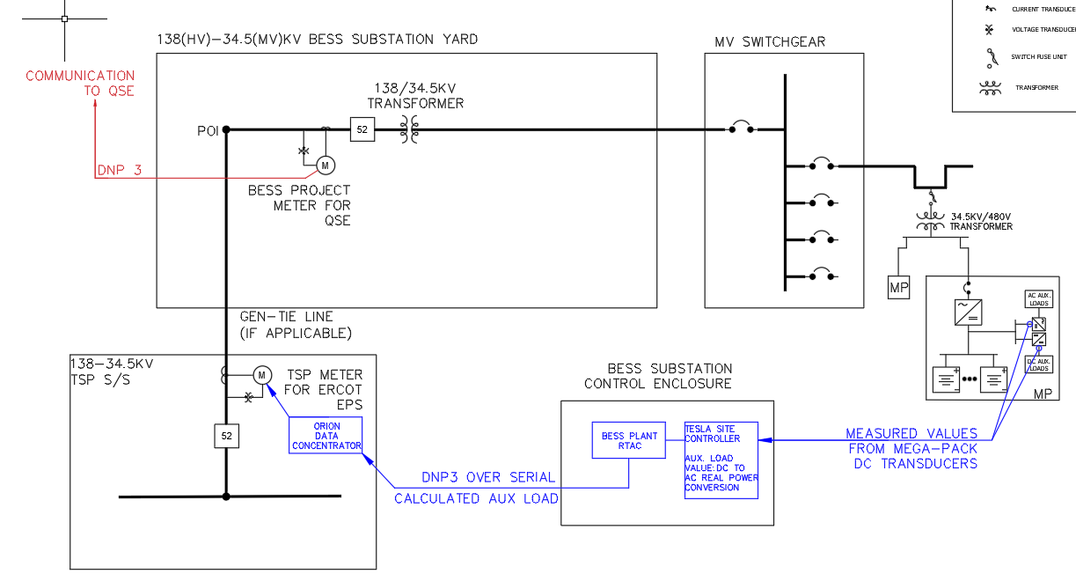

Slide 5
Proposed NPRR1020 Implementation Steps
Proof of Concept Steps
Resource Entity actions – completed:
Tested linkage from RTAC to MV90 Meter ( examples: SEL-735; Schneider ION )
TDSP actions – completed by 7/30:
Tested communication between RTAC, Data Concentrator and EPS Meter to verify 15-min interval value in the meter and historization
Items to Implement in Settlement Metering Operating Guide
Metering Arrangement Description
Reference Resource Entity ESR Certification Form (pro forma or legal letterhead with certified diagrammatic attachment)
State that ESR integrated loads cannot be metered separately as designed
Submitted to ERCOT as part of EPS Metering Design package in normal resource entity registration/commissioning process
Calculation Requirements & ERCOT Approval of Calculation Methodology
Equipment used to measure the aux loads (DC transducers; master controller; battery plant RTAC) and associated software programming
Methodology for using the data from the sensors (describe data flow from ESR readings to site controller to local historian and RTAC)
Details of the Audit Process – steps + reference annual attestation
Attestation (include in SMOG Appendix or separately include on Settlement Metering landing page)
Develop ERCOT recurring submission process (e.g. ERCOT market notices); change control process for affidavit form)

Slide 6
APPENDIX

Slide 7
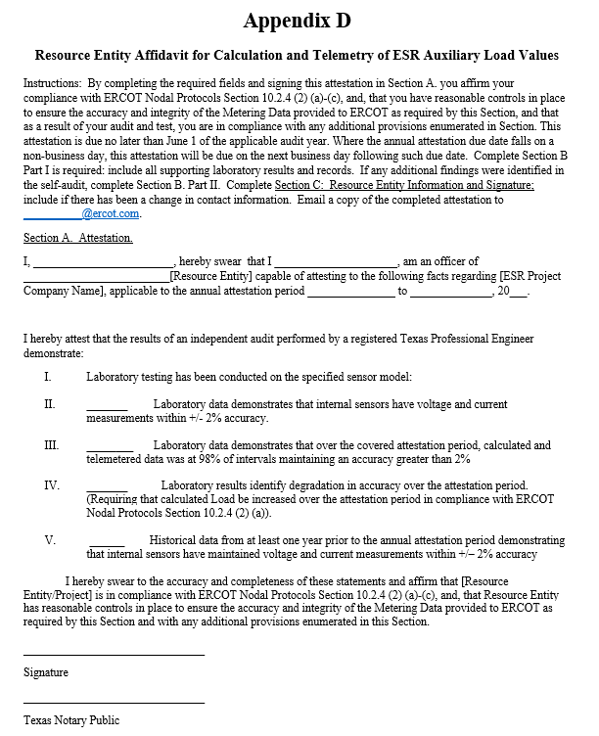
Attestation
(2) An officer of the Resource Entity shall annually attest to the methodology and validity of the auxiliary Load calculation, as further described in the SMOG. The Resource Entity shall include with their annual attestation an independent audit performed by a registered Texas Professional Engineer of the performance of the internal sensors to prove the ESR has demonstrated one of the following:
The accuracy of the internal sensors, based on laboratory testing of the same model of internal sensors, which accounts for any possible degradation in accuracy over time. The attestation shall either state that the internal sensors have maintained +/– 2% accuracy or state that the Resource Entity has increased the calculated Load to account for any laboratory found inaccuracies for the attestation period;
+/– 2% accuracy measurement of the auxiliary Load via historical data for the past year; or
(c) Any ESR that utilizes internal sensors and is either not able to maintain +/– 2% accuracy or demonstrate via the Resource Entity’s audit that the calculated meter data provided was at 98% of intervals maintaining an accuracy greater than 2% to compensate for any uncertainty of actual value of the auxiliary Load.

Slide 8
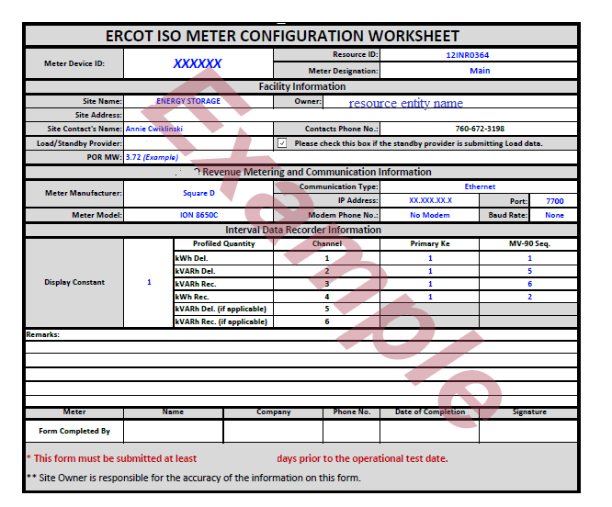
Resource Entity Certification
10.2.4 Resource Entity Calculation and Telemetry of ESR Auxiliary Load Values
(1) When the Resource Entity certifies, the interconnecting TDSP confirms by approving the metering design, and, based on the information provided by the TDSP as part of the EPS Design Proposal, ERCOT agrees that metering of an ESR’s Wholesale Storage Load separate from the ESR’s auxiliary Load is not feasible based on the ESR’s physical design, the Resource Entity for that ESR shall be permitted to calculate the auxiliary Load using measurements from its own internal sensors and telemeter a Real-Time aggregated value for that Load to the TDSP’s EPS Meter. The Resource Entity may telemeter a zero Load value only when the ESR is discharging. The methodology by which the auxiliary Load is calculated is subject to ERCOT approval.
Submit ESR metering configuration worksheet + certification statement to TDSP in Metering Design Package

