Slide 1
Distribution Generation Resource (DGR) Workshop IV Update
July 20, 2020

Slide 2
DGR Review
ERCOT issued a Market Notice 9/26/19
  http://www.ercot.com/services/comm/mkt_notices/archives/4288
  Moratorium on further DGR interconnection until necessary rules can be developed
First Eight Workshops held 11/5/2019- 06/26/2020
  (hyper links on DGR Workshop IX website http://www.ercot.com/calendar/2020/6/26/208498

Slide 3
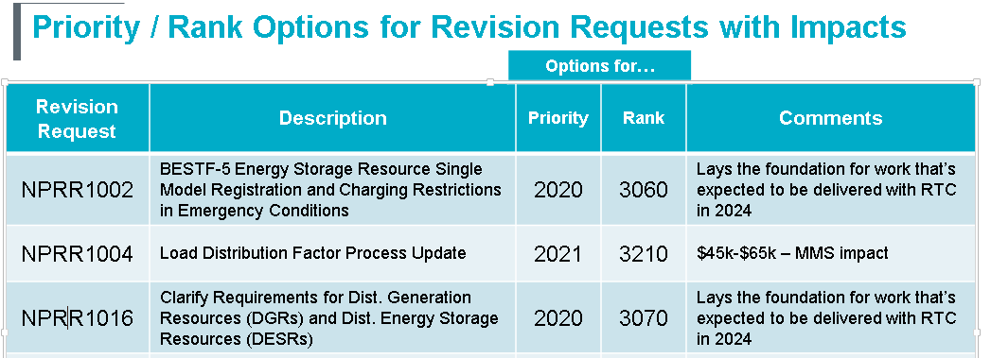
Key Workshop Results
Phase 1 – NPRR and NOGRR Approval
  NPRR1016 approved by PRS on 07/16/2020 and forwarded to TAC
  NOGRR212 and RRGRR026 approved by ROS on 07/09/2020 and forwarded to TAC
  Scheduled to be on July 29 TAC agenda
  Possible ERCOT BOD approval on Aug 11.

Slide 4
Key Workshop Results (cont’d)
Phase 2 – PGRR Approval
  PGRR082 was posted on June 30, 2020
    Reorganizes the existing PG Section 5 to define processes for large or small generators
      Large generators -10 MW or greater -> Full FIS process
      Small generators – SODG, DGR,SOTG less than 10 MW -> Abbreviated process
  Scheduled to be on ROS agenda Aug 6
Main topic of discussion for DGR Workshop IX

Slide 5
Questions?

