Slide 1
DGR Workshop IX: PGRR Summary
July 20, 2020

Slide 2
Background
SODGs | # Units | MW
Non-Renewable | 175 | 505
Renewable + Storage | 61 | 345
TOTALS | 236 | 850
23 units totaling 66 MW added in 2019
3 units totaling 36 MW retired in 2019

Slide 3
PGRR Purpose
Create the concept of large and small generators
  Large generators are 10 MW or greater
  Small generators are less than 10 MW
  Interconnection kV level is not considered in the definition
Maintain the existing interconnection process for large generators
Create a tracking process for small generators, regardless of interconnection kV level
Create language specific to large generators on the distribution system
Streamline and reorganize the existing PG Section 5 language in order to better incorporate new language

Slide 4
Proposed Additions to the PG
A new sub-section was added to create a tracking process for small generators
  Interconnection Procedures for Small Generators
Several existing sub-sections were modified to include small generators and large, distribution-connected generators in Section 5 and 6.9
  Applicability
  Status sub-sections
  Interconnection Agreements
  Security Screening Study
  Additions of Proposed Generation to the Planning Models

Slide 5
Proposed: 5.2 General Provisions
Reorganized
Ordered the sequence of the initiation process
Moved several existing sub-sections into the new 5.2
  Applicability
  Confidentiality
  Renamed the section related to updating requested information
  Inactive Status
  Project Cancellations
  Interconnection Agreements and Procedures

Slide 6
Proposed concepts for Applicability
New Generator Interconnection
Small Generator Process
  Aggregate nameplate capacity is less than 10 MW
Large Generator Process (FIS)
  Aggregate nameplate capacity is 10 MW or greater

Slide 7
Proposed concepts for Applicability
Modification of capacity routes
Small Generator Process
  Increase any generator’s nameplate capacity by 1 MW or greater, but less than 10 MW
Large Generator Process
  Increase any generator’s nameplate capacity by 10 MW or greater
  Increase an existing small generator to now a large generator nameplate capacity

Slide 8
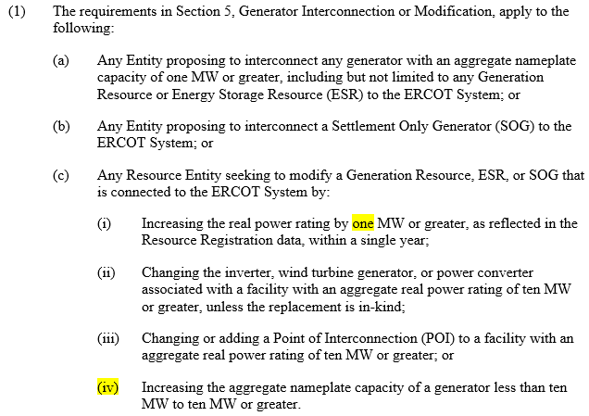
Proposed: 5.2.1 Applicability

Slide 9
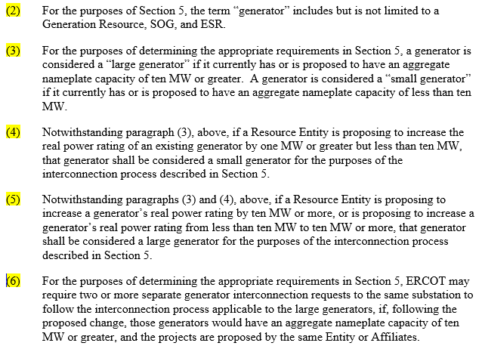
Proposed: 5.2.1 Applicability

Slide 10
Examples for Applicability (Initial Interconnection)

Slide 11
Examples for Applicability (Modification Interconnection)

Slide 12
Examples for Applicability (Modification Interconnection)

Slide 13
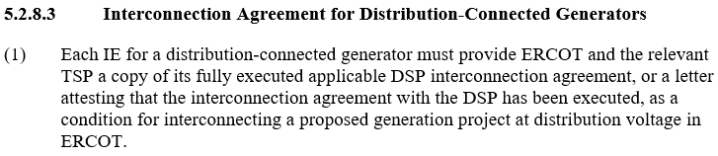
Proposed: 5.2.8.3 Interconnection Agreement for Distribution-Connected Generators

Slide 14
Proposed: 5.3 Interconnection Study Procedures for Large Generators
Several existing sub-sections were relocated into the new 5.3
  Security Screening Study
  Full Interconnection Study
    Proof of Site Control
    FIS Scoping Process
      Incorporated new feasibility for distribution projects 10 MW or greater
    FIS Description and Methodology
    FIS Elements (SS, SC, Stability, and Facility studies)
    FIS Report and Follow-up
  ERCOT Economic Study

Slide 15
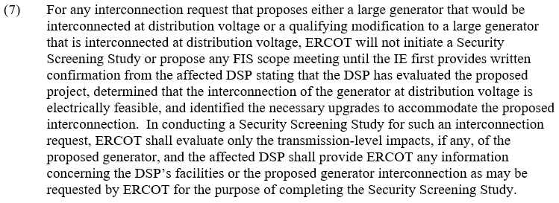
Proposed: 5.3.1 Screening Study

Slide 16
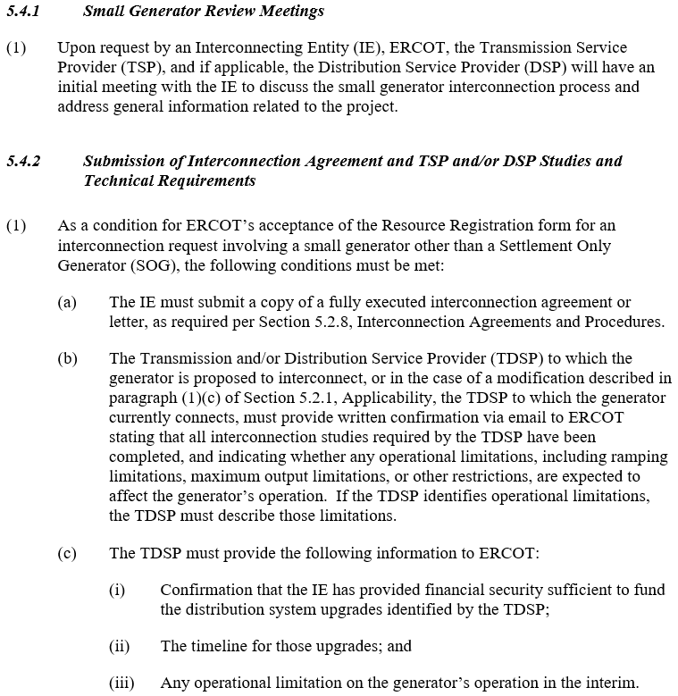
Proposed: 5.4 Interconnection Procedures for Small Generators

Slide 17
Proposed: 5.4 Interconnection Procedures for Small Generators

Slide 18
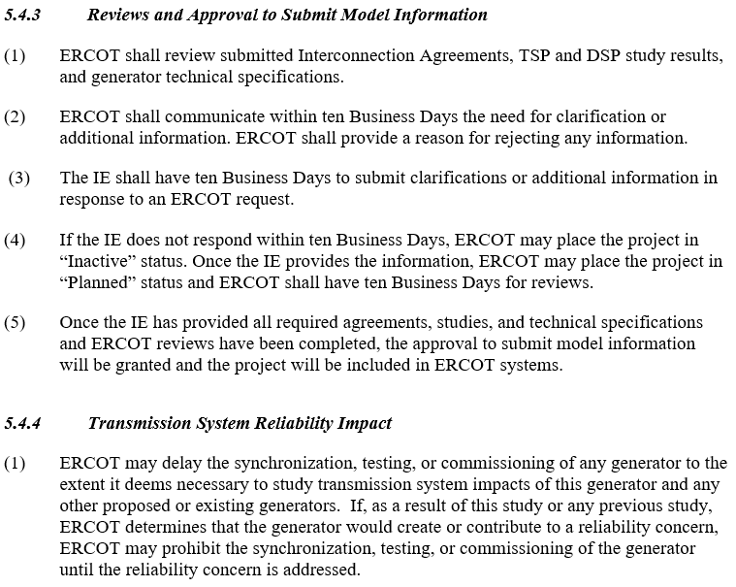
Proposed: 5.4 Interconnection Procedures for Small Generators

Slide 19
Proposed: 5.4 Interconnection Procedures for Small Generators

Slide 20
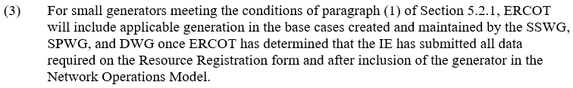
Proposed: 6.9 Addition of Proposed Generation to the Planning Models

Slide 21
Proposed Deletions to PG Section 5
Existing Sub-section | Existing Sub-section Name | Reason for Deletion
5.1 | Introduction: Paragraph (2) | unnecessary
5.1.1 | Applicability: Paragraph (2) | unnecessary
5.1.2 | Responsibilities | redundant
5.2 | Generation Interconnection Process: Paragraph (1) | unnecessary
5.2.2 | Generation Interconnection or Change Request Submission Requirements: Paragraph (1), (3) | redundant
5.3 | Full Interconnection Study Request: Paragraph (2), (3), (4) | unnecessary/redundant
5.4.2.1 | Full Interconnection Study Process Overview: Paragraph (6) | unnecessary
5.4.2.2 | Full Interconnection Study Elements: Paragraph (7) | unnecessary
5.5.2 | Other Arrangements for Transmission Service | unnecessary
5.7.2 | Interconnection Study Fees: Paragraph (1) | unnecessary
5.7.3 | Generation Interconnection and Full Interconnection Study Application Fees: Paragraph (2)(c) | unnecessary
5.7.5 | Interconnection Process Timetables | belongs in handbook
5.8.1 | Other Standards | unnecessary

Slide 22
Proposed Relocations in PG Section 5
Existing Sub-section | Existing Sub-section Name | New Sub-section
5.2.1 | Generation Interconnection or Change Request Application: Paragraph (7), (8), (9) | 5.2.2
5.2.2 | Generation Interconnection or Change Request Submission Requirements: Paragraph (2) | 5.2.2(4)
5.3 | Full Interconnection Study Request | 5.3.2
5.4.7 | Economic Study | 5.3.3
5.4.9 | Proof of Site Control | 5.3.2.1
5.4.10 | Confidentiality | 5.2.3
5.5 | Interconnection Agreement | 5.2.8
5.7.2 | Interconnection Study Fees: Paragraph (2) | 5.2.2
5.7.3 | Generation Interconnection and Full Interconnection Study Application Fees: Paragraph (1)(c) | 5.2.2(3)
5.7.3 | Generation Interconnection and Full Interconnection Study Application Fees: Paragraph (2) | 5.3.2(2)(c)
5.7.6 | Inactive Status | 5.2.5
5.7.7 | Cancellation of a Project Due to Failure to Comply with Requirements | 5.2.6
5.8.2 | Transformer Tap Position | 5.2.4(1)
5.9 | Quarterly Stability Assessment | 5.3.4

Slide 23
Proposed Renaming in PG Section 5
Existing Sub-section | Existing Sub-section Name | New Sub-section Name
5 | Generation Interconnection or Change Request | Generation Interconnection or Modification
5.2 | Generation Interconnection Process | Initiation of the Generation Interconnection or Modification
5.3 | Full Interconnection Study Request | Full Interconnection Study
5.3.2 | Modifications to Request Declarations of Resource Data Accuracy | Duty to Update Project Information and Respond to ERCOT and TSP Requests
5.4 | Study Processes and Procedures | Interconnection Study Procedures for Large Generators
5.4.2.1 | Full Interconnection Study Process Overview | Full Interconnection Study Scoping Process
5.4.2.2 | Full Interconnection Study Elements | Full Interconnection Study Procedure

Slide 24
Comments
Bill Blevins
Bill.Blevins@ercot.com
(512)-248-6691

