Slide 1
Emergency Settlement
for Energy Storage Resources
Austin Rosel
ERCOT
July 23, 2020

Slide 2
Emergency Settlements for ESRs
Emergency Settlements for ESRs should be discussed to ensure settlements are appropriate when considering bid/offer curves in the single model era. This also includes the case when ESRs receive a Verbal Dispatch Instruction (VDI) in place of a RUC commitment.

Slide 3
Key Topics and Concepts
KTC 7.4
ESRs will not receive RUC instructions, therefore RUC Make-Whole payments and Clawback Charges do not apply. In the event an ESR receives a Verbal Dispatch Instruction they will be considered for additional compensation via Emergency Operations Settlement.
KTC 7.7
The Emergency Operations Settlement rules will be extended to include negative Base Points. If the RTSPP is greater than the price on the Bid to Buy curve at the negative base point, the QSE for the ESR will be considered for additional compensation.

Slide 4
Real Time Co-Optimization Changes
There is an ongoing discussion at in the RTC task force meetings regarding emergency settlement under RTC. The current proposal at RTC is:
Consider net revenues of AS and Energy combined for emergency settlement for scenarios in which both energy awards/prices and AS awards/prices can be affected.
Continue current emergency settlement process for all other scenarios.
This was introduced on 06/22/2020 at the RTCTF.

Slide 5
ESR Emergency Settlement Proposal
Extend the net settlement approach being discussed at the RTCTF to ESRs with the following major changes:
Consider the entire bid/offer curve, not just the offer curve.
Cap the bid/offer curve with the highest RTSPP for the operating day for override emergency settlement.
Create proxy curves at the highest RTSPP as opposed to the MOC.
Lock the bid/offer curve for settlement at time of the event.

Slide 6
Bid Offer Curve
ESR’s will have a Bid/Offer curve that can extend from a negative LSL to HSL.
Current settlements do not consider the bid portion of the curve.
Examples below show how the settlement approach introduced at RTC can be extended to accommodate the entire bid/offer curve.

Slide 7
Cap the Bid/Offer Curve with RTSPP
Current emergency settlements cap energy offer curves with the Mitigated Offer Cap (MOC).
ESR’s MOC will be the System Wide Offer Cap.
Will be revisited in December 2023.
The highest RTSPP at the Resource Node for the Operating Day can be used as an alternative to the MOC for ESRs .
Upper bound on cost for charging earlier in the day
Upper bound on opportunity cost of lost revenues later in the day

Slide 8
Proxy Curves
Currently for capacity tests if the EOC does not exist for the resource a proxy curve at the MOC is created for the purpose of emergency settlement.
For this scenario we propose the proxy curve be created at the max RTSPP for ESRs with no bid/offer curve submitted. This is same value that will be used to cap the curve for settlement.
For all other emergency settlements the current policy is to not create a proxy curve. We propose this policy continue for ESRs as well.

Slide 9
Lock the Bid/Offer Curve used for settlement
NPRR986 will allow ESRs to update their Energy Offer Curves in Real-time.
This means in some circumstances the QSE could know in advance of submitting a bid/offer curve that it will be used for emergency settlement.
Propose the bid/offer curve used in settlement to be the last curve received before the event.
Propose the AS offer curve be locked as well.

Slide 10
Summary of Proposed Changes
The following table shows the current proposal at RTCTF for which emergency settlement types would receive net treatment under RTC and what is being proposed today for ESRs.
6.6.9 Settlement | RTC Net Treatment | ESR Cap at max RTSPP | ESR Lock Curves | Create Proxy at max RTSPP
(1) Emergency Base Points Issued. | No, KP1.5(15) | Yes | Yes | No
(2) VDI to operate for unannounced Generation Resource Test | No | Yes | Yes | Yes
(4) QSE receives a Base Point that is inconsistent with RTSPP (price correction). | Yes | Yes | N/A | No
(4) QSE that receives a manual override. (Emergency “hold” approach). | Yes | Yes | Yes | No
(5) SCED failure. | No, KP1.5(15) | Settled under (1) or (4) | Settled under (1) or (4) | Settled under (1) or (4)
(8) CFC test or instructed to operate in CFC mode. | No | Yes | Yes | No

Slide 11
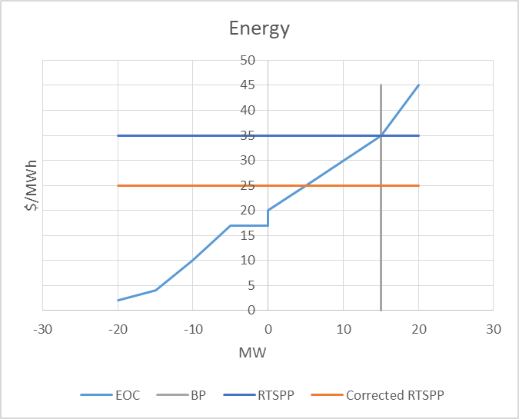
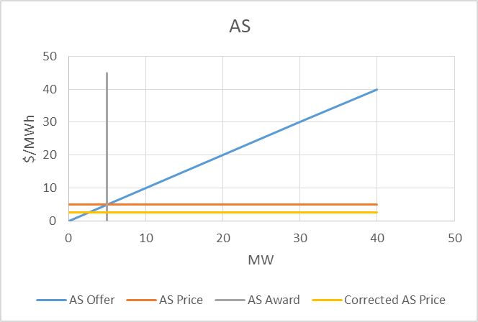
Price Correction Example 1
Resource was awarded energy and AS “on their curves”.
Energy and AS prices were corrected, resulting in lower prices for both.
Energy price from $35 to $25
AS price from $5 to $2.50

Slide 12
Price Correction Example 1
The price reduction reduced revenue for the ESR for both AS and energy. The ESR qualifies for an emergency payment.
 | Before Correction | After Correction
Energy Revenue | 525 | 375
Target Revenue | 525 | 525
Difference | 0 | -150
AS Revenue | 25 | 13
Target Revenue | 25 | 25
Difference | 0 | -13
Total Over (Under) Target | 0 | -163

Slide 13
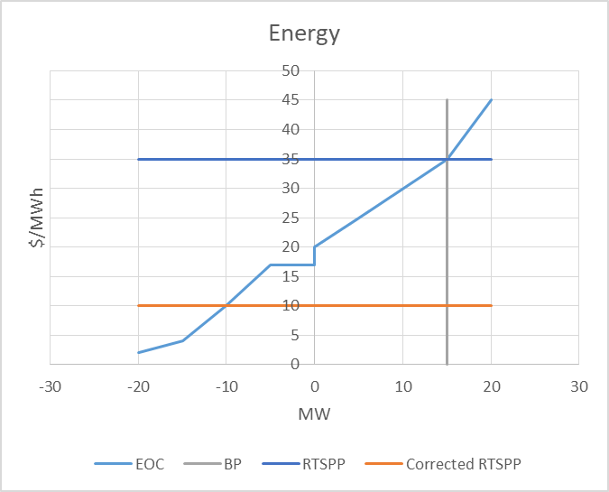
Price Correction Example 2
Resource was awarded energy and AS “on their curves”.
Energy and AS prices were corrected, resulting in lower prices for both.
Energy price from $35 to $10
AS price from $5 to $2.50

Slide 14
Price Correction Example 2
The price reduction reduced revenue for the ESR for both AS and energy. The ESR qualifies for an emergency payment.
 | Before Correction | After Correction
Energy Revenue | 525 | 150
Target Revenue | 525 | 525
Difference | 0 | -375
AS Revenue | 25 | 13
Target Revenue | 25 | 25
Difference | 0 | -13
Total Over (Under) Target | 0 | -388

Slide 15
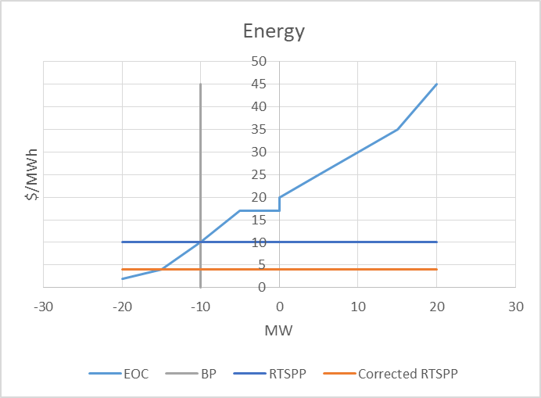
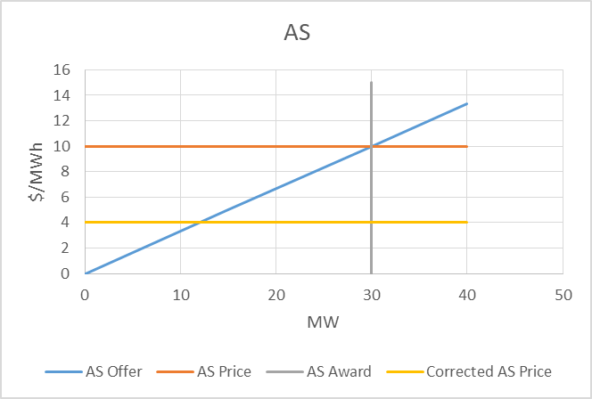
Price Correction Example 3
Resource was awarded energy and AS “on their curves”.
ESR awarded negative BP to charge.
Energy and AS prices were corrected, resulting in lower prices for both.
Energy price from $10 to $4
AS price from $10 to $4

Slide 16
Price Correction Example 3
The downward price correction reduced the ESR’s cost to charge resulting in a benefit to the ESR, however loss due to the AS price reduction was greater, resulting in a net Emergency payment to the QSE.
 | Before Correction | After Correction
Energy Revenue | -100 | -40
Target Revenue | -100 | -100
Difference | 0 | 60
AS Revenue | 300 | 120
Target Revenue | 300 | 300
Difference | 0 | -180
Total Over (Under) Target | 0 | -120

Slide 17
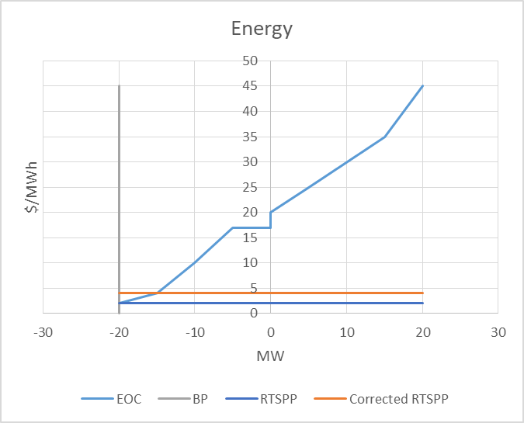
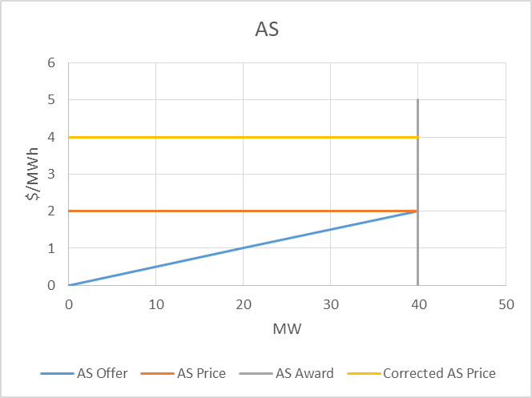
Price Correction Example 4
Resource was awarded energy and AS “on their curves”.
ESR awarded negative BP to charge.
Energy and AS prices were corrected, resulting in higher prices for both.
Energy price from $2 to $4
AS price from $2 to $4

Slide 18
Price Correction Example 4
The upward price correction increased the ESR’s cost to charge and increased the ESR’s AS Revenue. The ESR would have qualified for an emergency payment for the increased charging cost if the additional AS revenues did not cover those costs.
 | Before Correction | After Correction
Energy Revenue | -40 | -80
Target Revenue | -40 | -40
Difference | 0 | -40
AS Revenue | 80 | 160
Target Revenue | 80 | 80
Difference | 0 | 80
Total Over (Under) Target | 0 | 40

Slide 19
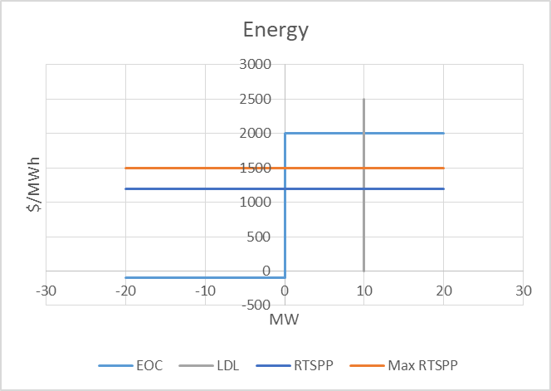
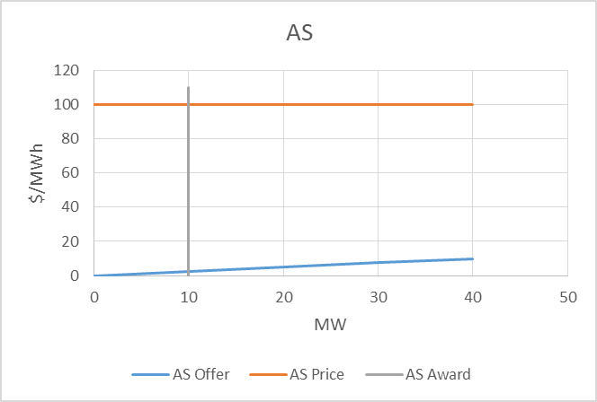
Override Example
Offer at the SWCAP
LDL override of 10 MW, RTSPP is $1200
Max RTSPP for the day of $1500
AS price of $100 with an award of 10MW

Slide 20
Override Example
The override at 10MW was not on the ESR’s offer curve, however the price on the curve was higher than the highest RTSPP for the day. The QSE qualifies for a capped emergency payment which is reduced some when netted with AS revenues.
 | Override Payment
Energy Revenue | 12,000
Target Revenue(capped) | 15,000
Difference | -3,000
AS Revenue | 1,000
Target Revenue | 25
Difference | 975
Total Over (Under) Target | -2,025

