Slide 1
Energy Storage Metering
ERCOT Staff
MWG
July 23, 2020

Slide 2
Some background…
History of Wholesale Storage Load
Commission rule on WSL clearly contemplates WSL for distribution-connected batteries
Initial implementation timeline – needed a quick solution to accommodate project in development
ERCOT implementation required the unit to be a Generation Resource/CLR with EPS metering
The market has evolved
Batteries are become increasingly common deployments
Market is looking at definitions for SOES
NPRR 917 creates nodal pricing for SODG
Market wants same pricing for batteries when charging & discharging and if this pricing is nodal then the charging energy must be separately metered
Some thoughts on the future
Should nodal pricing implementation be tied to EPS Meters or is it time to consider alternative implementation options?
Metering requirements would be the same whether (non-WSL) nodal pricing or WSL implementation
Timing seems ripe for market discussions on future concepts for WSL implementation

Slide 3
Observations on metering requirements
Nodal pricing of SOES
Nodal WSL or nodal non-WSL
Metering at the SDP to measure generation exports
Separate metering of charging energy
Either as currently required or with NPRR 1020 solution
Metering scenarios
Stand alone, auxiliary loads connected at a separate delivery point
Stand alone, auxiliary loads connected behind the same delivery point
Retail load and auxiliary loads connected behind the same delivery point

Slide 4
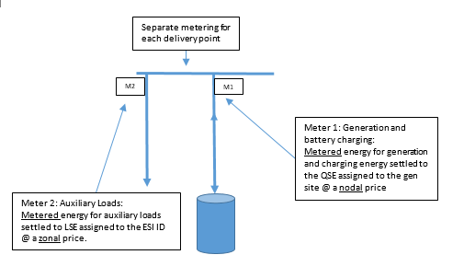
SOES - Scenario #1
Stand alone, auxiliary loads connected at a separate delivery point

Slide 5
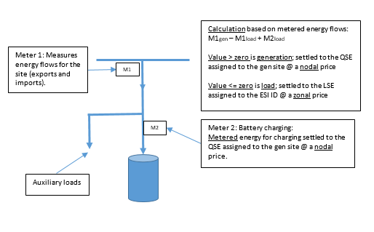
SOES – Scenario # 2
Stand alone, auxiliary loads connected behind the same delivery point

Slide 6
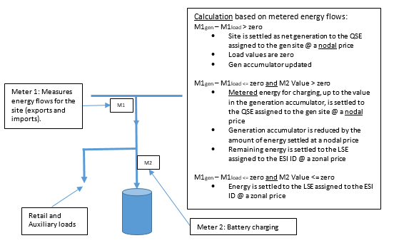
SOES - Scenario # 3
Retail load and auxiliary loads connected behind the same delivery point

Slide 7
Questions?

