Slide 1
Effects of Activating Low Shift Factor Constraints in SCED
Analysis of Stakeholder-Requested Constraints on 6/18/2018 and 8/15/2018
Alex Giarratano
Market Analysis & Validation
CMWG
July 13th, 2020

Slide 2
Agenda
Overview of New Material
Methodology
Analysis of Constraint SWINWIN8: WINKS_FMR1
  Impact on System Lambda, Resource BPs, and Resource Node LMPs
  Impact on Congestion Rent
Analysis of Constraint SMSHNH28: 3740__A
  Impact on System Lambda, Resource BPs, and Resource Node LMPs
  Impact on Congestion Rent
Conclusions

Slide 3
Overview of New Material
The following material is a follow-up to material presented at the February 3rd, 2020 (link) and May 11th, 2020 (link) CMWG meetings
Specifically, it is a detailed analysis to understand the potential impact of activating the constraints requested by a stakeholder, as described in the table below.
Date | Equipment | Contingency
June 18th, 2018 | WINKS_FMR1 | XWIN389
 |  | SCHYWIN8
 |  | XWIN289
 |  | SWINWIN8
August 15th, 2018 | 3740_A | SMSHNH28
 |  | SBNDKR28

Slide 4
Overview of New Material (cont’d.)
RTCA solutions for these Operating Days were examined to see which contingencies and constraints showed up in TCM and would have been activated if the 2% shift factor threshold for activating constraints had not been in effect.
Certain contingencies were redundant so the constraint that occurred the first, was the most limiting, and lasted the longest was the one that was selected to be activated for this analysis.
The following constraints, each of which did not have Resource Shift Factors ≥ 2% (absolute value), were chosen and activated for this analysis:
  June 18th, 2018
    SWINWIN8: WINKS_FMR1
      Would have been activated for SCED intervals between 9:45 and 16:35
  August 15th, 2018
    SMSHNH28: 3740__A
      Would have been activated for SCED intervals between 16:15 and 19:45
  Both of these constraints were radial

Slide 5
Methodology
Analysis performed using an ERCOT internal SCED simulation tool, intended to rerun production SCED cases sequentially
  Assumes that Resources follow their Base Points exactly
For each analysis, a baseline was created by simply rerunning the sequential SCED cases
The new constraints, their limits, and their respective Resource Shift Factor matrices were added to the original SCED constraints
SCED results from the baseline case and the modified (w/ additional constraint) case were compared including System Lambda, LMPs, and Base Points

Slide 6
Constraint
SWINWIN8: WINKS_FMR1 on 6/18/2018

Slide 7
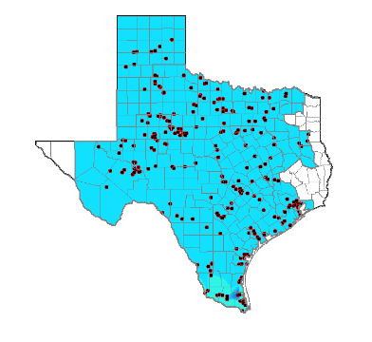
SWINWIN8: WINKS_FMR1 Constraint
Wink Sub in the Far West region.
SWINWIN8 contingency, the loss of 138kV circuit between Wink Sub and Wink Tap, overloads the two transformers in Wink Sub.

Slide 8
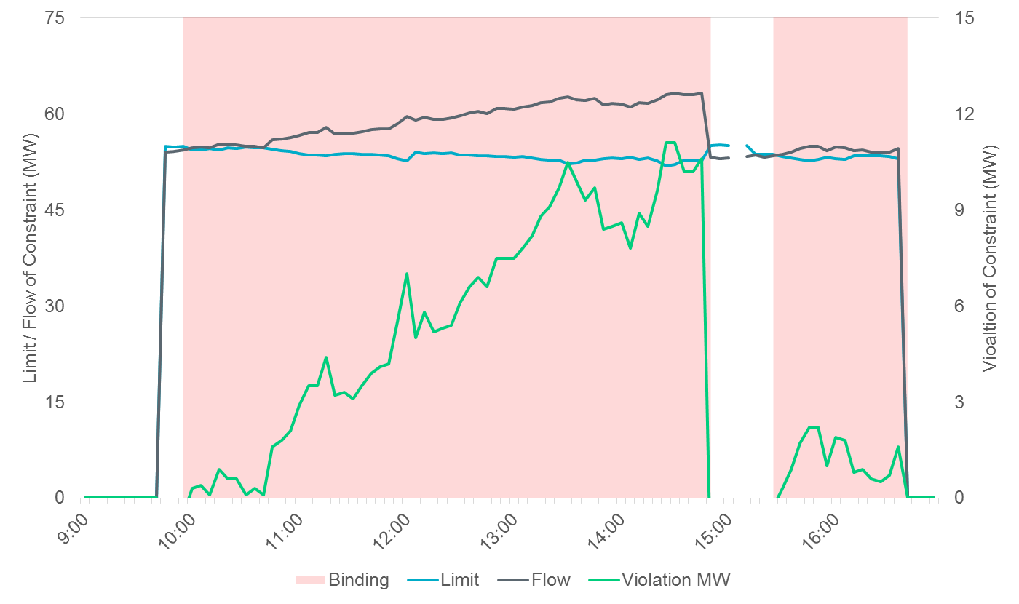
Activation of SWINWIN8: WINKS_FMR1 Constraint

Slide 9
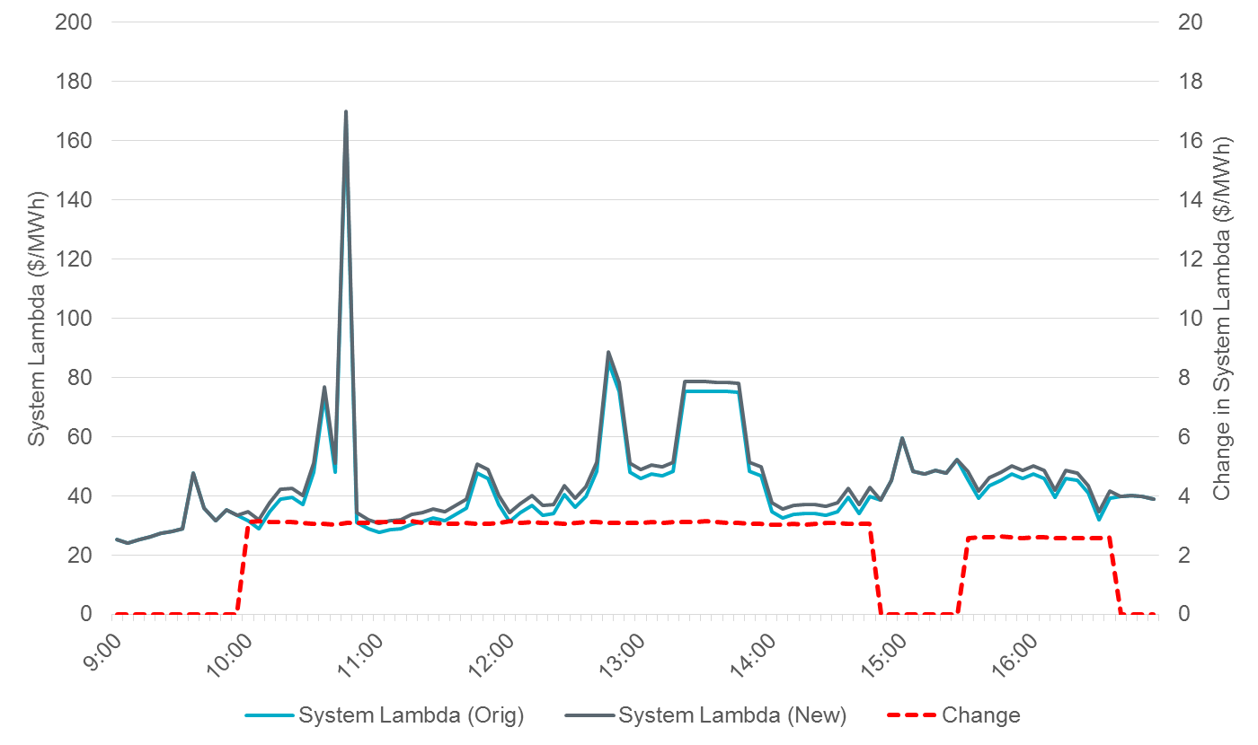
SWINWIN8: WINKS_FMR1
Impact on System Lambda

Slide 10
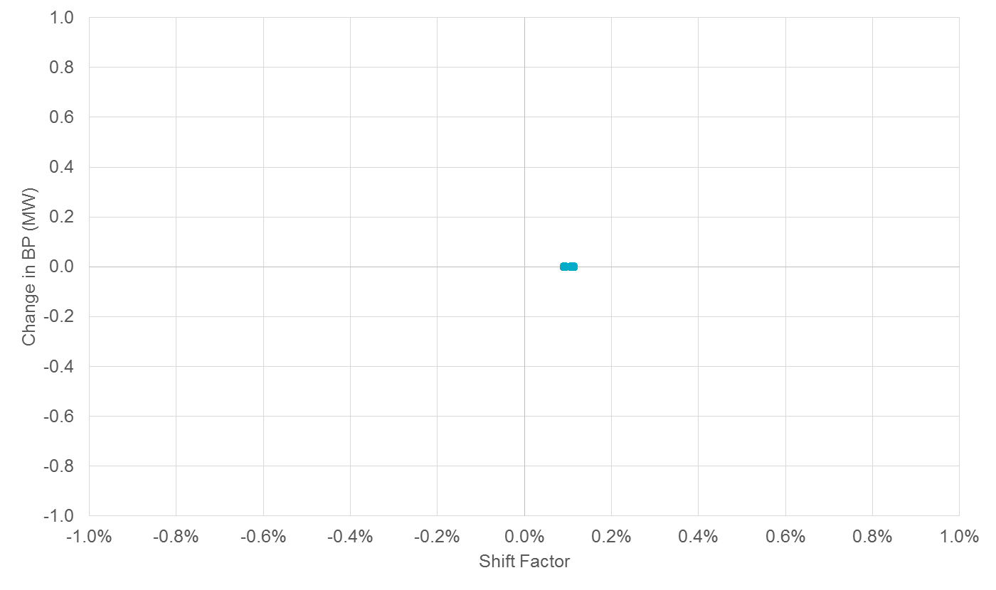
SWINWIN8: WINKS_FMR1
Impact on Resource Base Points
SWINWIN8: WINKS_FMR1, a radial constraint (as evidenced by the uniform SF matrices), had no impact on the dispatch of Resources.

Slide 11
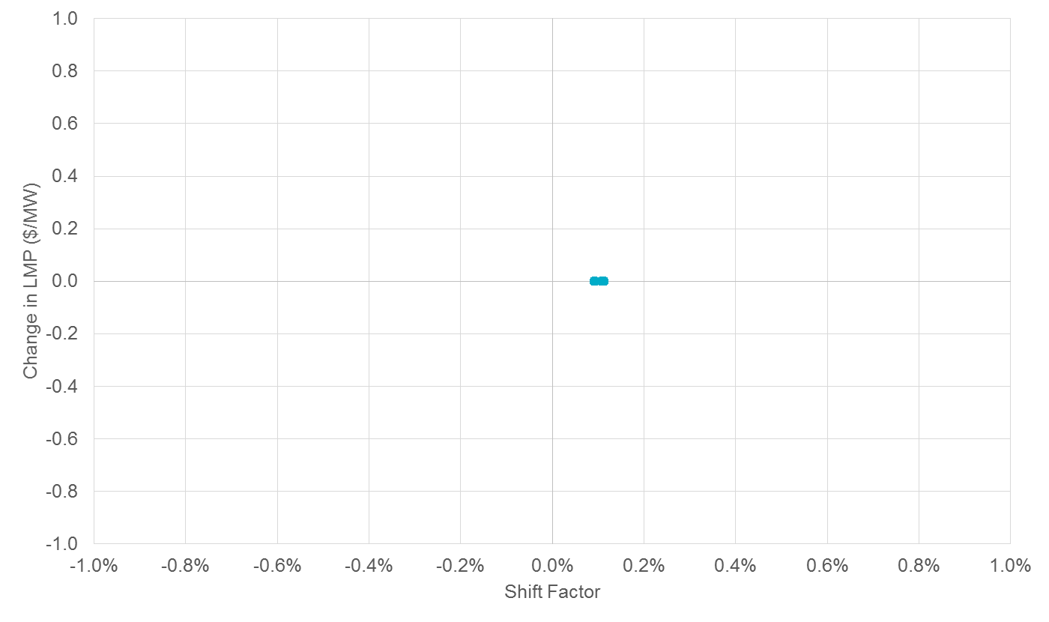
SWINWIN8: WINKS_FMR1
Impact on Resource Node Locational Marginal Prices
SWINWIN8: WINKS_FMR1, a radial constraint (as evidenced by the uniform SF matrices), had no impact on LMPs around the system

Slide 12
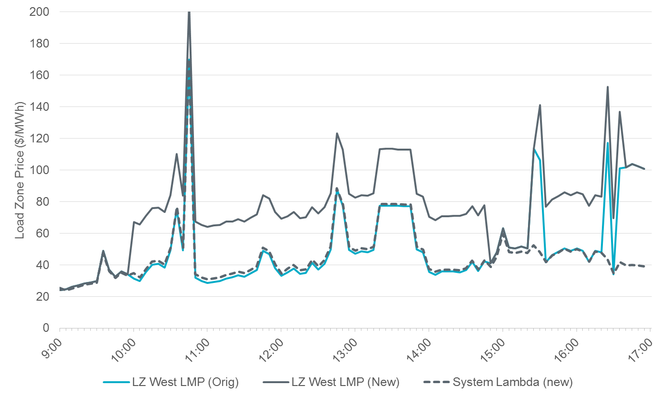
SWINWIN8: WINKS_FMR1
Impact on West Zone Price

Slide 13
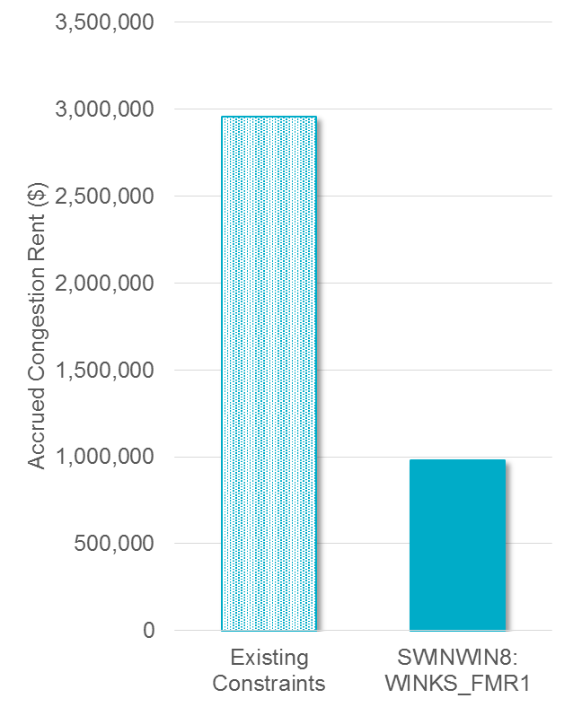
Impact on Congestion Rent on June 18th, 2018
On June 18th, 2018, there were a total of 13 constraints activated, 10 of which actually became binding
The addition of SWINWIN8: WINKS_FMR1 would increase the daily accrued congestion rent by $1M, or ~33%
Existing Congestion Rent: $2,957,573
Estimated Congestion Rent from SWINWIN8: WINKS_FMR1: $979,440

Slide 14
Constraint
SMSHNH28: 3740__A on 8/15/2018

Slide 15
SMSHNH28: 3740__A Constraint
SMSHNH28 contingency and overload in the North Dallas region.
SMSHNH28 contingency, the loss of 138kV circuit between Northaven Switch and Morrison Lane Switch, overloads the 138kV circuit between Marsh Lane and Morrison Lane

Slide 16
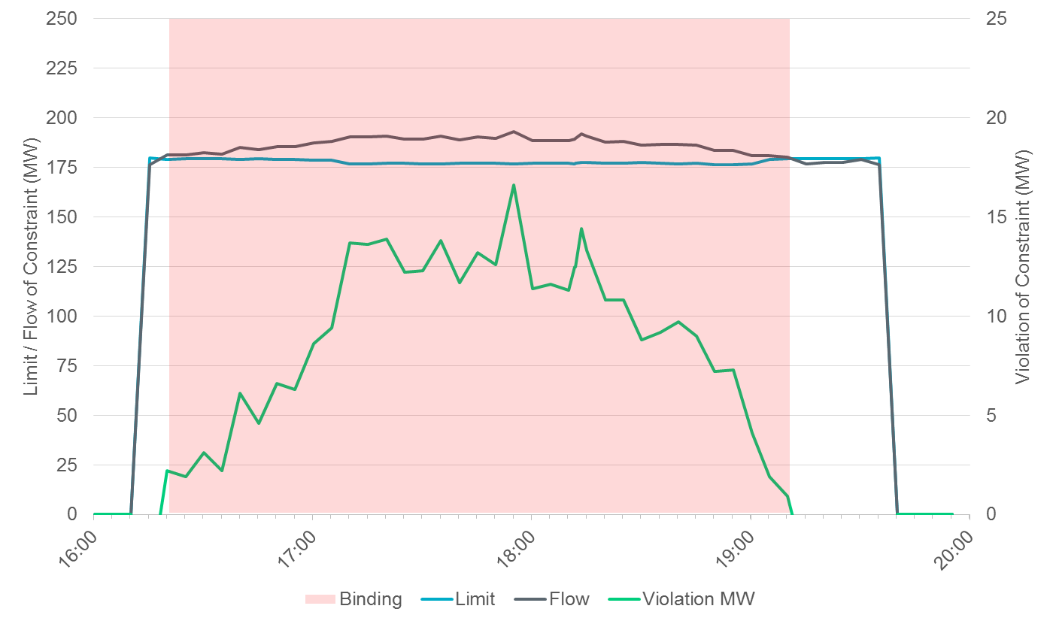
Activation of SMSHNH28: 3740__A Constraint

Slide 17
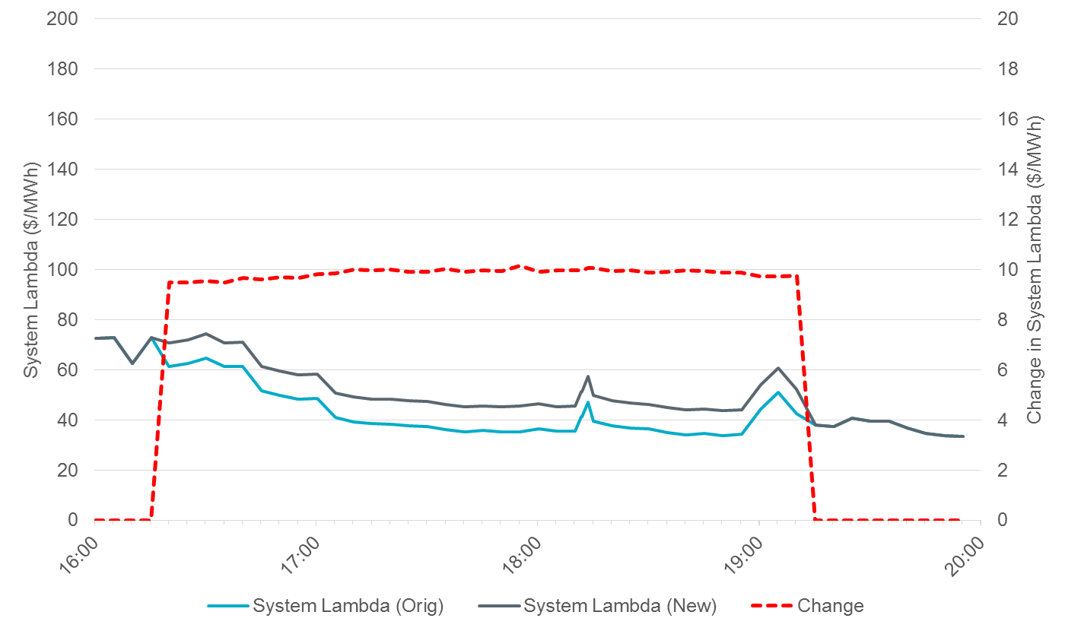
SMSHNH28: 3740__A
Impact on System Lambda

Slide 18
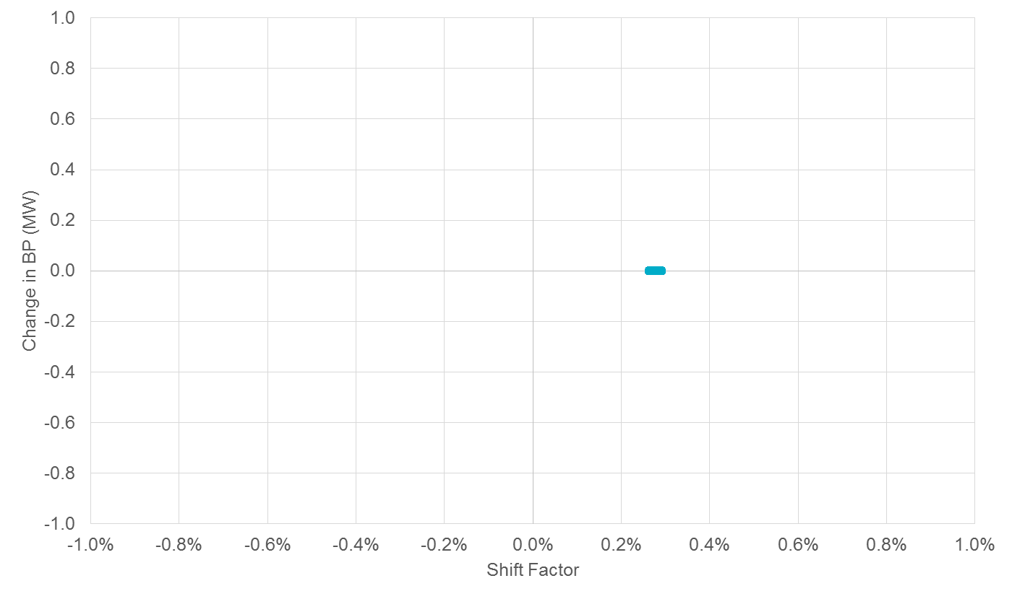
SMSHNH28: 3740__A
Impact on Resource Base Points
SMSHNH28: 3740__A, a radial constraint (as evidenced by the uniform SF matrices), had no impact on the dispatch of Resources.

Slide 19
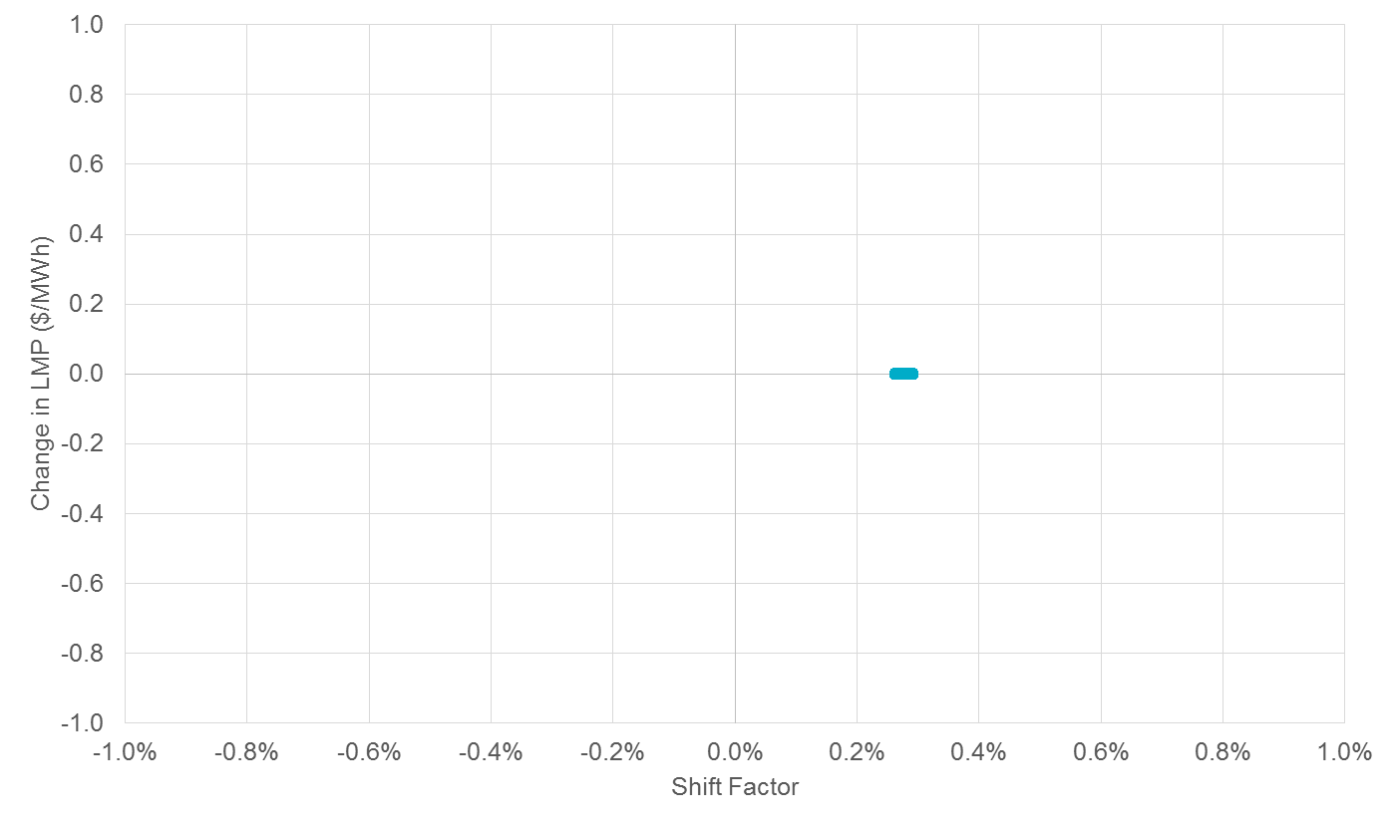
SMSHNH28: 3740__A
Impact on Resource Node Locational Marginal Prices
SMSHNH28: 3740__A, a radial constraint (as evidenced by the uniform SF matrices), had no impact on LMPs around the system

Slide 20
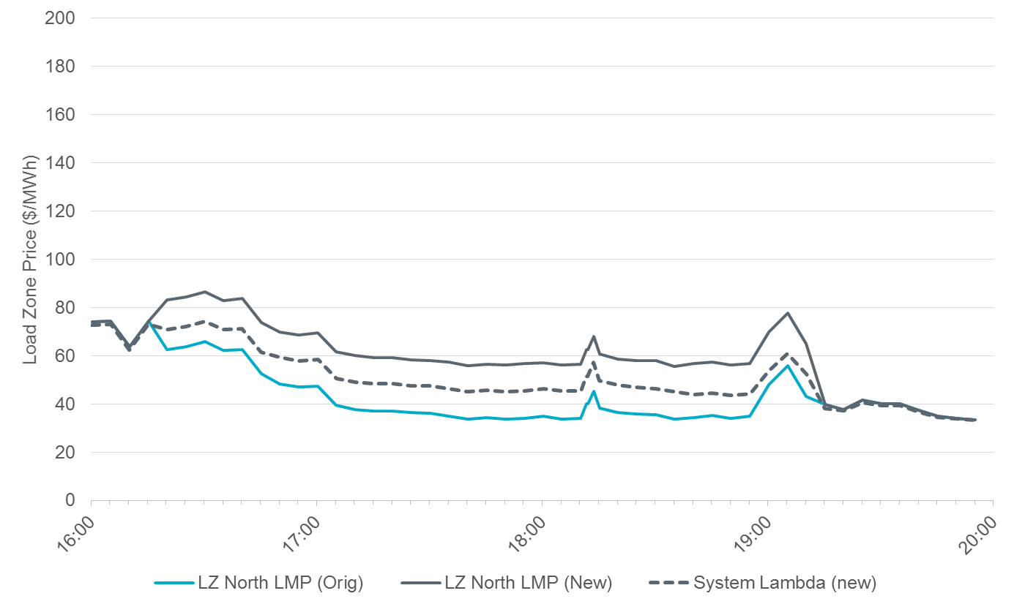
SMSHNH28: 3740__A
Impact on North Load Zone Price

Slide 21
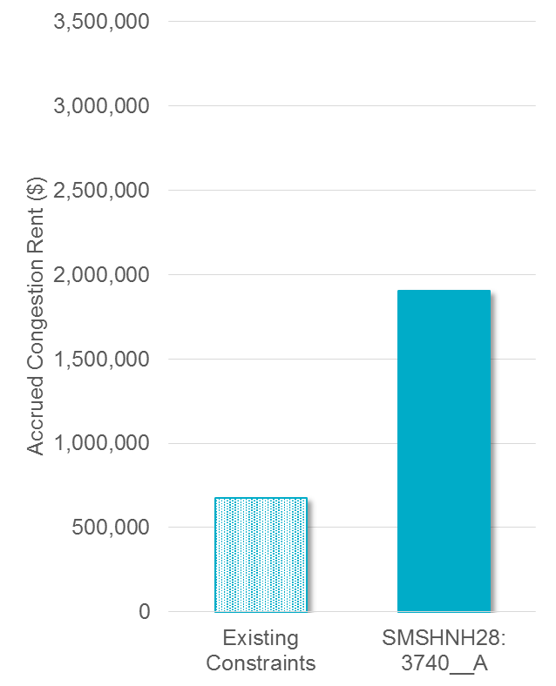
Impact on Congestion Rent on August 15th, 2018
On August 15th, 2018, there were a total of 14 constraints activated, 11 of which actually became binding
The addition of SMSHNH28: 3740__A would increase the daily accrued congestion rent by $1.9M, or ~282%
Existing Congestion Rent: $676,506
Estimated Congestion Rent from SMSHNH28: 3740__A: $1,905,730

Slide 22
Conclusions
No changes in Base Points or Resource LMPs were observed in these cases because the constraints were radial. No oscillations in Base Points were observed.
The impact of constraints being activated is dependent on the topology of the system (e.g., radial vs. non-radial, outages) near the constraint. The examples shown here may not be representative of all cases.

Slide 23
Questions?
Thank you!

