Slide 1
ERCOT Frequency Control Report
June 2020
ERCOT
Operations Planning
PDCWG | July 15th, 2020

Slide 2
Summary of June 2020
CPS1: 170.75%
Current CPS1 12-Month Rolling Average: 173.74%
0 BAAL Exceedance
5 hourly CPS1 score below 100%
BAAL-003 Events have updated through 2019
2018 BAAL-003 FRM Performance: -843.17
2020 RMS1 Statistics
Mean: 16.00 mHz
Min: 12.25 mHz
Max: 20.34 mHz
Energy Statistics
Total Energy: 35,374,846 MWh
Wind Energy: 8,304,076 MWh
Percent Energy from Wind: 23.47%
Solar Energy: 980,459 MWh
Percent Energy from Solar: 2.77%
Minimum System Inertia
Mean: 232,728
Max: 272,282 on Jun 10th
Min: 206,068 on Jun 14th

Slide 3
Frequency Control
CPS1, BAAL, & RMS1

Slide 4
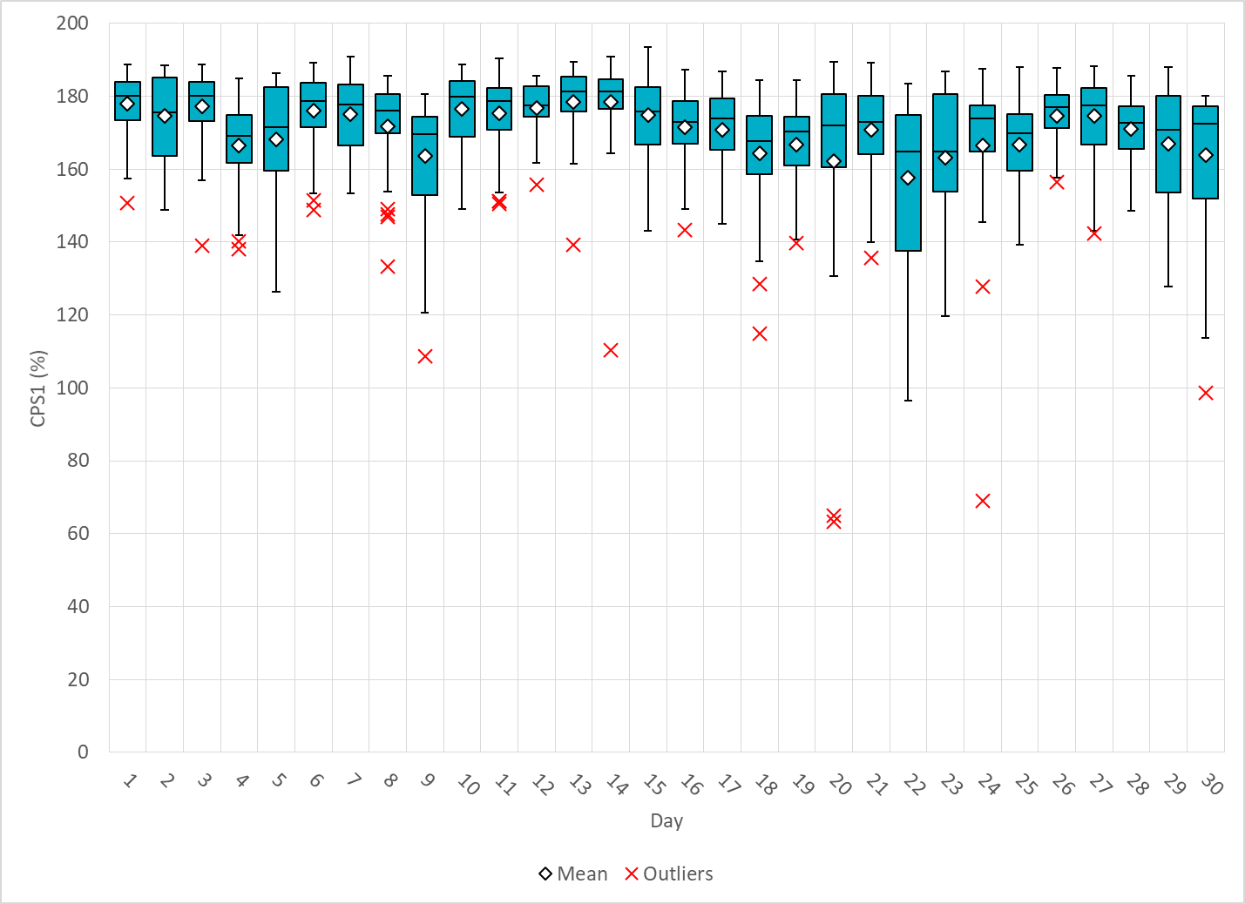
Hourly CPS1 by Day
Jun-20 CPS1 (%): 170.75
Notes:
Outliers:
1. 63.2% @ 17:00 6/20/2020:
Expected gen deviation:
Large expected gen deviation a the beginning of the hour.(-1812 MW @17:19)
Solar resources contribute significantly to total expected gen deviation from 17:05 to17:20.
Wind/Solar Ramp:
Solar ramps down from 2940 MW to 2380 MW within a 15 min interval from 17:05 to 17:20.
All reg-ups are deployed.
2. 64.8% @ 18:00 6/20/2020:
Expected gen deviation:
Large expected gen deviation for two periods of time for the hour.(18:10 to 18:15,18:26 to 18:46)
(-1228 MW @18:14; -774 MW @18:37 )
Large expected gen deviations are mostly from solar with the exception of thermal generation in shutdown mode.
A thermal unit was in shutdown mode
Wind /solar Ramp: Solar down ramps from 2072 MW to 1885 MW within a 5 min interval from 18:10 to 18:15
Solar down ramps from 2195 MW to 1550 MW within a 20 min interval from 18:26 to 18:46
3. 96.4% @ 12:00 6/22/2020:
Expected gen deviation:
Large expected gen deviation from 12:30 to 12:45. (-2137 MW @12:42 )
Negative throughout the hour.
Large expected gen deviations are from both renewables and thermal resources.
Wind/solar Ramp:
Consistent Wind down ramp throughout the entire hour 11077 MW to 7488 MW ( 300MW /5min)
A steep 100 MW solar down ramp wihtin 5 min from 12:35 to 12:43.
Other:
Generation loss of approximately 72 MW.
4. 69.0% @ 22:00 6/24/2020:
Expected gen deviation:
Large expected gen deviation from 22:10 to 22:20. (-1900 MW @22:20)
A combine cycle resource coming off at the beginning of the hour causing low frequency.
Wind Ramp:
A 170MW /10min wind down occurred at 22:10.
5. 98.7% @ 16:00 6/30/2020:
Expected gen deviation:
Large expected gen deviation at the beginning and the end of the hour. (-1190 MW @16:03; -1498MW @16:48 )
DC tie export ramps from 179 MW to 226 MW during the first 5 minute of the hour.
Wind/Solar Ramp:
Solar ramps down from 2879MW to 2696 MW within 4 minutes at the beginning of the hour.
Wind down ramp 164MW/5min at 16:40
Solar down ramp 191 MW/5min at 16:40.

Slide 5
BAAL Exceedances & Violations
There was 0 BAAL exceedance in June

Slide 6
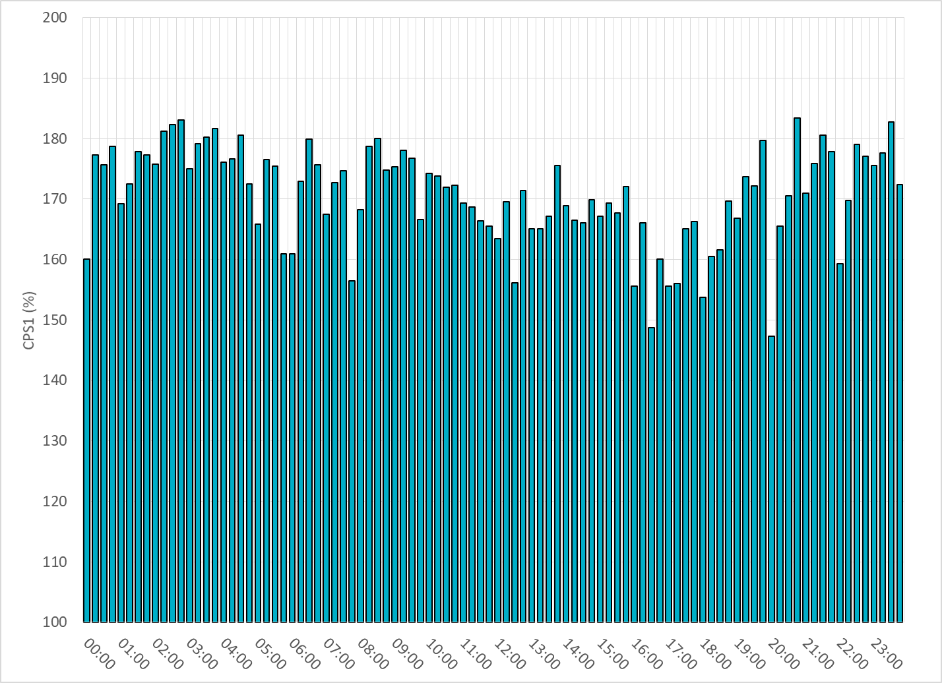
15-Minute Average CPS1%
June-20 CPS1 (%): 170.75

Slide 7
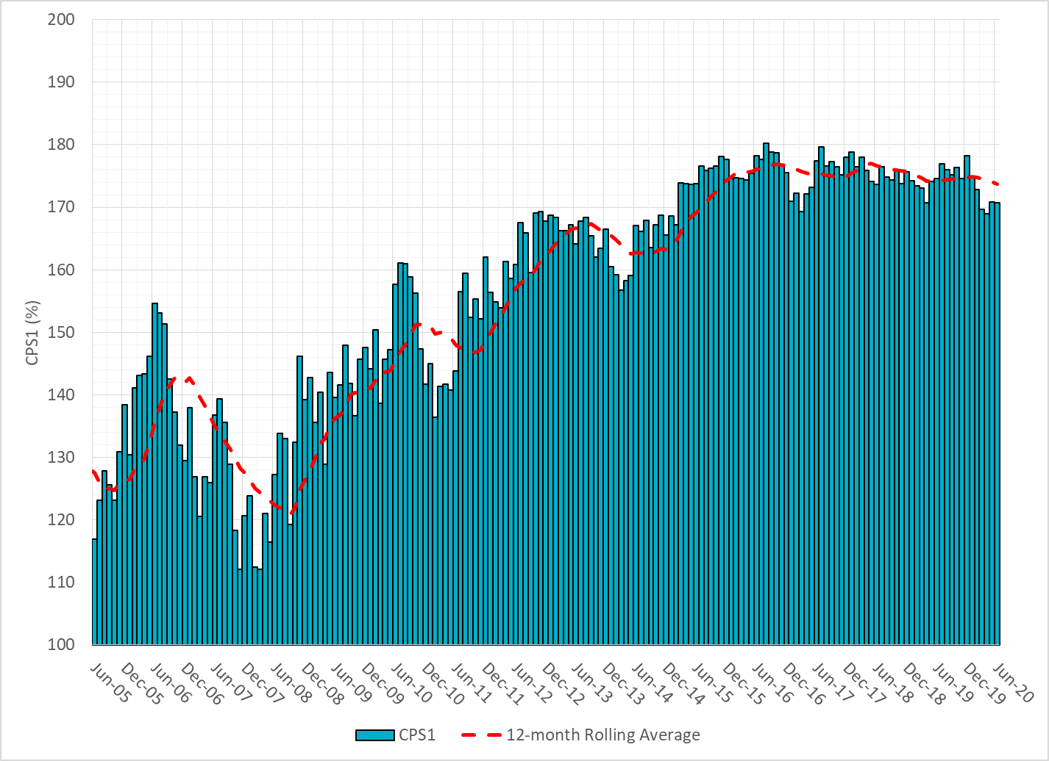
12-Month Rolling Average CPS1
Current 12-Month Rolling Average: 173.74%

Slide 8
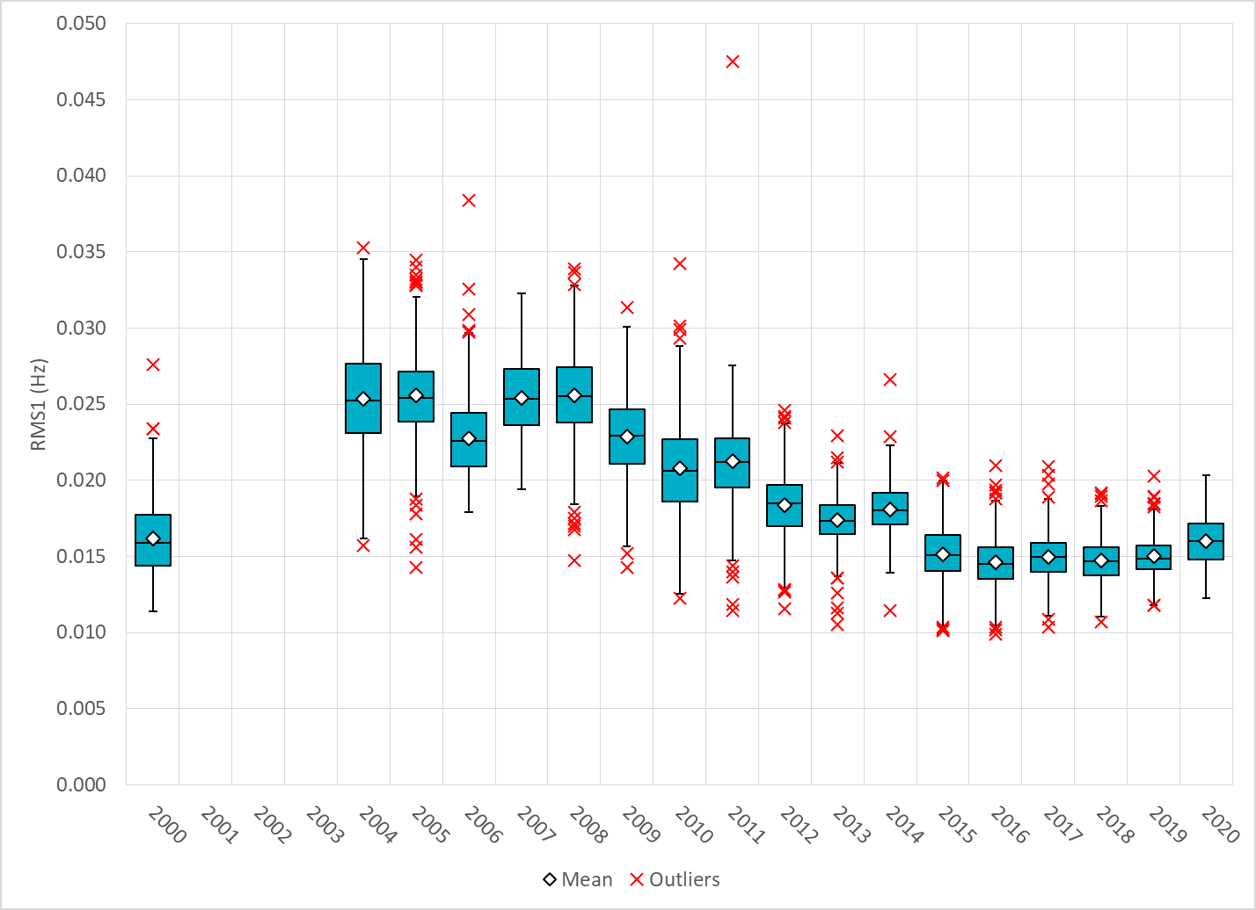
Daily RMS1 of ERCOT Frequency by Year

Slide 9
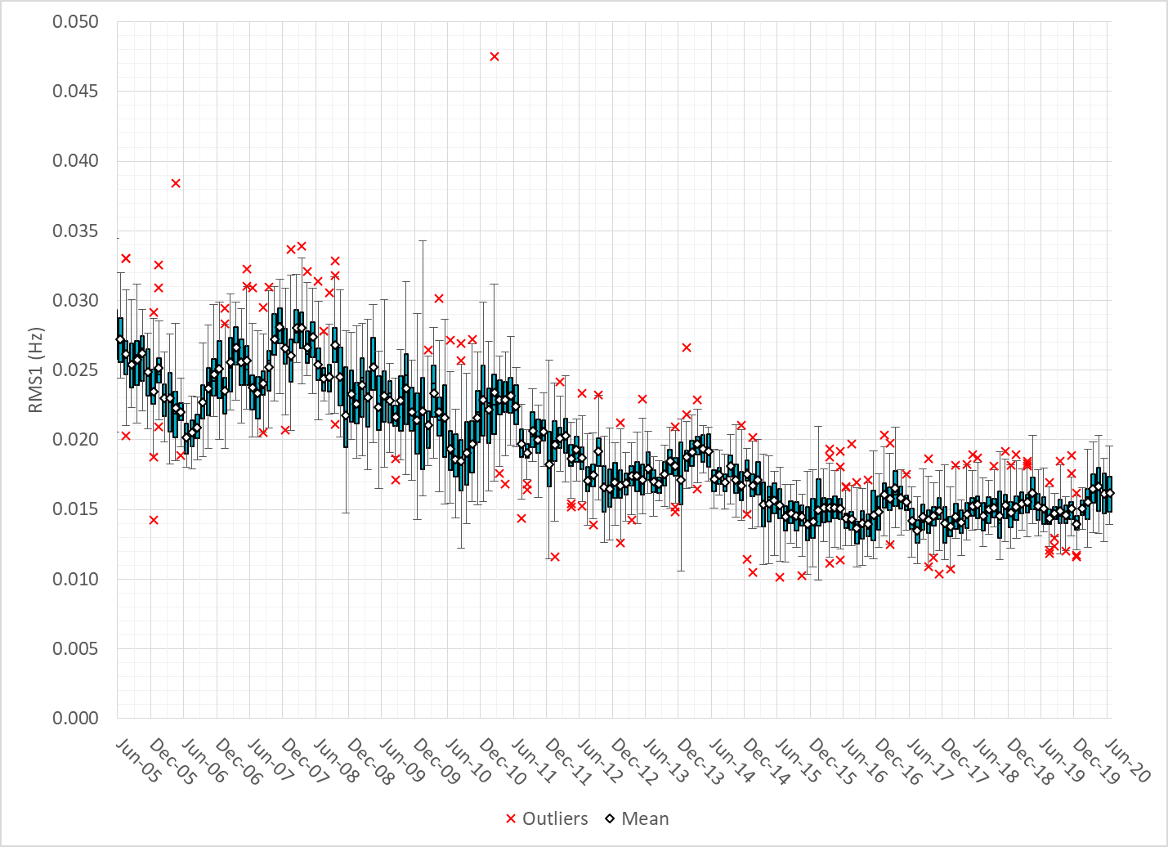
Daily RMS1 of ERCOT Frequency by Month

Slide 10
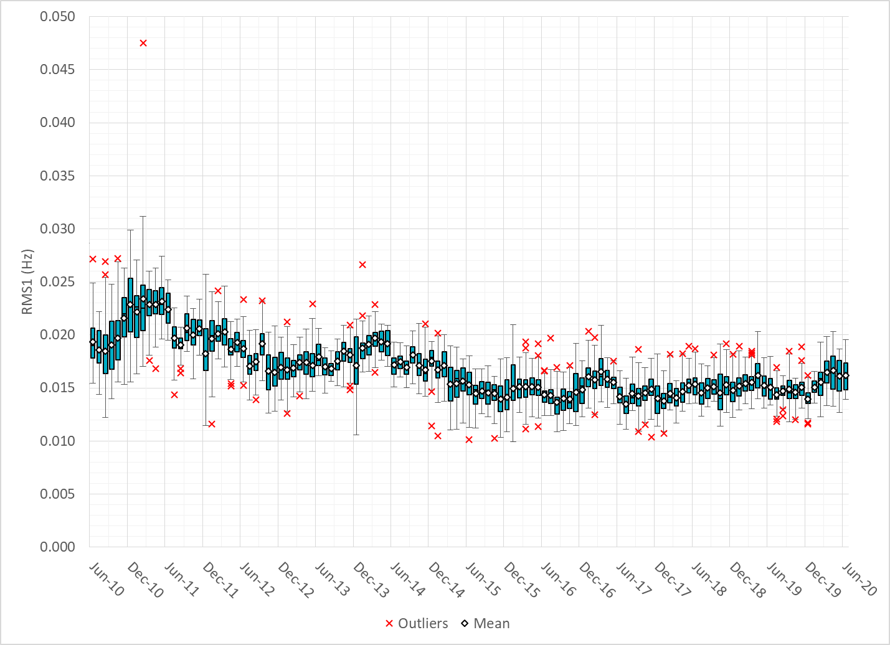
Daily RMS1 of ERCOT Frequency by Month

Slide 11
Frequency Profile Comparison

Slide 12
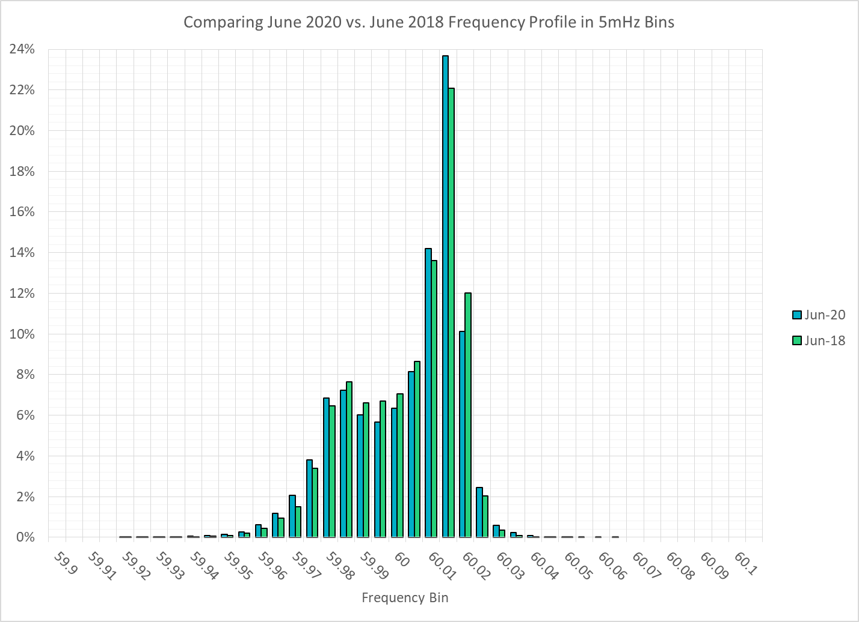
Frequency Profile Comparison

Slide 13
Frequency Profile Comparison

Slide 14
Time Error Correction

Slide 15
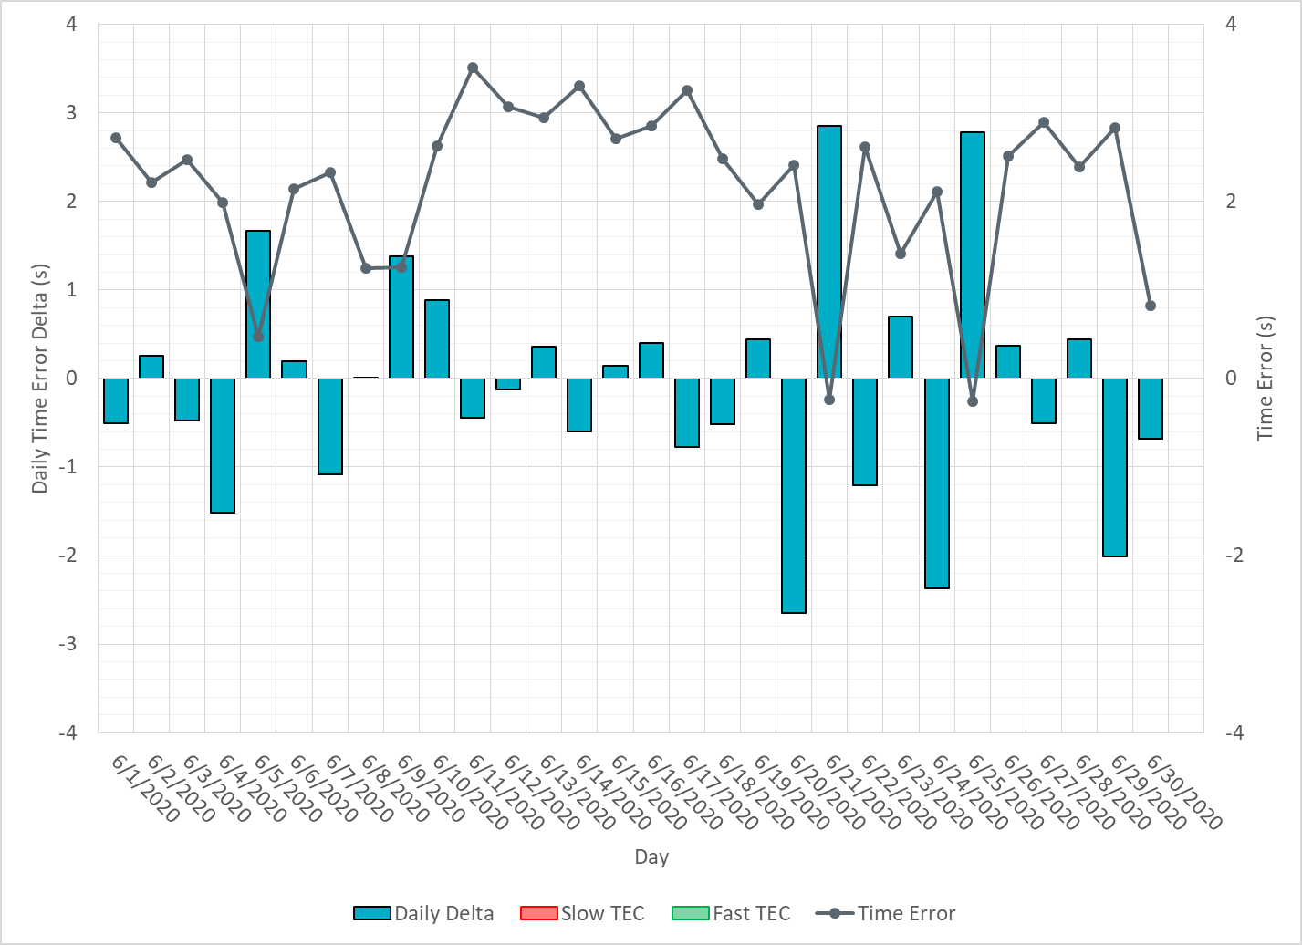
ERCOT Daily Time Error

Slide 16
Time Error Corrections Log Summary
There have been no time error corrections since December 2016

Slide 17
BAL-003 Performance

Slide 18
Op. Year 2018 BAL-003 Selected Events – Update
Notes:
BAL-003

Slide 19
Op. Year 2018 BAL-003 FRM Performance - Update
Notes:
OP2018: FRO = -381.0, FRM_median = -843.17, FRM_average = -959.7
OP2019: FRO = -381.0
OP2020: FRO = -425.0, FRM_median = -811.14, FRM_average = -892.5

Slide 20
ERCOT Energy Statistics

Slide 21
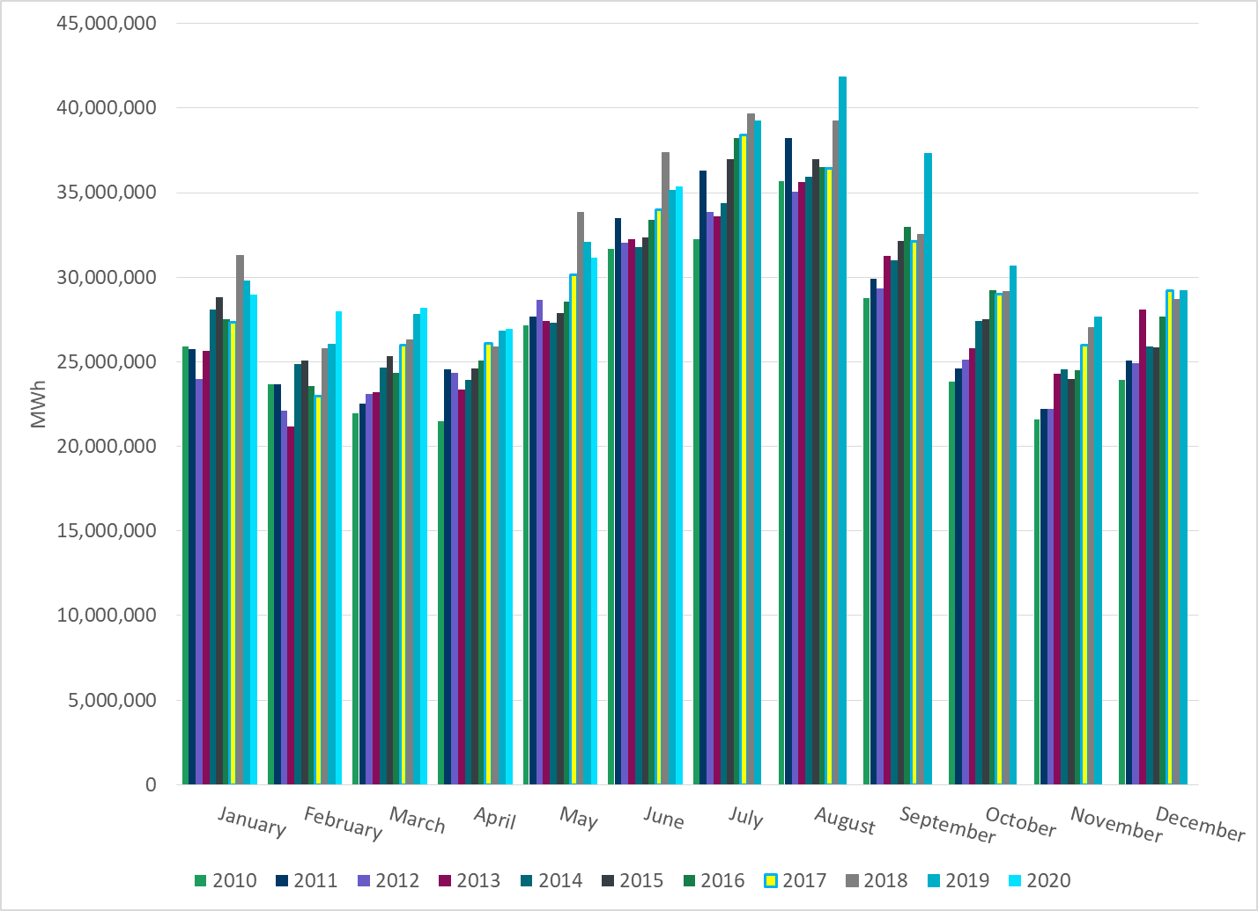
Total Energy
Notes:
35,374,846 MWh

Slide 22
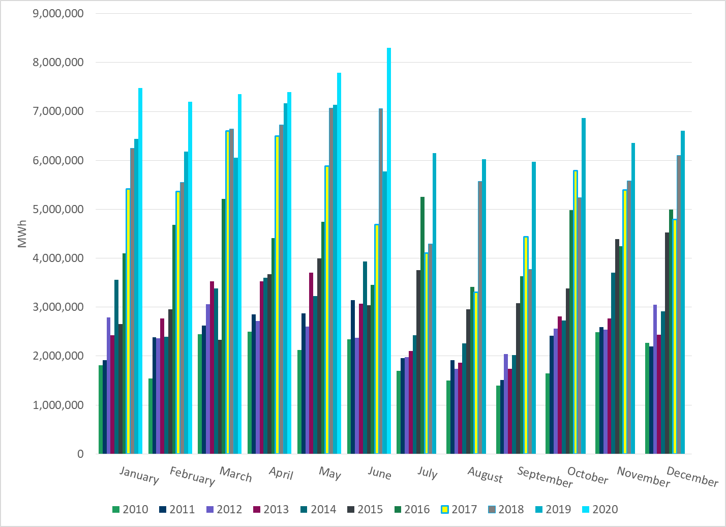
Total Energy from Wind Generation
Notes:
8,304,076 MWh

Slide 23
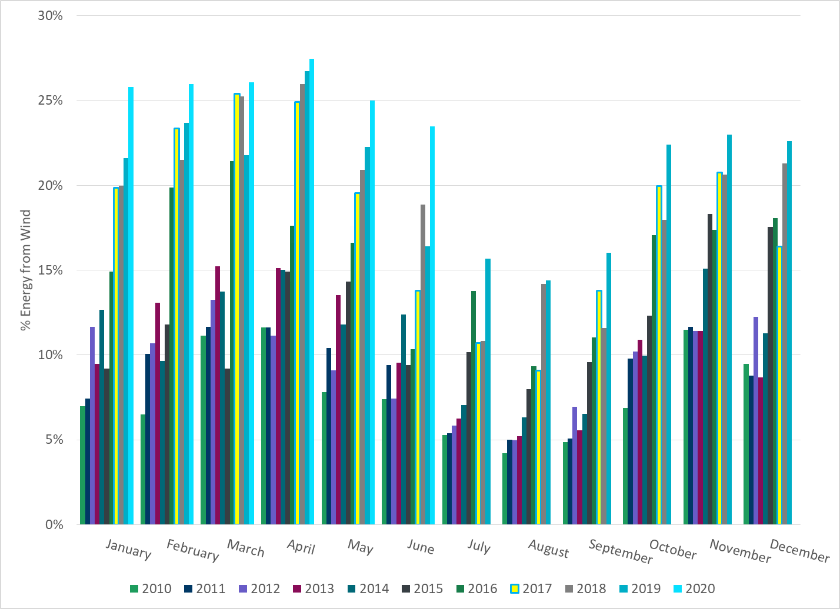
% Energy from Wind Generation
Notes:
23.74%

Slide 24
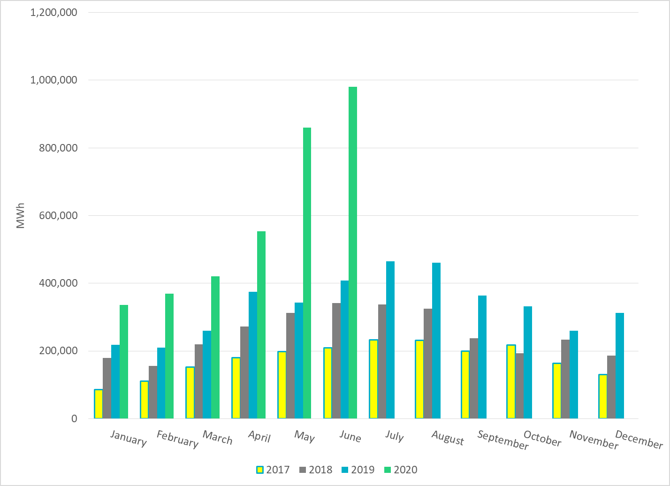
Total Energy From Solar Generation
Notes:
980,459 MWh

Slide 25
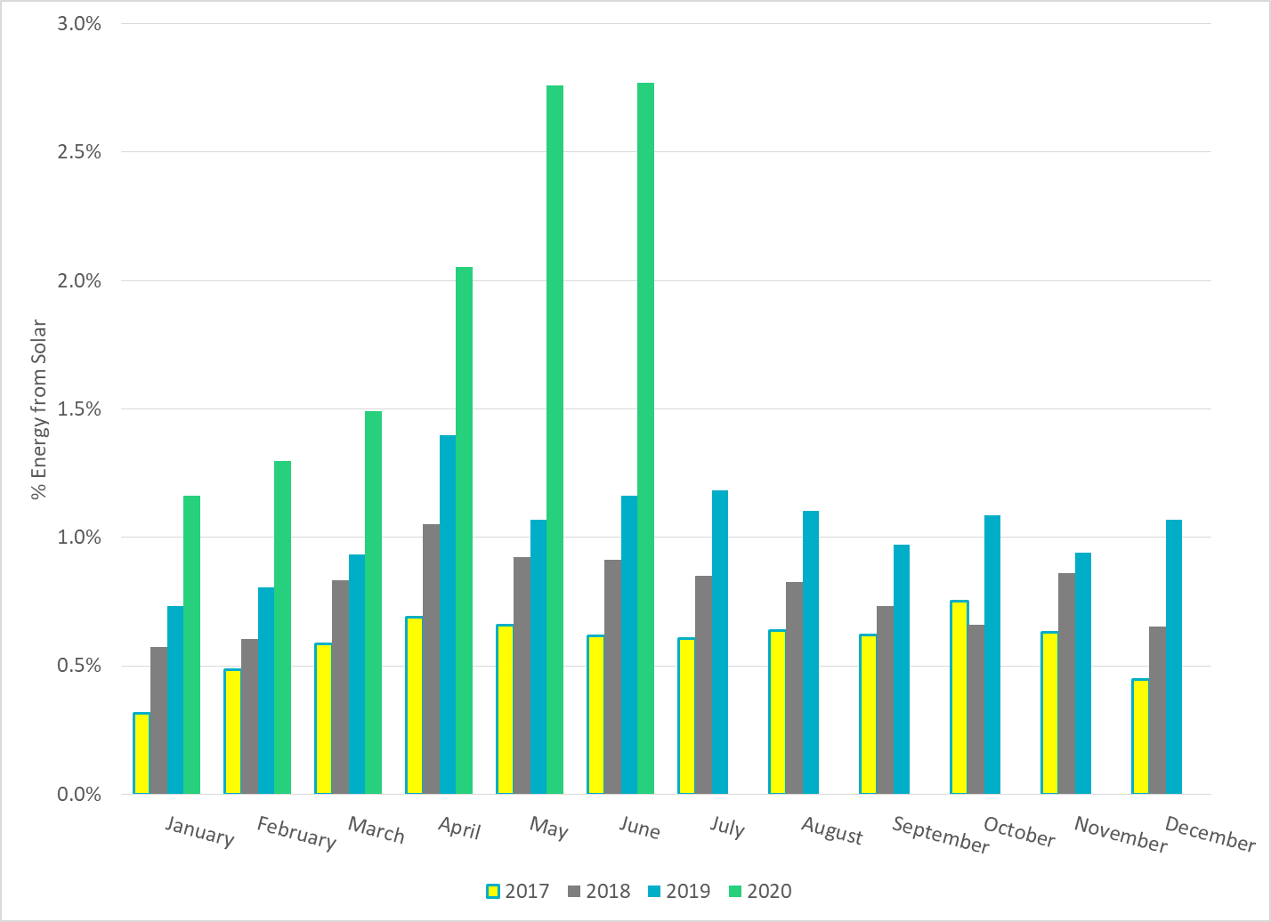
% Energy from Solar Generation
Notes:
2.77%

Slide 26
ERCOT System Inertia

Slide 27
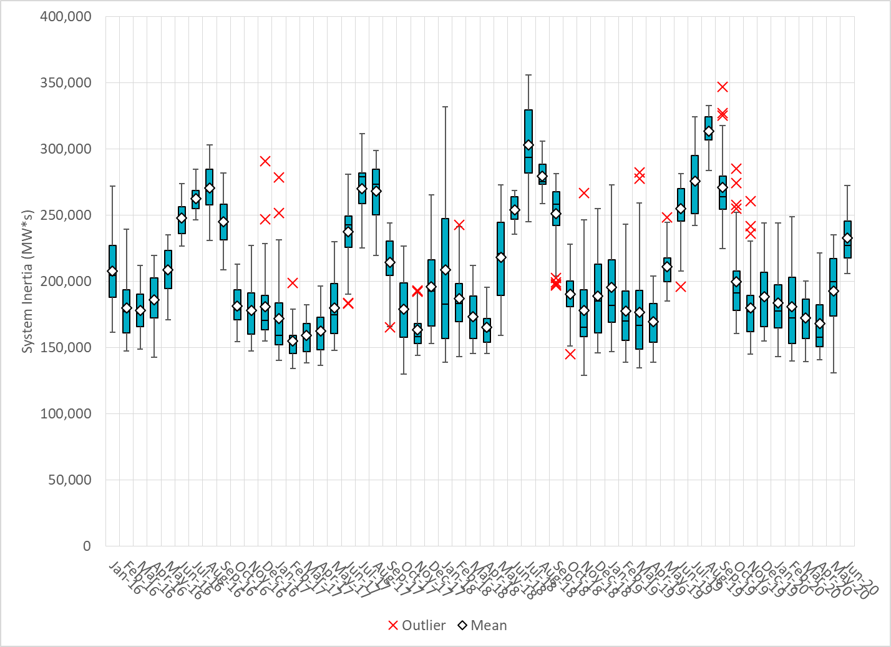
Daily Minimum System Inertia
Notes:
Minimum Inertia = 206,068 MW*s on 6/14/2020
Previous Minimum was 128,759 MW*s on 11/18/2018.
Data:
Mean: 232,728
Max: 272,282 on Jun 10th
Min: 206,068 on Jun14th

Slide 28
Questions?
Thank you!

