Slide 1
Credit Exposure Update
Spoorthy Papudesi
Credit Work Group
ERCOT Public
Jul 15, 2020

Slide 2
Monthly Highlights May 2020- Jun 2020
Market-wide average TPE slightly decreased from $ 442.4 million to $ 439.5 million
TPE decreased mainly due to lower Real-Time and Day-Ahead prices in June compared to May
Discretionary Collateral is defined as Secured Collateral in excess of TPE,CRR Locked ACL and DAM Exposure
Average Discretionary Collateral decreased from $ 1,319.1 million to $1,243.6 million
The decrease in Discretionary Collateral is largely due to increase in CRR Locked ACL
Number of active Counter-Parties increased by 5
No unusual collateral call activity

Slide 3
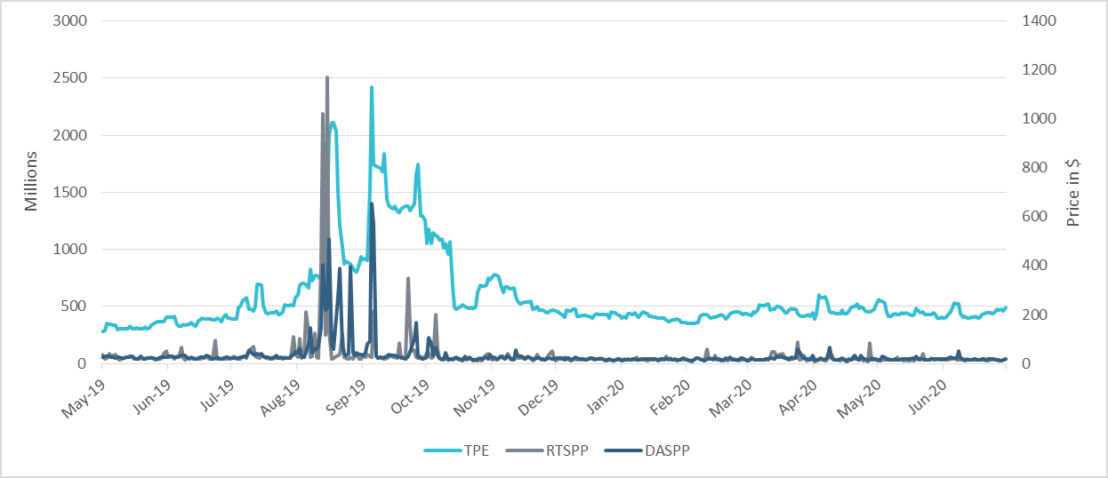
TPE/Real-Time & Day-Ahead Daily Average Settlement Point Prices for HB_NORTH May 2019- Jun 2020

Slide 4
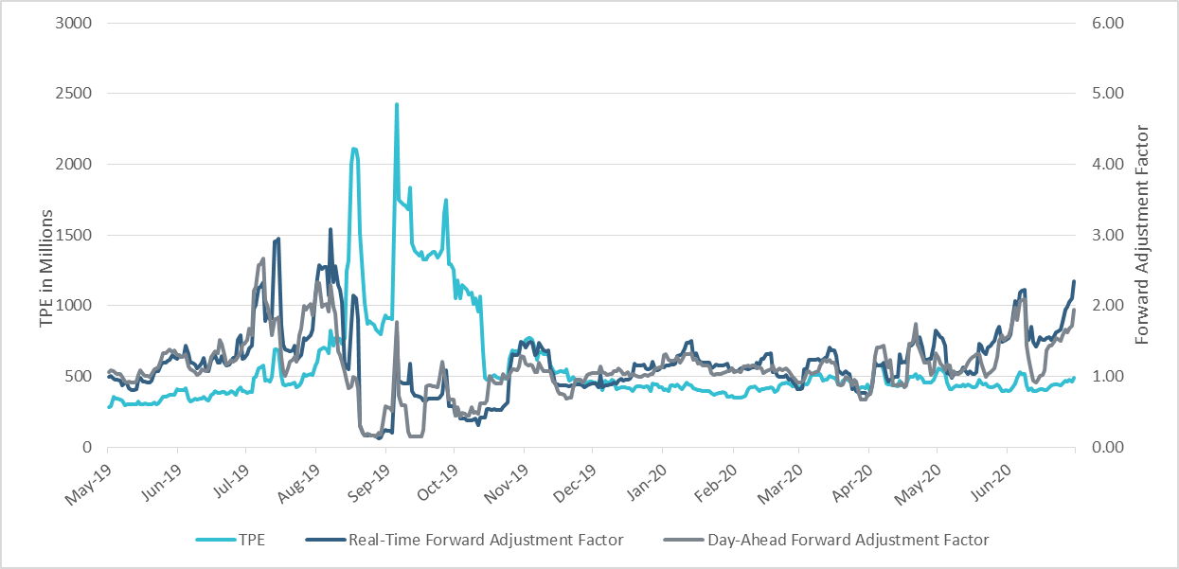
TPE and Forward Adjustment Factors May 2019- Jun 2020

Slide 5
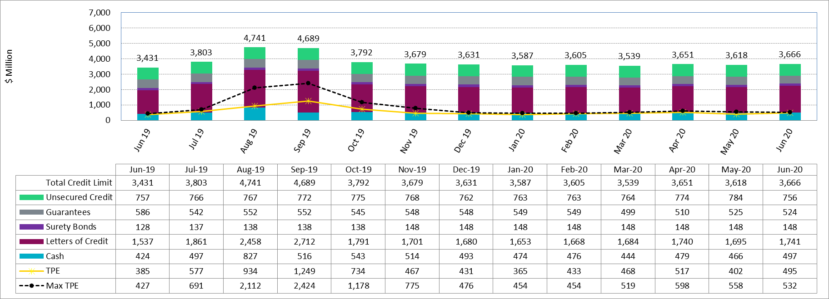
Available Credit by Type Compared to Total Potential Exposure (TPE)
*Numbers are as of month end except for Max TPE

Slide 6
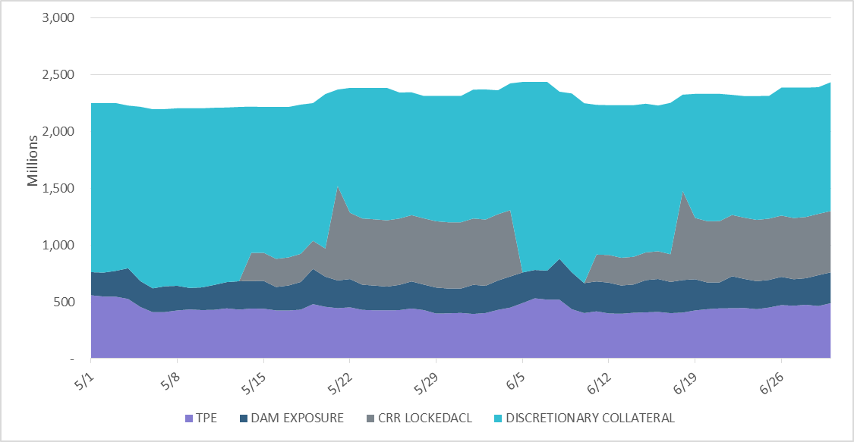
Discretionary Collateral May 2020- Jun 2020
At a Counter-Party level, no unusual changes were noted
Note: Discretionary collateral doesn’t include Unsecured Credit Limit or parent guarantees

Slide 7
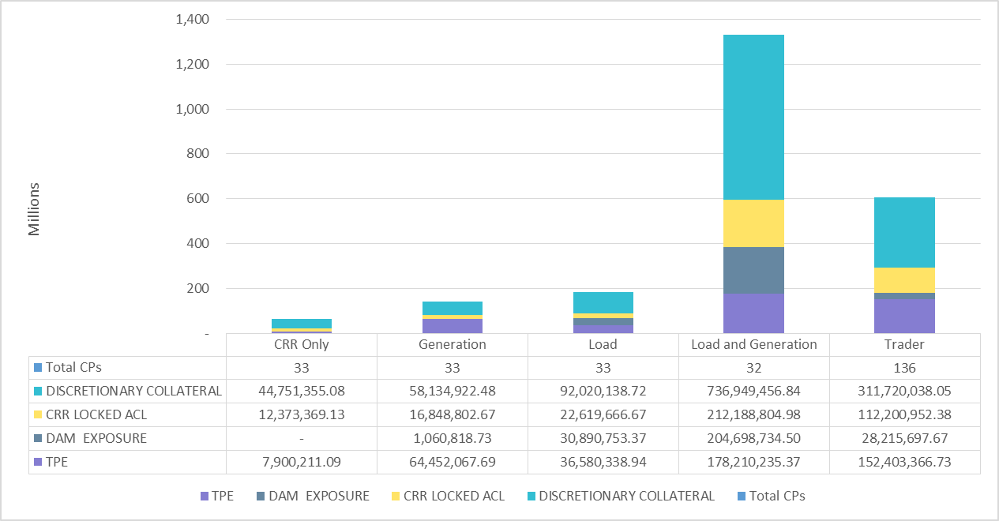
TPE and Discretionary Collateral by Market Segment- Jun 2020
Load and Generation entities accounted for the largest portion of discretionary collateral

Slide 8
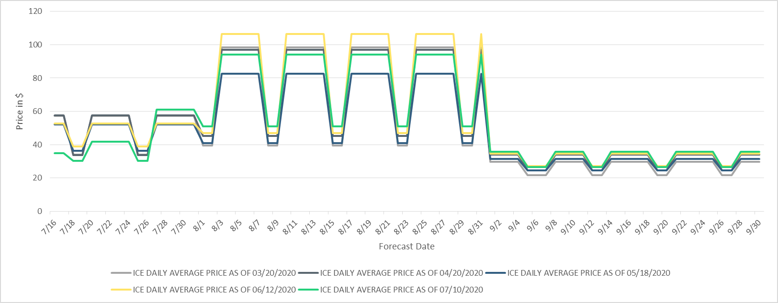
ICE Daily Average Price Evolution Jul 2020- Sep 2020

Slide 9
TPE coverage of settlements
TPEA covers Settlement/Invoice exposure and estimated Real-Time and Day- Ahead completed but not settled activity (RTLCNS and UDAA)
The analysis was performed for the period, Apr 2019- May 2020
Only Settlement invoices due to ERCOT are considered in the calculation
M1 values as of May 28, 2020 were used for the entire period
Example
For business date 2/1/2020, if a Counter-Party has M1 value of 20, then all the charge invoices till 2/21/2020 including RTLCNS and UDAA as of 2/1/2020 is summed up to arrive at “Invoice Exposure”

Slide 10
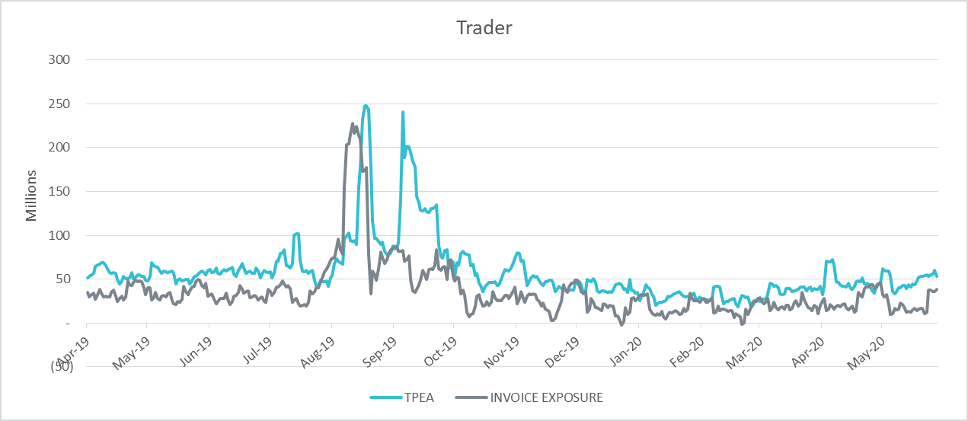
TPE coverage of settlements Apr 2019-May 2020
TPEA generally exceeds actual/invoice exposure

Slide 11
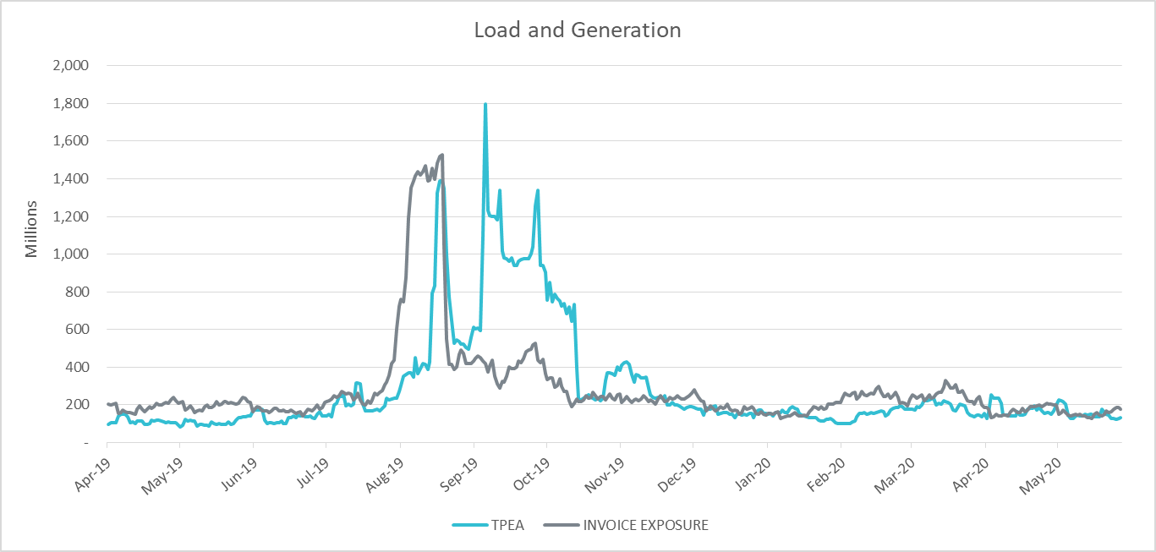
TPE coverage of settlements Apr 2019-May 2020
Actual/invoice exposure slightly higher than TPEA except during summer peak and fall

Slide 12
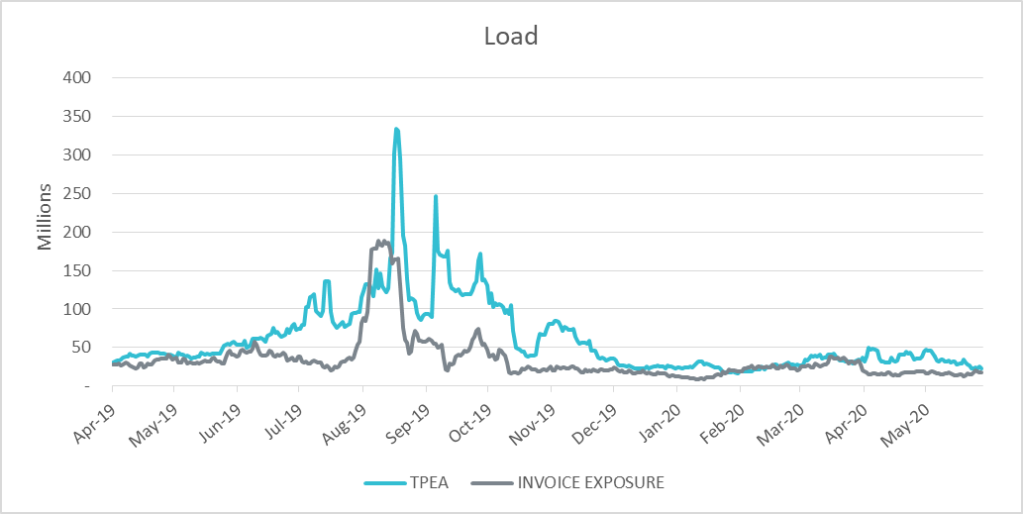
TPE coverage of settlements Apr 2019-May 2020
TPEA closely approximates actual/invoice exposure except during summer peak and fall

Slide 13
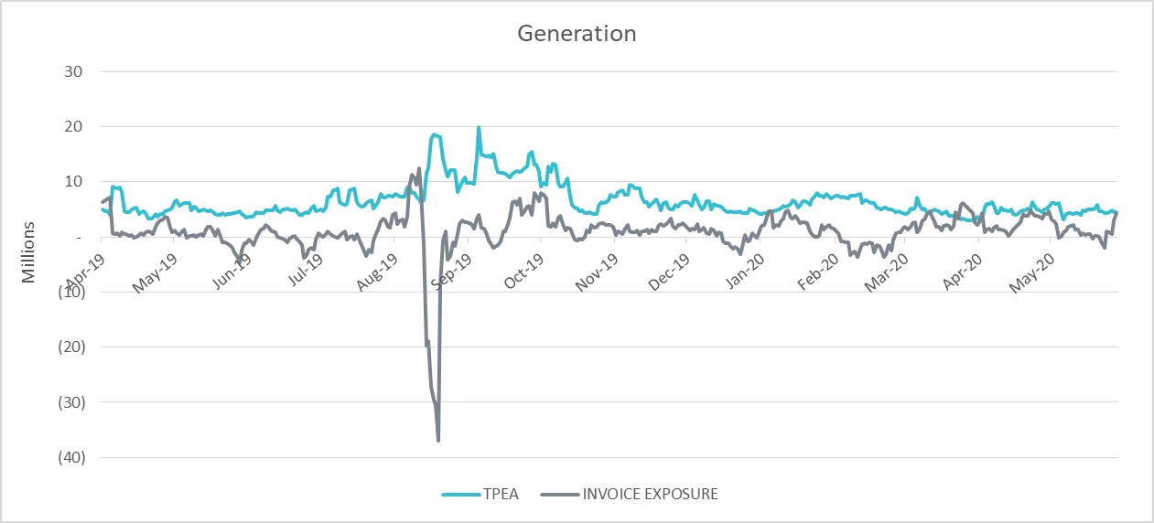
TPE coverage of settlements Apr 2019-May 2020
TPEA generally exceeds actual/invoice exposure

Slide 14
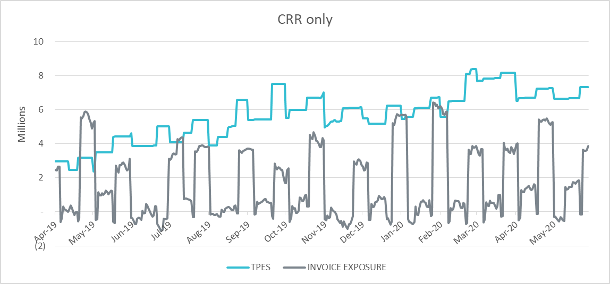
TPE coverage of settlements Apr 2019-May 2020
TPES mostly exceeds actual/invoice exposure

Slide 15
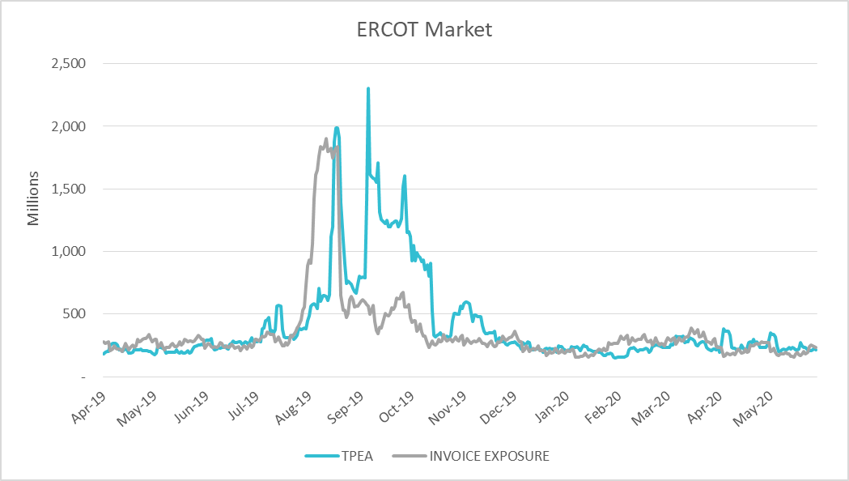
TPE coverage of settlements Apr 2019-May 2020
TPEA closely approximates actual/invoice exposure during winter and shoulder months

Slide 16
Appendix

Slide 17
Summary of Distribution by Market Segment
Note: Excess collateral doesn’t include Unsecured Credit Limit and is defined as Collateral in excess of TPE

Slide 18
Summary of Distribution by Rating Group

Slide 19
Distribution of TPE by Rating and Category

Slide 20
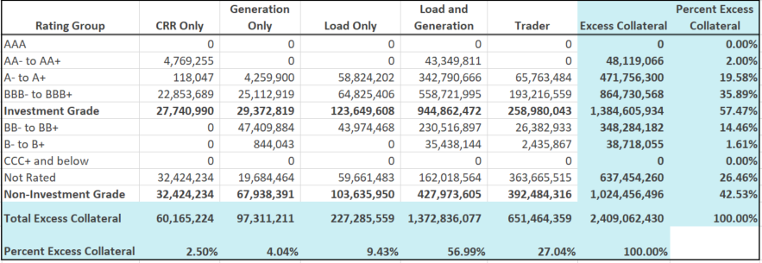
Distribution of Excess Collateral by Rating and Category
Note: Excess collateral doesn’t include Unsecured Credit Limit

Slide 21
Questions

