Slide 1
Item 11: CMM Process Issue
Vanessa Spells
Manager, Credit
Credit Work Group
ERCOT Public
July 15, 2020

Slide 2
CMM Process Issue
On July 9, 2020, ERCOT issued Market Notice M-A070920-01, Error Identified in ERCOT’s Credit Monitoring and Management (CMM) System. The Notice is linked below:
http://www.ercot.com/services/comm/mkt_notices/archives/4605
Per the Notice, ERCOT identified an error in the CMM system that occurred beginning January 1, 2020. The error affected the calculation of the Future Credit Exposure (FCE) component of Total Potential Exposure (TPE). FCE determines the amount of Financial Security that a Counter-Party (CP) must provide for activity related to Congestion Revenue Rights (CRRs).
ERCOT implemented a software fix on July 5, 2020 to correct the error.

Slide 3
CMM Process Issue
Per Protocol Section 16.11.4.5, Determination of the Counter-Party Future Credit Exposure, an average of rolling consecutive Day-Ahead Market (DAM) settled prices for a period representing a month is used to calculate two components of FCE: the Portfolio Weighted Adder (PWA) and the Path Specific DAM Based Adder. The PWA is used to determine the FCE for PTP Obligations (FCEOBL). The Path Specific DAM Based Adder is used to determine the FCE for PTP Options (FCEOPT).
From January 1 to July 5, 2020, ERCOT used DAM settled prices as of December 31, 2019, rather than continuously updated prices, to determine the PWA and Path Specific DAM Based Adder. ERCOT has determined that this error occurred because the table of DAM settled prices used for this calculation must be updated periodically via a manual process, and the required update to the table was not executed. ERCOT has corrected the error and is developing an automated process to update the table as a permanent solution.

Slide 4
CMM Process Issue
Although this error impacted the calculation of FCEOBL and FCEOPT from January 1 to July 5, 2020, it did not affect the FCE for any CP until March 19, 2020. ERCOT has identified 25 CPs whose FCE was incorrectly calculated on at least one Operating Day from March 19 to July 5, 2020, due to this error.
ERCOT is aware of one instance where the error triggered a request for additional Financial Security; however, this did not result in a breach or default scenario.

Slide 5
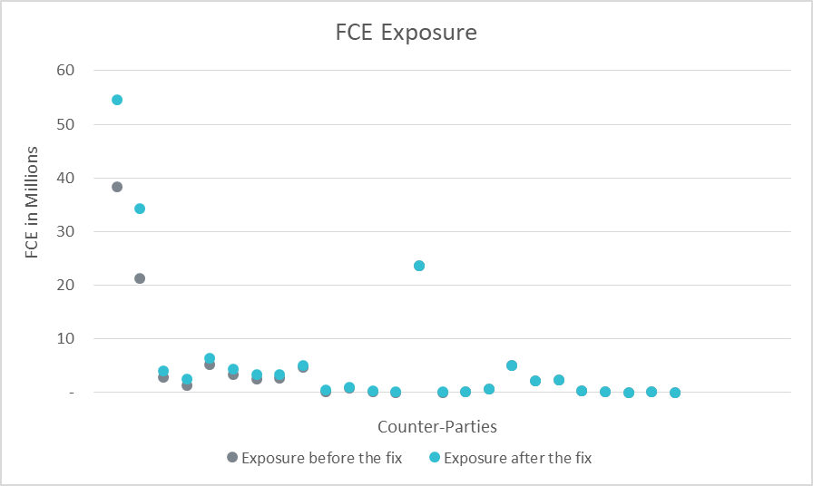
CMM Process Issue

Slide 6
CMM Process Issue
Degree of change among the 25 CP’s
Increase in exposure between | Number of CP’s
1 to 1,050 | 5
1,051 to 100,000 | 9
100,001 to 1,000,000 | 5
1,000,001 to 1,500,000 | 4
13,000,000 to 16,500,000 | 2

Slide 7
CMM Process Issue
Questions

