Slide 1
Project Update and Summary of
Project Priority List (PPL) Activity
July 16, 2020

Slide 2
Project Update Agenda
Project Portfolio Update
Recent / Upcoming Project Implementations
2020 Release Targets
Planned Project Starts / Prioritization Discussion
Initial Discussion at July PRS / Follow-Up at August PRS
Revision Request Inventory
In-Flight Revision Requests
Candidates for Summer 2021
Candidates for Implementation Prior to 2024 RTC Go-Live
Remaining Items
2020/2021 Project Spending Forecast
Priority/Rank Options for Revision Requests with Impacts
Location of Project Priority List (PPL): http://www.ercot.com/services/projects/index

Slide 3
Recent / Upcoming Project Implementations
2020 July Release – Off-Cycle – 7/1/2020 Complete
NPRR837 – Regional Planning Group (RPG) Process Reform
NPRR930(a) – Process, Pricing, and Cost Recovery for Delayed Resource Outages
O&M portion – i.e. elements of the NPRR that aren’t part of the $100k-$200k IA project
2020 August Release – Off-Cycle – 8/1/2020 In Flight
NPRR933 – Reporting of Demand Response by Retail Electric Providers and Non-Opt-In Entities
RRGRR021 – Dynamic Model Requirement for TSAT
2020 August Release – R4 – 8/4/2020 – 8/6/2020 In Flight
NPRR935(a) – Post All Wind and Solar Forecasts
Section 4.2.2 (1)(6) and Section 4.2.5
NPRR951 – Active and Inactive SCED Constraint Reporting
NPRR977 – Create MIS Posting for RUC Cancellations
2020 September Release – Off-Cycle – 9/x/2020 In Flight
SCR804 – ERCOT GridGeo Access for Transmission Operators
2020 Q3 Release – Off-Cycle – 9/3/2020 (target date) In Flight
RIOO – RARF Replacement – View/Update
Note: Projected Go-Live dates are subject to change. Please watch for market notices as the effective dates approach.

Slide 4
2020 Release Targets – Board Approved NPRRs / SCRs / xGRRs
R1
R3
R5
February 2/4 – 2/6 | April 3/31 – 4/2 | May 5/26 – 5/29 | August 8/4 – 8/6 | October 10/13 – 10/15 | December 12/8 – 12/10
NPRR873 SCR797 NPRR877 Ph2 NPRR968 NPRR943 EMIL Web Interface NPRR863 Ph1 NPRR960 NOGRR187 OBDRR011 | SCR802 NPRR928 NPRR929 NPRR978(a) NPRR988 NPRR953 | NPRR856 NPRR884 OBDRR006 SCR803 NPRR887 NPRR907 NPRR985 RMGRR163 NPRR837 NPRR930(a) NPRR933 RRGRR021 | NPRR935(a) NPRR951 NPRR977 SCR804 SCR781(a) RRGRR016 RRGRR019 | NPRR902 NPRR998 MIS Go-Live MMS/OS Refresh NPRR863 Ph2 | NPRR978 SCR806 NPRR857 NPRR885 NPRR904 NPRR905 NPRR917 NPRR936 NPRR941 NPRR963 NPRR971 NPRR986 NPRR998 OBDRR009 PGRR070(b) SCR781(b) SCR799
R2
R4
R6
ü
ü
ü
ü
ü
ü
ü
ü
ü
ü
ü
ü
ü
E
E
E
P
P
NS
NS
NS
NS
P
NS
NS
NS
NS
P
P
P
NS
E
E
NS
1/1
2021 Go-Lives
ü
ü
October
CMM Release 2a
ü
ü
ü
1/19
September
Off-Cycle (At Risk)
November
Off-Cycle
ü
1/30
7/1
E
ü
ü
Q3 RIOO
RARF Go-Live - View/Update
3/1
5/1
8/1
2022 Go-Lives
ü
ü
ü
ü
ü
P
MMS/OS Upgrade “Chill”
MMS/OS Upgrade “Freeze”
TBD Items | 2017 | 2018 | 2019 / 2020
 | NPRR702, NPRR829 | NPRR825(b), NPRR867, NPRR841 | NPRRs: 826, 879, 885, 918, 930, 935(b), 939, 962, 965, 974, PGRR066, SCR800, SCR805
Go-live dates can differ from Protocol effective dates – Please refer to market notices for more details
APPENDIX
Red Text: New additions and target release changes
Strike-Through Text: Previous target release
(a), (b), etc.: Multiple phase release
Project Status Codes
NS = Not Started
I = Initiation
P = Planning
E = Execution
H = On Hold
NPRR863 Ph1 – FFR
NPRR863 Ph2 – ECRS
NPRR930(a) – O&M portion
NPRR935(a) – Sections 4.2.2 (1) (6), 4.2.5
NPRR935(b) – Sections 2.1, 2.2, 4.2.3
NPRR978(a) – Initial report decommissions
PGRR070(b) – Remaining PGRR language
SCR781(a) – View / Edit capability
Release targets are subject to change

Slide 5
Project Prioritization Discussion
A number of Revision Requests were approved in late 2019 and early 2020
Revision Request project demand is high relative to historical norms
Project resources are at a very high utilization level
A review of priorities is needed to ensure funding is available for the most critical Revision Requests
ERCOT has identified candidates for delivery by summer 2021
ERCOT has also identified candidates to be started in the next 6 months so they can be delivered prior to the software development phase of Real-Time Co-Optimization (RTC)
Market input is requested on:
Summer 2021 / Pre-RTC (summarized on slide 7)
Remaining Revision Requests (summarized on slide 8)
The next project starts are targeted for September/October so this discussion can conclude at the August PRS meeting

Slide 6
Revision Requests – In-Flight Spending Forecasts
Revision Request | Phase | 2020 Spend | 2021 Spend | Comment
NPRR863 Phase 2 – ECRS (ERCOT Contingency Reserve Service) | Planning | $700k | $1.40M | 2022 Go-Live Target
SCR781 – RARF Replacement (RIOO) | Execution | $400k | $300k | View/Change in progress
CMM Phase 2 – NPRRs 484, 867, 887, 907, 985 | Execution | $400k | $200k | 2020 R3 Go-Live (partial)
NPRR856 / NPRR884 / OBDRR006 | Execution | $350k | – | 2020 R3 Go-Live
SCR804 – ERCOT GridGeo Access for Transmission Operators | Planning | $350k | – | 2020 Sept. Go-Live Target
NPRR863 Phase 1 – FFR (Fast Frequency Response) | Execution | $250k | – | 3/1/2020 Go-Live
NPRR986 / NPRR971 – BESTF-2 / RT AIEC | Planning | $200k | $50k | 2021 Go-Live Target
NPRR929 – PTP Obligations w/Links to Option DAM Award Eligibility | Closing | $150k |  | 2020 R2 Go-Live
NPRR902 – ERCOT Critical Energy Infrastructure Information | Planning | $100k | – | 2020 R5 Go-Live Target
SCR803 – Wind Integration Rpt / Solar Integration Rpt/Dashboard | Execution | $50k | – | 2020 R3 Go-Live
NPRR935 – Post All Wind and Solar Forecasts | Execution | $50k | – | 2020 R4 Go-Live Target
NPRR951 – Active and Inactive SCED Constraint Reporting | Execution | $50k | – | 2020 R4 Go-Live Target
NPRR905 – CRR Balancing Account Resettlement | Planning | $50k | $25k | 2021 Go-Live Target
NPRR873, NPRR911, NPRR920, NPRR952, NPRR998, SCR797, SCR802 (all <$25k spend in 2020) | Various | $100k | –
Total |  | $3.20M | $1.98M

Slide 7
Revision Requests – 2020 / 2021 Spending Scenario
Revision Request | 2020 Spend | 2021 Spend | Comments
In-Flight (from previous slide) | $3.20M | $1.98M
Potential Candidates for Summer 2021
NPRR930 – Pricing /Cost Recovery for Delayed Res. Outages | $50k | $100k | Shoulder month issue – Early 2021 target
NPRR939 – Mod. to Load Resources Providing RRS… | $10k | $50k
NPRR904 / OBDRR009 – ORDC Revisions | $50k | $200k | Address market concerns and events that are more likely to occur in the summer months
NPRR1019 – Pricing & Settlement Changes for SWGRs... | $10k | $100k
NPRR974 – Capacity Insufficiency OCN Transparency | $10k | $50k
Potential Candidates to Implement Prior to RTC
NPRR1029 – BESTF-6 DC Coupled Resources | – | $500k | ERCOT evaluating this group of RRs to assess if: Needed before RTC go-live in 2024 … or … Lays the foundation for work that’s expected to be delivered with RTC in 2024
NPRR1016 – DGRs and DESRs | $25k | $400k
NPRR917 – Nodal Pricing for SODGs and SOTGs | $10k | $300k
NPRR1026 – BESTF-7 Self-Limiting Facilities/Resources | – | $150k
NPRR963 – Base Point Deviation - Combo Model | $10k | $150k
NPRR987 – BESTF-3 ESR PRC & RT Capacity Calcs | $25k | $150k
NPRR1002 – BESTF-5 ESR Single Model Registration & Charging Restrictions | $25k | $100k
PGRR082 – Establish Small Generation Interconnection | $25k | $50k
Total | $3.45M | $4.28M
Important: These items have not been assessed for resource availability.
That review will be done once agreement is reached on overall priorities.

Slide 8
Approved Revision Requests “Not Started” – Market Input Requested
Revision Request | Priority | Cost Est. | Comments
NPRR826 – Mitigated Offer Caps for RMR Resources | 2020 | $100k-$200k | Market input needed
NPRR829 – Incorporate RT Non-Modeled Telemetered Net Generation… | 2019 | $200k-$300k | ERCOT recommends separating from CMM Phase 2 for delivery by summer 2021
NPRR841 – RT Adj. to Day-Ahead Make Whole Pmts due to A/S Infeasibility | 2019 | $60k-$80k | Does RTC change the need for this?
NPRR879 – SCED Base Point, Base Point Deviation, & Performance Eval… | 2020 | $200k-$250k | Market input needed
NPRR918 – Validation for PTP Obligations with Links to an Option | 2020 | $30k-$50k | Market input needed
NPRR936 – CRR Account Holder Limits | 2020 | $150k-$250k | Market input needed
NPRR941 – Create a Lower Rio Grande Valley Hub | 2020 | $250k-$350k | Market input needed
NPRR962 – Publish Approved DC Tie Schedules | 2020 | $15k-$30k | Market input needed
NPRR965 – GREDP Shutdown Exemption | 2020 | $10k-$20k | Market input needed
NPRR975 – Load Forecast Model Transparency | 2020 | $75k-$100k | Market input needed
NPRR1006 – Update RT On-Line Reliability Deployment Price Adder Inputs... | 2020 | $140k-$180k | Market input needed
PGRR066 – Interconnection Req. Cancellation & Creation of Inactive Status | 2019 | $100k-$150k | Next phase of RIOO
SCR799 – ERCOT Outage Study Cases in the SOTE | 2019 | $150k-$250k | Market input needed
SCR800 – Addition of DC Tie Ramp to GTBD Calculation | 2020 | $30k-$50k | Market input needed
SCR805 – Early Access to Certain 60-Day Reports to TSPs | 2020 | $40k-$60k | Market input needed
SCR807 – Increase CRR Transaction Capability | 2020 | $50k-$100k | Potential efficiencies with related CMM work
SCR809 – Changes to Ext. Telemetry Validations in Resource Limit Calc. | 2020 | $40k-$60k | Market input needed
SCR810 – EMS Change to Count DC Ties towards 2% Constraint Criterion | 2020 | $15k-$25k | Market input needed (August Board)

Slide 9
Approved Revision Requests “Not Started” – Others
Revision Request | Priority | Start Date | Cost Est. | Comment / Recommended Action
NPRR702 – Flexible Accounts, Payment of Invoices, and Disposition of Interest on Cash Collateral | 2016 | N/A | $150k-$200k | NPRR1027 proposes to strike remaining gray-box language
NPRR825 – Require ERCOT to Issue a DC Tie Curtailment Notice Prior to Curtailing DC Tie Load | 2018 | TBD | $200k-$300k | Pending internal ERCOT project that will provide required data
NPRR857 – Creation of Direct Current Tie Operator Market Participant Role | 2019 | TBD | $500k-$700k | Southern Cross – no budgetary impact
Revision Requests – In Stakeholder Process
Revision Request | Next Approval | Target Start Date | Cost Est. | Comment / Recommended Action
NPRR1004 – Load Distribution Factor Process Update | PRS | TBD | $45k-$65k | Market input needed
NPRR1030 – Modify Allocator for CRR Auction Revenue Distribution | PRS | TBD | $20k-$40k | Urgency requested at July PRS Market input needed
NOGRR195 – Generator Voltage Control Tolerance Band | PRS | TBD | $30k-$50k | Market input needed
PGRR076 – Improvements to GINR Process | PRS | TBD | $50k-$75k | Market input needed

Slide 10
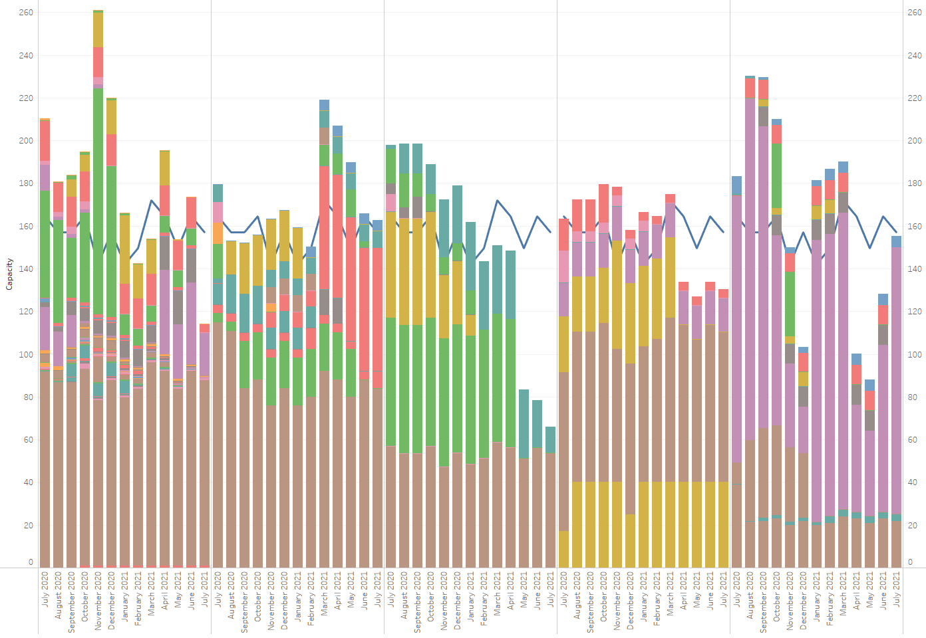
Resource Allocation Analysis Example – Five Project Team Members
Production Support
IT Architect
Tester
Project Manager
Developer
Tan colors near bottom of each bar: O&M demand
Other colors: Assigned work by project

Slide 11
2020 Project Spending
2020 PPL Budget = $29.0M
“Potential Demand” represents internal ERCOT projects that have not been fully approved

Slide 12
Revision Request Funding Placeholder Status
In ERCOT’s 2020/2021 proposed budget, the following amounts are allocated for Revision Request work
2020 = $4M
2021 = $4M
Yearly Revision Request Spending Forecast Summary
Project Status | 2020 | 2021
YTD Actuals | $1.32M | -
Approved – In-Flight / Complete | $3.20M | $1.98M
Approved – Not Started | $0.58M | $2.30M
Remaining Funding | $0.22M | $0.00M
Total Allocation | $4.00M | $4.28M
As of 6/30/2020
Changes to priorities will impact “Approved – Not Started” forecasts

Slide 13
Priority / Rank Options for Revision Requests with Impacts
Options for…
Revision Request | Description | Priority | Rank | Comments
NPRR1002 | BESTF-5 Energy Storage Resource Single Model Registration and Charging Restrictions in Emergency Conditions | 2020 | 3060 | Lays the foundation for work that’s expected to be delivered with RTC in 2024
NPRR1004 | Load Distribution Factor Process Update | 2021 | 3210 | $45k-$65k – MMS impact
NPRR1016 | Clarify Requirements for Dist. Generation Resources (DGRs) and Dist. Energy Storage Resources (DESRs) | 2020 | 3070 | Lays the foundation for work that’s expected to be delivered with RTC in 2024
NPRR1030 | Modify Allocator for CRR Auction Revenue Distribution | TBD | TBD | $20k-$40k – S&B impact Market input requested
NOGRR195 | Generator Voltage Control Tolerance Band | 2020 | 300 | REGULATORY Discussed at ROS on 7/9/2020
PGRR076 | Improvements to Generation Resource Interconnection or Change Request (GINR) Process | 2021 | 3200 | RIOO-IS impacts (GINR) Project team is fully allocated to RIOO-RS (RARF) work Discussed at ROS on 7/9/2020
PPL Rank Information
Next available 2020 Rank in Business Strategy = 3060
Next available Rank in Regulatory = 260
Note
Items in the Regulatory section of the PPL are not tracked against the market Revision Request funding allocation

