Slide 1
Impact of New Equipment Outages on DAM
Anson Lee
Market Analysis and Validation
CMWG
July 13th, 2020

Slide 2
Overview
All the transmission outages relating to New Equipment Energization (NEE)
Study Period: January 2017 and June 2020
Represents 10% of all Transmission outages (Second largest category after “Other”)
There are 7,797 distinct NEE transmission outages or 48,137 NEE-related transmission outage records (i.e. status update, start/end time update and etc.) during the study period
Grouped Outage (3,090 or 39.63%)
Grouped Outage could involve up to 58 equipment
Each outage could have several extensions
Number of extensions ranged from 1 to 21
65.23% (or 5,086) had no extension
34.77% (or 2,711) had at least one extension
18.6 % (or 1450) had at least two extensions
10.25 % (or 799) had at least three extensions
Notes:
Outages without actual start date or actual end date are excluded (5%)

Slide 3
Methodology
Data
New Equipment Energization Transmission Outages
Outages which are either cancelled, withdrawn or rejected are not included
Outages involving multiple equipment are treated as one if submitted together
Outage extensions submitted on the same day are consolidated
Use 10AM as date break instead of midnight.
Assumption
Actual end date is the exact time when the equipment came into service
Three scenarios
Outage extensions submitted after DAM
Outages completed earlier than expected in DAM
Outages completed later than expected in DAM
6/1/2020 10AM
6/3/2020 10AM
1 hr
2 hr
3 hr
3 hr
6 hr
1 hr
4 hr
6/2/2020 10AM
Extension
Early
Late

Slide 4
Analysis – Outage Extension
Outage extension submitted after DAM
If an outage extension is submitted after DAM deadline at 10AM, the topological change will not be modeled in DAM.
Example: New equipment Outage A was scheduled to be completed on 6/1/2020 17:00. An outage extension was submitted on 6/1/2020 13:00 to extend outage to 6/2/2020 20:00.
Percentage of New Equipment Outages with extension
Extension submitted after DAM deadline at 10AM
152 (2.46%) out of 6,247 outage extensions
Extended duration ranged from 7 minute to 18.56 days
Median is 2.88 hours
Original Planned End Date
6/1/2020 17:00
New Planned End Date
6/2/2020 20:00
DAM
5/31/2020
10:00
Update time
5/31/2020 13:00
6/2/2020 00:00
Outage Not modelled in DAM

Slide 5
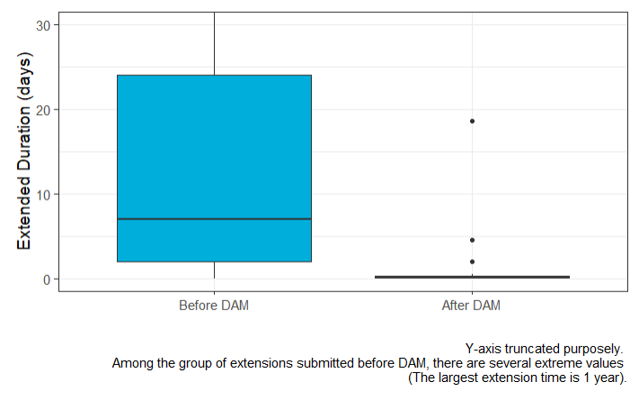
Comparison of Extended Outage Duration
Longer term extension tends to be submitted ahead of time, while
extension submitted after DAM deadline is mostly
for shorter term extension (less than 12 hours)
Notes:
The difference is statistically significant.

Slide 6
Analysis – Outage Early Completion
Outage completed earlier than expected in DAM
If an outage is completed earlier than the planned end date seen in DAM, it will cause topological difference between DAM and Real-Time.
Example: New equipment Outage C was scheduled to be completed on 6/1/2020 18:00. However, the outage work completed early on 6/1/2020 00:00.
Percentage of New Equipment Outages with early completion
Outage completed earlier than expected in DAM*
860 (11 %) out of 7,797 outages
385 (44.77 %) had prior extension(s)*
Shortened duration ranged from 1 minute to 168 days**
Median is 2.49 hours
* With respect to the outage snapshot used for DAM for the operating day (i.e. 6/1/2020)
** Note: In this specific case, it was found that a new outage was submitted for the new equipment.
Outage Completed
6/1/2020 00:00
Original Planned End Date
6/1/2020 18:00
DAM
5/31/2020
10:00
Outage still modelled in DAM

Slide 7
Analysis – Outage Late Completion
Outage completed later than expected in DAM
If an outage is completed later than the planned end date seen in DAM, it will cause topological difference between DAM and Real-Time.
Example: New equipment Outage B was scheduled to be completed on 6/1/2020 18:00. However, the outage work was not completed until 6/1/2020 21:00.
Percentage of New Equipment Outages with early completion
Outage completed later than expected in DAM*
943 (12 %) out of 7,797 outages
509 (53.98 %) had prior extension(s)*
Delayed duration ranged from 1 minute to 11 hours**
Median is 1.15 hours
* With respect to the outage snapshot used for DAM for the operating day (i.e. 6/1/2020)
** Note: Real impact on DAM is between 0 to 24 hours
Original Planned End Date
6/1/2020 18:00
Outage Completed
6/1/2020 21:00
DAM
5/31/2020
10:00
Outage Not modelled in DAM

Slide 8
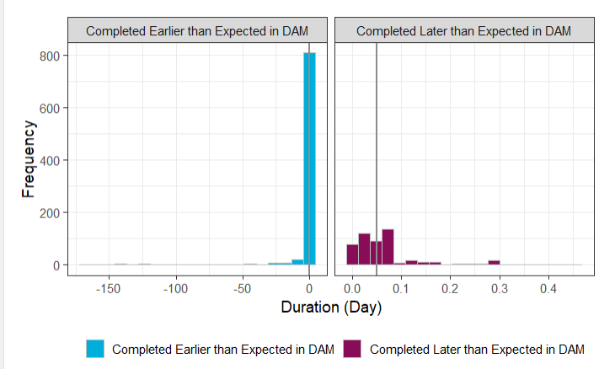
Shortened vs Delayed Duration
Median: 2.49 hours
Median: 1.15 hours
Completed Early
On Time
Completed Later

Slide 9
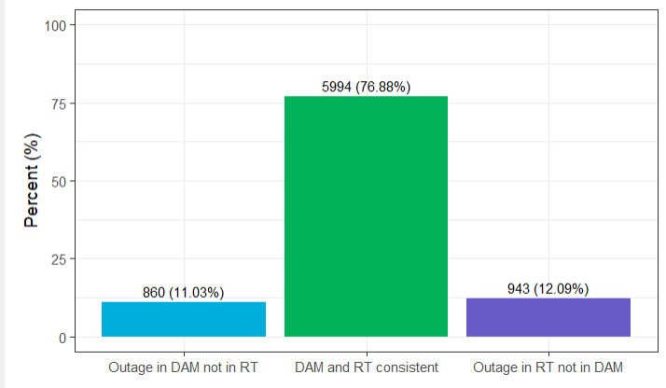
DAM/RT NEE Outage Model Consistency

Slide 10
Questions?

