Slide 1
PDCWG Report to ROS
Chair: Chad Mulholland, NRG
Vice Chair: Jimmy Jackson, CPS
ROS
July 9th, 2020

Slide 2
Report Overview & Notes
Report Overview
Meeting Minutes
BAL-001-TRE-1 FMEs & IMFR
2 FMEs in the month of May
Frequency Control Report

Slide 3
Meeting Minutes
PDCWG Meeting 6/16/2020
Regulation & Frequency Control Reports
FME Resource Performance Discussion
High Frequency Event Follow-up Discussion (Event from 3/16/20)
RRS Qualification Process for Battery Energy Storage Resources
Update on ERCOT Analysis: Limit for Carrying RRS on Individual Units

Slide 4
Frequency Measurable Events Performance

Slide 5
Frequency Measurable Events
There were 2 FMEs in May
5/26/2020 21:23:41
Loss of 481 MW
Interconnection Frequency Response: 1002 MW/0.1 Hz
11 of 39 Evaluated Generation Resources had less than 75% of their expected Initial Primary Frequency Response.
11 of 39 Evaluated Generation Resources had less than 75% of their expected Sustained Primary Frequency Response.
5/31/2020 10:45:26
Loss of 820 MW
Interconnection Frequency Response: 759 MW/0.1 Hz
5 of 38 Evaluated Generation Resources had less than 75% of their expected Initial Primary Frequency Response.
8 of 38 Evaluated Generation Resources had less than 75% of their expected Sustained Primary Frequency Response.

Slide 6
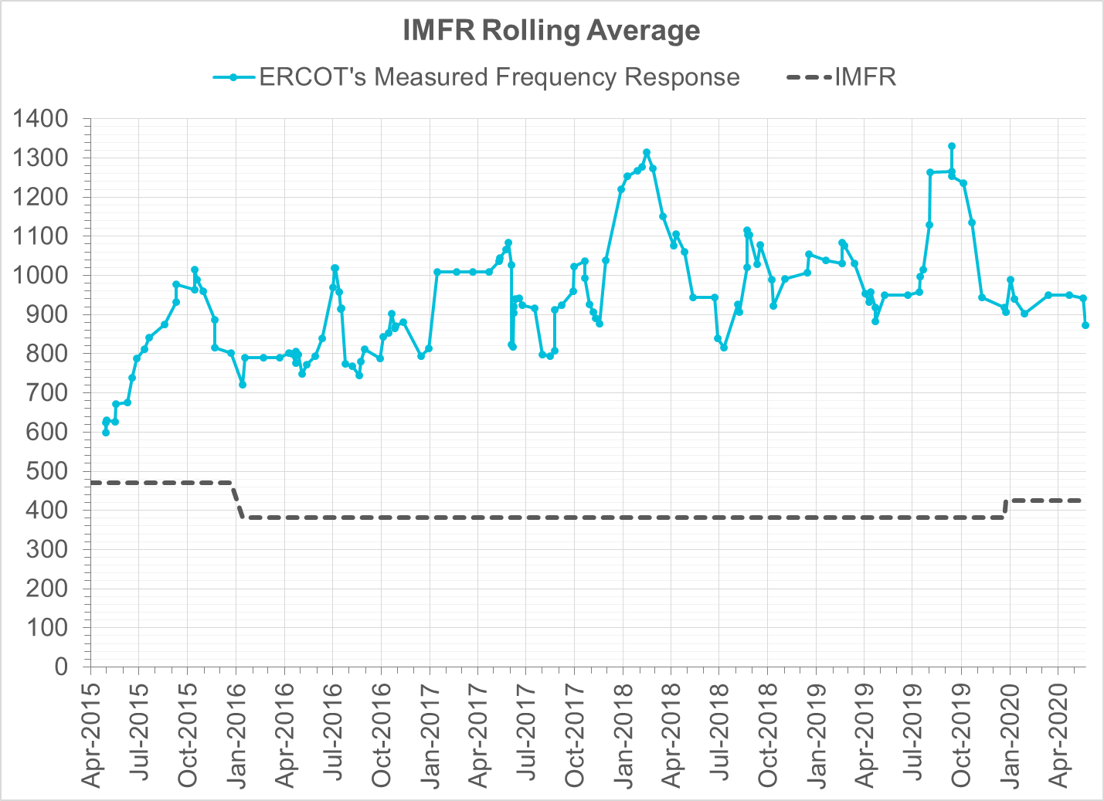
Interconnection Minimum Frequency Response (IMFR) Performance
IMFR Performance currently 872.75 MW/0.1Hz
Frequency Response Obligation (FRO): 425 MW/0.1 Hz

Slide 7
Frequency Control Report
May 2020

Slide 8
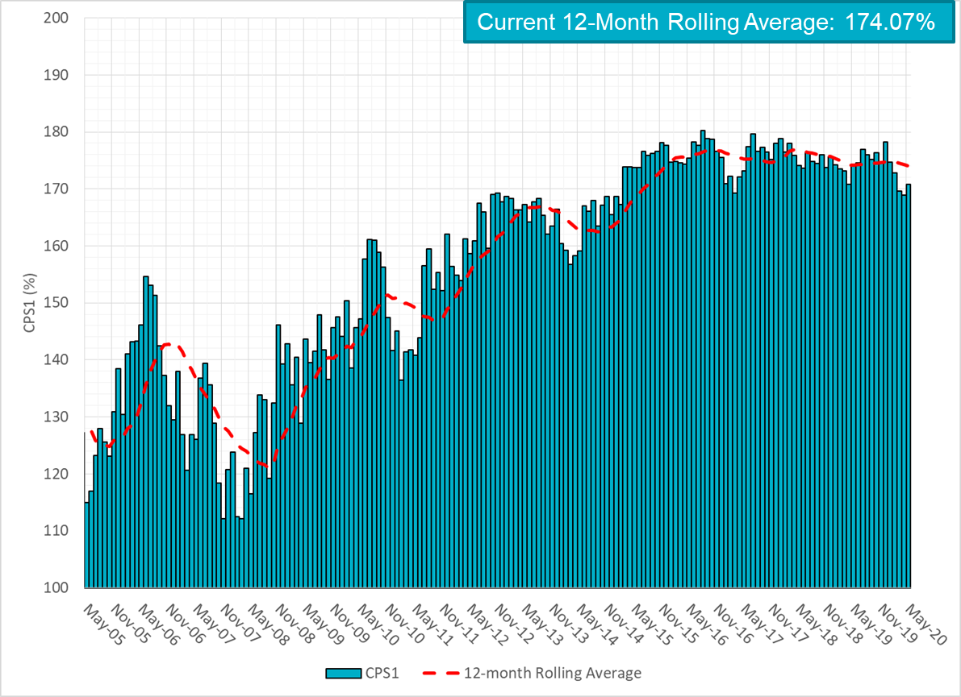
CPS1 Performance

Slide 9
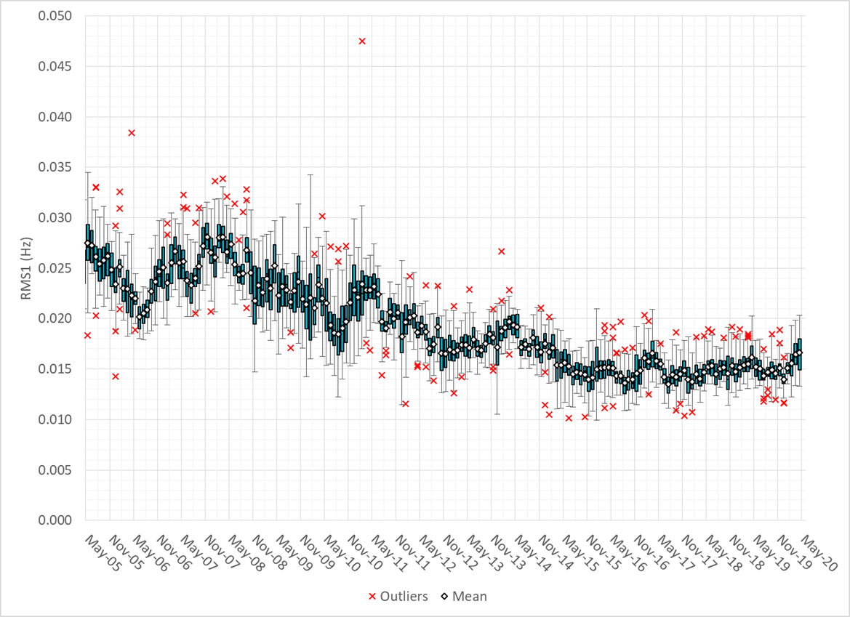
RMS1 Performance of ERCOT Frequency

Slide 10
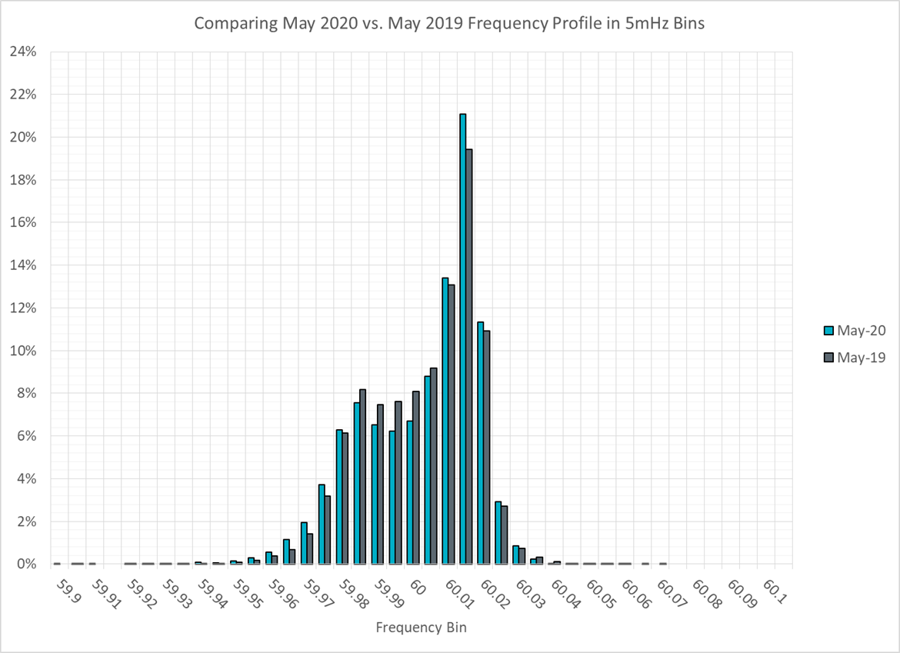
Frequency Profile Analysis

Slide 11
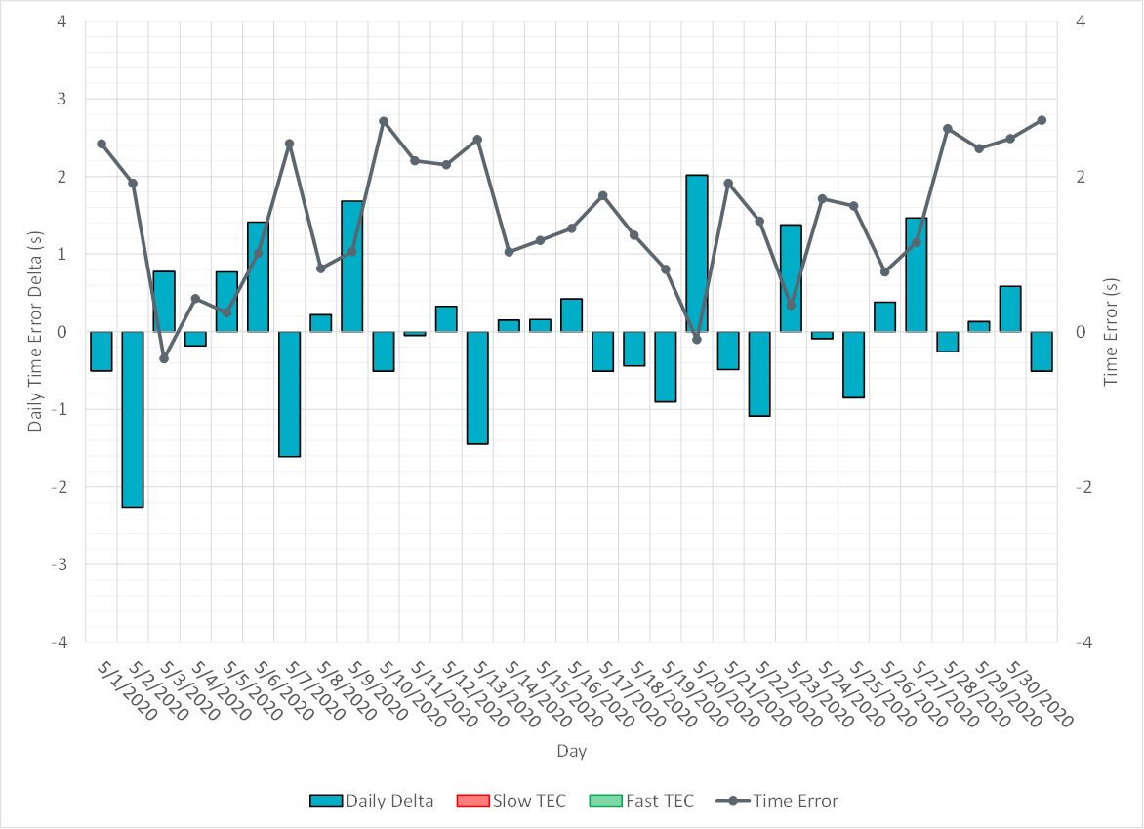
Time Error Corrections

Slide 12
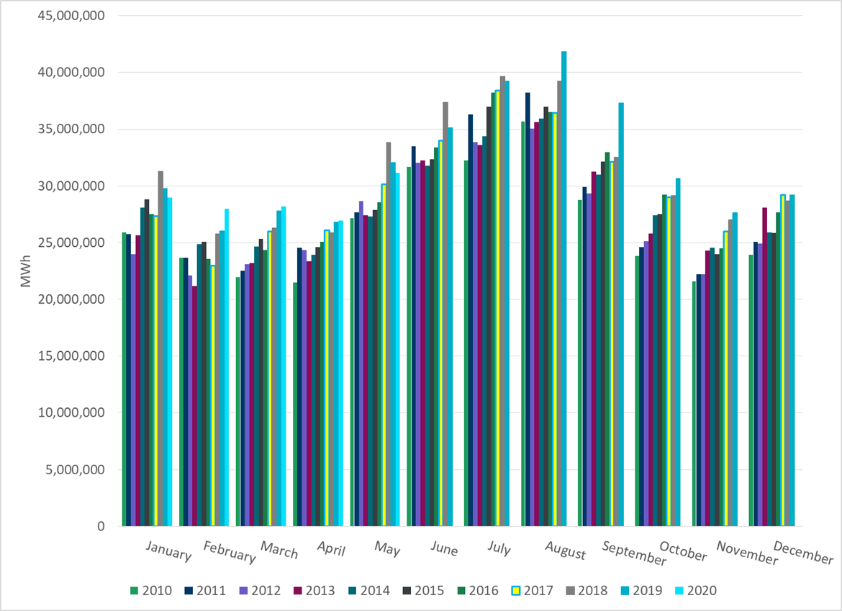
ERCOT Total Energy

Slide 13
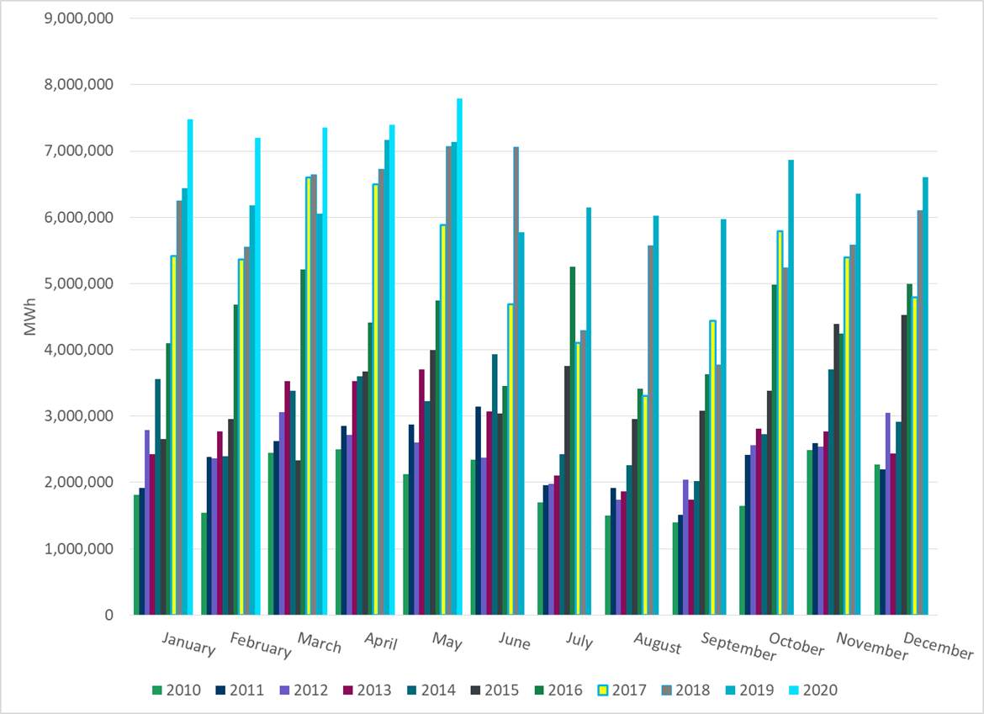
ERCOT Total Energy from Wind Generation

Slide 14
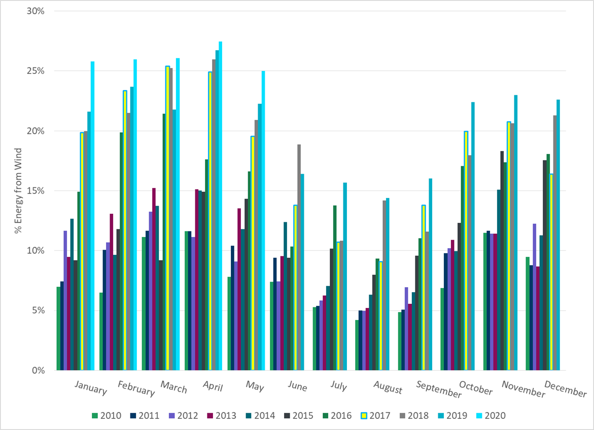
ERCOT % Energy from Wind Generation

Slide 15
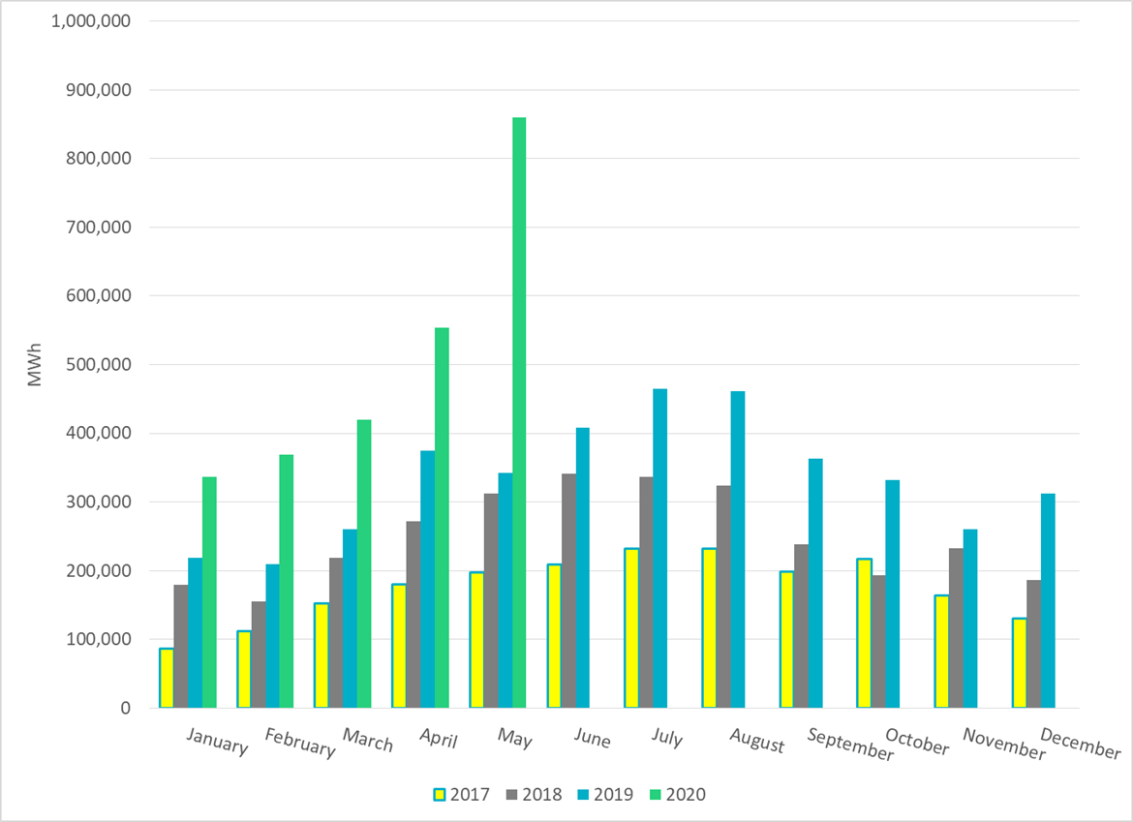
ERCOT Total Energy from Solar Generation

Slide 16
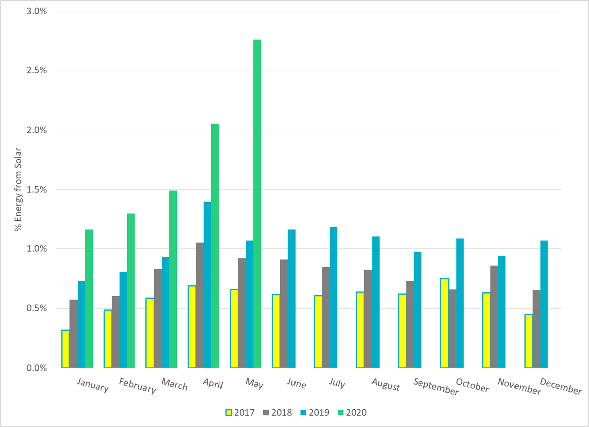
ERCOT % Energy from Solar Generation

Slide 17
Questions?

