Slide 1
Recommendations from the
2019 State of the Market Report by the Independent Market Monitor (IMM)
Carrie Bivens
ERCOT IMM Director
cbivens@potomaceconomics.com
Wholesale Market Subcommittee
ERCOT Public
July 8, 2020

Slide 2
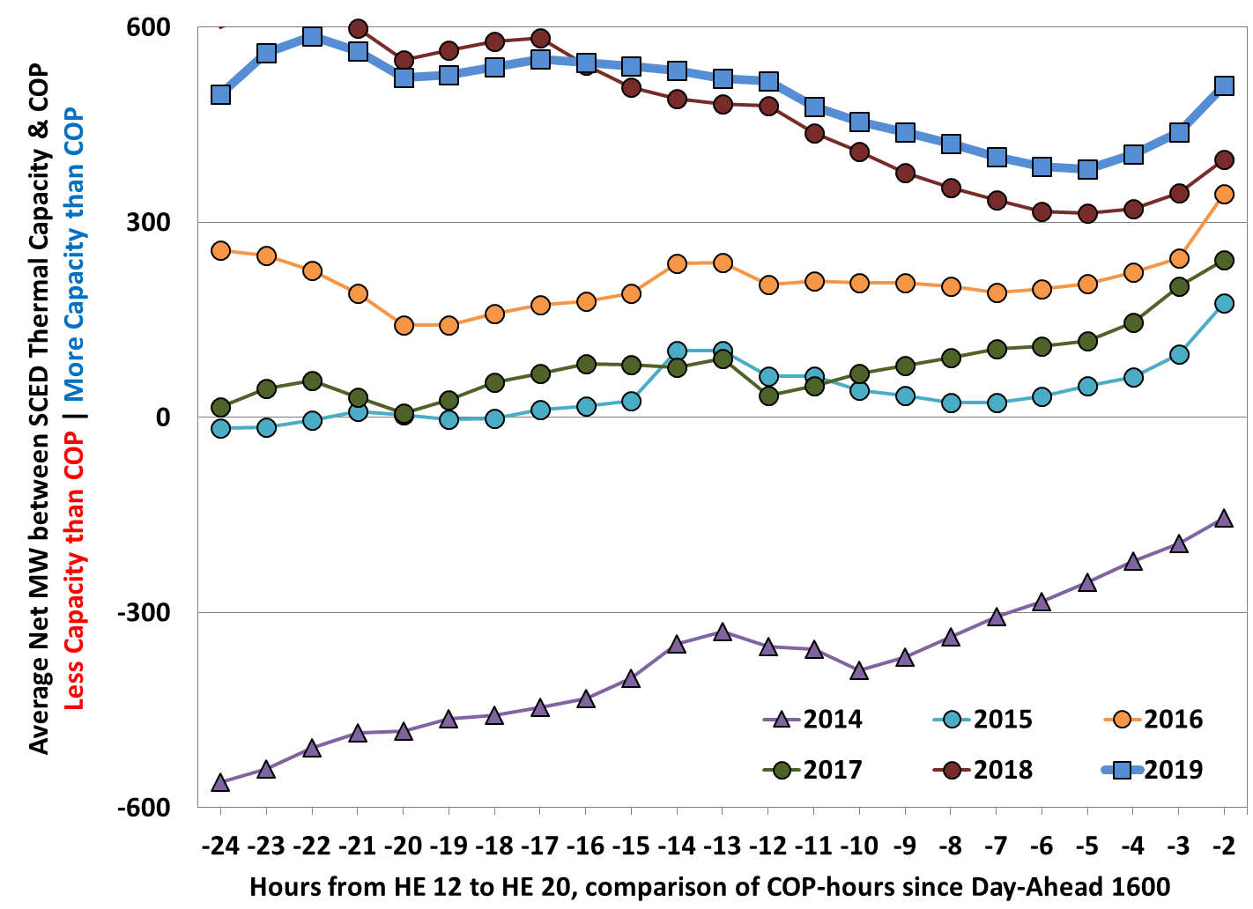
2019 State of the Market Recommendations
Remove RUC opt-out
Capacity Commitment Timing – July and August
Hour Ending 12 through 20

Slide 3
2019 State of the Market Recommendations
Remove RUC opt-out
Eliminate 2% rule
Contingency constraints are only activated if the following conditions are met:
Above Loading Threshold: loaded at 98% of Emergency Limit
Shift Factors Available: there exists a Resource Shift Factor ≥ 2% (absolute value)
Not Redundant: a similar constraint is not already activated
Source: January 2020 CMWG

Slide 4
2019 State of the Market Recommendations
Remove RUC opt-out
Eliminate 2% rule
Change transmission cost allocation
The current method of transmission cost allocation provides incentives for load to behave in ways that do not necessarily forestall the construction of new transmission equipment and that do not apply equally to all loads.

Slide 5
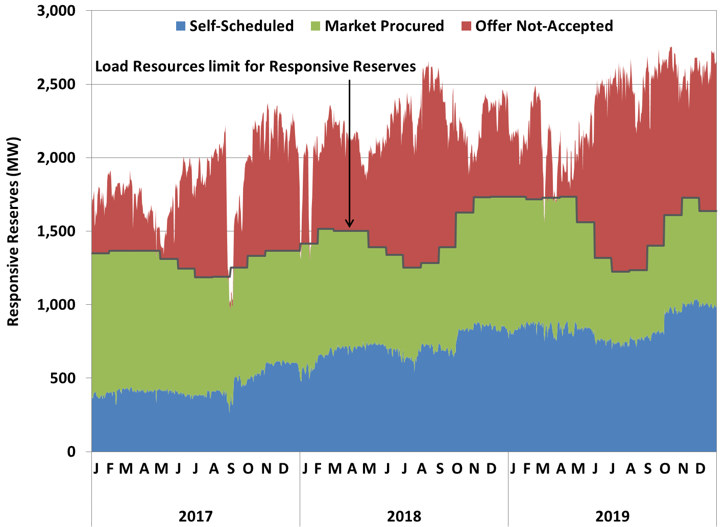
2019 State of the Market Recommendations
Remove RUC opt-out
Eliminate 2% rule
Change transmission cost allocation
Include shadow price of AS constraints in clearing prices
Daily Average of Responsive Reserves Provided by Load Resources

Slide 6
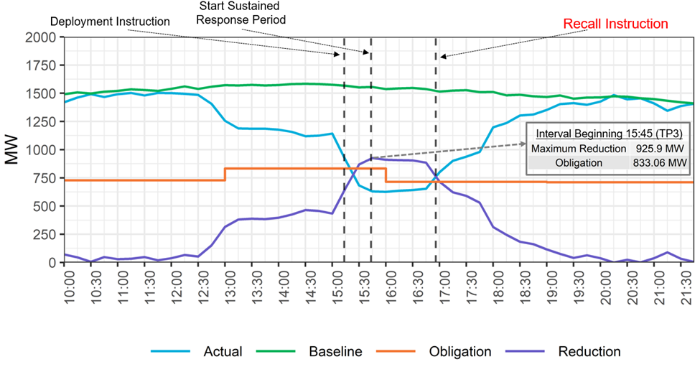
2019 State of the Market Recommendations
Remove RUC opt-out
Eliminate 2% rule
Change transmission cost allocation
Include shadow price of AS constraints in clearing prices
Modifications to RDPA
Reliability MWs, not market MWs
Adjust restoration time
Remove ERS deployed MWs from ORDC reserve calculations
ERS-30 deployment event on August 15, 2019
Source: 2019 Annual Report of Demand Response in the ERCOT Region (Mar. 2020)

Slide 7
2019 State of the Market Recommendations
Remove RUC opt-out
Eliminate 2% rule
Change transmission cost allocation
Include shadow price of AS constraints in clearing prices
Modifications to RDPA
Reliability MWs, not market MWs
Adjust restoration time
Remove ERS deployed MWs from ORDC reserve calculations
Local (zonal) RDPA

Slide 8
2019 State of the Market Recommendations
Remove RUC opt-out
Eliminate 2% rule
Change transmission cost allocation
Include shadow price of AS constraints in clearing prices
Modifications to RDPA
Reliability MWs, not market MWs
Adjust restoration time
Remove ERS deployed MWs from ORDC reserve calculations
Local (zonal) RDPA
Mitigated offer changes
Commitment costs for RUC intervals
Opportunity costs
Ensure no fixed/non-marginal costs included in fuel adder
- Marginal costs include more than direct financial costs, including risk and opportunity costs
- Commitment costs (startup and min-energy) should be factored into the mitigated offer when ERCOT makes the commitment decision.

Slide 9
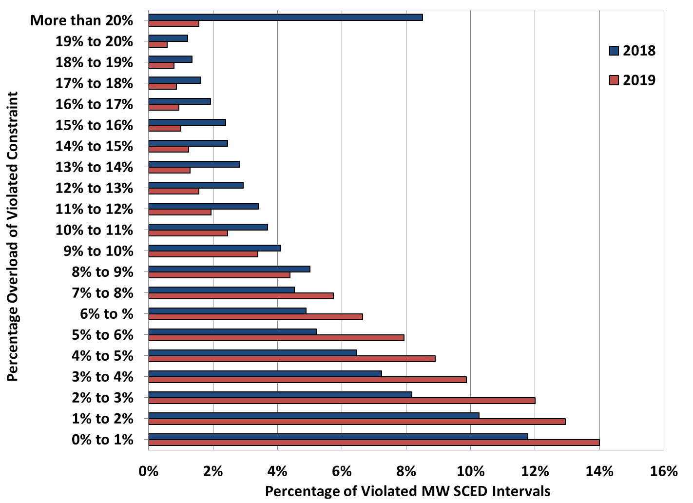
2019 State of the Market Recommendations
Percentage Overload of Violated Constraints
Remove RUC opt-out
Eliminate 2% rule
Change transmission cost allocation
Include shadow price of AS constraints in clearing prices
Modifications to RDPA
Reliability MWs, not market MWs
Adjust restoration time
Remove ERS deployed MWs from ORDC reserve calculations
Local (zonal) RDPA
Mitigated offer changes
Commitment costs for RUC intervals
Opportunity costs
Ensure no fixed/non-marginal costs included in fuel adder
Implement transmission demand curves

Slide 10
2019 State of the Market Recommendations
Remove RUC opt-out
Eliminate 2% rule
Change transmission cost allocation
Include shadow price of AS constraints in clearing prices
Modifications to RDPA
Reliability MWs, not market MWs
Adjust restoration time
Remove ERS deployed MWs from ORDC reserve calculations
Local (zonal) RDPA
Mitigated offer changes
Commitment costs for RUC intervals
Opportunity costs
Ensure no fixed/non-marginal costs included in fuel adder
Implement transmission demand curves
Full 2019 State of the Market Report can be found here

