Slide 1
Supply Analysis Working Group Report to WMS
July 8, 2020

Slide 2
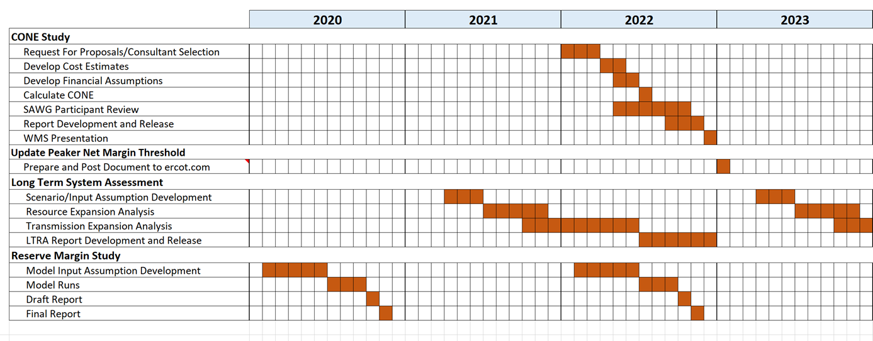
SAWG Open Action Items from TAC
TAC Assignment: Review Methodology used to determine CONE
Changed assignment to “CONE” from “PNM”
Status:
Will incorporate development and implementation of new methodology
Will need future scope change to SAWG to include “annual/periodic review of …CONE Study”
Goal: NPRR by end of 2020 for implementation by CONE study starting 2022

Slide 3
SAWG Open Action Items from TAC
TAC Assignment: Review Methodology used to determine CONE continued.
Background:
ERCOT previously presented a timeline for the study to be done in coordination with every other LTSA (= every 4 years) and to feed into the Reserve Margin Study
June SAWG Meeting:
Reviewed both documents posted at http://www.ercot.com/calendar/2020/6/22/195754-SAWG
CONE Studies NPRR to Protocols Section 4.4.11
Take comments before next SAWG
Goal to have NPRR filed and through stakeholder process by end of 2020
CONE Study Methodology Draft
ERCOT presented “Study Process and Methodology Manual: Estimating Economically Optimum and Market Equilibrium Reserve Margins (EORM and MERM)” with updated language for 8.3.Generator Cost of New Entry (CONE) based on previous feedback to SAWG
Consensus on this draft

Slide 4
SAWG Open Action Items from TAC
Review of Resource Adequacy forecasts and development of a Net Load forecast
Will update action item to include possible evaluation adn implementation of possible supplemental forecasts to CDR and SARA
Plan to review net load forecasting for the CDR

Slide 5
SAWG Open Action Items from TAC
Review of Resource Adequacy forecasts and development of a Net Load forecast continued.
Status of Probabilistic SARA
Completed and posted Probabilistic SARA Model
Final Model posted http://www.ercot.com/content/wcm/key_documents_lists/195751/Probabilistic_SARA_Model_5-22-2020_Public_NoMacros.xlsx
Final Probabilistic SARA Model Findings Review:
Probability of ERCOT needing to declare an EEA is 26% based on Final Summer SARA peak load forecast, which accounts for COVID-19 impacts; probability is 38% using the Preliminary Summer SARA forecast
Relative to the traditional SARA report, probabilistic modeling demonstrates the impact of considering joint probabilities of risk variables and a full range of capacity reserve outcomes
Wind output is the most important EEA risk determinant
HE 17:00 is the biggest EEA risk hour and the EEA risk is roughly symmetrical for hours before and after HE 17:00
Plan to review the accuracy of Probabilistic SARA Model this post Summer 2020
Will come back to WMS and TAC at that time for guidance on beginning discussions on implementation of any supplement to SARA

Slide 6
SAWG June Meeting – Storage Capacity Contribution for CDR
ERCOT currently uses 0% capacity contribution for battery storage
ERCOT will begin to collect data on storage duration (h) and/or maximum energy (MWh) once BESTF NPRR1002 and RRGRR023 are approved and implemented
At that time, ERCOT proposes to evaluate storage capacity contribution based on historic performance over peak load hours (or peak net load hours), like wind and solar
Once a meaningful amount of storage resources becomes commercial (capacity or number of resources threshold?), ERCOT will start including storage for CDR Reserve Margin calculation purposes.
ERCOT will file an NPRR documenting the methodology for calculating storage capacity contribution
Interim:
Issue an RFI, in coordination with PLWG, to collect planning information
SAWG to continue discussions with ERCOT on capacity contribution methodology this fall

Slide 7
SAWG June Meeting – Interconnection process for Gibbons
At May SAWG, ERCOT described that Gibbons Creek met the requirements in Planning Guide Section 5.4.9 Proof of Site Control
The specific information provided by an IE under 5.4.9 is protected
At June SAWG, discussed options for addressing this:
Discussed items to increase transparency to Planning Guide Section 5.4.9
Possible NPRR:
Addition to Section 1.3.1.2 (Items Not Considered Protected Information) to make the information needed in Planning Guide 5.4.9 exempt from protected information
ERCOT internal change request to add already public information to the GIS:
The Site Control Date is the date when ERCOT determines that the "proof of site control" requirement has been met according to ERCOT Planning Guide Section 5.4.9. The prerequisite for this determination is the uploading, via the RIOO-IS system, of a copy of a valid contract, deed, lease or agreement of the four conveyance types listed in the Section.

Slide 8
SAWG June Meeting – Interconnection process for Gibbons continued.
Discussed NPRR language that would change how planned restarts of retired/mothballed resources are handled in the CDR
Possible changes to Protocol Section 3.2.6.2.2 Total Capacity Estimate
Exclude resource previously mothballed or retired, unless documentation is presented to verify that there is an owner that intends to operate
Next Steps:
ERCOT input at next SAWG on documentation for a change to Protocol 3.2.6.2.2
Discuss ERCOT internal change for GIS to include “Site Control Date”
Stakeholder to files an NPRR

