Slide 1
Market Credit Working Group update to the Wholesale Market Subcommittee
Bill Barnes, NRG, Chair
Josephine Wan, Austin Energy, Vice Chair
7/08/2020

Slide 2
MCWG update to WMS
General Update
June 17 Joint MCWG/CWG WEBEX Meeting
6 NPRRs reviewed for their credit impacts (email vote)
984NPRR Change ERS Standard Contract Terms – No Credit Impact
996NPRR Alignment of Hub Bus Names Between Protocols and ERCOT Model – No Credit Impact
1002NPRR BESTF-5 Energy Storage Resource Single Model Registration and Charging Restrictions in Emergency Conditions – No Credit Impact
1003NPRR Elimination of References to Resource Asset Registration Form – No Credit Impact
1004NPRR Load Distribution Factor Process Update – No Credit Impact
1016NPRR Clarify Requirements for Distribution Generation Resources (DGRs) and Distribution Energy Storage Resources (DESRs) – No Credit Impact

Slide 3
MCWG update to WMS
Late Payment Enforcement Provisions
The potential conflict with the SFA could be addressed by:
Removing the termination option for Level III Enforcement
Providing graduated penalties for Level III Enforcement
This also eliminates the “do nothing” option for the first late payment.
ERCOT staff incorporating this feedback into NPRR to be filed soon.
Late Pmt. | Existing Enforcement Provisions |  |  | Proposed Enforcement Provisions
1 | Review, or | Level I Enforcement | Increase to or provide 110% collateral for min. 60 days | Level I Enforcement | Increase to or provide 110% collateral for min. 60 days
2 | Level I Enforcement, or | Level II Enforcement | 110% collateral in cash or LC for 60 days | Level II Enforcement | 115% collateral in cash or LC for 60 days
3 | Level II Enforcement, or | Level III Enforcement | Warning or terminate SFA | Level III Enforcement | 120% collateral in cash for 90 days
4 | Terminate SFA |  |  | Terminate SFA

Slide 4
MCWG update to WMS
Software Error Identified in ERCOT’s Credit Monitoring and Management (CMM) System
ERCOT identified a software error in its CMM system that occurred with the implementation of Nodal Protocol Revision Request (NPRR) 347, Single Daily Settlement Invoice and Updates to Credit Calculations, including addition of a Minimum Collateral Exposure Component, on November 9, 2012.
ERCOT implemented a software fix on June 4, 2020 to align the Total Potential Exposure (TPE) calculation with NPRR347.
ERCOT has determined that the 110% and 90% adjustments to RTL have not been included in the RTLF calculation since the implementation of NPRR347. In addition, the 150% RTLF adjustment has not been applied to two RTL components:
Real-Time Congestion payments/charges for Self-Schedules
Payments/charges for Point-To-Point (PTP) Obligations settled in Real-Time.
Because RTL can represent charges or credits, the impact of the errors on RTLF can be either positive or negative.

Slide 5
MCWG update to WMS
Software Error Identified in ERCOT’s Credit Monitoring and Management (CMM) System
Therefore, the error may have increased TPE in cases where it incorrectly caused RTLF to exceed the maximum of RTLE (with RFAF applied), and decreased TPE when the opposite occurred resulting in more or less collateral being posted with ERCOT than would otherwise have been the case.
Due to system limitations, ERCOT is unable to quantify the number of instances where an erroneous RTLF determined the TPE for a Counter-Party since the implementation of NPRR347.
However, since January 2019, ERCOT estimates that on most days:
The total aggregate RTLF, if corrected, would have exceeded the erroneously computed RTLF.
The maximum of RTLE (with RFAF applied) would likely have exceeded the corrected RTLF on all but one day, indicating that the error impacting RTLF was likely not a material driver of total TPE since January 2019.

Slide 6
MCWG update to WMS
Settlement Timeline Discussion
CWG/MCWG was exploring the possibility to shortening the ERCOT settlement timeline from OD+5 to OD+X.
Data streams and ERCOT processes were reviewed at a June 2 2020 workshop.
The risk of using estimated and/or inaccurate meter data increases substantially as the timeline is shortened. Counterproductive to credit metrics.
ERCOT data validation processes are also squeezed.
ERCOT analysis shows limited benefit in reducing collateral requirements of shortening the timeline except to OD+1 which is unworkable.

Slide 7
MCWG update to WMS
Counter-Party Credit Risk Assessment
The May 13, 2020 workshop “Proposed Qualifications and Requirements for Market Entry and Continued Participation by ERCOT Counter-Parties” introduced a number of proposals affecting ERCOT processes for Counter-Party qualification and ongoing credit risk management.
The proposals in the initiative are in part “lessons learned” from the PJM Greenhat default, and are similar to initiatives being undertaken at other ISO/RTOs.
Introduction
Market Entry Credit Impacts
Credit Assessment
Scoring Models
Next Steps

Slide 8
MCWG update to WMS
Counter-Party Credit Risk Assessment
The purpose of this discussion is to highlight credit impacts, primarily the proposed use of a credit scoring model for Counter-Party credit risk assessment.
Because of the complexity of credit risk assessment issues, this phase of the market entry initiative will be addressed in detail at stakeholder meetings and may proceed on a different timeline than other aspects of market entry qualification.
The second workshop on Market Entry is scheduled for July 29, 2020.
Introduction
Market Entry Credit Impacts
Credit Assessment
Scoring Models
Next Steps

Slide 9
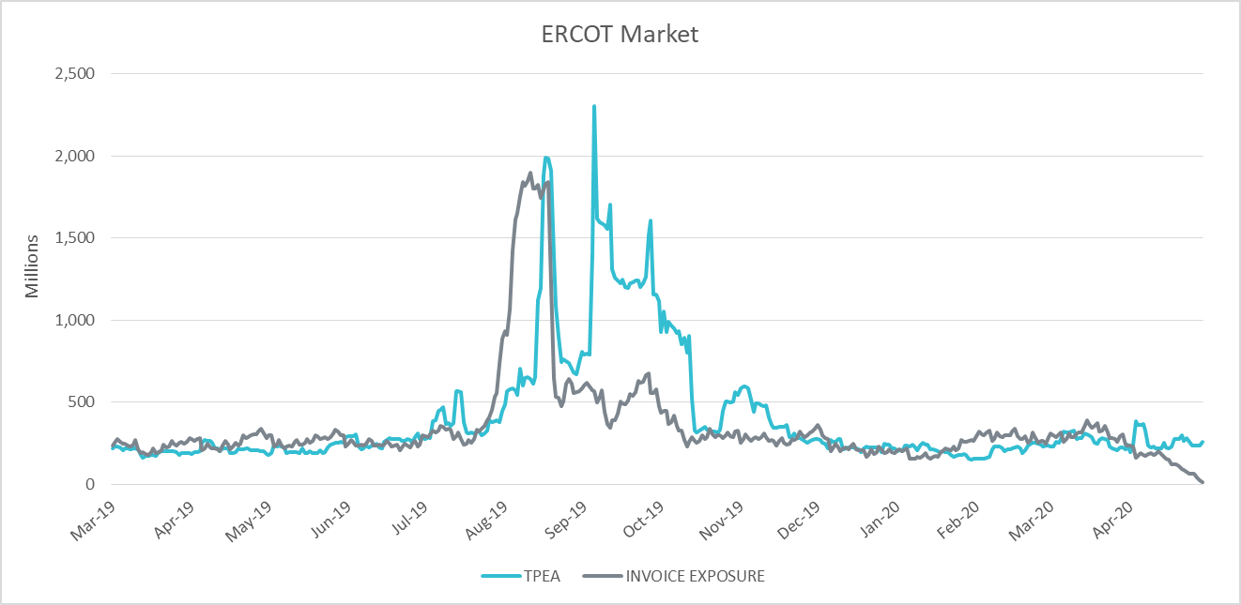
MCWG update to WMS
TPE (Credit Exposure) Coverage of Settlements Mar 2019-Apr 2020

