Slide 1
NPRR 995
ERCOT Staff
WMS
July 8, 2020

Slide 2
NPRR 995
The following language is proposed as new subsection 6.6.3.9 (9) in NPRR 995, RTF-6 Create Definition and Terms for Settlement Only Energy Storage:
ERCOT was asked to write specific settlement language necessary to support this concept
But note that language needs to change
This presentation outlines what ERCOT intends to file as comments to NPRR 995

Slide 3
Nodal pricing for SOES charging & discharging
ERCOT concurs that an SOES resource* should not be settled using a mixture of nodal and zonal prices
This is consistent with ESR settlement as developed in NPRR 986, BESTF-2 Energy Storage Resource Energy Offer Curves, Pricing, Dispatch and Mitigation – approved by ERCOT Board Feb. 2020 (injections and withdrawals by an ESR are settled using nodal prices)
ERCOT’s position is that the appropriate price for an SOES resource* should be a nodal price for both charging and discharging
There should not be a zonal option for SOES
This is consistent with the concept embraced in NPRR 917, Nodal Pricing for Settlement Only Distribution Generators (SODGs) and Settlement Only Transmission Generators (SOTGs) – approved by BoD Aug. 2019
* Note lower-case ‘r’, consistent with PUC Rules

Slide 4
Observations on metering requirements
Nodal pricing for SOES
Metering at the SDP to measure generation exports
Separate metering of charging energy
Metering scenarios (next slides)
Stand alone, auxiliary loads connected at a separate delivery point
Stand alone, auxiliary loads connected behind the same delivery point
Retail load and auxiliary loads connected behind the same delivery point

Slide 5
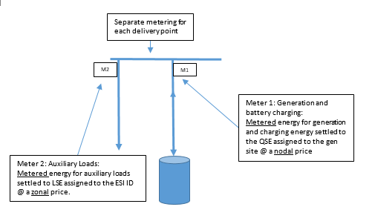
SOES - Scenario #1
Stand alone, auxiliary loads connected at a separate delivery point

Slide 6
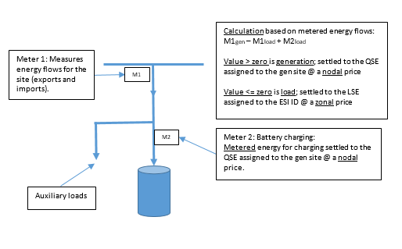
SOES – Scenario #2
Stand alone, auxiliary loads connected behind the same delivery point

Slide 7
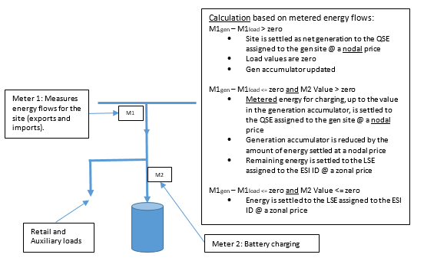
SOES - Scenario #3
Retail load and auxiliary loads connected behind the same delivery point

Slide 8
WSL for SOES
Today, Wholesale Storage Load (WSL) is available only to Energy Storage Resources (Controllable Load Resources in the combo model) with ERCOT Polled Settlement (EPS) Metering
ERCOT believes that language in PUC Subst. R. 25.501 (m) indicates that distribution-connected SOES systems should also be eligible for WSL treatment
‘…..ERCOT shall settle wholesale storage using the nodal energy price at the electrical bus that connects the storage facility to the transmission system, or if the storage facility is connected at distribution voltage, the nodal price of the nearest electrical bus that connects to the transmission system.’
WSL for SOES could follow existing rules for ESRs or, depending on fate of NPRR 1020, could potentially adhere to that policy as developed

Slide 9
Decision points for framing Protocol language
Pricing for SOES
Nodal pricing for SOES generation exports (price at the modeled or mapped electrical bus)
Nodal pricing for SOES charging energy when the energy is returned to the grid (price of the modeled or mapped electrical bus)
Zonal pricing for SOES charging energy when the energy is serving on-site retail loads (using generation accumulator logic)
Metering type and data
EPS Metering always an option
Explore use of TDSP-read metering as an option
Requires dialogue with TDSPs
Extend access to WSL to SOES
Time the implementation of system changes so there can never be a mix of zonal and nodal prices

Slide 10
Questions?

