Slide 1
DGR Workshop
PGRR IA discussion
ERCOT
Bill Blevins
June 26, 2020

Slide 2
Impact Analysis
RIOO-Integration Services 66%
RIOO-Resource Services 26%
Network Model Management System 4%
Data Services 4%
2.9 FTEs
*Assume 100 projects per year in Small Gen aspects of RIOO includes SOG and DGR/DESR at 50/50 mix

Slide 3
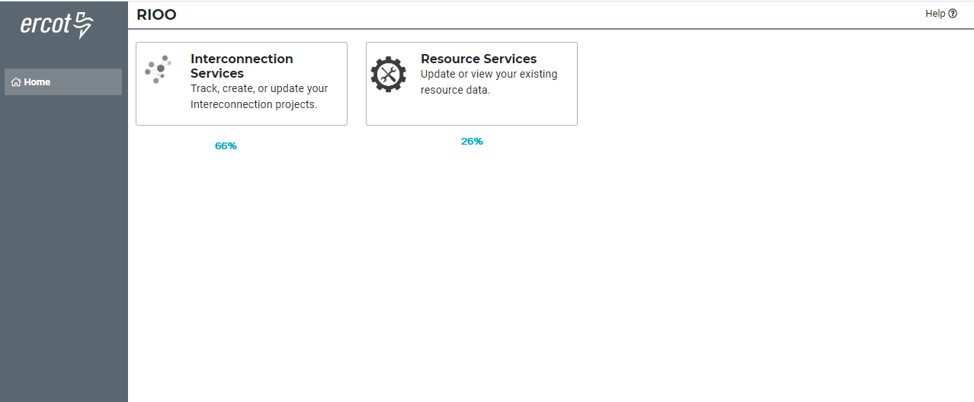
Breakout

Slide 4
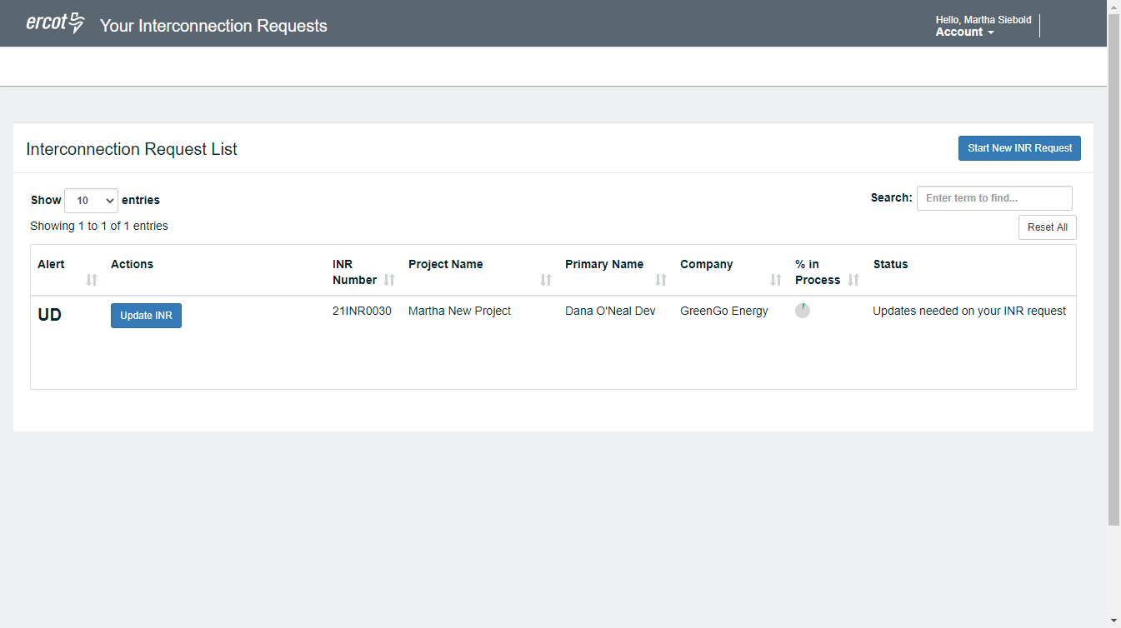
Input IE dashboard to include both Large and Small INRs-example only

Slide 5
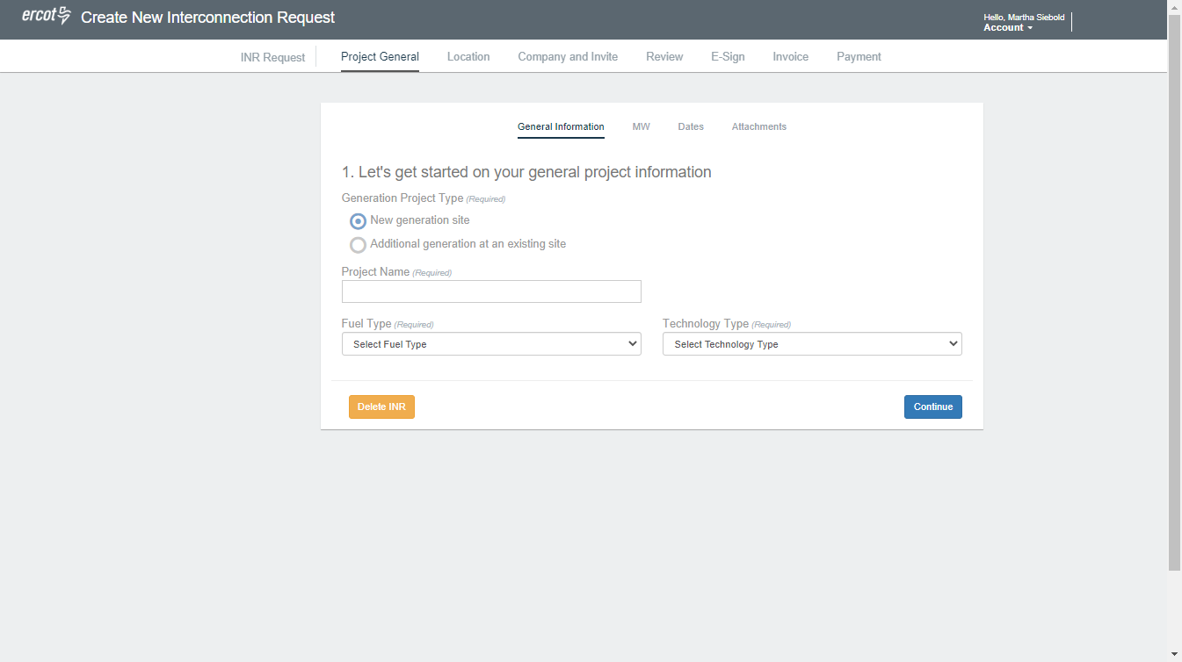
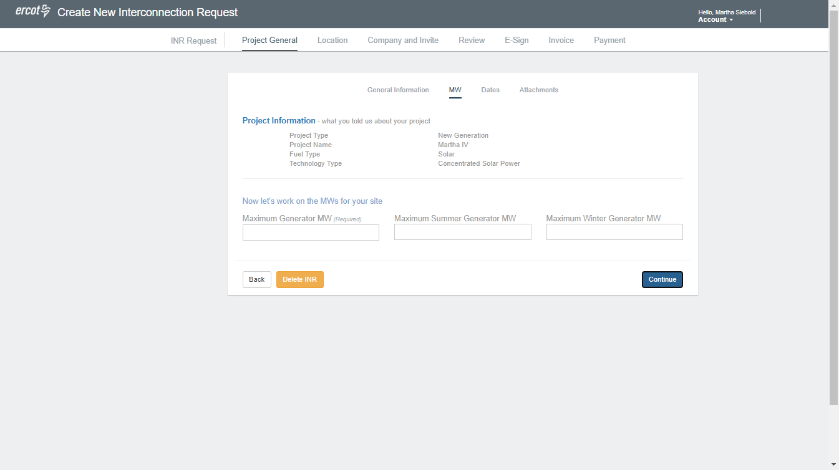
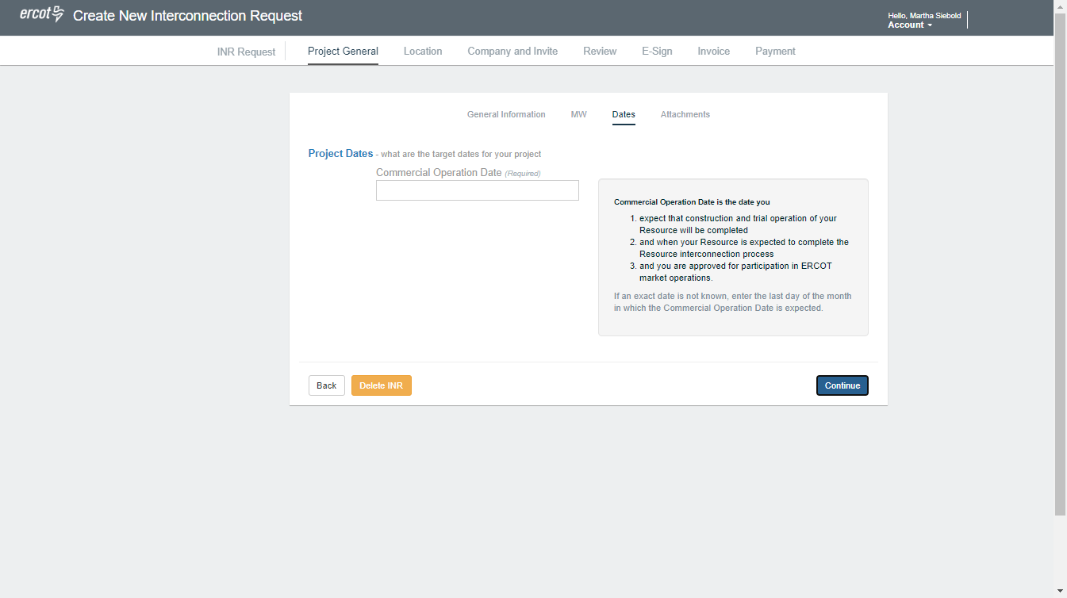
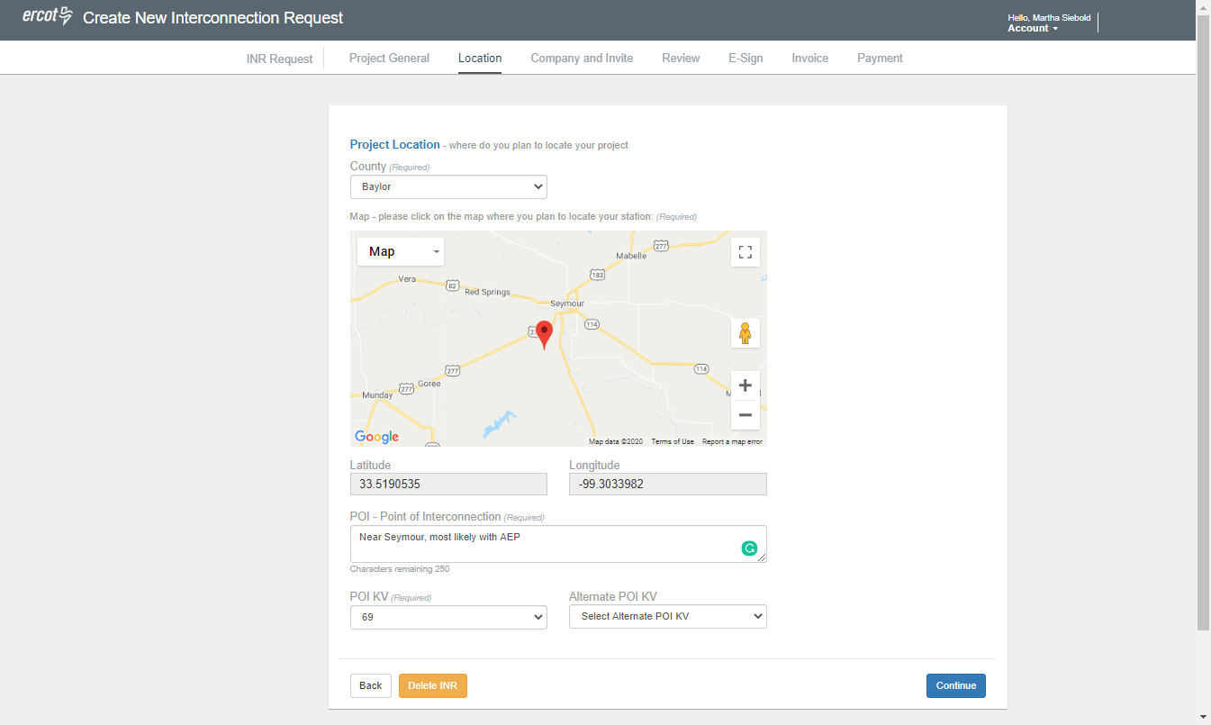
Modify Input data for Small Gen-example only

Slide 6
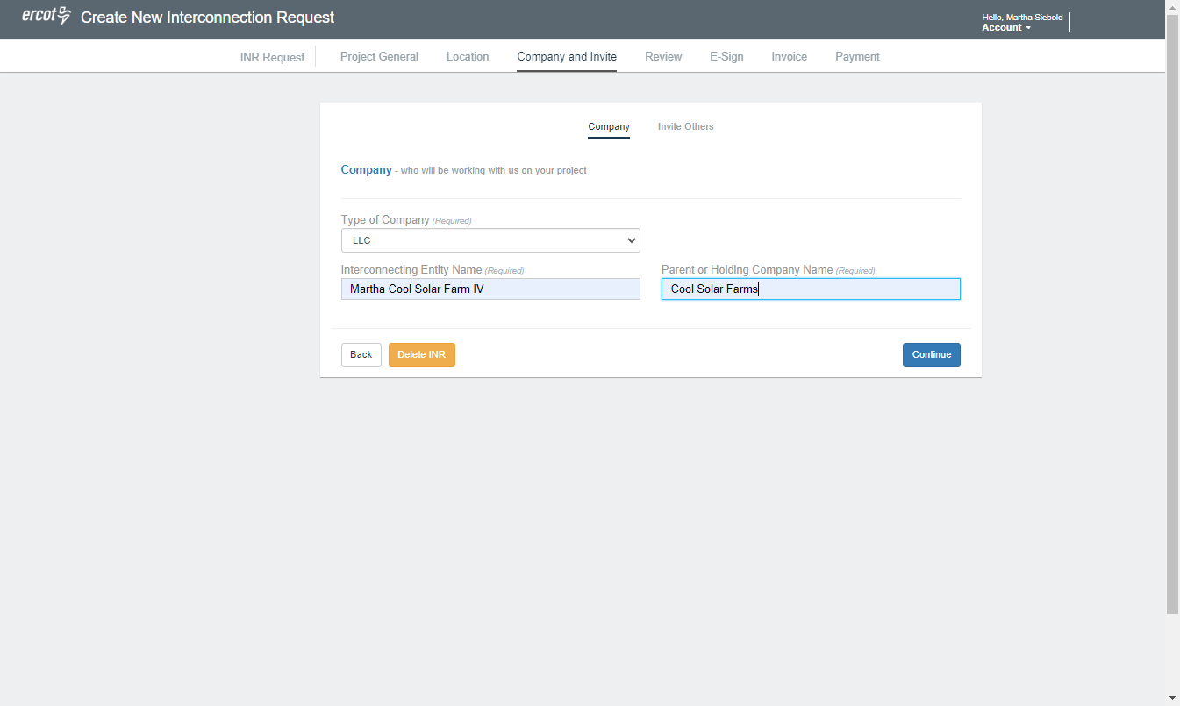
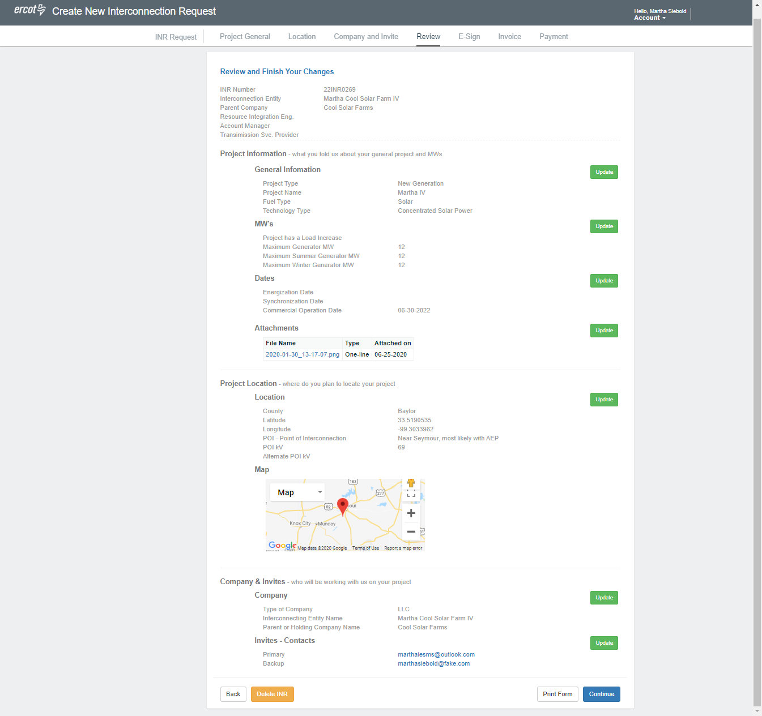
Project Info-example only

Slide 7
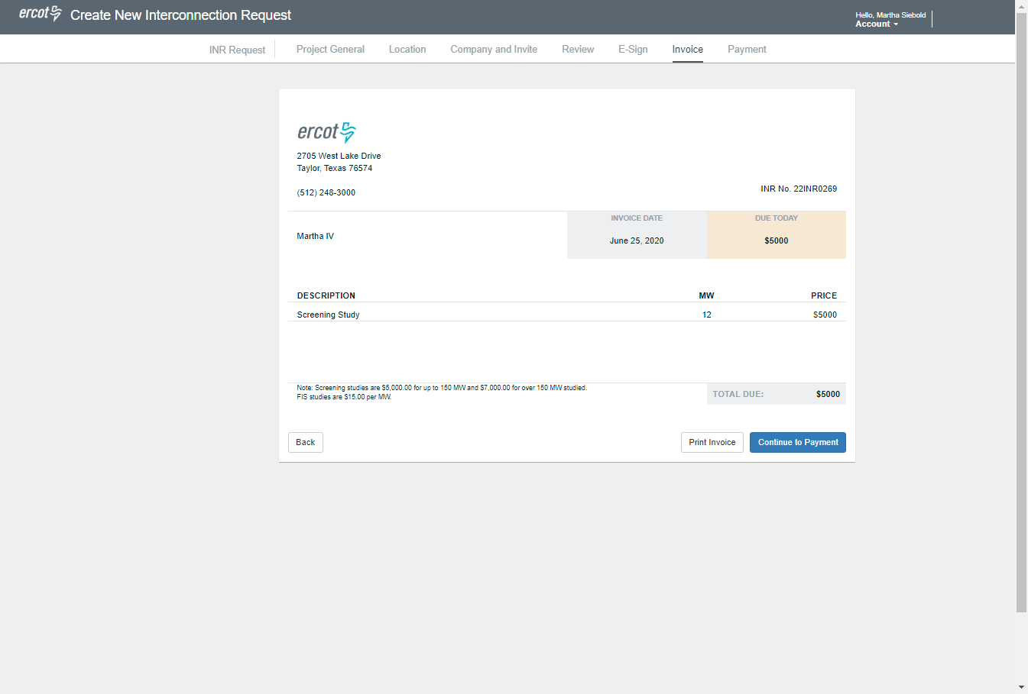
Small Gen Fee changes-example only

Slide 8
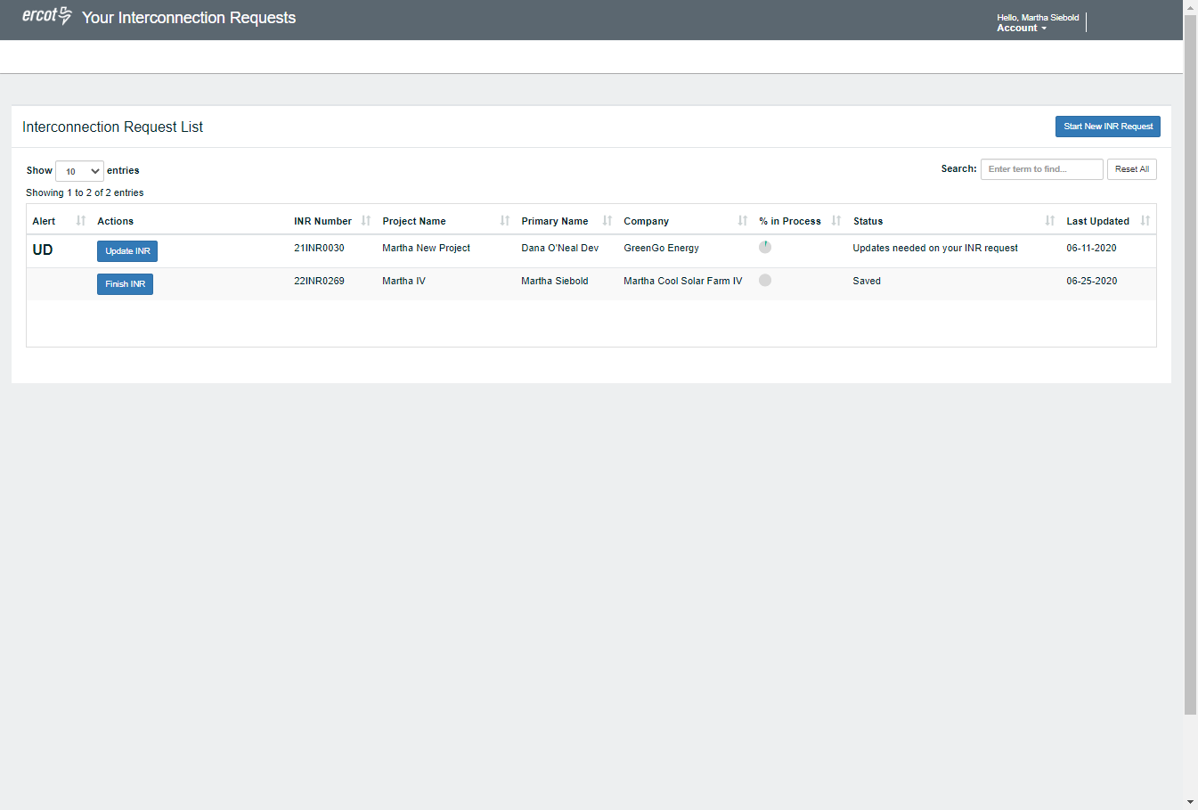
Tracking for IEs of their projects-example only

Slide 9
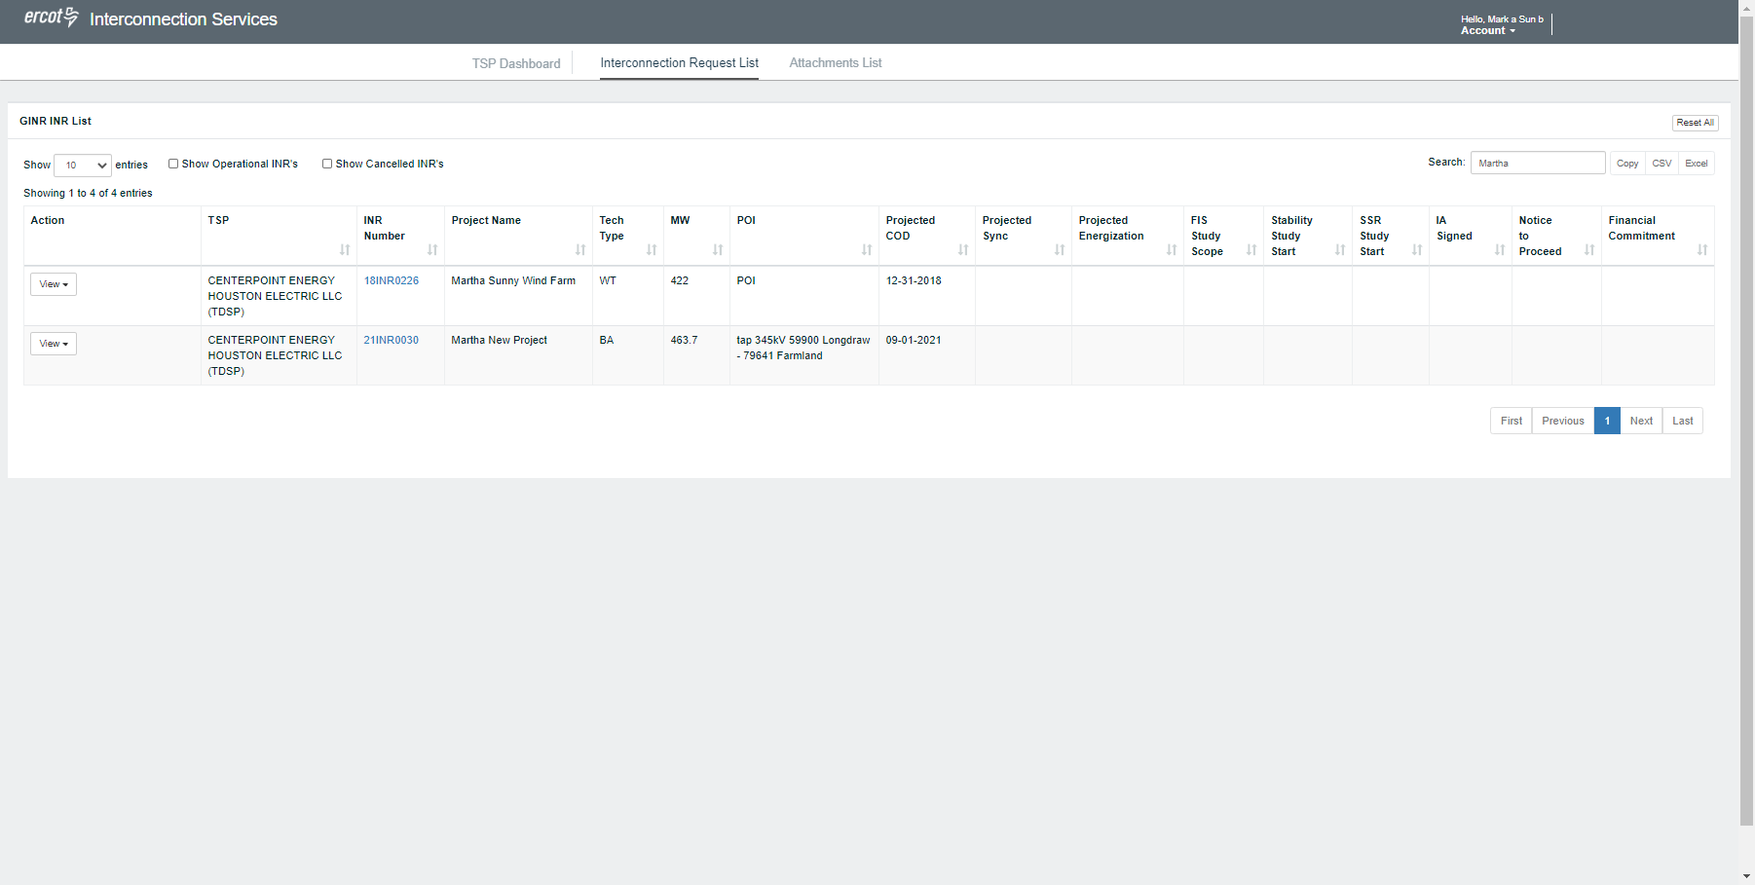
TDSP and TSPs-dashboard-example only

Slide 10
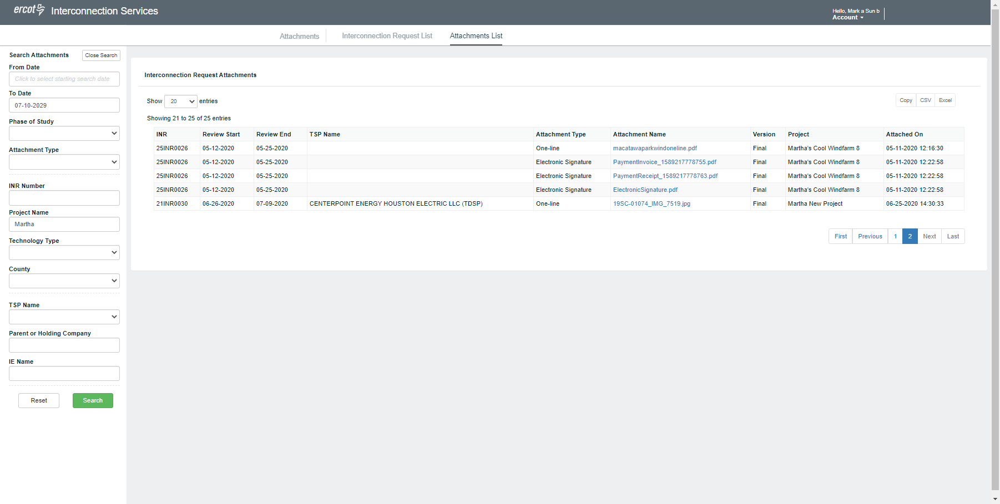
TSP and DSP attachments-example only

Slide 11
Additional items
Needs to be tracked using different logic than large gen process.
Timelines need to be shorter for Small Gen projects
Some key info will be different for DGR/DESR vs SODG
Fee for DGR/DESR will be different than for SODG.
Notifications need to be triggered on different items.
  Example 6 conditions for DGR vs Planning Guide 6.9 for large gen
Will want to add in reporting for Small Gen INRs for GIS reports

Slide 12
Timeline
Project scope says 18-24 months
Looking at this schedule and all RIOO-deliveries.
Would like to try and have RIOO-updates for small Gen end of 2021.
Depends on when PGRR would be approved.

