Slide 1
DGR Workshop VIII: PGRR Summary
June 26, 2020

Slide 2
PGRR Purpose
Create the concept of large and small generators
  Large generators are 10 MW or greater
  Small generators are 1 MW or greater, but less than 10 MW
  Interconnection location is not considered in the definition
Maintain the existing interconnection process for large generators
Create a tracking process for small generators, regardless of interconnection location
Create language specific to large generators on the distribution system
Streamline and reorganize the existing PG Section 5 language in order to better incorporate new language

Slide 3
Proposed Additions to the PG
A new sub-section was added to create a tracking process for small generators
  Interconnection Procedures for Small Generators
Several existing sub-sections were modified to include small generators and large, distribution-connected generators in Section 5 and 6.9(1)
  Applicability
  Status sub-sections
  Interconnection Agreements
  Security Screening Study
  Additions of Proposed Generation to the Planning Models

Slide 4
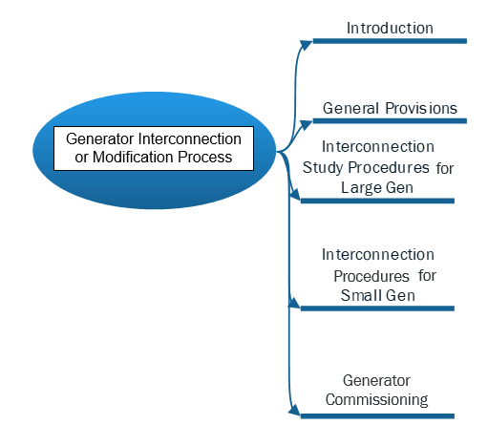
Proposed Planning Guide Section 5

Slide 5
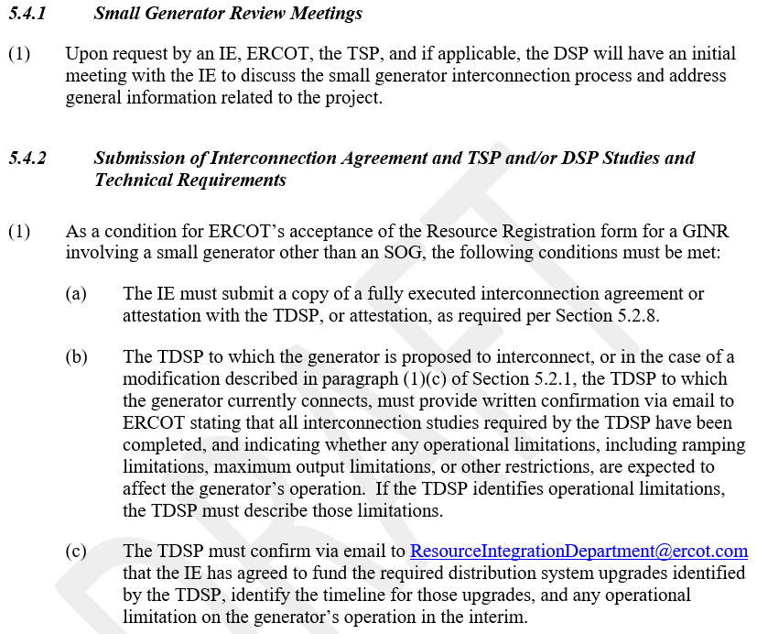
Proposed: 5.4 Interconnection Procedures for Small Generators

Slide 6
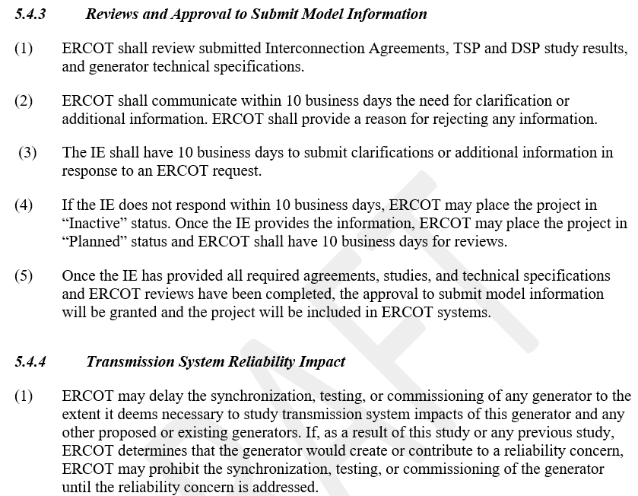
Proposed: 5.4 Interconnection Procedures for Small Generators

Slide 7
Proposed Deletions to PG Section 5
Existing Sub-section | Existing Sub-section Name | Reason for Deletion
5.1 | Introduction: Paragraph (2) | unnecessary
5.1.1 | Applicability: Paragraph (2) | unnecessary
5.1.2 | Responsibilities | redundant
5.2 | Generation Interconnection Process: Paragraph (1) | unnecessary
5.2.2 | Generation Interconnection or Change Request Submission Requirements: Paragraph (1), (3) | redundant
5.3 | Full Interconnection Study Request: Paragraph (2), (3), (4) | unnecessary/redundant
5.4.2.1 | Full Interconnection Study Process Overview: Paragraph (6) | unnecessary
5.4.2.2 | Full Interconnection Study Elements: Paragraph (7) | unnecessary
5.5.2 | Other Arrangements for Transmission Service | unnecessary
5.7.2 | Interconnection Study Fees: Paragraph (1) | unnecessary
5.7.3 | Generation Interconnection and Full Interconnection Study Application Fees: Paragraph (2)(c) | unnecessary
5.7.5 | Interconnection Process Timetables | belongs in handbook
5.8.1 | Other Standards | unnecessary

Slide 8
Proposed Relocations in PG Section 5
Existing Sub-section | Existing Sub-section Name | New Sub-section
5.2.1 | Generation Interconnection or Change Request Application: Paragraph (7), (8), (9) | 5.2.2
5.2.2 | Generation Interconnection or Change Request Submission Requirements: Paragraph (2) | 5.2.2(4)
5.3 | Full Interconnection Study Request | 5.3.2
5.4.7 | Economic Study | 5.3.3
5.4.9 | Proof of Site Control | 5.3.2.1
5.4.10 | Confidentiality | 5.2.3
5.5 | Interconnection Agreement | 5.2.8
5.7.2 | Interconnection Study Fees: Paragraph (2) | 5.2.2
5.7.3 | Generation Interconnection and Full Interconnection Study Application Fees: Paragraph (1)(c) | 5.2.2(3)
5.7.3 | Generation Interconnection and Full Interconnection Study Application Fees: Paragraph (2) | 5.3.2(2)(c)
5.7.6 | Inactive Status | 5.2.5
5.7.7 | Cancellation of a Project Due to Failure to Comply with Requirements | 5.2.6
5.8.2 | Transformer Tap Position | 5.2.4(1)
5.9 | Quarterly Stability Assessment | 5.3.4

Slide 9
Proposed Renaming in PG Section 5
Existing Sub-section | Existing Sub-section Name | New Sub-section Name
5 | Generation Interconnection or Change Request | Generation Interconnection Process
5.2 | Generation Interconnection Process | Initiation of the Generation Interconnection or Change Request Process
5.3 | Full Interconnection Study Request | Full Interconnection Study
5.3.2 | Modifications to Request Declarations of Resource Data Accuracy | Duty to Update Project Information and Respond to ERCOT and TSP Requests
5.4 | Study Processes and Procedures | Interconnection Study Procedures for Large Generators
5.4.2.1 | Full Interconnection Study Process Overview | Full Interconnection Study Scoping Process
5.4.2.2 | Full Interconnection Study Elements | Full Interconnection Study Procedure

Slide 10
Comments
Bill Blevins
Bill.Blevins@ercot.com
(512)-248-6691

