Slide 1
DGR Workshop VIII: PGRR Applicability
June 26, 2020

Slide 2
Proposed concepts for Applicability
Modification of capacity routes
Small Generator Process
  Increase any generator’s capacity by 1 MW or greater, but less than 10 MW
Large Generator Process
  Increase any generator’s capacity by 10 MW or greater
  Increase an existing small generator to now a large generator capacity

Slide 3
Examples for Applicability (Initial Interconnection)

Slide 4
Examples for Applicability (Modification Interconnection)

Slide 5
Examples for Applicability (Modification Interconnection)

Slide 6
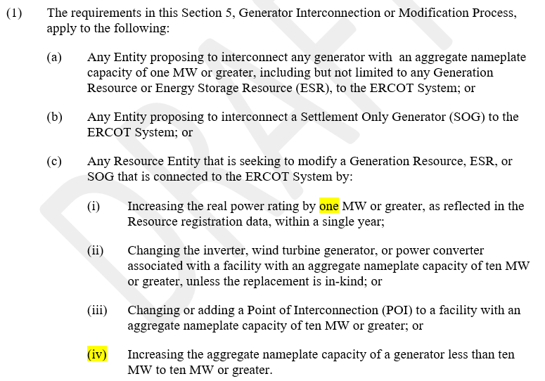
Proposed Language: 5.2.1 Applicability

Slide 7
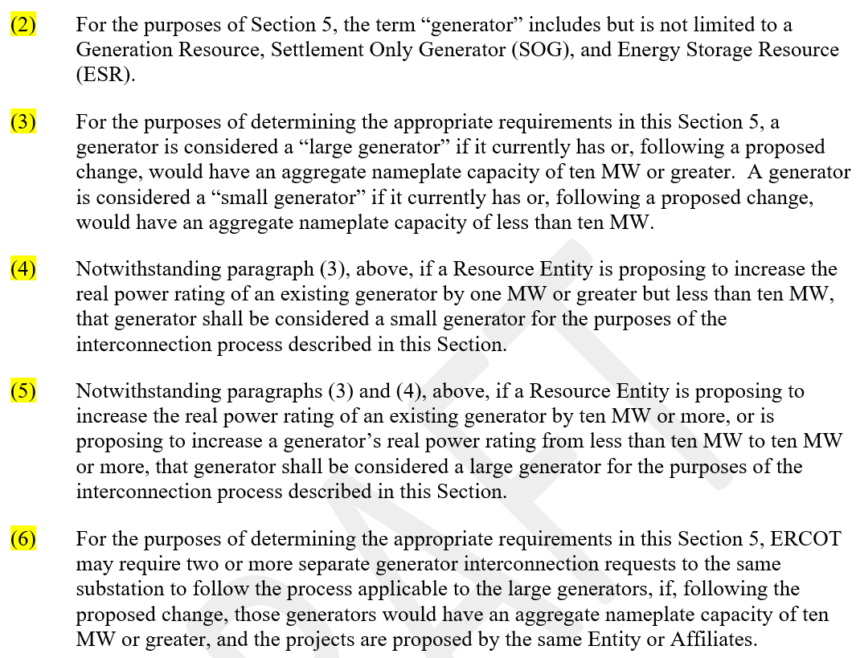
Proposed Language: 5.2.1 Applicability

Slide 8
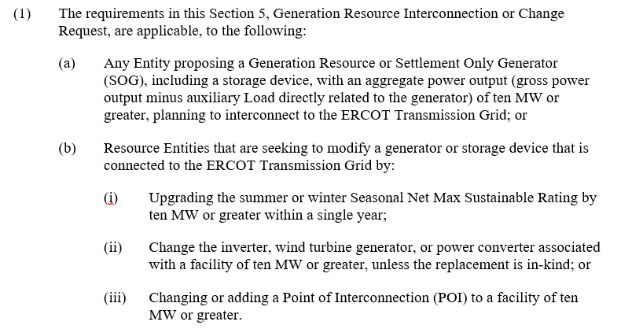
Existing Language: 5.1.1(1) Applicability

Slide 9
Comments
Bill Blevins
Bill.Blevins@ercot.com
(512)-248-6691

