Slide 1
MIS and ERCOT.com User Workshop
June 24, 2020

Slide 2
Agenda
MIS Sandbox Feedback
MIS Home Page Demo
Notices UI Review
Looking Ahead
  “If I could fix just one thing…..”
  Technical Integrations
  Planning Content Meeting

Slide 3
MIS Sandbox User Analytics
Total number of users on the Sandbox MIS site since we went live on the 28th of May 2020 till 18th of June 2020 – 468
Average session duration – 2 minutes and 48 seconds
Frequently used search terms – Invoice, NOMCR
Devices- 97% of the users used desktop and 3% used tablet to access the site

Slide 4
MIS Sandbox User Feedback
Data Product Search
  Show/Hide descriptions
Category Pages
  Miss the ability to see groupings
Digital Certificate Switching
  Have to close browser
  Can’t see which cert is being used

Slide 5
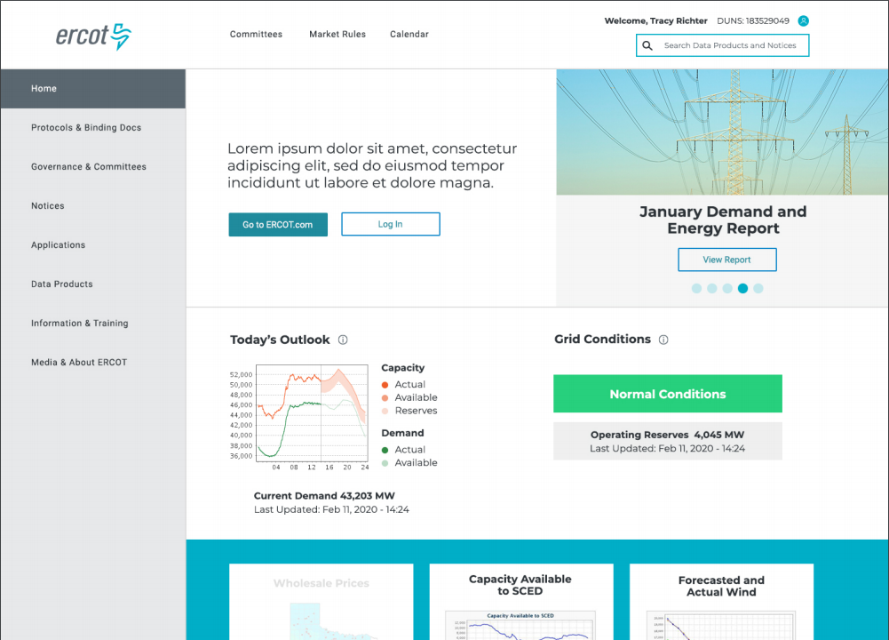
MIS Home Page Demo

Slide 6
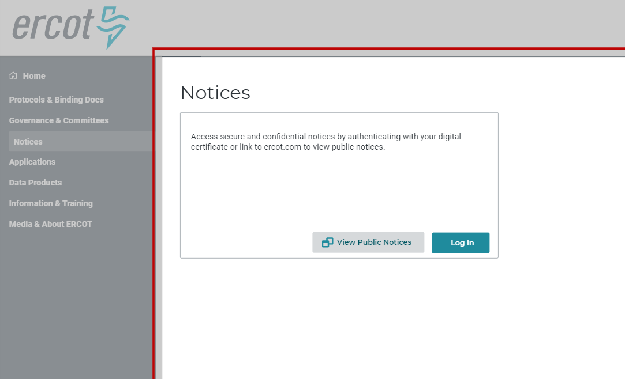
MIS Public Notices

Slide 7
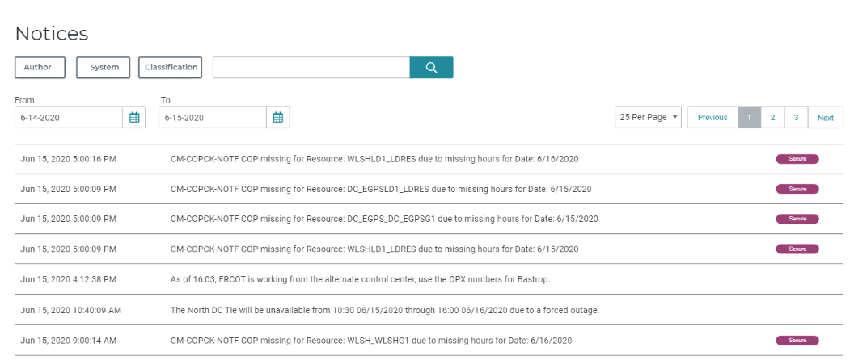
MIS Public, Secure & Certified Notices

Slide 8
Release Plan
January 30: EMIL web interface release - DONE
May 2020: Sandbox version of new MIS - DONE
Sept 2020: MIS Production version available for testing
November 2020: MIS Production go-live
Q1 2021: Decommission old MIS
2021: Transition ERCOT.com content to platform

Slide 9
ERCOT.com Planning
Early Planning Stage & Setting Priorities
If you could fix one thing…..what would it be??

Slide 10
Upcoming Conversations
Technical Integration Discussions
  Who do we need to be talking to?
  What is the right forum?
Planning Content Workshop in July
  Best way to advertise?
Next MIS & ERCOT.com User Workshop will be August
Feedback to webmaster@ercot.com is welcome any time

