Slide 1
Emergency Settlement under RTC – Non-SCED Failure Scenarios
Austin Rosel
June 29, 2020

Slide 2
Emergency Settlement under RTC
Emergency settlements under non-SCED failure scenarios needs to be reviewed to ensure Resource cost recovery is adequate.
Under scenarios when AS awards and/or prices are not changing, the current emergency settlement policy of looking only at EOCs is sufficient.
Under scenarios when AS awards and/or prices are changing, a method that looks at both energy offer curves and AS curves is needed.

Slide 3
Summary of Proposed Changes
The following table and slides propose which emergency settlements would be changed and which would remain to be settled per current Protocol.
6.6.9 Settlement | RTC Change?
(1) Emergency Base Points Issued. | No, KP1.5(15)
(2) VDI to operate for unannounced Generation Resource Test | No
(3) QSGR that comes On-Line as a result of a Base Point greater than zero. | Yes
(4) QSE receives a Base Point that is inconsistent with RTSPP (price correction). QSE that receives a manual override. (Emergency “hold” approach). | Yes
(5) SCED failure. | No, KP1.5(15)
(8) CFC test or instructed to operate in CFC mode. | No

Slide 4
Review of Current Emergency Settlement
The intersection of the Base Point (BP) on the EOC (capped by the MOC) is compared to the RTSPP.
If the RTSPP is less than the price at the intersection the QSE is made whole for the price difference.

Slide 5
Example Simplifications
Settlements considers the minimum of Real-Time Metered Generation (RTMG) or the BP.
Assume the BP = RTMG for these examples.
Assume hourly settlements and BPs.
Energy offer curves are capped by the MOC for these settlements.
Assume the MOC is greater than the EOC for these examples.

Slide 6
Emergency Review; Example
Example: Price Correction Issued.
RTSPP = $30
Corrected RTSPP = $20
BP = 12
Price at BP on EOC = $30
Make Whole:
($30 - $20) * (12 – 0) = $120

Slide 7
Emergency Review; Example

Slide 8
RTC Proposal
Consider net revenues of AS and Energy combined for the two scenarios, where AS Awards/Prices are affected
If the net revenues of the combination is less than the offers at the awarded amounts, a make whole payment is made.
The following price correction examples illustrate this net revenue method.

Slide 9
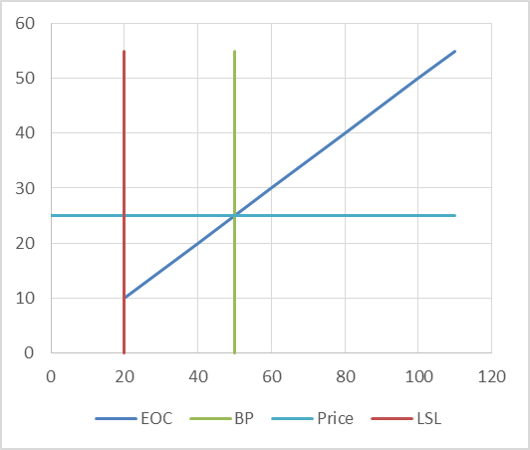
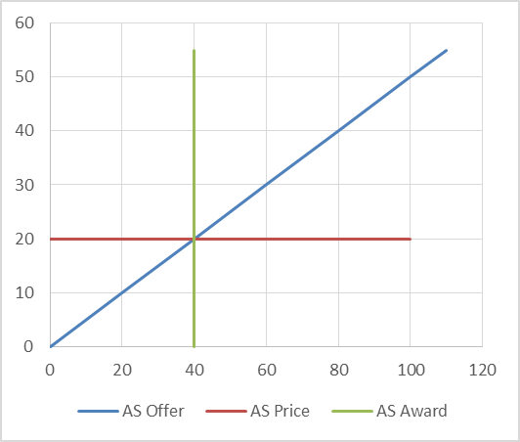
RTC Price Correction Example 1
Resource was awarded energy and AS “on their curves”.
Energy Revenue = 50 * $25 = $1,250
AS Revenue = 40 * $20 = $800
Total Revenue = $2,050

Slide 10
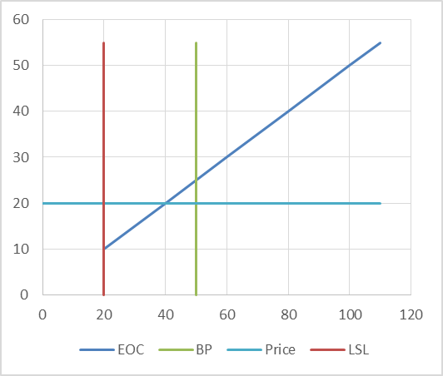
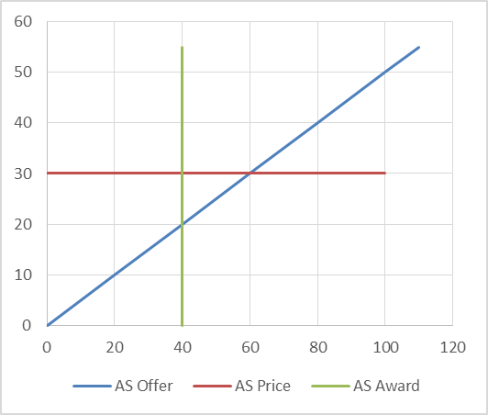
RTC Price Correction Example 1
Price correction issued
Energy Price corrected from $25 -> $20
Energy Revenue: $20 * 50 = $1,000
AS Price corrected from $20 -> $30
AS Revenue: $30 * 40 = $1,200
Total Revenue = $2,200

Slide 11
RTC Price Correction Example 1
The Price correction increased revenue for the Resource, however if the Energy Offer Curve was evaluated separately (current protocols) an emergency make-whole payment would be calculated.
 | Before Correction | After Correction
Energy Revenue | 1,250 | 1,000
Target Revenue | 1,250 | 1,250
Difference | 0 | (250)
AS Revenue | 800 | 1,200
Target Revenue | 800 | 800
Difference | 0 | 400
Total Over (Under) Target | 0 | 150

Slide 12
RTC Price Correction Example 2
Resource was awarded energy and AS “on their curves”. Same as example 1.
Energy Revenue = 50 * $25 = $1,250
AS Revenue = 40 * $20 = $800
Total Revenue = $2,050

Slide 13
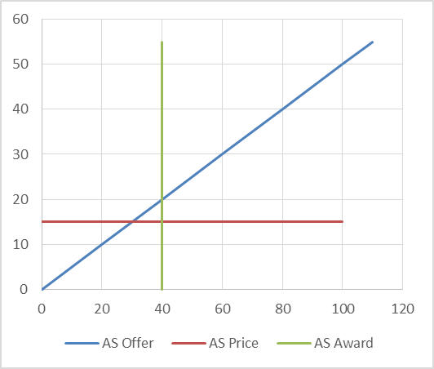
RTC Price Correction Example 2
Price correction issued
Energy Price corrected from $25 -> $20
Energy Revenue: $20 * 50 = $1,000
AS Price corrected from $20 -> $15
AS Revenue: $15 * 40 = $600
Total Revenue = $1,600

Slide 14
RTC Price Correction Example 2
The Price correction decreased revenue for the Resource to below target revenues based on offers. If the Energy Offer Curve was evaluated separately (current protocols) the make whole payment would not be sufficient.
 | Before Correction | After Correction
Energy Revenue | 1,250 | 1,000
Target Revenue | 1,250 | 1,250
Difference | 0 | (250)
AS Revenue | 800 | 600
Target Revenue | 800 | 800
Difference | 0 | (200)
Total Over (Under) Target | 0 | (450)

Slide 15
RTC Price Correction Example 3
Resource was awarded energy and AS “on their curves”. Same as examples 1 and 2.
Energy Revenue = 50 * $25 = $1,250
AS Revenue = 40 * $20 = $800
Total Revenue = $2,050

Slide 16
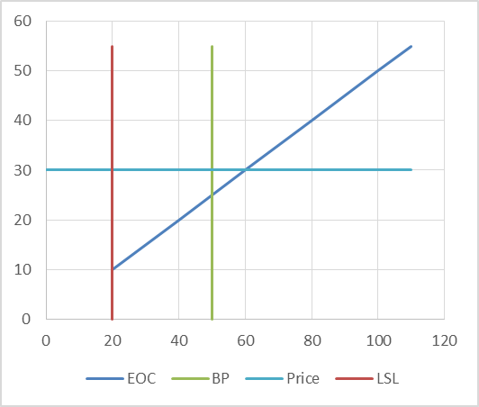
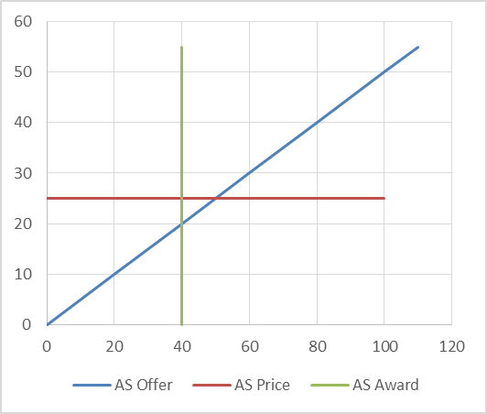
RTC Price Correction Example 3
Price correction issued
Energy Price corrected from $25 -> $30
Energy Revenue: $30 * 50 = $1,500
AS Price corrected from $20 -> $25
AS Revenue: $25 * 40 = $1,000
Total Revenue = $2,500

Slide 17
RTC Price Correction Example 3
The Price correction increased revenue for the Resource above target revenues based on offers. No make whole payment is necessary, this would be the case under current protocols and proposed changes for RTC.
 | Before Correction | After Correction
Energy Revenue | 1,250 | 1,500
Target Revenue | 1,250 | 1,250
Difference | 0 | 250
AS Revenue | 800 | 1,000
Target Revenue | 800 | 800
Difference | 0 | 200
Total Over (Under) Target | 0 | 450

Slide 18
RTC: Manual Override
Manual override
Handled the same as a price correction under current Protocols.
AS awards still issued and affected by the override.
Propose to continue to handle the same as a price correction under RTC.

Slide 19
RTC: QSGRs
QSGRs are eligible for emergency settlement for the clock hour in which they come On-Line as a result of a BP greater than zero and the BP is less than Seasonal minimum sustainable rating.
QSGRs that were instructed to come online are eligible for emergency settlement for the clock hour in which they check for continued commitment by telemetering a zero LSL. NP 3.8.3.1.
Propose to handle the same as a price correction under RTC.
Ensure Resource revenues are not less than the combined offers, including AS awards and prices.

Slide 20
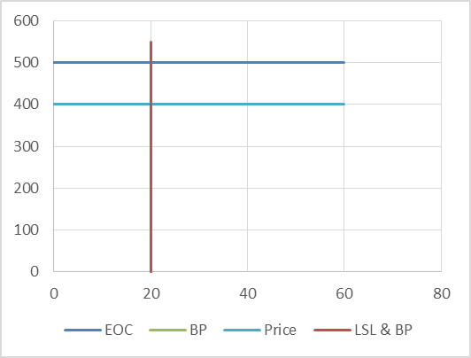
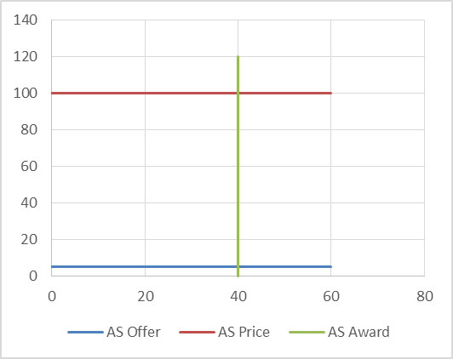
QSGR Example 1
QSGR is at LSL, with RTSPP less than EOC at LSL.
LSL = 20; HSL = 60
Energy Revenue = 20 * $400 = $8,000
AS Revenue = 40 * $100 = $4,000
Total Revenue = $12,000

Slide 21
QSGR Example 1
When considering the overall position of the QSGR an emergency make-whole payment is not needed, if the energy portion only was considered, an emergency make-whole payment would be calculated.
 | Calculation
Energy Revenue | 8,000
Target Revenue | 10,000
Difference | (2,000)
AS Revenue | 4,000
Target Revenue | 200
Difference | 3,800
Total Over (Under) Target | 1,800

Slide 22
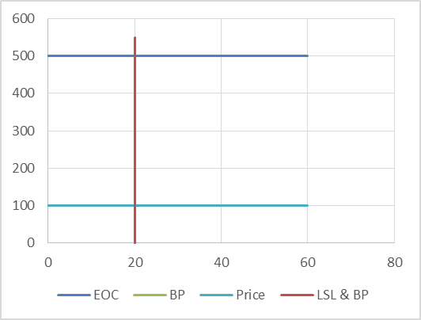
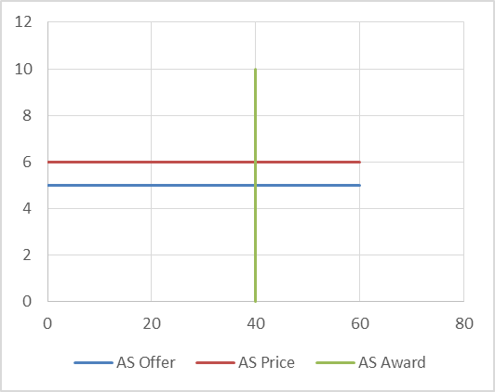
QSGR Example 2
QSGR is at LSL, with RTSPP less than EOC at LSL.
LSL = 20; HSL = 60
Energy Revenue = 20 * $100 = $2,000
AS Revenue = 40 * $6 = $240
Total Revenue = $2,240

Slide 23
QSGR Example 2
When considering the overall position of the QSGR an emergency make-whole payment is needed.
 | Calculation
Energy Revenue | 2,000
Target Revenue | 10,000
Difference | (8,000)
AS Revenue | 240
Target Revenue | 200
Difference | 40
Total Over (Under) Target | (7,960)

Slide 24
Emergency Settlements with no changes
SCED Failure with EBP issued:
KP1.5(14) and KP1.5(15) address AS awards and emergency settlement when Emergency Base Points are issued due to a SCED failure.
AS awards from the most recent SCED are held. KP1.5(14).
No new settlement calculations are needed for this situation KP1.5(15).
The QSE would be settled the same as today (per Emergency Review, example 1). The AS revenues and AS offer curve would not be considered.
If a price correction were issued with the EBP, the Resource would be Settled with the “net approach” proposed in this presentation.

Slide 25
Emergency Settlements with no changes
Capacity tests
Unit will not be awarded AS during a capacity test, the current emergency settlement that looks only at the EOC can still apply. The “net approach” introduced will not be necessary.
Unit is ONTEST which is not dispatched economically by SCED. SCED will give a base point equal to the telemetered MW and zero AS awards.

Slide 26
Emergency Settlements with no changes
CFC mode
AS awards are held.
The Resource is settled via emergency for any changes to generation that are not on their curve, per the ATG.
The current emergency settlement that looks only at the EOC can still apply. The “net approach” introduced will not be necessary.

Slide 27
Emergency Settlement under RTC
Questions

