Slide 1
Resource Integration & On-going Operations Resources Services
(RIOO-RS)
Project Update
23 June 2020

Slide 2
Test System Updated March 23
Expands View and Update Capability to include
  REC info
  PUN
  Limits
  Operational Parameters
  Reactive Capability
  SSR
Data reflects February 10th refresh
  User registration information is retained
  All updates and change requests in RIOO are deleted
Market notice sent March 26 to all REs
  Signup Guide attached
  All REs should get access to the system now
If you need help, email RIOO-HELP@ercot.com

Slide 3
Next Update Planned for July
Expand View and Update Capability beyond March update to include
  Breaker Switch
  Ramp Rates
  Substation Details and Parameters
  Unit Details
  Series Devices
Data reflected is late May submissions
  User registration information is retained
  All updates and change requests in RIOO are deleted

Slide 4
What to do in the RIOO Test System?
User access will need to be coordinated by the MP with its Company USA
  Each user needs his/her own email to get into the system – not an alias or group email
  Each user needs to have a mobile phone number to received messages from the authentication service
RIOO-RS system is available for training and testing; each release provides additional view and update capability
What users can do:
  Verify data.
  The “Update Capability” is being made available for the most frequently changed items first.
  Data will be updated and over-written with production data on a regular interval.
  Data changed during the training/testing phase will not be stored.
  User registration information is the exception, this will be saved.
Let us know:
  RIOO-HELP@ercot.com

Slide 5
How to get access
The user:
  Gets the role “RIOORS_M_OPERATOR” from his/her USA
  Gets an email
    Clicks on “Verify my account” button
  Types in URL for the system
    Clicks “Don’t remember your password” button
  Gets a change password email
    Clicks on change my password button
  Changes his/her password
  Types in URL for the system, sign with user-id / password
  Setups authentication
    Scans code or enter mobile phone for SMS
    Saves Recovery code
    Confirms authorization method
    (Google Authenticator/ Auth0 guardian/SMS)
  Get an email
  Click on verify my account button
  Access the RIOO-RS, sign with user-id / password

Slide 6
Information/Data issues
ERCOT provided an updated RARF, Delta Report, and Audit Report to the REs in August 2019
  195 of 212 received and processed
  17 outstanding
Sites may need to be split
  Less than 10

Slide 7
TSP Input Request
Request that TSPs provide availability dates to allow the team to set up a call in order to discuss their requirements for the application
Email: RIOO-Help@ercot.com with date proposals

Slide 8
Discussion
or
Questions

Slide 9
Wireframe Review

Slide 10
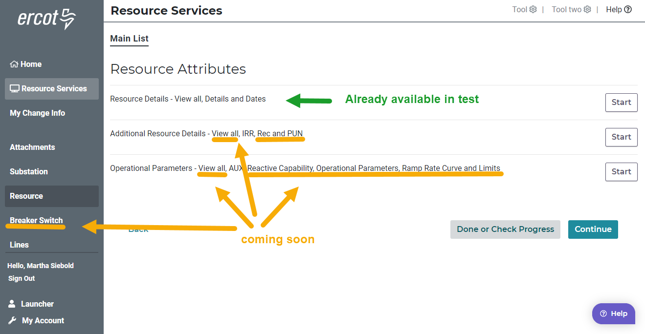
Test Environment

Slide 11
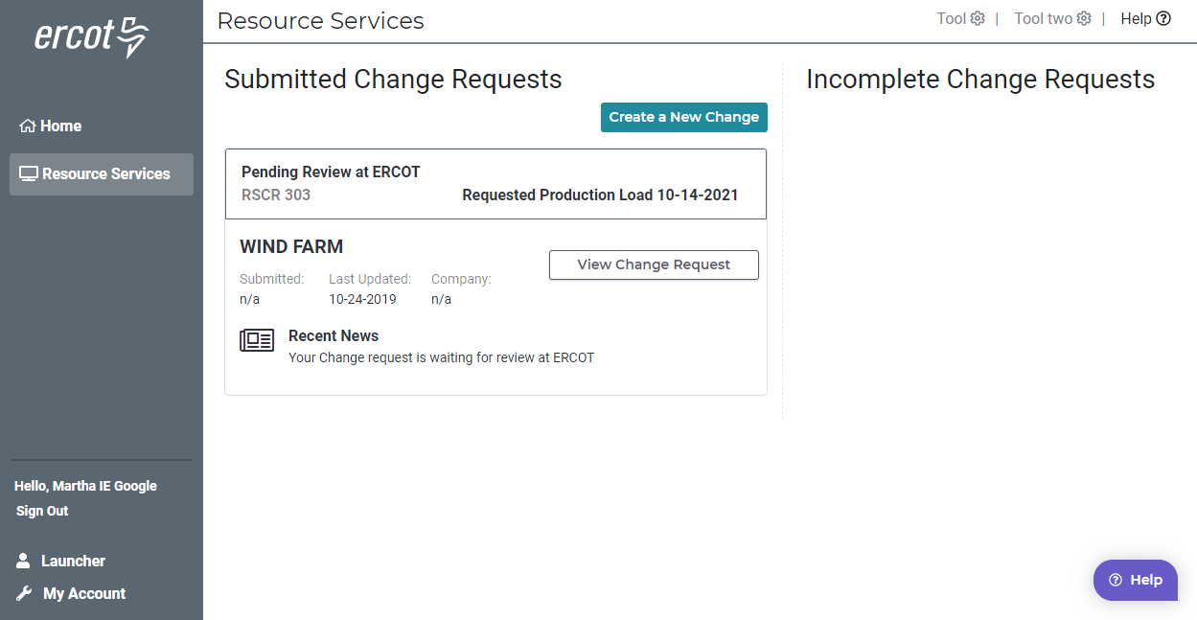
Resource Entity Dashboard

Slide 12
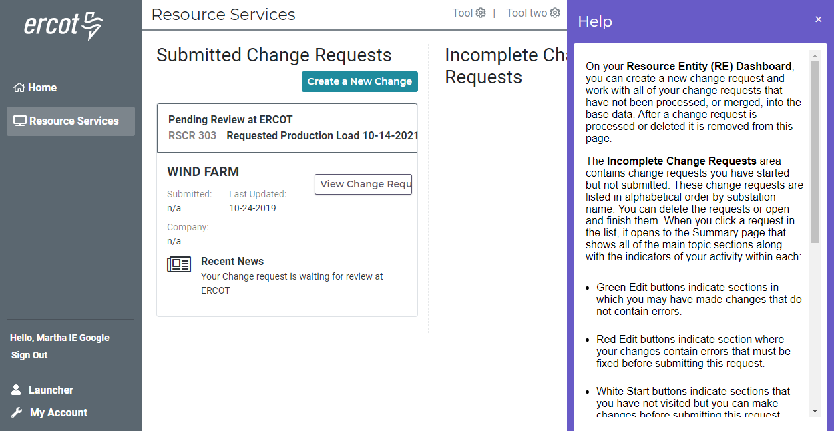
Help – on every page

Slide 13
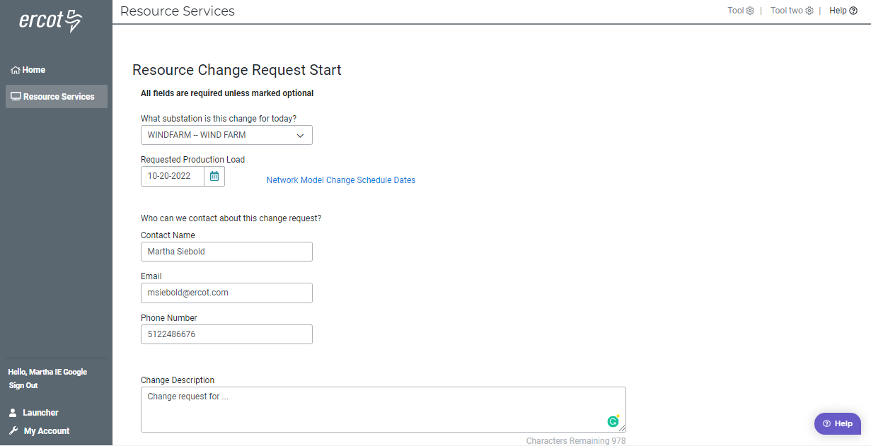
Starting your change request

Slide 14
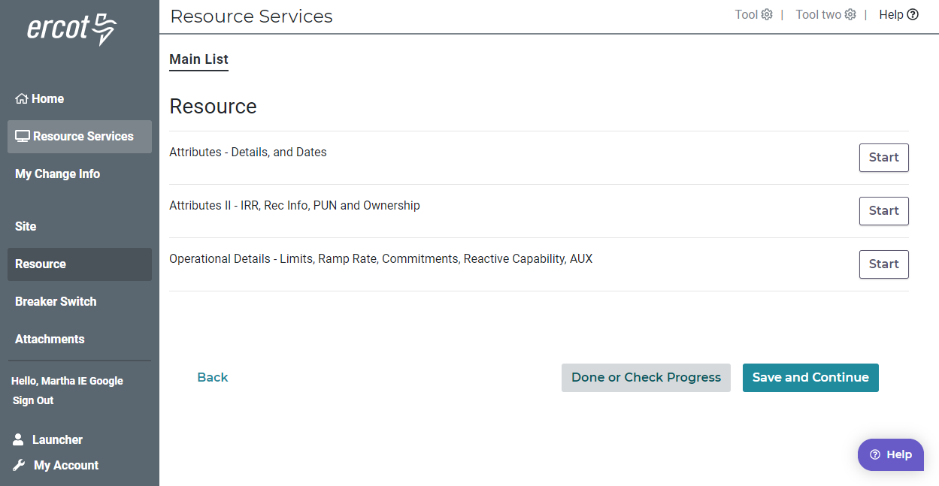
Main List

Slide 15
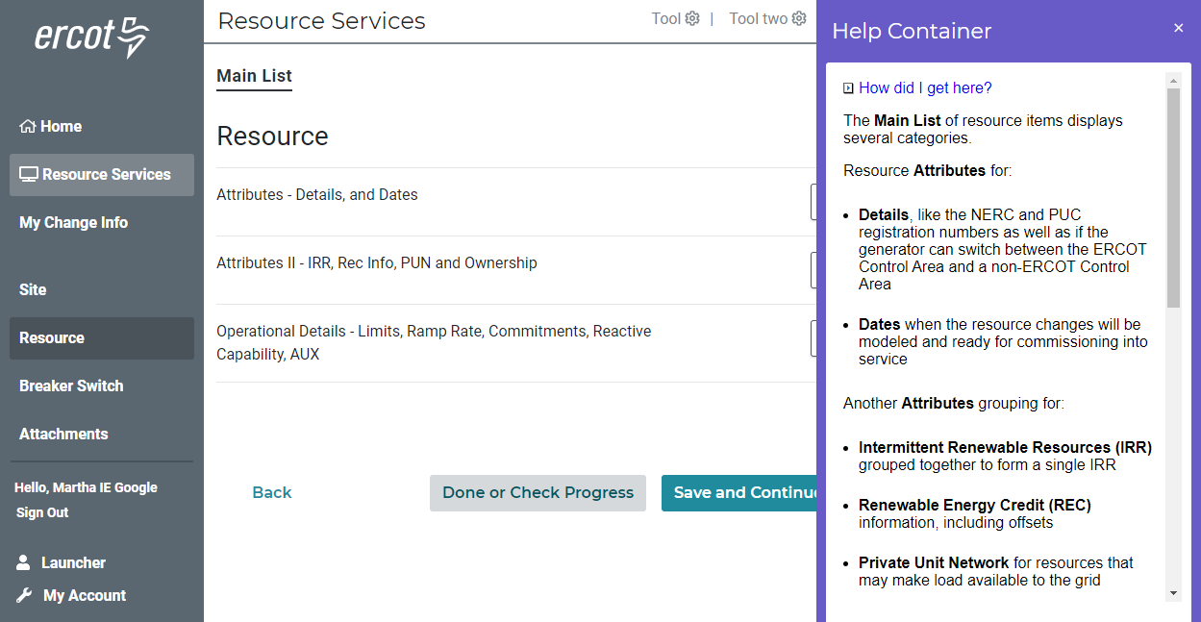
Main Lists – Help – Describes Lists

Slide 16
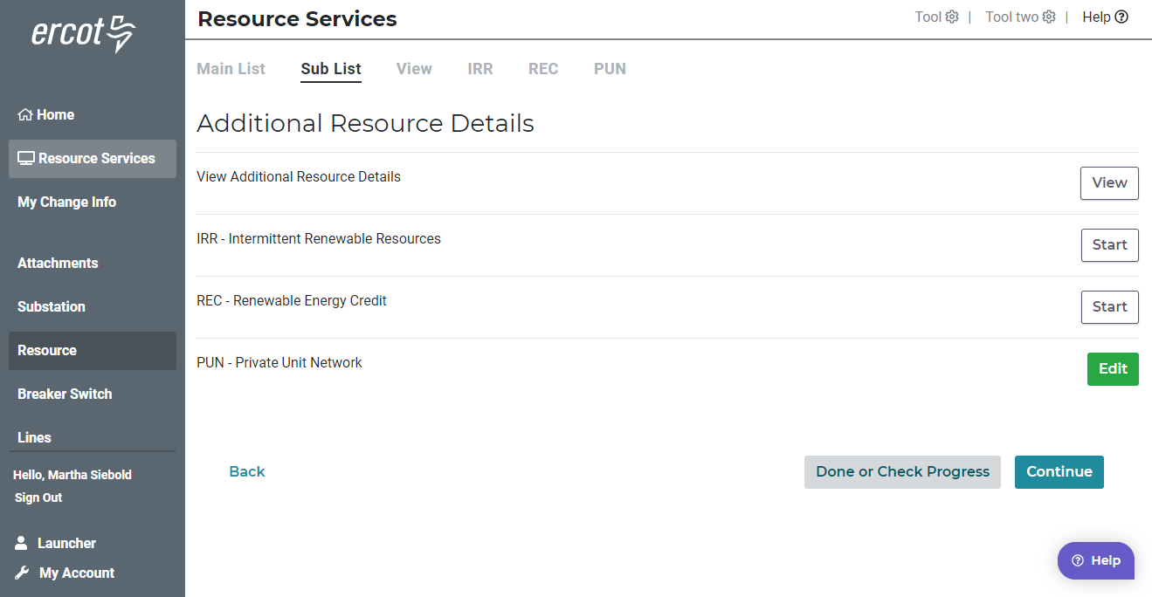
Additional Resource Details – Sub list

Slide 17
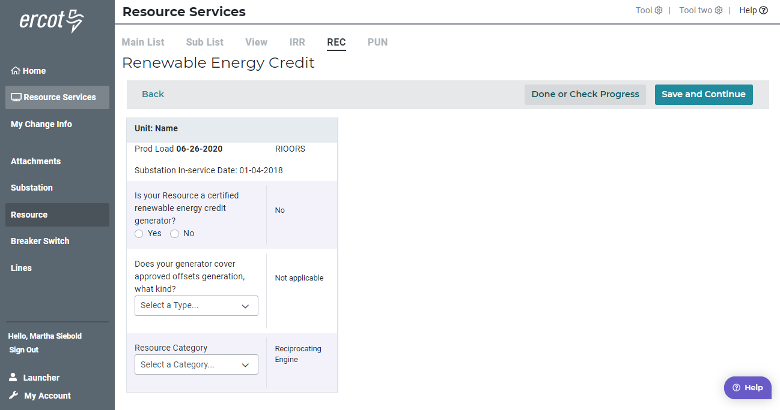
Renewable Energy Credit

Slide 18
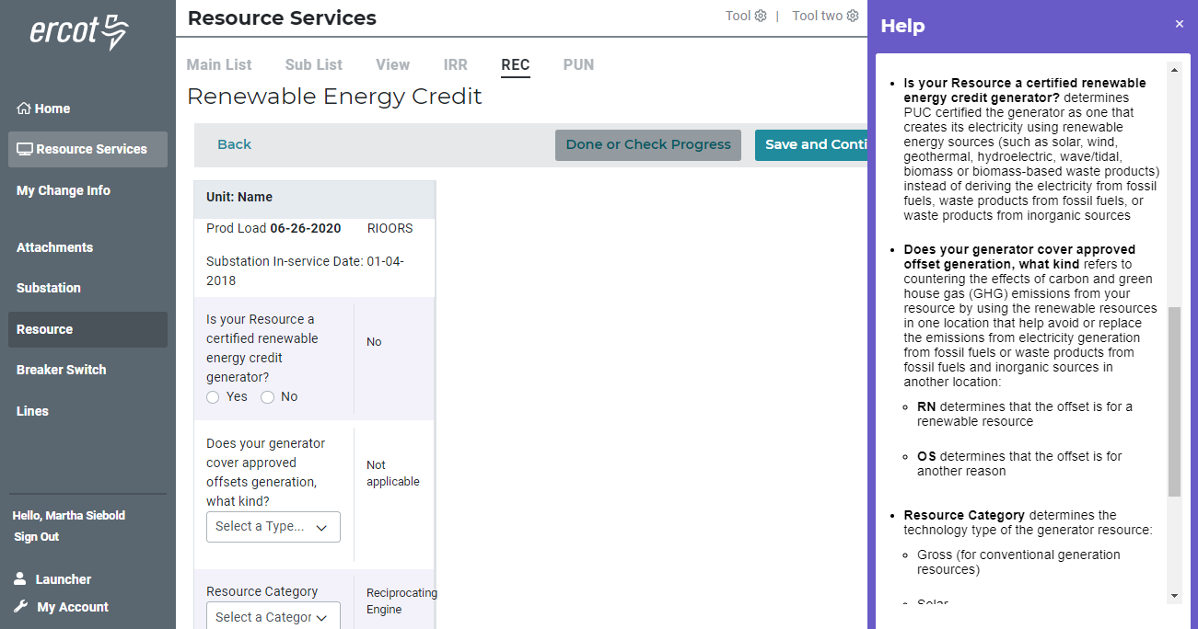
Renewable Energy Credit - Help

Slide 19
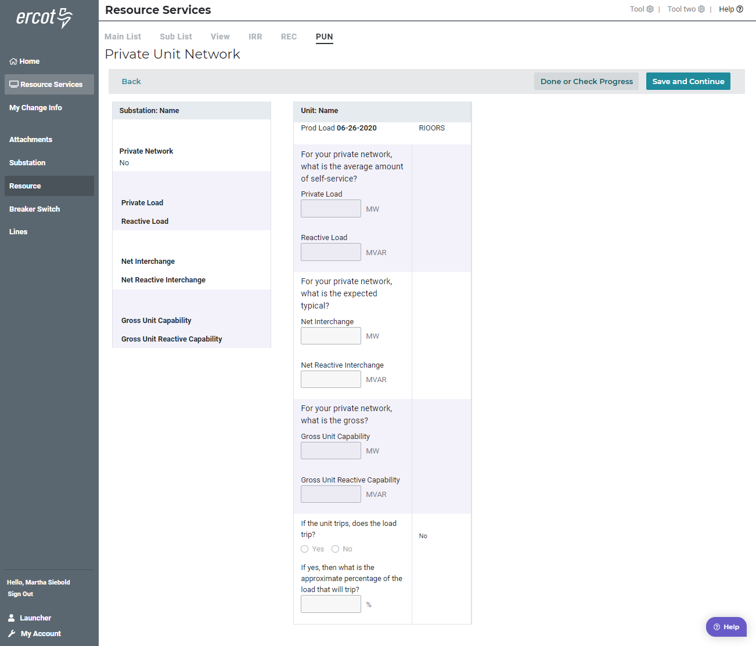
Private Unit Network

Slide 20
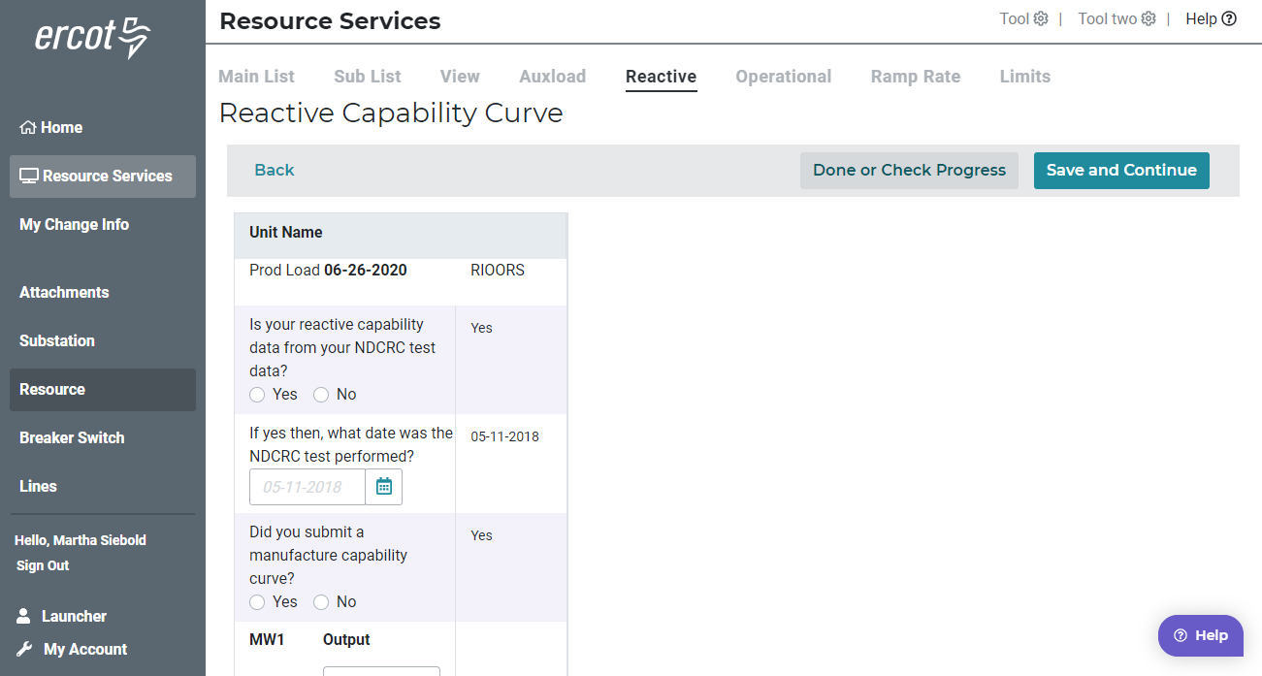
Reactive Capability Curve

Slide 21
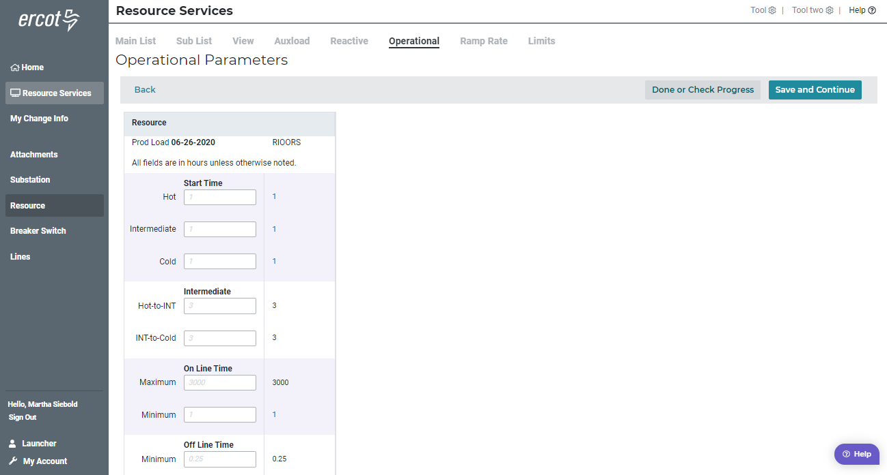
Operational Parameters

Slide 22
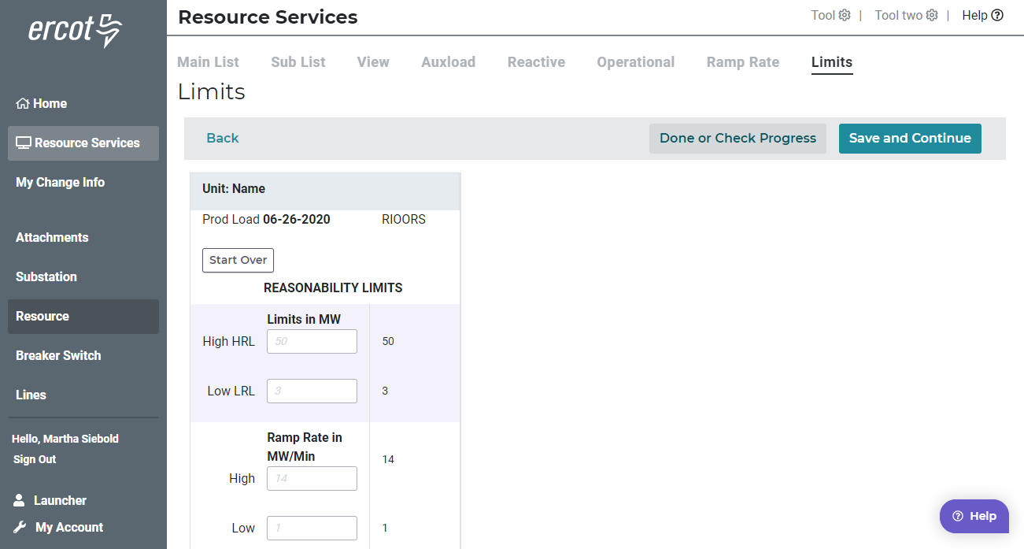
Limits

Slide 23
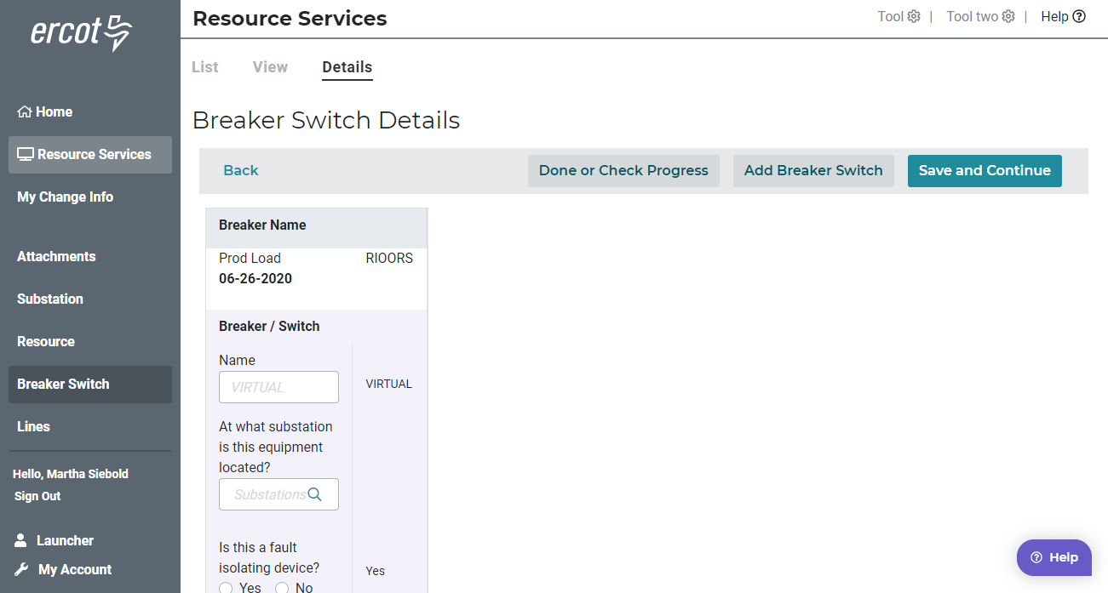
Breaker - Modify

Slide 24
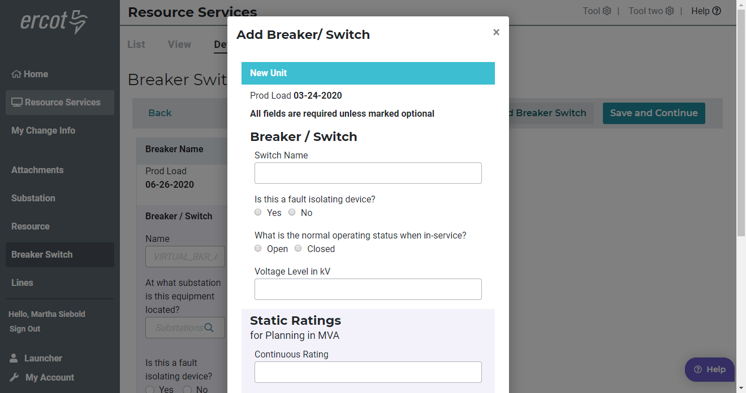
Breaker - Add

Slide 25
Questions?

