Slide 1
Special RTCTF Meeting on Ancillary Service Deployment and Recall
ERCOT
June 22, 2020

Slide 2
Areas of focus for today’s special meeting
The primary focus for today’s discussion is Ancillary Services where there is some potential need for ERCOT operator interaction. Specifically, deployment and recall of:
Resources with a Resource Status of “ONSC” (synchronous condenser fast response mode operation for Responsive Reserve Service (RRS) and ERCOT Contingency Reserve Service (ECRS))
Resources providing Fast Frequency Response (FFR)
Resources providing Ancillary Services via an Under-Frequency Relay (UFR) (RRS and ECRS)
“Off-line” Non-Spinning Reserve Service (Non-Spin)

Slide 3
Areas of focus for today’s special meeting cont.
The material today will cover manual ERCOT operator deployments and automatic deployments of those same services, where applicable.
The following Ancillary Services deployments are generally understood and will not be covered by a special RTCTF meeting:
Regulation Up and Down Reserve Service (Reg-Up and Reg-Down)
RRS provided via Primary Frequency Response (PFR)
“Online” ECRS and Non-Spin
Participants are welcome to reach out to david.maggio@ercot.com for questions on these areas

Slide 4
Goals of the Meeting
The topic of Ancillary Service deployment and recall is better suited for presentation form and this meeting provides an opportunity for us to walk through our view and understanding with the task force.
This discussion may identify technical or process issues that require language changes. If improvements are identified, ERCOT will submit comments for review at the regular task force meetings following the conceptual discussion
Other task force participants may also be interested in submitting comments to the RTC Revision Requests for discussion

Slide 5
Resources with a Resource Status of “ONSC”

Slide 6
ONSC Resource – Baseline
ONSC Resources may be deployed for Ancillary Services by one of the following methods
Automatic Deployment
Manual Deployment
To meet NERC Standard defined in Nodal Protocol Section 6.5.7.6.2.2 (2)(d) & (6)
During scarcity conditions following declaration of an EEA. Nodal Protocol Section 6.5.7.6.2.2 (5) & 6.5.9.4.2 (1)(a)(v).
MW qualified to provide ONSC is set equal to the Resource’s proven 20s response capability
ONSC Resource is expected to provide full response when deployed
RTC-SCED will set the BP for ONSC Resources to be equal to their MW output.

Slide 7
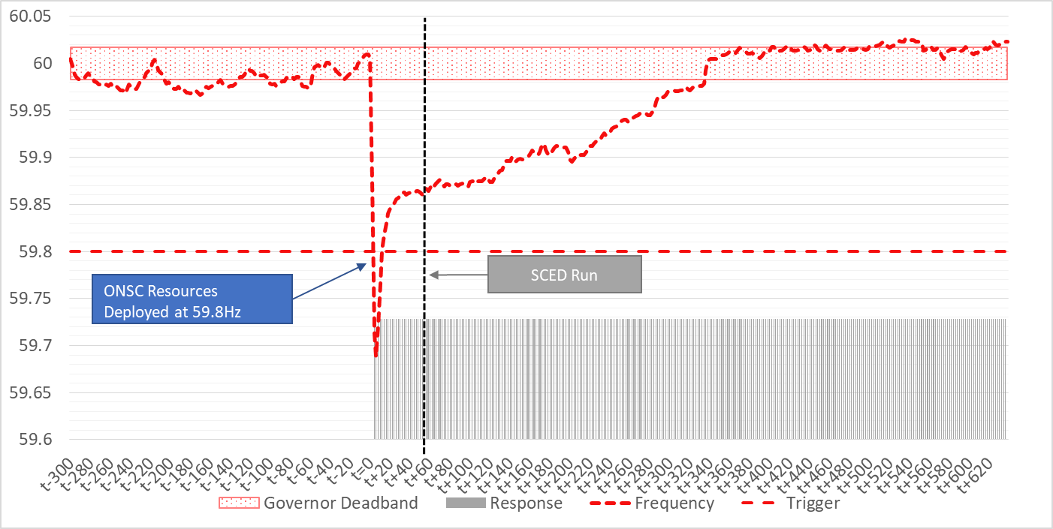
Automatic Deployment – Slide 1
Triggered when system frequency falls below 59.80 Hz.
Full response is expected within 20 seconds.
SCED will be triggered automatically after an ONSC event is detected (1 minute today).

Slide 8
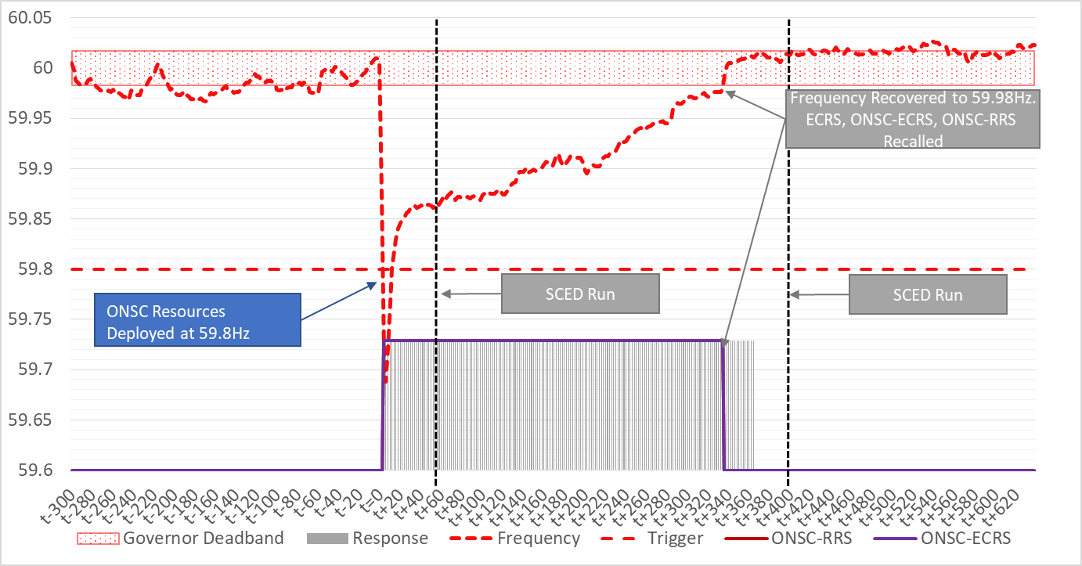
Automatic Deployment – Slide 2
ERCOT will send ICCP based deployment instructions to ONSC Resources providing RRS and ECRS (one per service).
ICCP deployment signals will remain non-zero MW until frequency has recovered above 59.98 Hz.
Once the ICCP Deployment signal reflects zero MW RRS or ECRS deployment, QSEs can stop generating MW from ONSC Resources and restore ONSC capability.

Slide 9
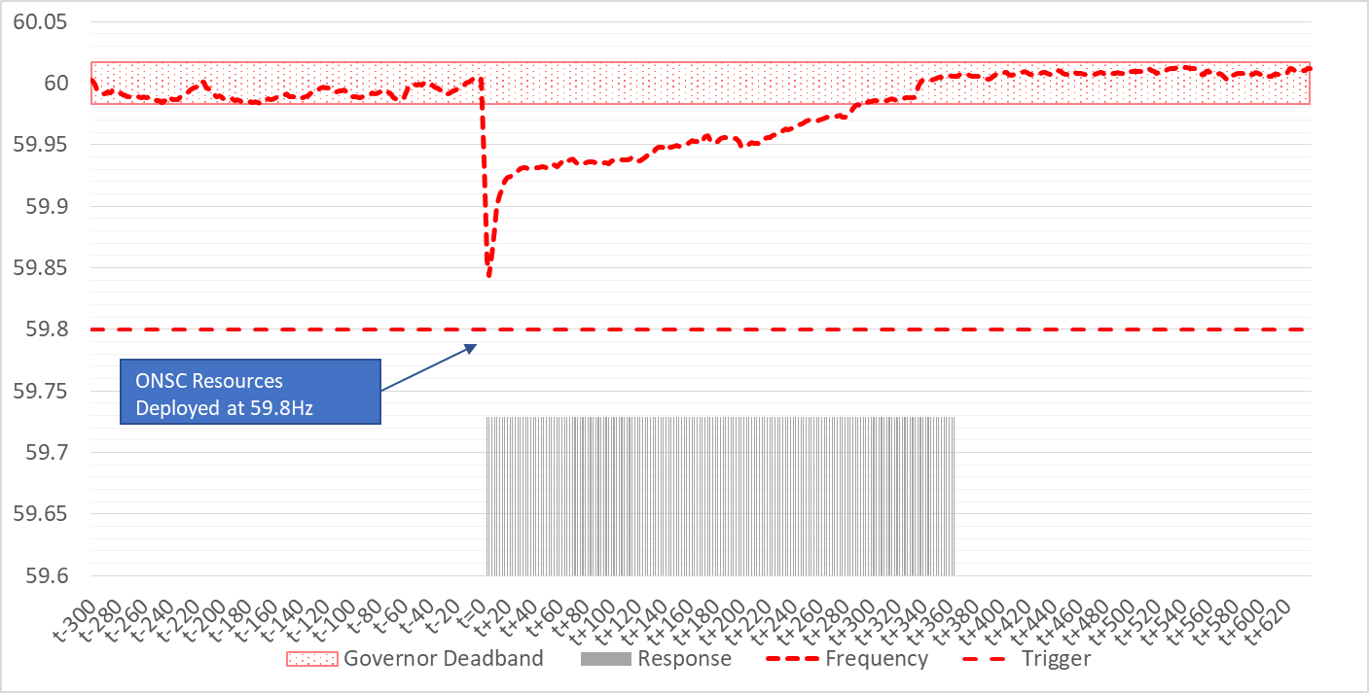
Automatic Deployment – Slide 3
IF
an automatic deployment of ONSC Resources occurs and the ONSC Resource subsequently does not receive non-zero MW ICCP Deployment signal from ERCOT OR
an ONSC Resource automatically responds and doesn’t have an RRS or ECRS award,
THEN, QSE is expected to call ERCOT operators prior to restoring ONSC capability.

Slide 10
Manual Deployment During EEA
Generally, manual deployment of ONSC Resources will be initiated following declaration of an EEA-1 but before ERCOT enters into EEA-2.
When ERCOT declares EEA-2 or EEA-3 without declaring EEA-1, ERCOT may immediately deploy ONSC Resources.
Manual deployment instructions will be sent via ICCP (same ICCP as automatic deployment) to deploy all awarded ONSC RRS and/or ECRS MW capacity.
QSEs will have 10 minutes following the receipt of ERCOT deployment instruction to provide energy from the ONSC Resources providing RRS and/or ECRS.
Following the recovery of PRC above 2500 MW and stable system frequency, ERCOT will reset the ONSC RRS and/or ECRS ICCP Deployment signals to reflect zero MW deployment.
QSEs can then stop generating MW from ONSC Resources and restore ONSC capability.

Slide 11
Manual Deployment Non-EEA Conditions
Manual deployment instructions will be sent via ICCP (same ICCP as automatic deployment) to deploy all awarded ONSC RRS and/or ECRS MW capacity.
QSEs will have 10 minutes following the receipt of ERCOT deployment instruction to provide energy from the ONSC Resources providing RRS and/or ECRS.
Following the recovery of system frequency (currently 59.98 Hz), and if ERCOT is not under an EEA condition, ERCOT will reset the ONSC RRS and/or ECRS ICCP Deployment signals to reflect zero MW deployment.
QSEs can then stop generating MW from ONSC Resources and restore ONSC capability.

Slide 12
Resources providing FFR

Slide 13
Fast Frequency Response
Level setting
Triggered when system frequency falls below 59.85 Hz (NP Section 3.18)
Full response within 15 cycles (NP Section 3.18)
MW qualified to provide FFR must be able to sustain its output for full 15 minutes (NP Section 3.18)
FFR capacity provides blocky response in the beginning but dispatchable by SCED after initial 15 cycles full-response is delivered
Load Resources providing FFR will be deployed using AS Manager
“ERCOT shall issue RRS deployment Dispatch Instructions, specifying the required MW output, through Extensible Markup Language (XML) for non-Controllable Load Resources.”
RTC NPRR-1010, Section 6.5.7.6.2.2 (11).

Slide 14
Fast Frequency Response
Level setting
ERCOT to send ICCP-based FFR deployment instructions (equal to FFR award) to SCED dispatchable Resources providing FFR:
For automatic deployment ICCP deployment signal remain active until Frequency recovers above 59.95 Hz and helps guide recall
Following the receipt of manual deployment instruction, provide full response immediately, and Manual ICCP deployment signal will remain active until Frequency recovers above 59.95 Hz
“For Resources providing RRS with FFR, ERCOT may manually deploy the FFR RRS in an attempt to recover frequency to meet NERC Performance Control Standards after utilizing Reg-Up and the SCED process which includes an off-cycle SCED run.” Per RTC NPRR-1010, Section 6.5.7.6.2.2 (6)

Slide 15
Fast Frequency Response
Resources must activate their controls to respond when they offer capacity to SCED to provide FFR
Resources can adjust the actual MW capacity after they receive awards
Resources can deactivate their controls to provide FFR, following notification from ERCOT if Resource’s FFR offer did not clear
Awards from previous RTC-SCED run are effective until QSEs receive new RTC-SCED FFR award and implement new awards in their control systems.
If Resources responded to provide FFR based on Frequency triggers but did not receive subsequent ICCP deployment from ERCOT then ERCOT and QSEs will work to ensure FFR was not activated due to control issues.

Slide 16
Automatic Deployment of FFR

Slide 17
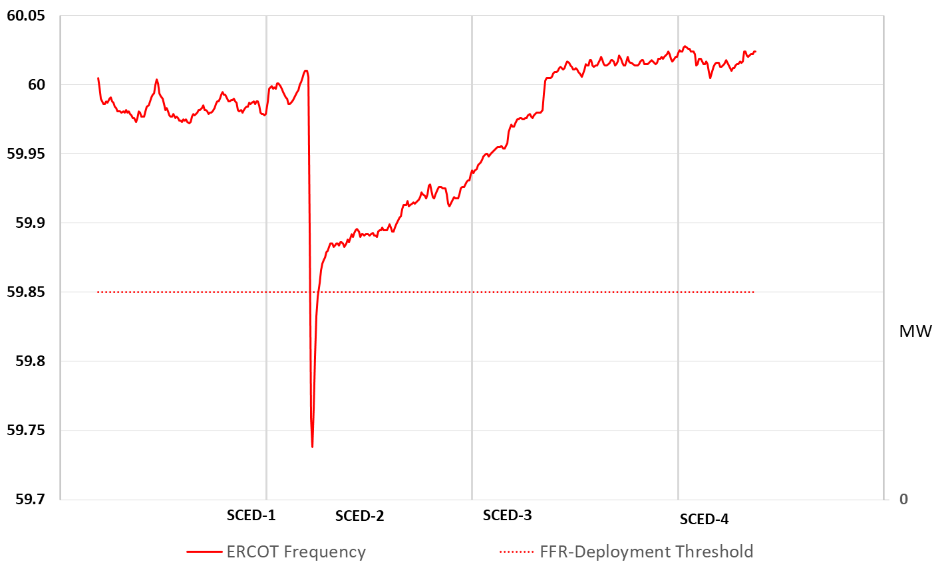
FFR – Automatic Deployment

Slide 18
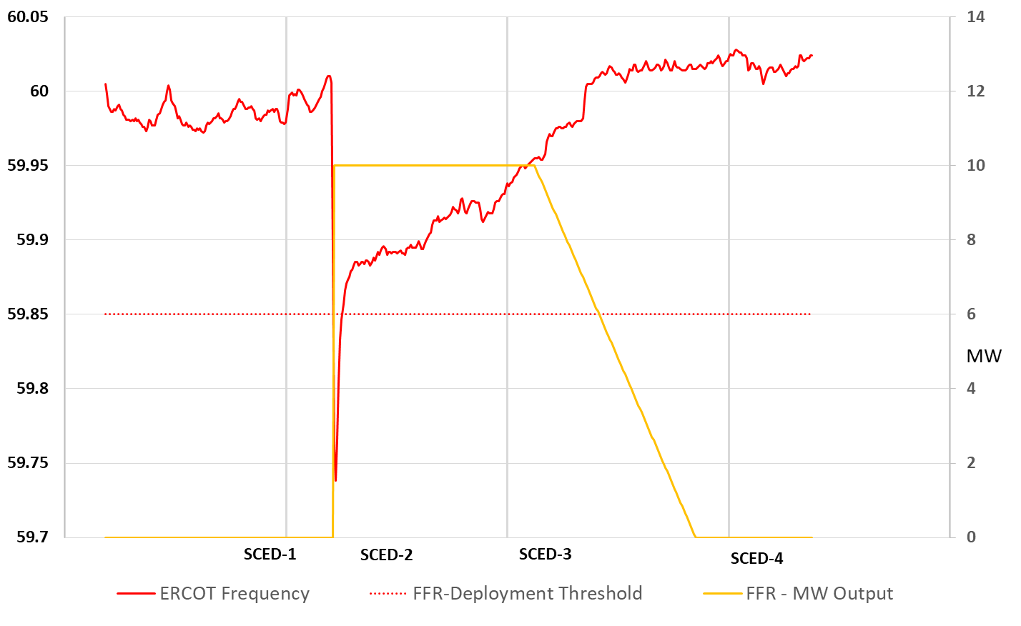
FFR – Automatic Deployment

Slide 19
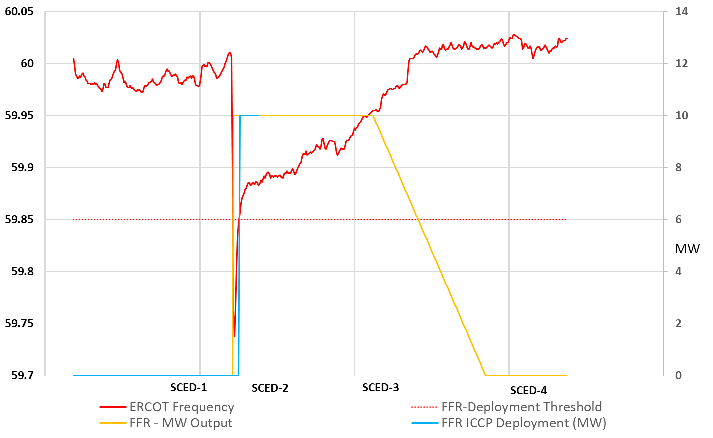
FFR – Automatic Deployment

Slide 20
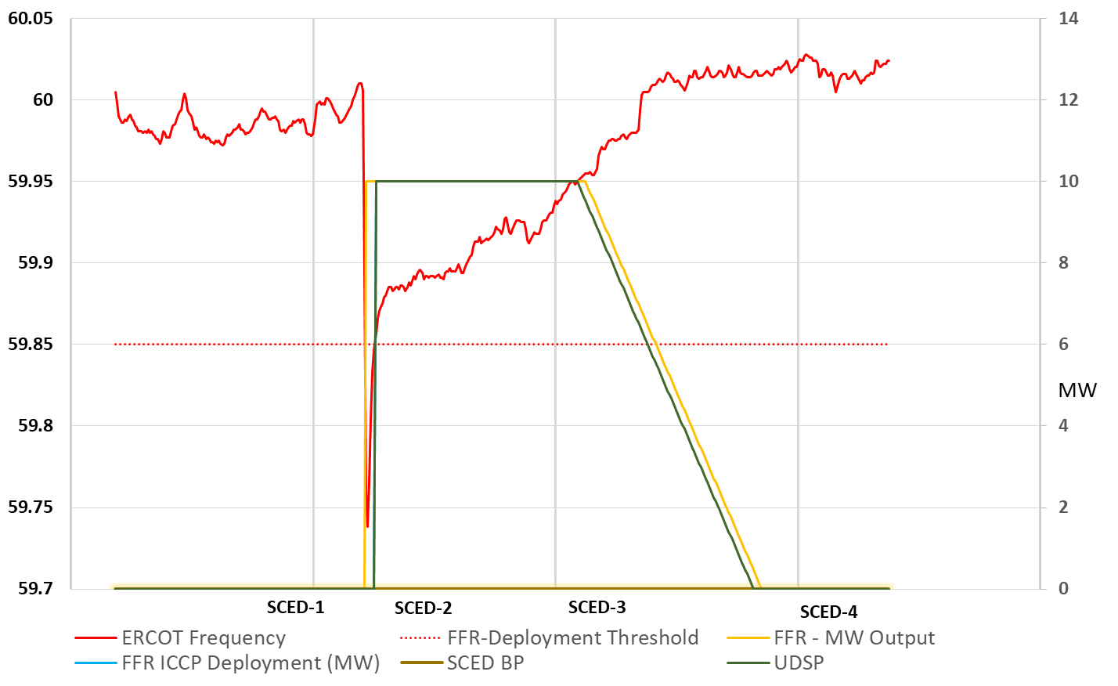
FFR – Automatic Deployment

Slide 21
FFR – Automatic Deployment

Slide 22
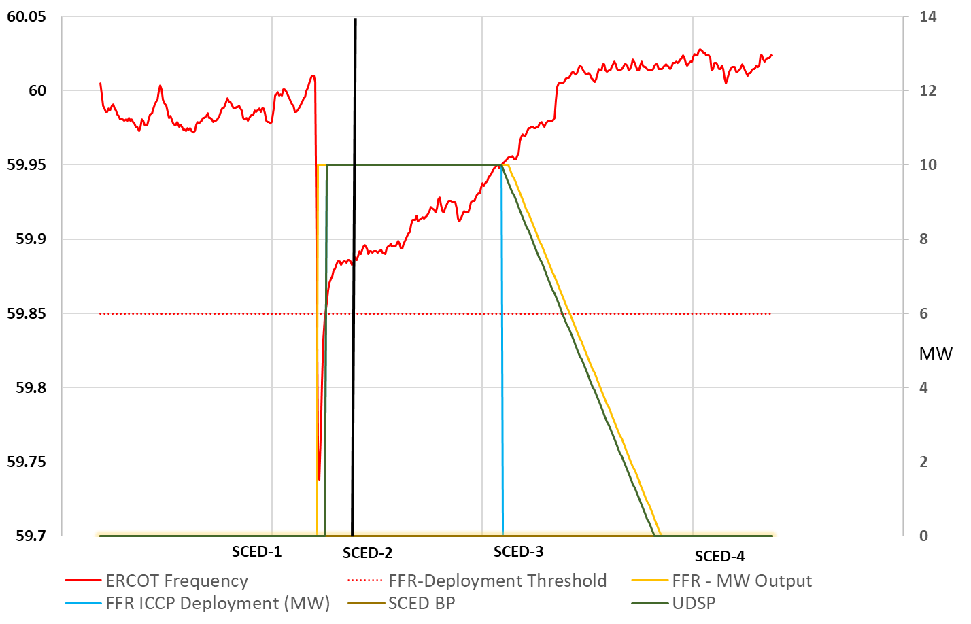
FFR – Automatic Deployment

Slide 23
FFR – Automatic Deployment

Slide 24
Manual Deployment of FFR

Slide 25
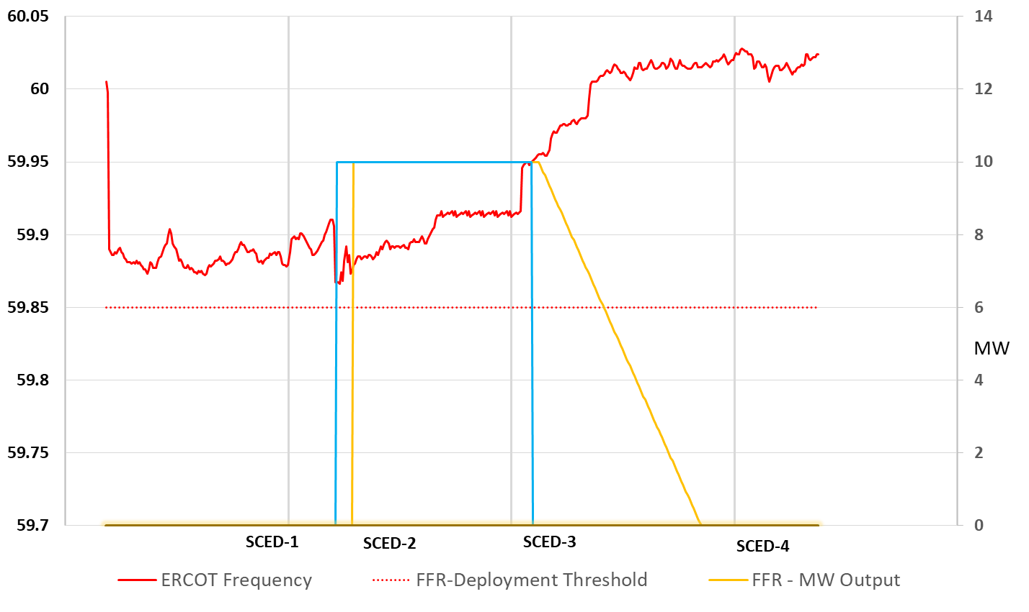
FFR – Manual Deployment

Slide 26
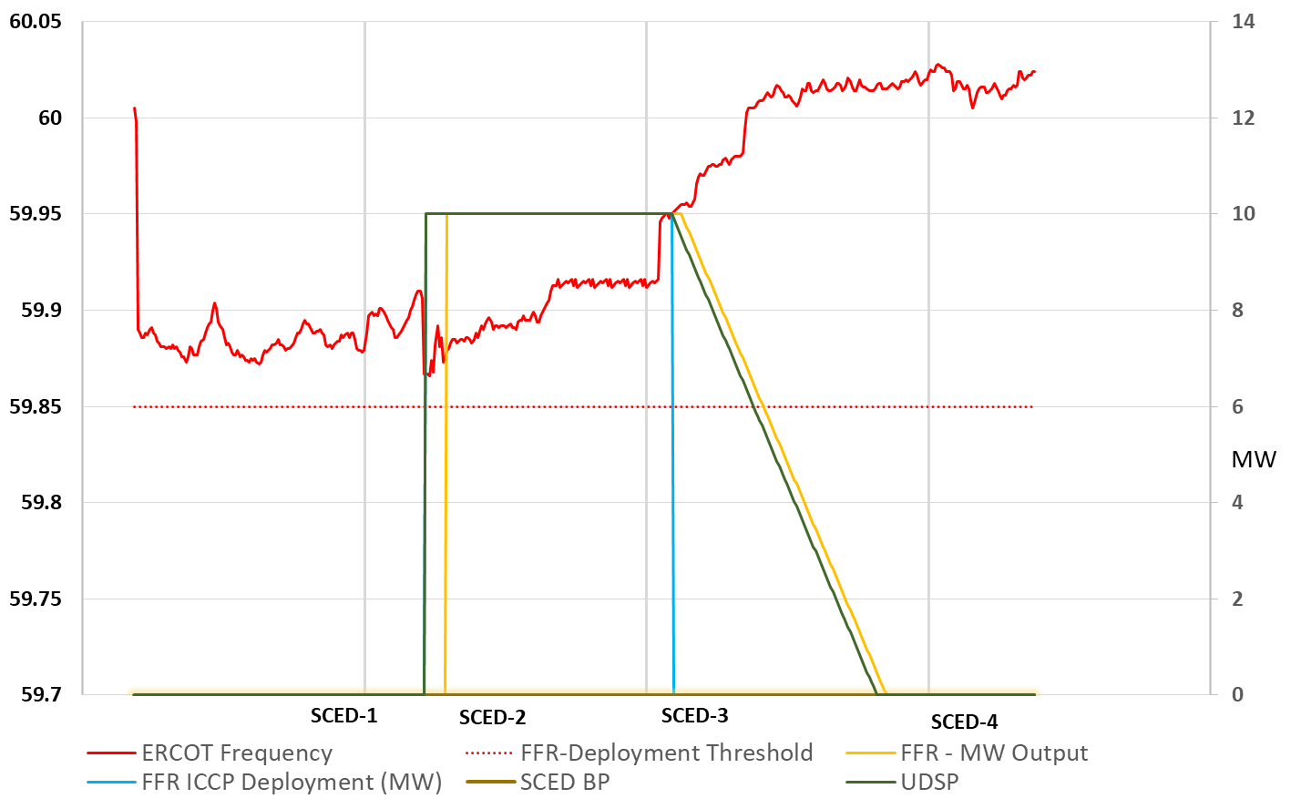
FFR – Manual Deployment

Slide 27
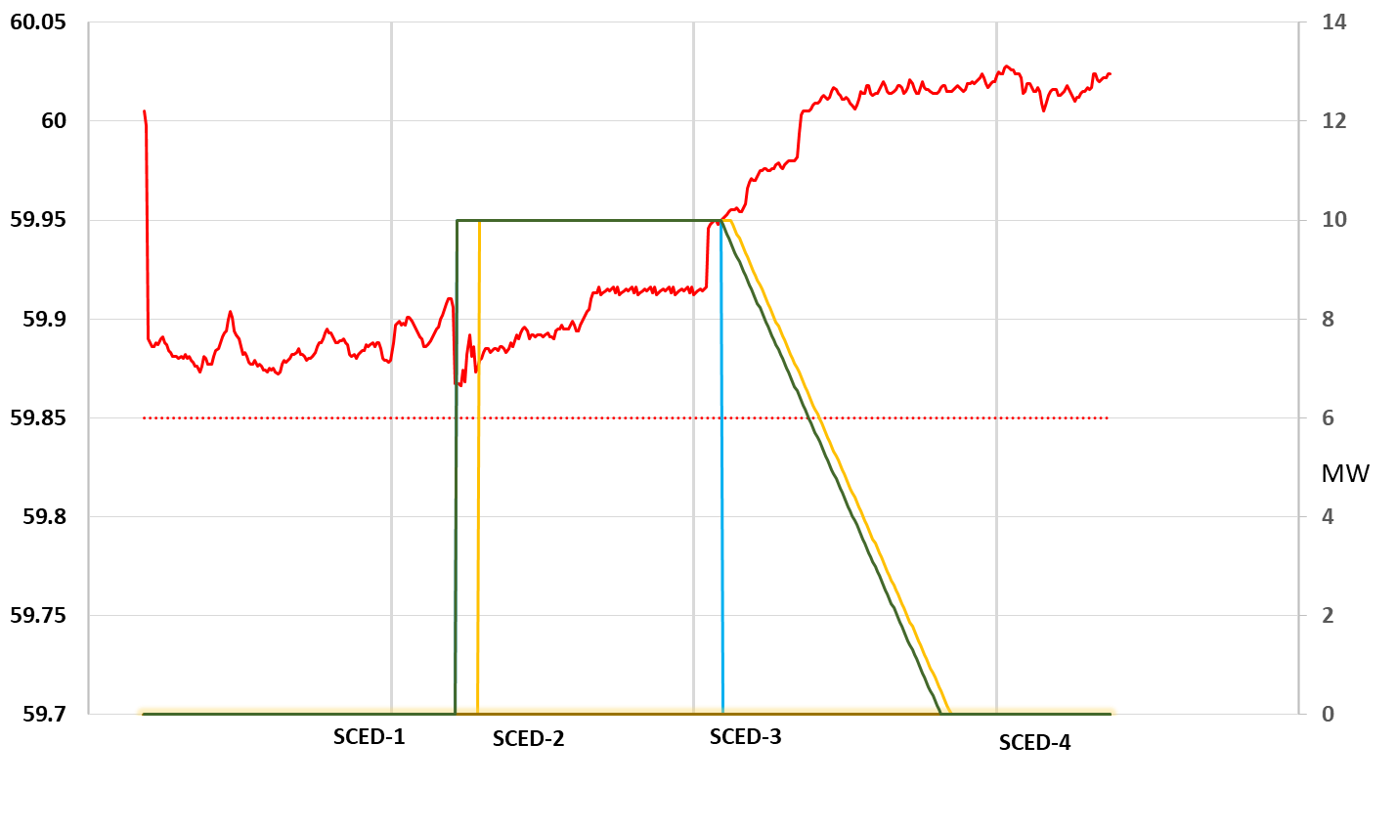
FFR – Manual Deployment

Slide 28
Summary
ERCOT will send ICCP deployment instructions to SCED dispatchable Resources providing FFR for both automatic and manual deployments
ICCP Deployment Instructions will be included in the Resource’s UDSP
FFR deployments will reset to zero once ERCOT Frequency recovers above 59.95 HZ.
For Load Resources controlled by UFR and awarded FFR, ERCOT will send manual deployment instructions and recall instruction through AS Manager (XML).
Awards from previous RTC-SCED run are effective until QSEs receive new RTC-SCED FFR award and implement new awards in their control systems

Slide 29
Resources providing Ancillary Services via a UFR

Slide 30
Load Resources and AS Deployment and Recall
Controllable Load Resource (CLR):
Awarded AS only when they are On-Line
No need for Manual Deployment of AS. CLRs are treated the same as On-Line Generation Resources (GRs)
Load Resource (LR) with UFR armed with frequency setting of 59.7 Hz.:
Eligible for RRS and ECRS awards if qualified
When deployed, if LR awarded both RRS and ECRS, then deployed MW will be, at a minimum, the sum of the RRS and ECRS awards.
Automatic deployment based on Frequency Threshold (59.7 Hz.) as defined in Nodal Protocol Section 3.18 (3)(b)
Manual Deployment of AS is based on Nodal Protocol Section 6.5.7.6.2.2 (RRS) and 6.5.7.6.2.4 (ECRS) and Nodal Operating Guide
LR without UFR (disarmed or not installed):
Eligible for ECRS awards if qualified
Manual Deployment of AS is based on Nodal Protocol Section 6.5.7.6.2.4 (ECRS) and Nodal Operating Guide

Slide 31
LR with UFR: Automatic Deployment of RRS
Automatic deployment based on Frequency threshold (59.70 Hz) as defined in Nodal Protocol Section 3.18 (3)(b)
Full response must be provided in 0.5 seconds
The LR must remain deployed until recall by ERCOT.

Slide 32
LR with UFR: Manual Deployment of RRS
ERCOT Instructed Deployment of RRS from LRs with UFR will occur under conditions described in Nodal Protocol Section 6.5.7.6.2.2 and Nodal Operating Guide
Under EEA2 and to meet NERC Standards
ERCOT will develop a procedure based on NPRR939 to assign each LR into a deployment group (mainly used in EEA2 deployments)
LRs providing ECRS that are not controlled by high-set UFRs shall be deployed prior to Group 1 deployment. ERCOT shall deploy ECRS and RRS capacity supplied by LRs (controlled by high-set UFRs) in groups, starting with group 1.

Slide 33
LR with UFR: Manual Deployment of RRS (continued)
ERCOT shall issue notification of the deployment via XML message. ERCOT shall follow this XML notification with a Hotline VDI, which shall initiate the ten-minute deployment period
Resource shall remain deployed until recalled by ERCOT via XML.

Slide 34
LR ECRS: Manual Deployment
To the extent that a Resource is awarded both ECRS and RRS, those MW will be deployed together as a block for either ECRS or RRS deployment (Manual or Automatic)
Energy from Resources providing ECRS may also be manually deployed by ERCOT pursuant to Section 6.5.9, Emergency Operations.
ERCOT shall deploy ECRS to meet NERC Standards by Dispatch Instruction for deployment of Load Resources energy via electronic Messaging System (XML).
Following an manual ECRS deployment to Load Resources, the LR shall remain deployed until ERCOT issues a recall instruction (XML)

Slide 35
Coordination between AS products that have automatic deployments based on a frequency trigger

Slide 36
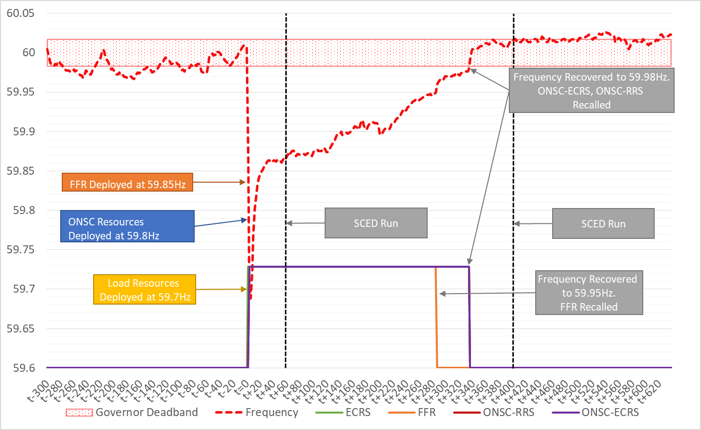
A/S Deployment Coordination

Slide 37
Resources providing “Off-Line” Non-Spin

Slide 38
Manual Deployment of Off-Line Non-Spin
Manual Deployment of Off-Line Non-Spin will occur under conditions described in Nodal Protocol Section 6.5.7.6.2.3 and Nodal Operating Guide
What qualifies as Off-Line Non-Spin?
Non-Spin awards to Off-Line Resources (Resource telemetering a status of OFF) qualified to provide Non-Spin
For On-Line dispatchable Resources with power augmentation that is not active, the portion of the Non-Spin award provided from this Resource’s power augmentation capacity.
Note that the power augmentation capacity must be qualified to provide Non-Spin service

Slide 39
Manual Deployment of Off-Line Non-Spin
Resource with status = OFF
Upon ERCOT Instruction to deploy Off-Line Non-Spin:
Resource must be On-Line@LSL within 25 minutes of ERCOT XML instruction
Resource will be in On-Line status until ERCOT XML Recall
During STARTUP Resource Status, Resource is eligible to be awarded Non-Spin.
This eligibility lasts for 25 minutes from time of ERCOT instruction to deploy Non-Spin from Off-Line Generation Resource
During STARTUP, RTC will determine Non-Spin Award based on Non-Spin Offer Price from the Resource On-Line AS Offer. i.e. will NOT use Off-Line AS Offer

Slide 40
Manual Deployment of Off-Line Non-Spin
For On-Line dispatchable Resources with power augmentation,
Propose new Resource telemetry of Inactive power augmentation MW capacity (e.g. unfired duct burner capacity)
This telemetry is not used in the RTC optimization that determines energy and AS Awards
In the post processing of RTC awards, this telemetry MW value is used to determine the amount of Non-Spin carried on the power augmentation capacity that is to be treated as Off-Line Non-Spin
Example: On-Line 2x1 Combined Cycle Configuration with Duct Burner (power augmentation) included in HSL=350MW
2 GTs each with 100 MW capacity
1 Steamer with 120 MW capacity without duct burner fired, with duct burner fired, Steamer capacity increased by 30 MW
New proposed telemetry value =
30 MW when Duct Burner NOT fired
0 MW when Duct Burner fired

Slide 41
Manual Deployment of Off-Line Non-Spin
For On-Line dispatchable Resources with power augmentation
Upon ERCOT Instruction to deploy Off-Line Non-Spin:
Resource must activate power augmentation (e.g. fire duct burner) and have available to RTC, additional rampable capacity equal to the Off-Line Non-Spin award that can be converted to energy by RTC, within 30 minutes of ERCOT XML instruction
Resource power augmentation will be active until ERCOT XML Recall

Slide 42
Discussion and wrap-up

