Slide 1
June 24, 2020 RMS Update to TAC
Eric Blakey
RMS Chair

Slide 2
RMS Meetings Since Last Report
Regular Meeting
February 4, 2020
June 2, 2020 (Webex)
Information Sessions
March 3, 2020
April 7, 2020
May 5, 2020

Slide 3
Updates
Voting Items since last TAC Update include:
Approved 2020 Goals and 2019 Accomplishments and Working Group Leadership
Texas SET Change Controls 820, 822, 823
2020 Market Data Transparency SLA
Email Vote Approvals include:
4/9/20 – RMGRR163
5/7/20 –LPGRR067 and Texas SET Change Controls 799, 806, 807, 811, 812, 813, and 814

Slide 4
COVID-19 Program
March 26 - PUC adopted an order creating program to protect customers impacted by pandemic.​
April 17 - Second order was adopted.
​The order established the COVID-19 Electricity Relief Program (ERP), which, among other things, created an assistance program for eligible residential customers in competitive areas of Texas who are financially impacted by COVID-19.​
July 17 - ERP ends, unless extended by the Commission. Details for transitioning out of the program are being finalized at the PUC.

Slide 5
COVID-19 Program - Details
Eligibility List Maintained by Solix (PUC administrator)
Unemployed - Self Enroll via Solix Process (weekly)
Low Income - Via “LILA” process (monthly)
No Disconnection for non-pay allowed during program for eligible customers
For qualified customers, rather than DNP, utility charges are suppressed and REP receives 4c/kWh
Funded by 33c/MWh utility charge

Slide 6
Covid-19 Program – Market Processes Established
Weekly communication from Solix to REPs with updated list of eligible customers, including de-enrollments
MarkeTrak used to communicate “adds”, “deletes” and “reimbursements” of qualified customers from REP to TDU
REP Reimbursement process (15th of the month)
Cancel/Rebill for initial TDU suppression

Slide 7
Demand Response Reporting
NPRR933 – Updates to REP/NOIE demand response reporting requirements
Board Approval – June 9, 2020
Creates Other Binding Document for the reporting requirements
TAC Approval July 29
Addresses Summer Assessment Action Item, to provide DR information to the PUCT in a more timely manner

Slide 8
DR Reporting – New Timeline
REP | Requirement | NOIE
Aug 1 | ERCOT Notice to Market Initiating Process | Aug 1
Aug 15 | Inform ERCOT they will not participate in that year’s DR report | Aug 15
Sept 1 | “Snapshot Date” | Sept 1
Oct 15 | Initial DR Report due | Oct 31
2 Business Days | ERCOT Validates Initial Report and returns errors to address | 2 Business Days
Oct 31 | Address any errors identified and resubmit report | Nov 7
Annual Report from ERCOT Due – December 15

Slide 9
Since the last TAC Meeting
March 3 – Mass Transition Workshop
April 28 – Mass Transition Drill Successfully Completed
March 21 – CNP Successfully Completes CIS Transition Project
May 5 – REP/Utility Communication Workshop
June 1 – AMS/IDR Workshop
June 2 - Settlement Timeline Workshop

Slide 10
Working Group Updates
Texas Standard Electronic Transaction (Texas SET)
TXSET Enhancements:
Minor enhancements – 4.0A
Future Release - Developing schedule for Texas SET 5.0 release
Texas Data Transport and MarkeTrak Systems (TDTMS)
Working on MarkeTrak Tool Enhancements
Guide Updates to follow
Inadvertent Gains – Reviewing processes

Slide 11
Working Group Updates
Profiling Working Group (PWG):
IDR vs AMS meters – NPRR877
Discussing customer options for an AMS meter vs an IDR Meter and how that might impact 4 CP billing, load profiles and settlement
June 1 - Workshop to ensure market-wide understanding of potential changes

Slide 12
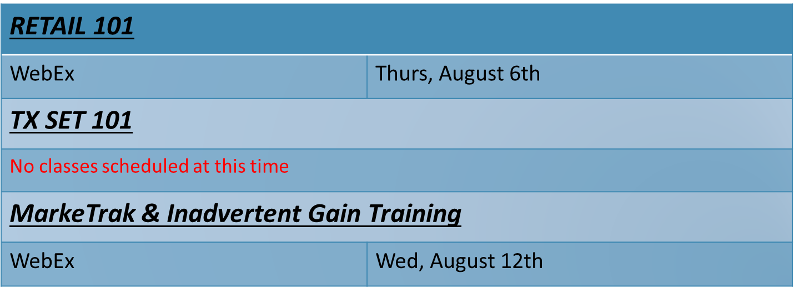
Working Group Updates
Retail Market Training Task Force (RMTTF):
RMTTF will continue to monitor ERCOT and market participant COVID-19 guidelines to determine if any instructor led classes may be held later in the year.

Slide 13
Retail Market Training - Registration
How do I register for Training?
Go to the ERCOT Training Website at http://www.ercot.com/services/training/
Select the course you are interested in attending
On the ‘Schedule/Registration’ tab, select the ‘enroll online’ link under ‘Registration’ to register for the course.
If you find the course is not listed under the Web-based training…
Go to ERCOT Training Website as shown above
Select the ‘ERCOT Learning Management System’ (LMS) link in the upper right hand corner under RELATED CONTENT
If necessary, set up a log on
Once in LMS, follow drop downs for ‘web-based training’ and ‘retail market’. Available modules will appear
Select ‘start course’
Note! Most modules are able to be completed in less than 30 minutes.

Slide 14
Questions?
Next RMS Meeting – July 14, 2020

