Slide 1
Met Center: Lease Expiration and Replacement
Betty Day
Vice President, Security & Compliance
Technical Advisory Committee
June 24, 2020

Slide 2
Met Center Lease Expiring
Lease expires March 2022
Do we need a “Met Center” going forward?
Yes
Support ~300 stakeholder meetings each year
House ~40 ERCOT staff
Provide required Independent Market Monitor (IMM) office space
Challenges with current Met Center building
Demand for more meeting space
Building and maintenance issues

Slide 3
Identification of Alternatives
Engaged a commercial real estate firm to help assess options
Worked with architect to determine square footage needs
Significant increase in meeting space
Two additional meeting rooms (comparable to 206A and 210)
Add public booths, phone rooms, and informal meeting areas
Total public meeting space will increase by approximately 5,000 square feet
Surveyed market for properties meeting the following criteria:
35,000 square feet
10 miles or 15 minutes from Austin airport
180 parking spaces (5.1:1,000 ratio)
Nearby hotels/amenities
Preference for single occupancy
Option for purchase
Reviewed 13 options as well as building at Bastrop Control Center site

Slide 4
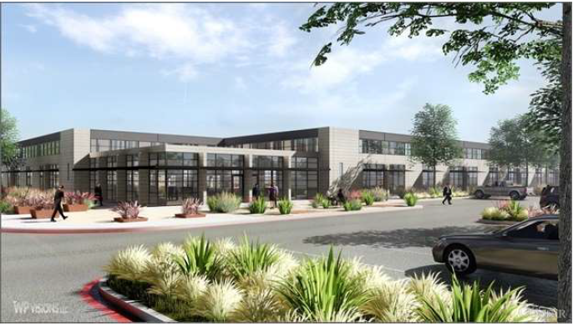
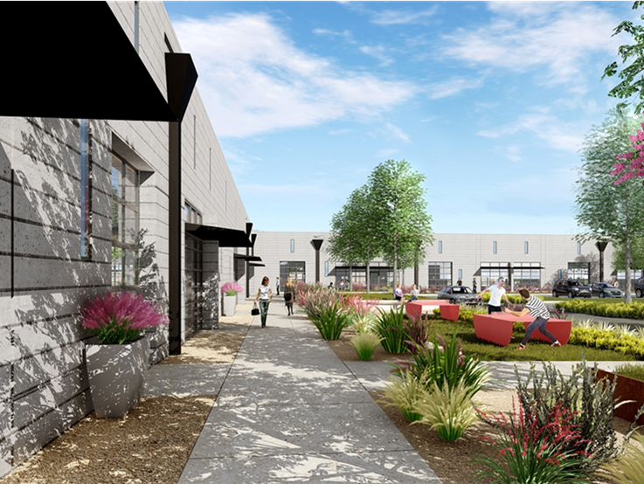
New Location Selected – Still the Met Center!
Met Center Creative Office E (37,650 square feet)
Located near existing Met Center building
New construction (not yet started)
Lease with option to purchase after one year

Slide 5
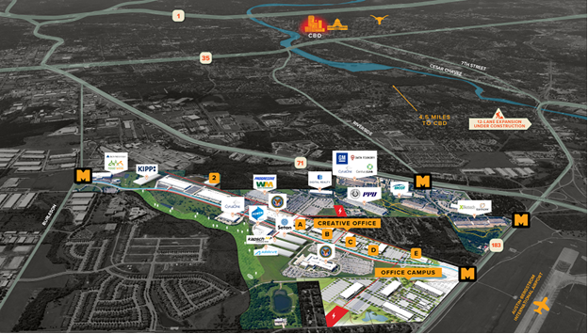
Met Center Creative E
Existing Met

Slide 6
Timeline
Board approved ERCOT to:
Execute agreement with developers for lease with an option to purchase Met Center Creative E
Next steps
Finalize lease/purchase documents by end of July
Expect 30-45 days to complete
Begin construction in August
Building should be ready for occupancy by late next summer 2021

Slide 7
Costs
Purchase, improvement, equipment and furnishing costs are expected to be approximately $20 million
Purchase versus lease
Cost is beneficial to purchase building
Breakeven when total cost of leasing surpasses total cost of purchasing occurs within 13 years
Annual cost savings realized with elimination of “rent” payments
Option to purchase allows flexibility
Approach complies with Board-approved Financial Corporate Standard
Maintain stable, fair, and predictable fees
No impact to System Administration Fee (SAF), currently at $0.555
Use lowest cost of borrowing
Fund with available CRR auction receipts
Funding of unbudgeted initiatives
Address at time of initiation with Finance & Audit Committee approval

