Slide 1
Estimated Aggregate Liability
(RTLF/RTLE)
CWG / MCWG
ERCOT Public
June 17, 2020

Slide 2
Determination of Counter-Party Estimated Aggregate Liability
EAL _{q} = Max [IEL, RFAF * Max {RTLE during the previous 40 days}, RTLF] + DFAF * DALE + Max [RTLCNS, Max {URTA during the previous 40 days}] + OUT _{q} + ILE _{q}
EAL _{t} = Max [RFAF * Max {RTLE during the previous 20 days}, RTLF] + DFAF * DALE + Max [RTLCNS, Max {URTA during the previous 20 days}] + OUT _{t}
EAL _{a} = OUT _{a}

Slide 3
Determination of Counter-Party Estimated Aggregate Liability
Variable | Description
RTL | Real-Time Liability—The estimated or settled amounts due to or from ERCOT due to activities in the RTM for an Operating Day, as defined in Section 16.11.4.3.2, Real-Time Liability Estimate.
RTLCNS | Real Time Liability Completed and Not Settled—For each Operating Day that is completed but not settled, ERCOT shall calculate RTL adjusted up by rtlcu% if there is a net amount due to ERCOT or adjusted down by rtlcd% if there is a net amount due to the QSE. RTLCNS = Sum of Max RTL(rtlcu% * RTL, rtlcd% * RTL) for all completed and not settled Operating Days Where: rtlcu (110%) = Real-Time Liability Markup rtlcd (90%) = Real-Time Liability Markdown
RTLF | Real-Time Liability Forward— rtlfp% the sum of estimated RTL from the most recent seven Operating Days. RTLF = rtlf% of the Sum of Max RTL(rtlcu% * RTL, rtlcd% * RTL) for the most recent seven Operating Days Where: rtlfp(150%) = Real-Time Liability Forward
RTLE | Real Time Liability Extrapolated for a QSE that represents either Load or generation —M1 multiplied by the sum of the net amount, with zero substituted for missing values, due to or from ERCOT by the Counter-Party in the 14 most recent Operating Days for which RTM Initial Statements are produced for Counter-Parties according to the ERCOT Settlement Calendar divided by 14.

Slide 4
Software Error Identified in ERCOT’s Credit Monitoring and Management (CMM) System
ERCOT identified a software error in its CMM system that occurred with the implementation of Nodal Protocol Revision Request (NPRR) 347, Single Daily Settlement Invoice and Updates to Credit Calculations, including addition of a Minimum Collateral Exposure Component, on November 9, 2012.
ERCOT implemented a software fix on June 4, 2020 to align the Total Potential Exposure (TPE) calculation with NPRR347.
ERCOT has determined that the 110% and 90% adjustments to RTL have not been included in the RTLF calculation since the implementation of NPRR347. In addition, the 150% RTLF adjustment has not been applied to two RTL components:
Real-Time Congestion payments/charges for Self-Schedules
Payments/charges for Point-To-Point (PTP) Obligations settled in Real-Time.
Because RTL can represent charges or credits, the impact of the errors on RTLF can be either positive or negative.

Slide 5
Software Error Identified in ERCOT’s Credit Monitoring and Management (CMM) System
Therefore, the error may have increased TPE in cases where it incorrectly caused RTLF to exceed the maximum of RTLE (with RFAF applied), and decreased TPE when the opposite occurred resulting in more or less collateral being posted with ERCOT than would otherwise have been the case.
Due to system limitations, ERCOT is unable to quantify the number of instances where an erroneous RTLF determined the TPE for a Counter-Party since the implementation of NPRR347.
However, since January 2019, ERCOT estimates that on most days:
The total aggregate RTLF, if corrected, would have exceeded the erroneously computed RTLF.
The maximum of RTLE (with RFAF applied) would likely have exceeded the corrected RTLF on all but one day, indicating that the error impacting RTLF was likely not a material driver of total TPE since January 2019.

Slide 6
RTFL and RTLE
In most cases, the maximum RTLE (with RFAF applied) is higher than RTLF. As a result, the maximum RTLE (with RFAF applied) would typically be used in the TPE calculation
Except on August 20, 2019 when RTLF was $230 million and maximum RTLE (with RFAF applied) was $200 million (due to high ERCOT prices)
Congestion charges (congestion payment/charge to each QSE submitting a Self-Schedule) are small and can be debits or credits
The majority of PTP activity results in a credit in Real-Time

Slide 7
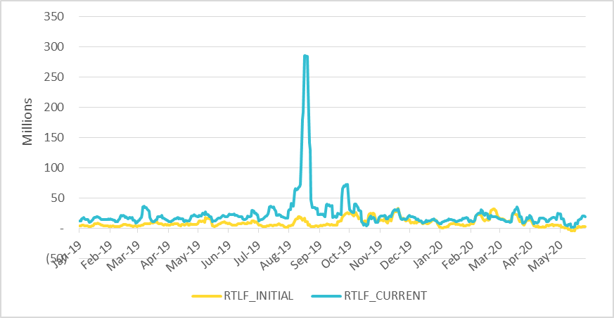
RTLF Initial vs RTLF Current Jan 2019- May 2020
RTLF Initial, if corrected, could have potentially increased the TPE.
Note: RTLF Initial is the way that RTLF was calculated prior to June 4, 2020
RTLF Current is the current method used in the calculation

Slide 8
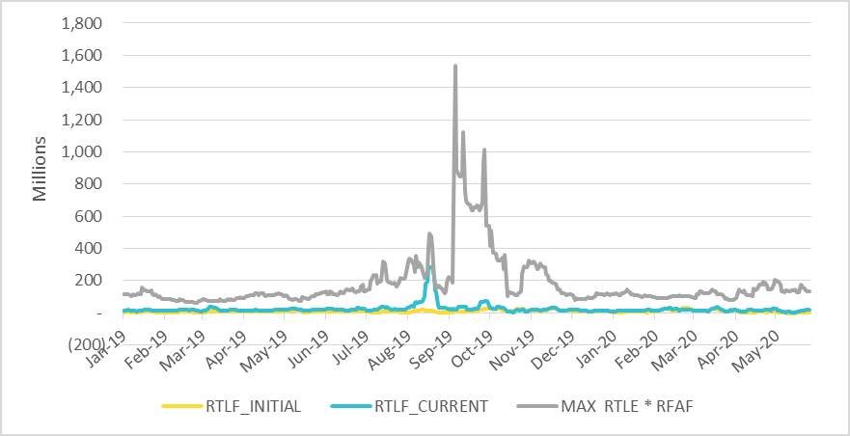
RTLF Initial, RTLF Current and MAXRTLE Jan 2019- May 2020
However, maximum RTLE (with RFAF applied) is still higher than RTLF Current, so aggregate TPE would most likely not have been materially affected if RTLF was correctly calculated.
Note: RTLF Initial is the way that RTLF was calculated prior to June 4, 2020
RTLF Current is the current method used in the calculation

Slide 9
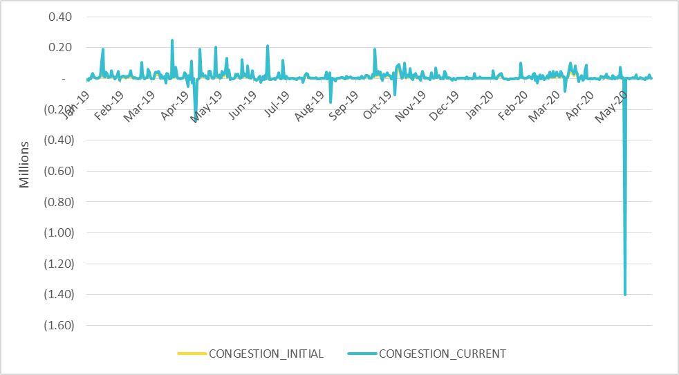
Congestion Initial vs Congestion Current Jan 2019- May 2020
Congestion charges, which can be credits or debits, are relatively small and impact only a few Counter-Parties (mostly Generators)
Note: Congestion Initial is the way that Congestion charges were calculated in RTLF prior to June 4, 2020
Congestion Current is the current method used in the calculation

Slide 10
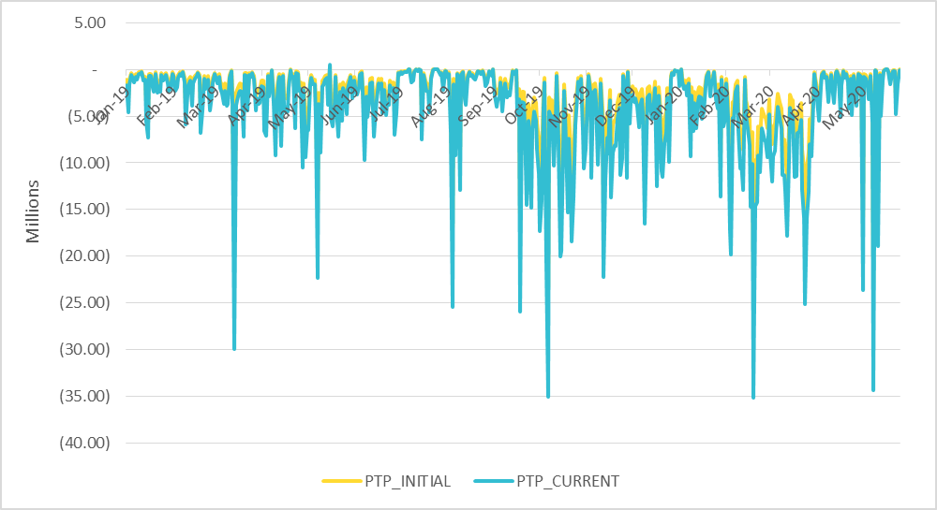
PTP Initial vs PTP Current Jan 2019- May 2020
PTP activity (which is a component of RTLF) impacts 108 CPs (August 20, 2019). PTP activity results in mostly credits to the TPE.
Note: PTP Initial is the way that PTP Obligation charges/payments were calculated in RTLF prior to June 4, 2020
PTP Current is the current method used in the calculation

Slide 11
Questions

