Slide 1
ERCOT Frequency Control Report
May 2020
ERCOT
Operations Planning
PDCWG | June 16th, 2020

Slide 2
Summary of May 2020
CPS1: 170.82%
Current CPS1 12-Month Rolling Average: 174.07%
4 BAAL Exceedances
5 hourly CPS1 score below 100%
BAAL-003 Events have updated through 2019
2018 BAAL-003 FRM Performance: -843.17
2020 RMS1 Statistics
  Mean: 16.13 mHz
  Min: 12.70 mHz
  Max: 18.69 mHz
Energy Statistics
  Total Energy: 31,167,811 MWh
  Wind Energy: 7,791,056 MWh
  Percent Energy from Wind: 25.00%
  Solar Energy: 859,972 MWh
  Percent Energy from Solar: 2.76%
Minimum System Inertia
  Mean: 192,543
  Max: 235,009 on May 29th
  Min: 131,096 on May 1st

Slide 3
Frequency Control
CPS1, BAAL, & RMS1

Slide 4
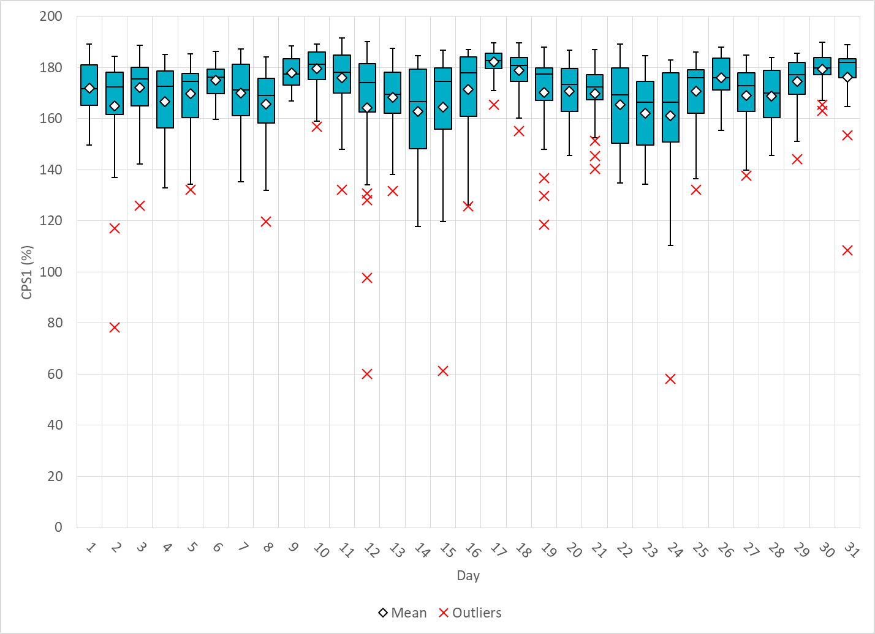
Hourly CPS1 by Day
May-20 CPS1 (%): 170.82
Notes:
Outliers:
1. 78.4% @ 17:00 5/2/2020:
Expected gen deviation:
Large expected gen deviation in the middle of the hour.(-1712 MW @17:24)
Solar resources and one combine cycle contribute significantly to total expected gen deviation from 17:15 to17:30.
Wind/Solar Ramp:
Solar ramps down from 2207 MW to 1803 MW within a 20 min interval from 17:05 to 17:25.
2. 97.7% @ 00:00 5/12/2020:
Expected gen deviation:
Large expected gen deviation during the first half of the hour. (-1312 MW @00:08; -1838 MW @00:26 )
Large expected gen deviations are from one combine cycle and renewables.
Wind Ramp:
Consistent Wind down ramp throughout the first half of the Hour.
Consistent wind down ramp from 15209 MW to 13819 MW over 25 min period.
3. 60.0% @ 1:00 5/12/2020:
Expected gen deviation:
Large expected gen deviation during the first 20 minutes. (-2409 MW @1:20 )
Negative throughout the hour.
Large expected gen deviations are mostly from wind resources.
Wind Ramp:
Consistent Wind down ramp throughout the Hour.
Steep wind down ramp during the first 20 minutes.
(1769 MW over 20 minutes)
4. 61.3% @ 16:00 5/15/2020:
Expected gen deviation:
Large expected gen deviation from 16:40 to 16:50. (-2535 MW @16:50)
A 200 MW resource went off line at 16:45.
Wind Ramp:
Steep wind down ramp @16:40 (700MW down ramp within 10 minutes)
5. 58.2% @ 21:00 5/24/2020:
Expected gen deviation:
Large expected gen deviation from 21:20 to 21:45.. (-2099 MW @21:27; )
Large expected gen deviations are from wind resources.
Wind Ramp:
Consistent wind down ramp throughout the hour.
(Over 2000 MW wind down ramp within 15 minutes @21:15.)

Slide 5
BAAL Exceedances & Violations
There were 4 BAAL exceedances in May
Notes:
2 exceedances on 5/12 and 2 exceedances on 5/31 due to loss of generation events.

Slide 6
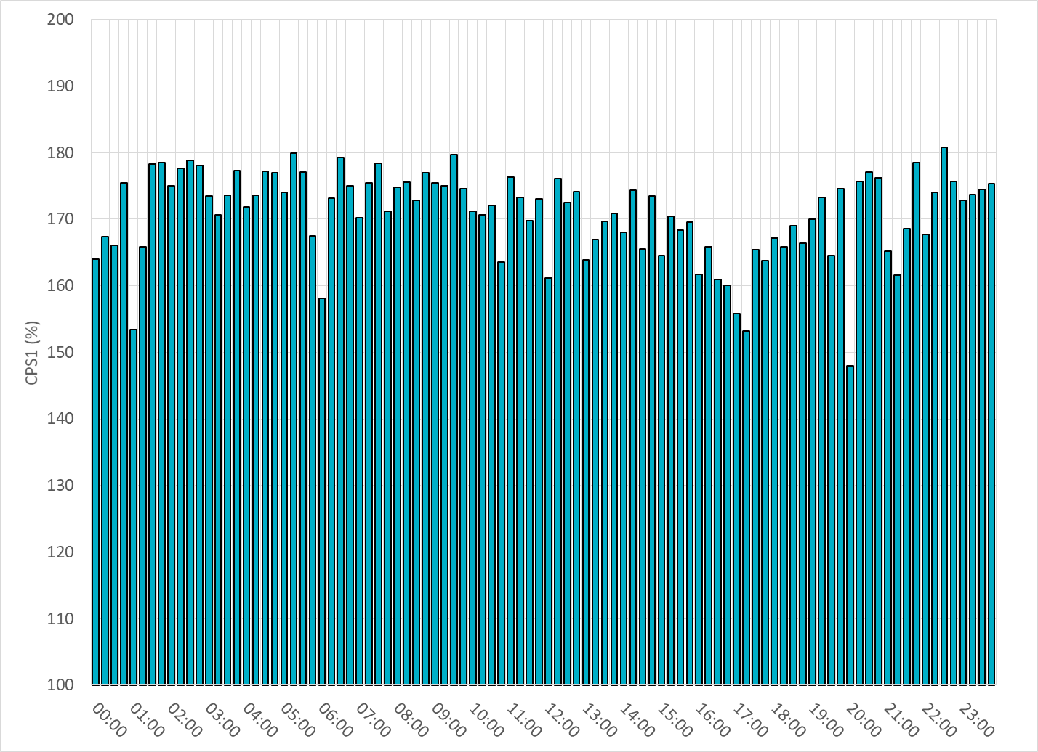
15-Minute Average CPS1%
May-20 CPS1 (%): 170.82

Slide 7
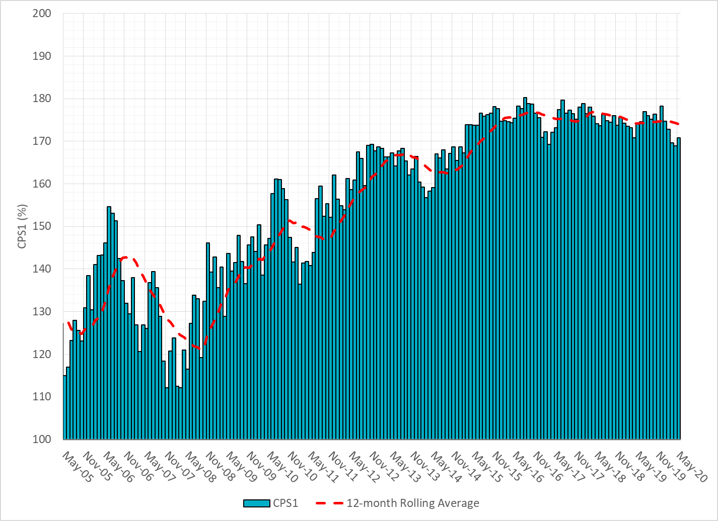
12-Month Rolling Average CPS1
Current 12-Month Rolling Average: 174.07%

Slide 8
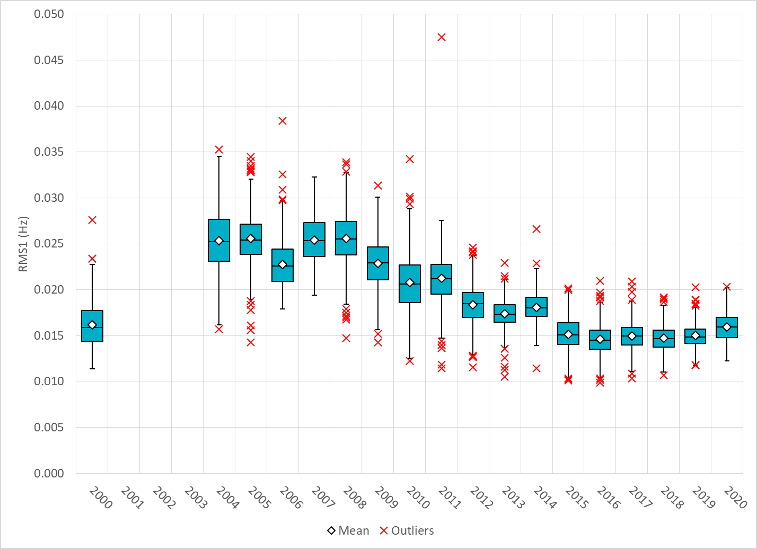
Daily RMS1 of ERCOT Frequency by Year

Slide 9
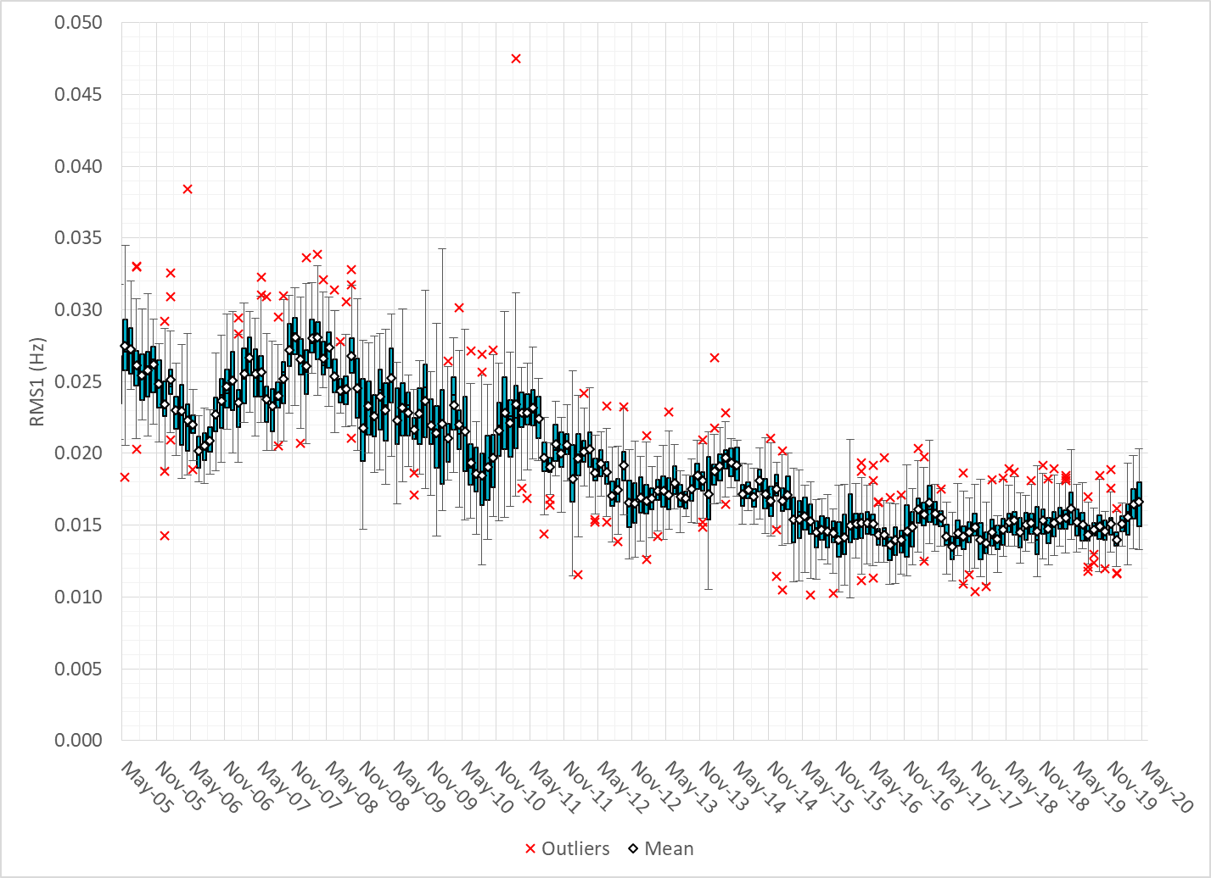
Daily RMS1 of ERCOT Frequency by Month

Slide 10
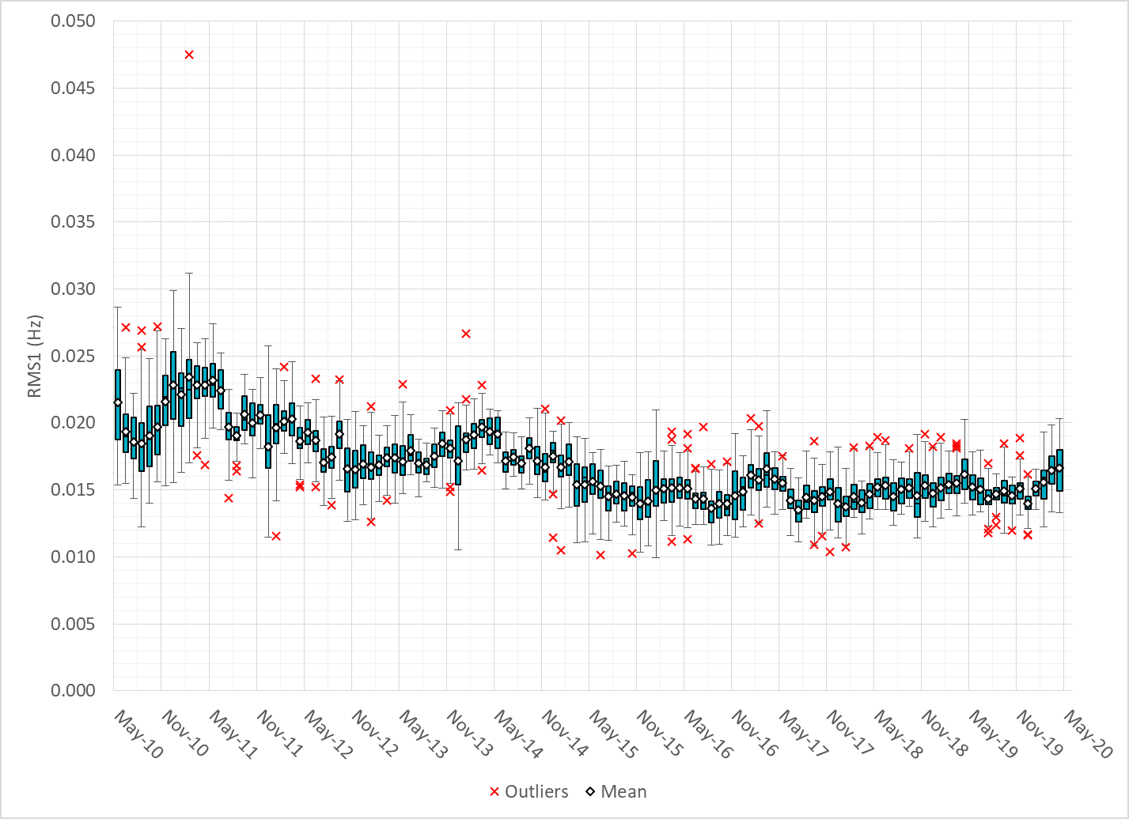
Daily RMS1 of ERCOT Frequency by Month

Slide 11
Frequency Profile Comparison

Slide 12
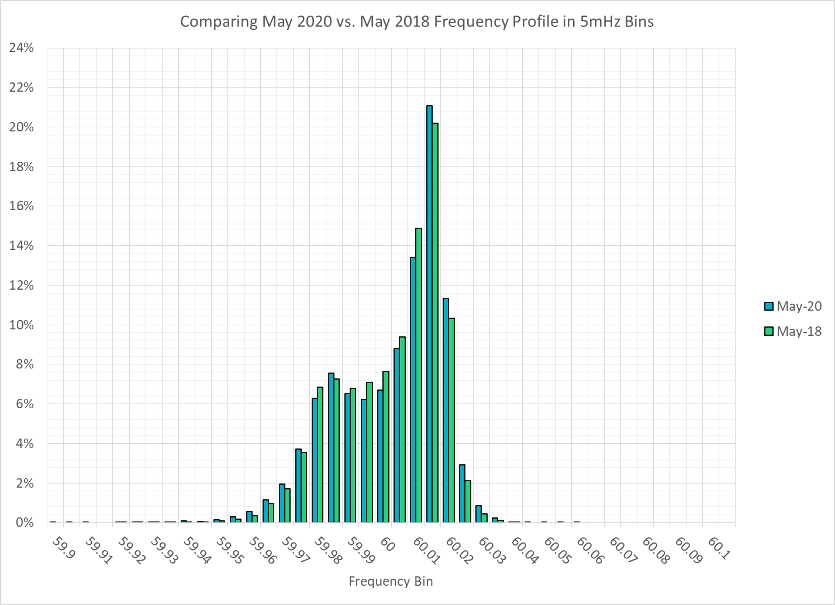
Frequency Profile Comparison

Slide 13

Frequency Profile Comparison

Slide 14
Time Error Correction

Slide 15
ERCOT Daily Time Error

Slide 16
Time Error Corrections Log Summary
There have been no time error corrections since December 2016

Slide 17
BAL-003 Performance

Slide 18
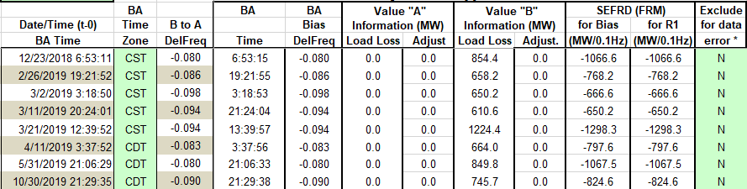
Op. Year 2018 BAL-003 Selected Events – Update
Notes:
BAL-003

Slide 19
Op. Year 2018 BAL-003 FRM Performance - Update
Notes:
OP2018: FRO = -381.0, FRM_median = -843.17, FRM_average = -959.7
OP2019: FRO = -381.0
OP2020: FRO = -425.0, FRM_median = -811.14, FRM_average = -892.5

Slide 20
ERCOT Energy Statistics

Slide 21
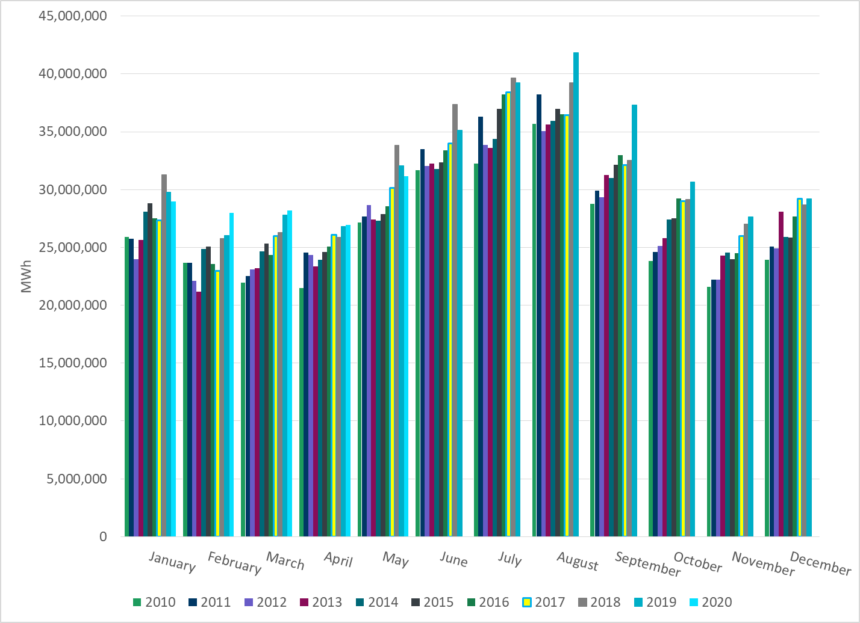
Total Energy
Notes:
31,167,811 MWh

Slide 22
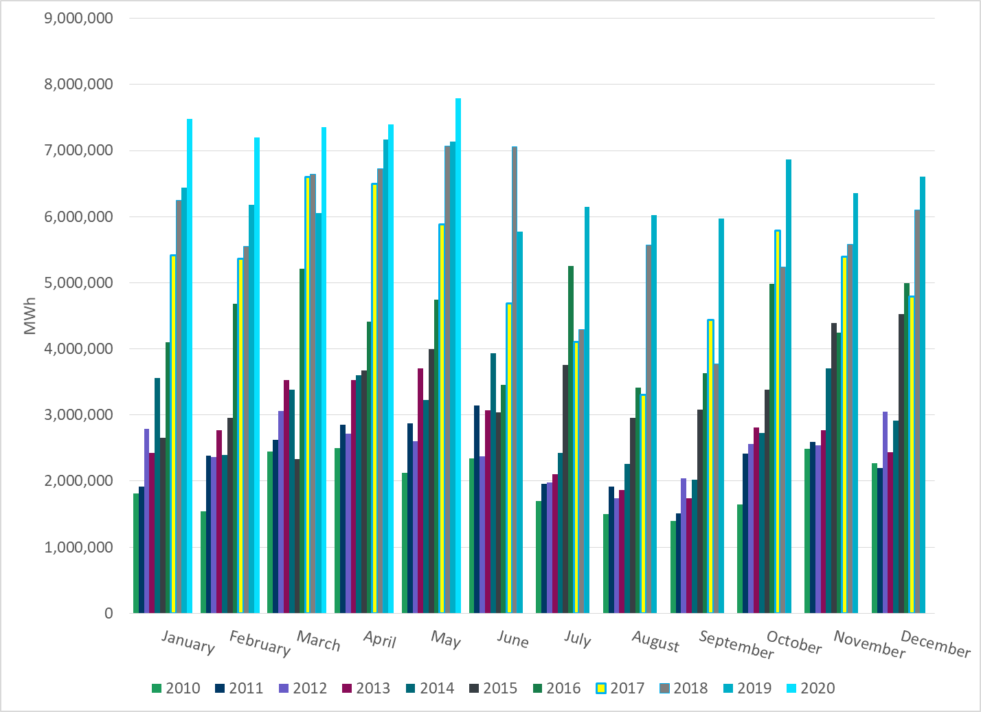
Total Energy from Wind Generation
Notes:
7,791,056 MWh

Slide 23
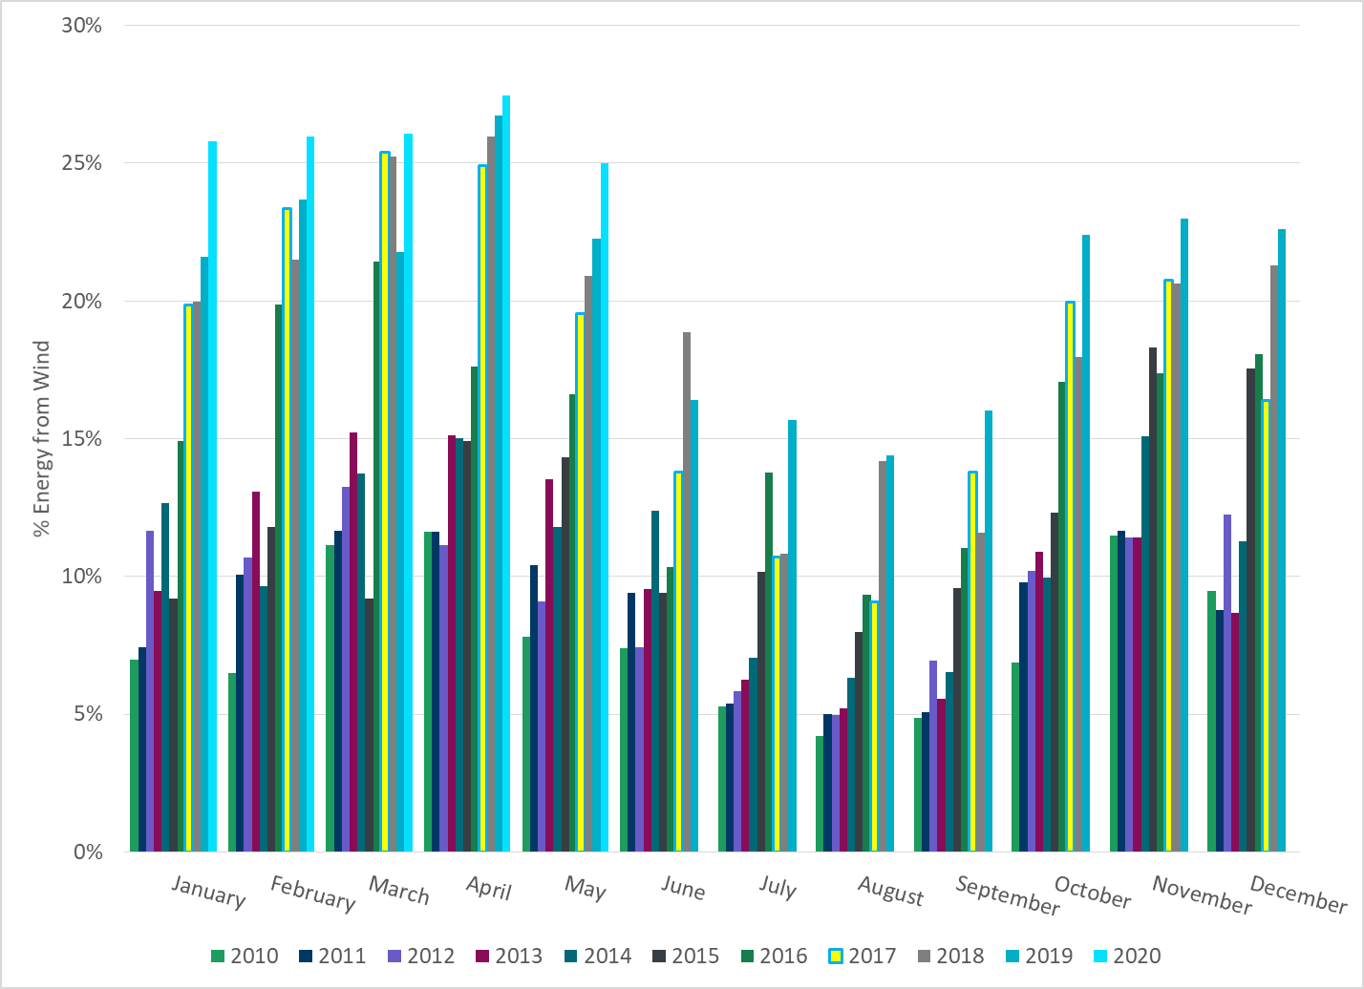
% Energy from Wind Generation
Notes:
25.00%

Slide 24
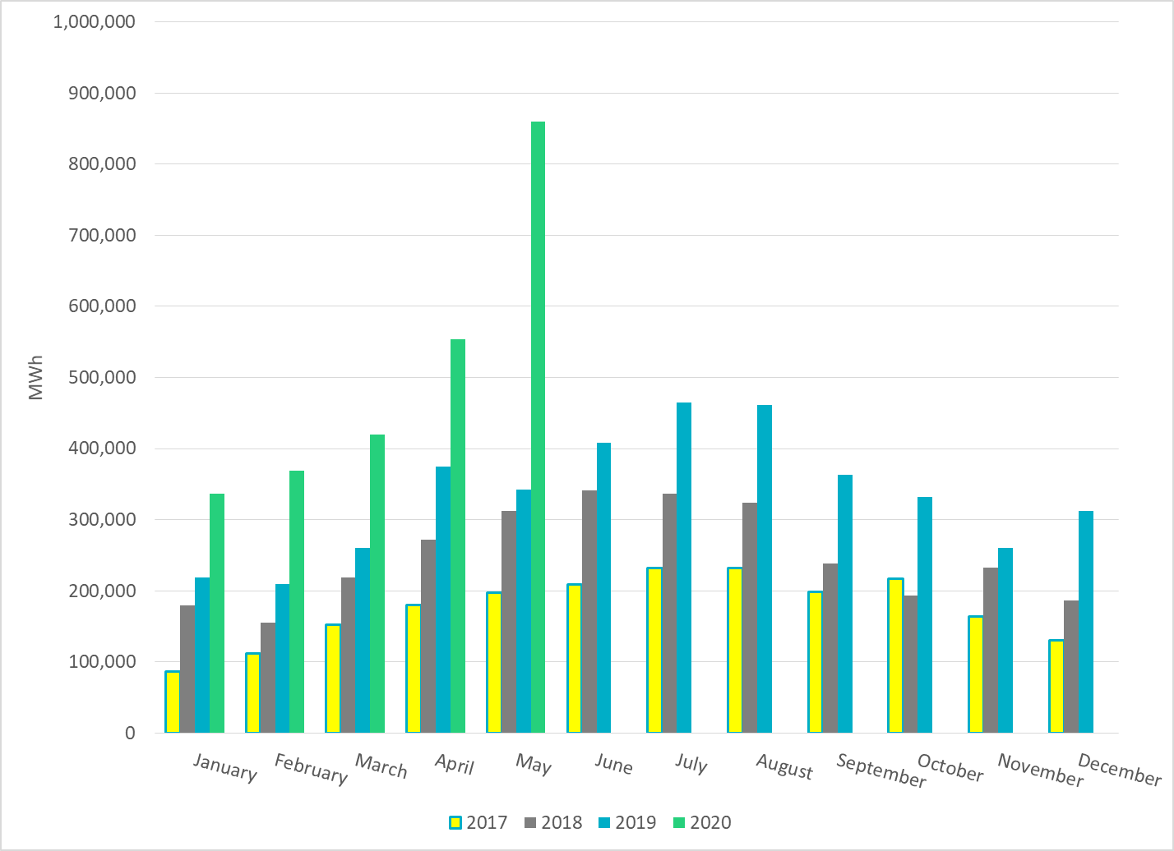
Total Energy From Solar Generation
Notes:
859,972 MWh

Slide 25
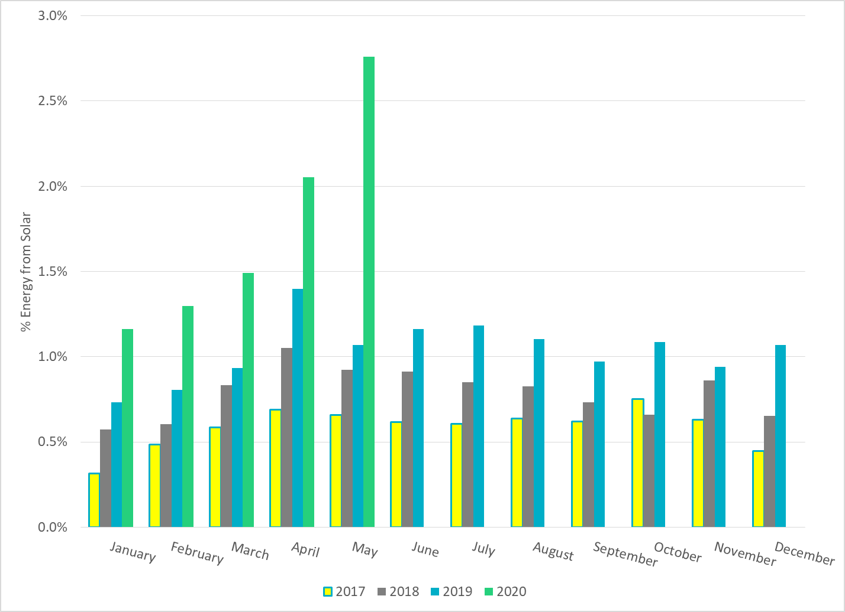
% Energy from Solar Generation
Notes:
2.76%

Slide 26
ERCOT System Inertia

Slide 27
Daily Minimum System Inertia
Notes:
Minimum Inertia = 131,096 MW*s on 5/1/2020
Previous Minimum was 128,759 MW*s on 11/18/2018.
Data:
Mean: 192,543
Max: 235,009 on May 29th
Min: 131,096 on May 1st

Slide 28
Questions?
Thank you!

