Slide 1
Resource Definition Task Force Final Report
06/11/2020

Slide 2
Accomplishments
Eliminated:
Modeled/Non-Modeled Non-Modeled/Non-Modeled
“All Inclusive Generation” – Exclusions
Did not create:
Registered/Registered Registered/Non-Registered
NERDs Non-ERCOT Registered Device
Remaining Items
Approval of NPRR 995 – no additional RTF Input Needed
Approval of a yet to be published NPRR (RTF-5) to replace unregistered distributed generation (“Non-Settled”) – ERCOT Sponsored –– RTF Input received by ERCOT – no further requirements for RTF
Possible New NPRR (RTF-3) to establish Basic Load Resource – RTF Input received by ERCOT – no further requirements for RTF

Slide 3
Resource Definition Task Force
“The purpose of the Resource Definition Task Force (RTF) is to formalize (through the initiation of appropriate Protocol and Guide changes after appropriate consideration of PUCT rules, NERC Reliability Standards, Protocols, and Operating Guides) the terms and requirements for classifying the different types of generation in the ERCOT region.”
While the protocols will continue to evolve, the problematic terms have been resolved.
The RTF has completed its work and may now be dissolved.

Slide 4
Total Framework

Slide 5
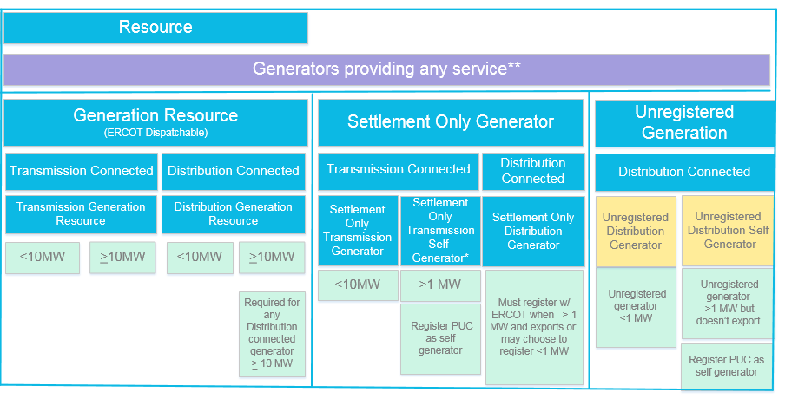
Generation Framework Status
RTF
RTF-1
NPRR 889
11/1/19
RTF-5
Pending
ERCOT

Slide 6
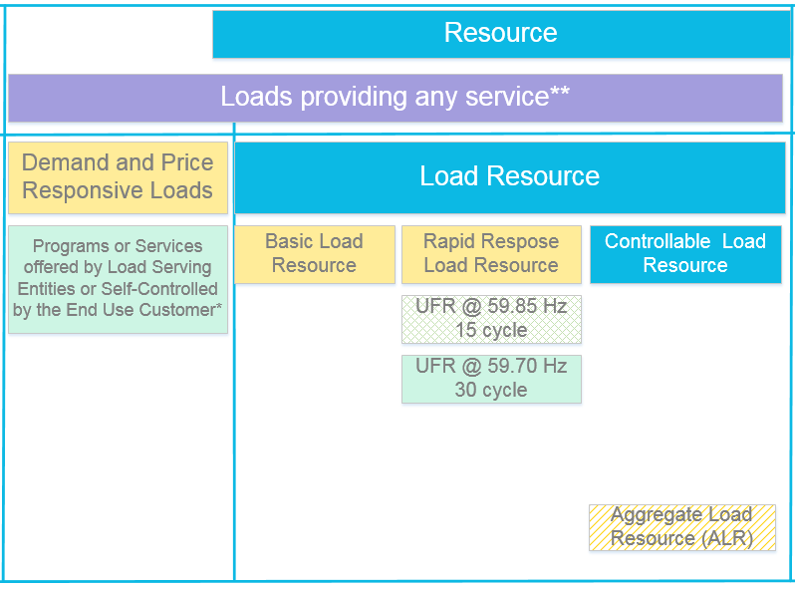
Load Framework Status
Future?
ERCOT Sponsored?

Slide 7
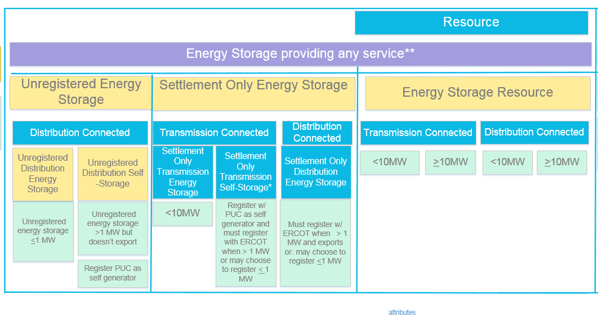
Energy Storage Framework Status
RTF
RTF-4
NPRR 957
12/10/19
RTF-6
NPRR 995
@ WMS/BESTF

