Slide 1
Defining Solar Regions
In ERCOT
ROS
Sean Chang
Sandip Sharma
Operations Planning
April 4, 2019

Slide 2
Introduction
Presented proposed solar regions at 3/7/19 ROS
Stakeholders asked for more information:
Market impacts
Data used to determine regions
Different number of regions
Zone names

Slide 3
No Market Impacts
No pricing impacts
No changes to any of the Hub / Load Zone definitions
No reporting impacts unless stakeholders want to eventually see forecast report similar to wind forecast report by wind regions
Used solely in Operations to characterize solar generation profile and forecasts
Seeking collective stakeholder wisdom for an internal process

Slide 4
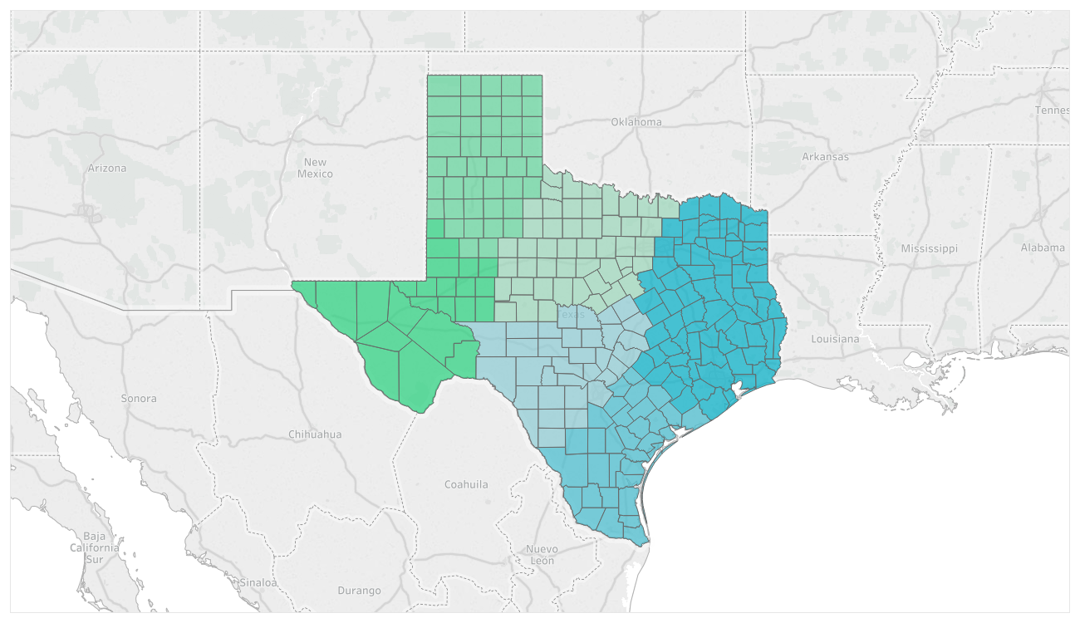
Proposed Solar Regions
Zone 5
Zone 4
Zone 6
Zone 1
Zone 3
Zone 2
Notes:
Includes only installed capacity

Slide 5
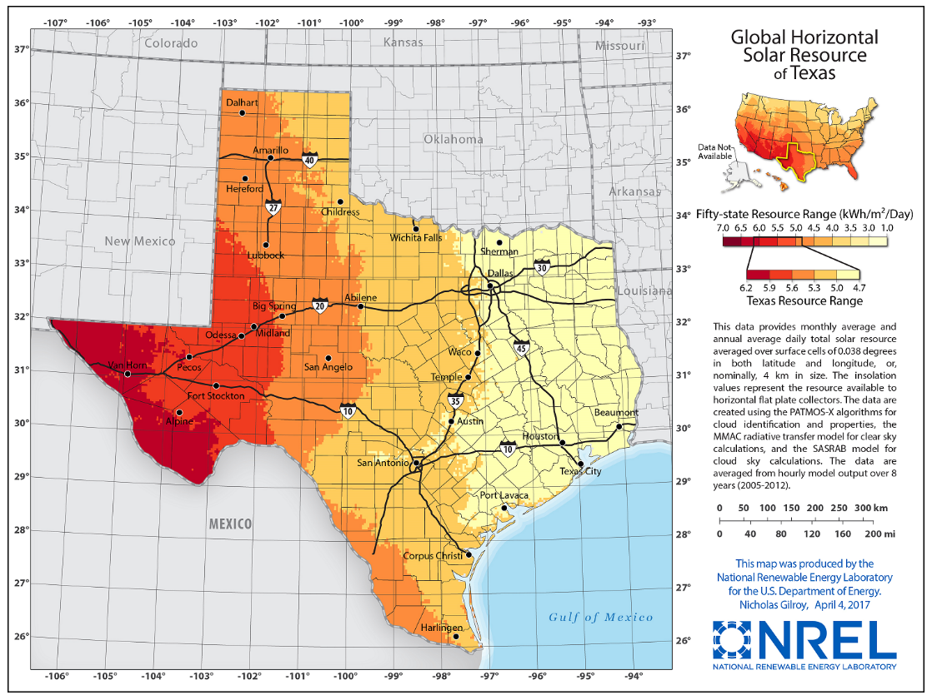
Global Horizontal Irradiance in Texas (NREL)
Source: https://www.nrel.gov/gis/solar.html

Slide 6
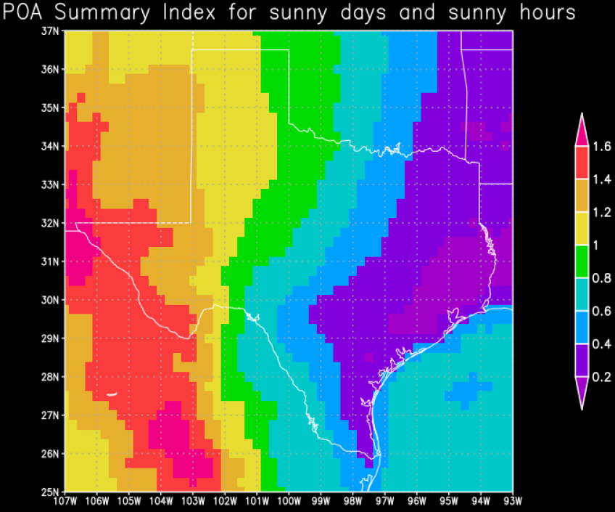
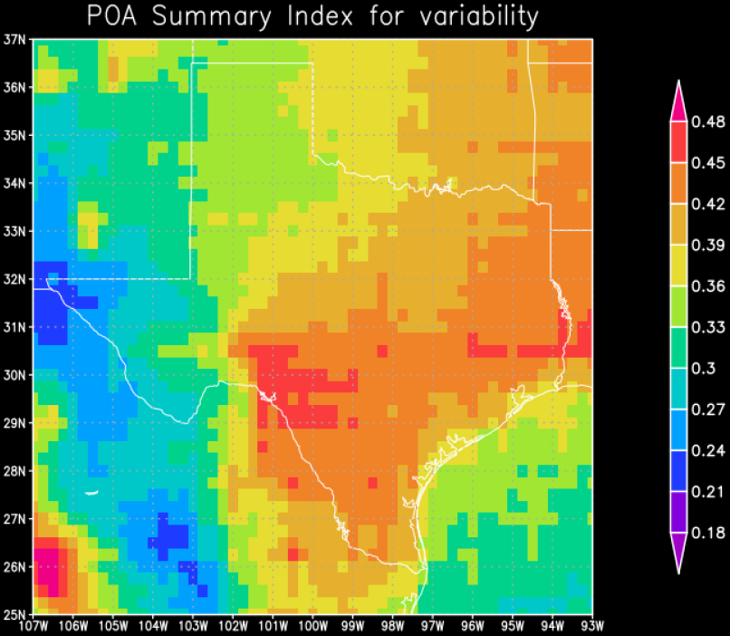
Irradiance Analysis from Solar Vendor
Solar vendor analysis uses Plane of Array (POA) to represent single axis trackers on north-south axis typical of utility-scale farms over a 16-year sample
Irradiance
Variability

Slide 7
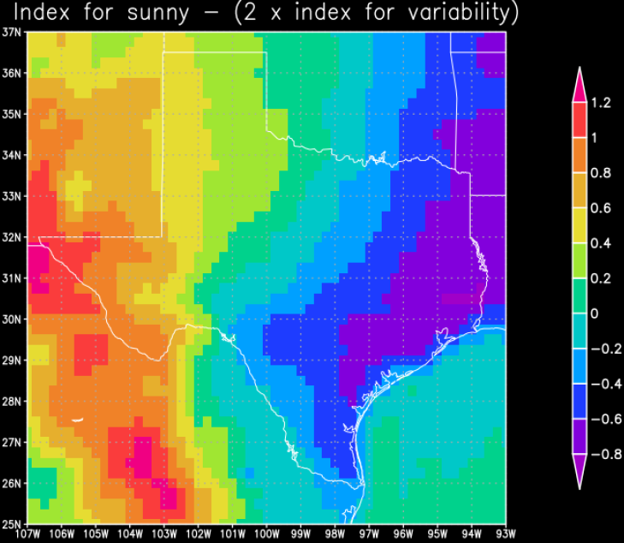
Irradiance Analysis from Solar Vendor
Solar vendor iteratively grouped each Texas county into different zones following the contours of the index below. Multiple zone number combinations were created.
Irradiance & Variability Indices Combined

Slide 8
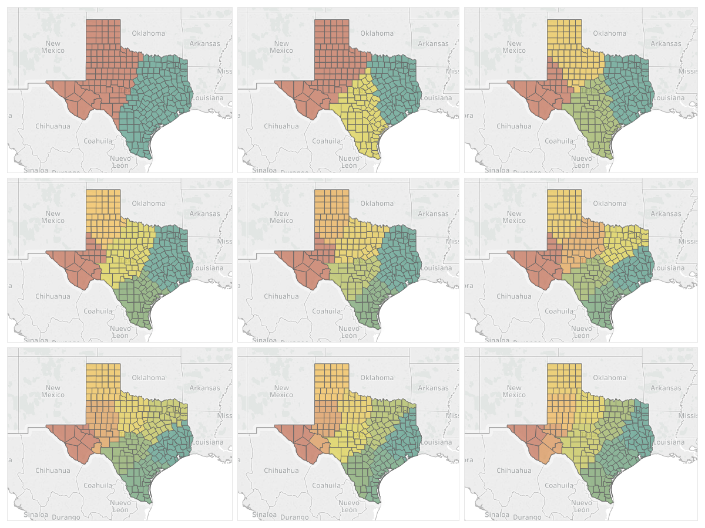
Different Numbers of Regions (2-10 Regions)

Slide 9
Proposed Solar Regions
Zone 1
Panhandle
S_PNHNDL
Zone 3
North Central
S_NCENT
Zone 5
East
S_EAST
Zone 2
West
S_WEST
Zone 4
South Central
S_SCENT
Zone 6
South
S_SOUTH
Notes:
Includes only installed capacity

Slide 10
Appendix

Slide 11
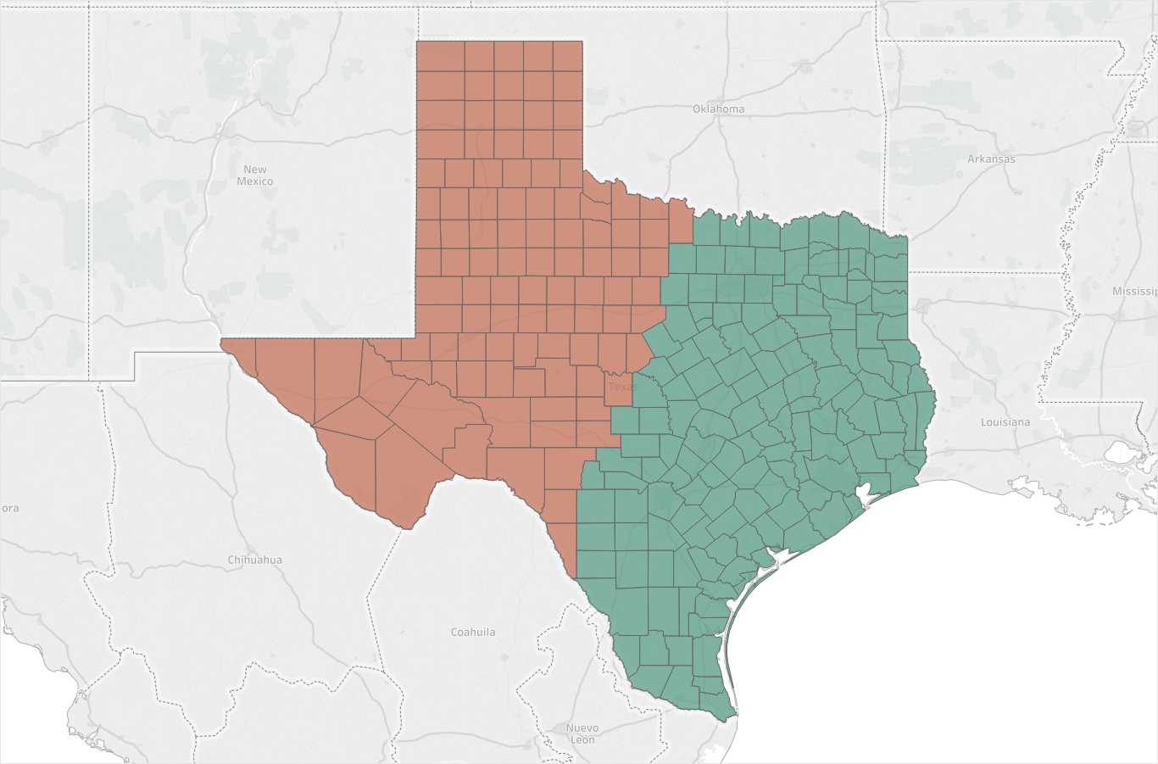
2 Regions

Slide 12
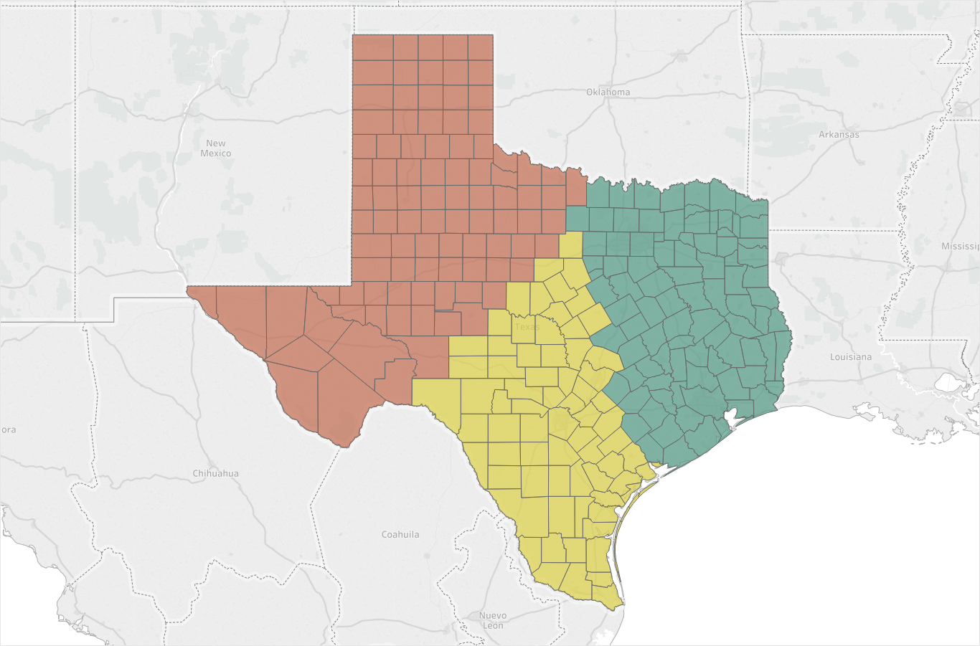
3 Regions

Slide 13
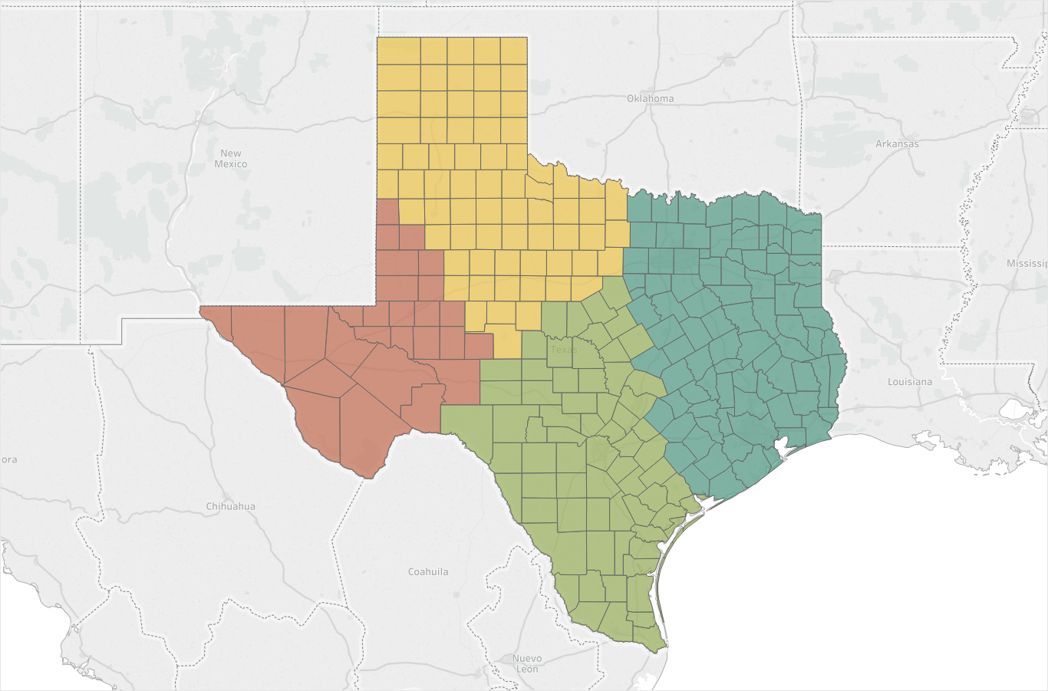
4 Regions

Slide 14
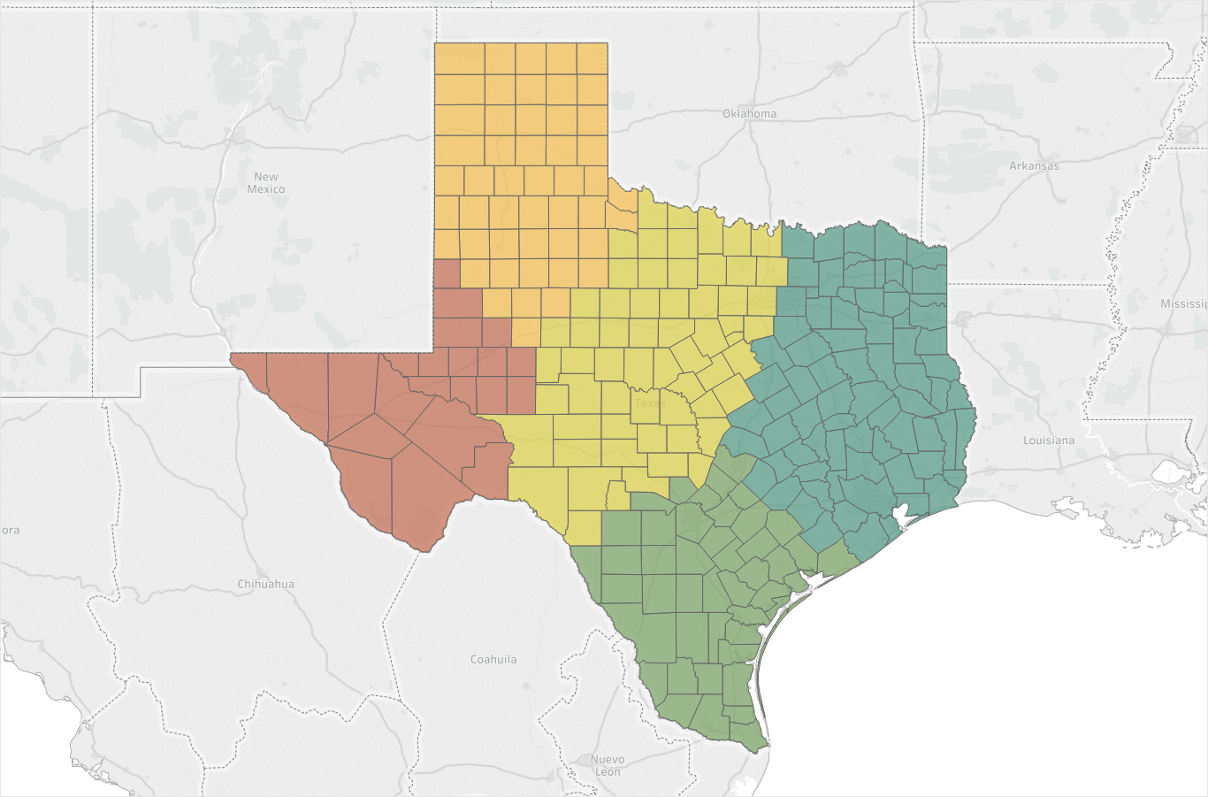
5 Regions

Slide 15
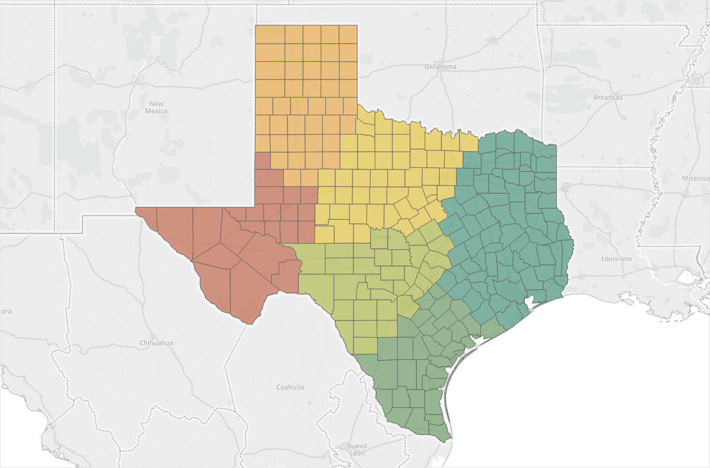
6 Regions

Slide 16
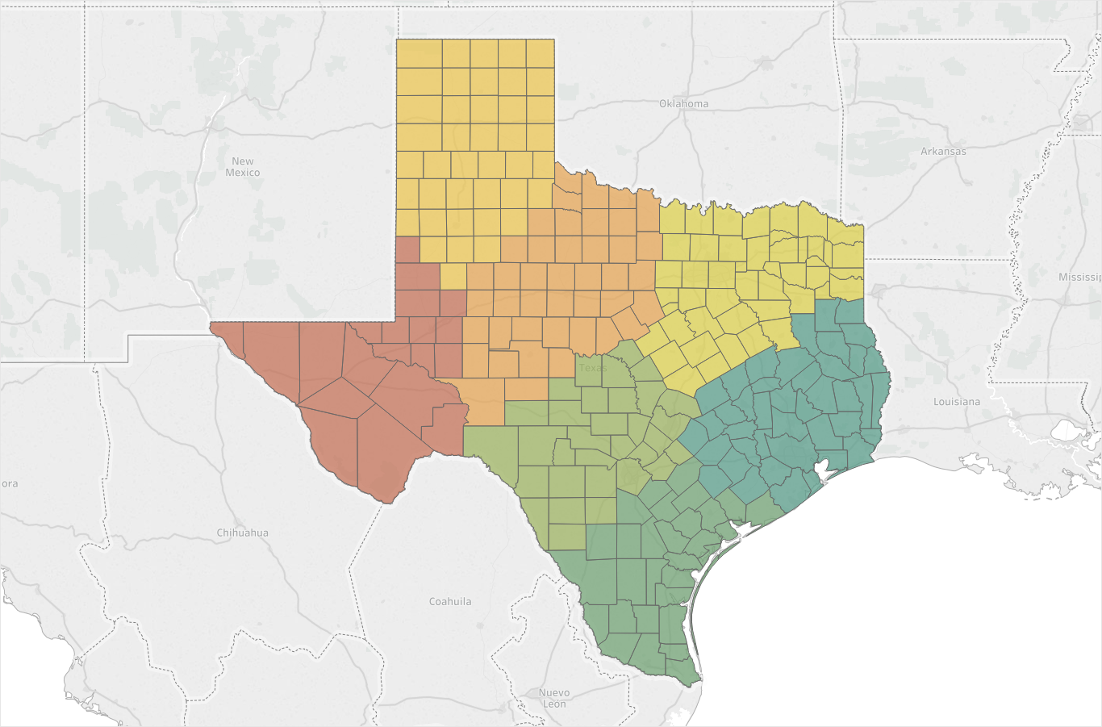
7 Regions

Slide 17
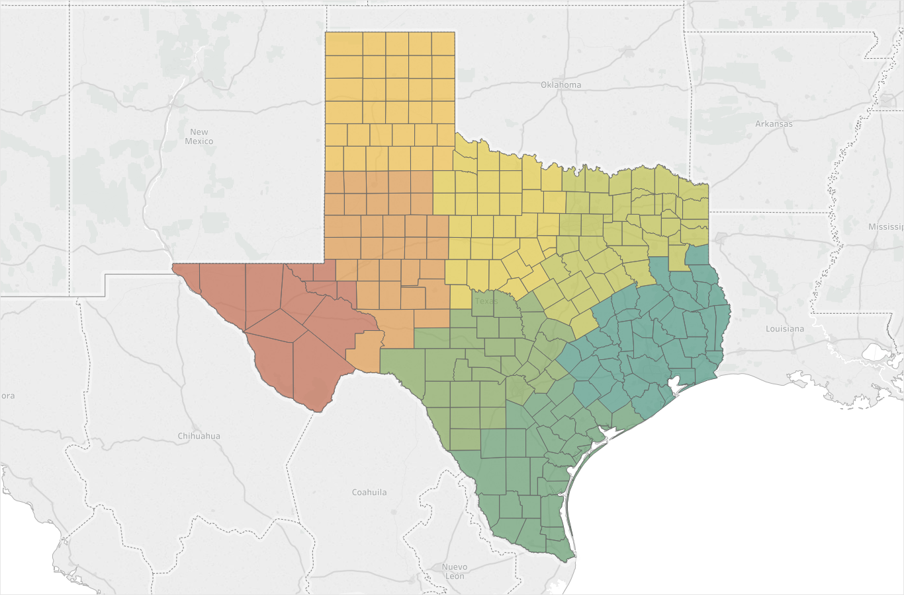
8 Regions

Slide 18
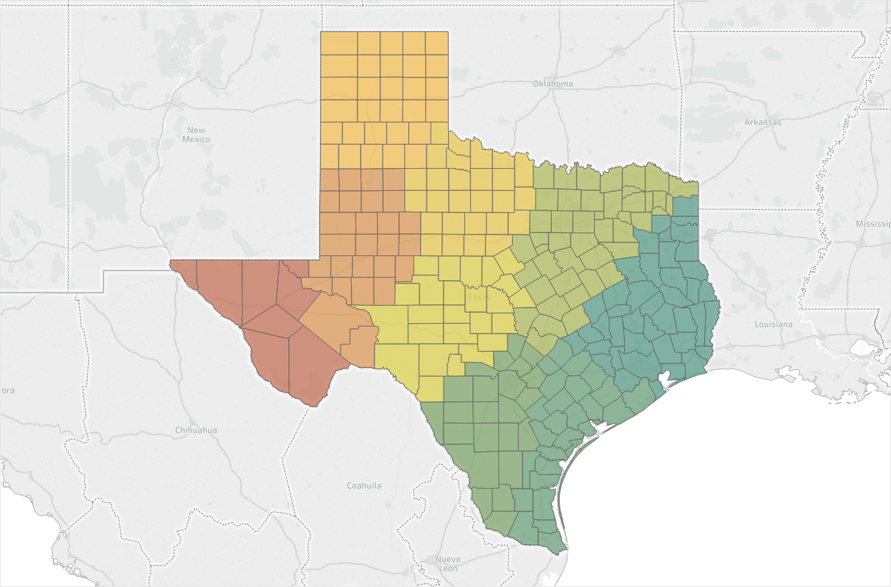
9 Regions

Slide 19
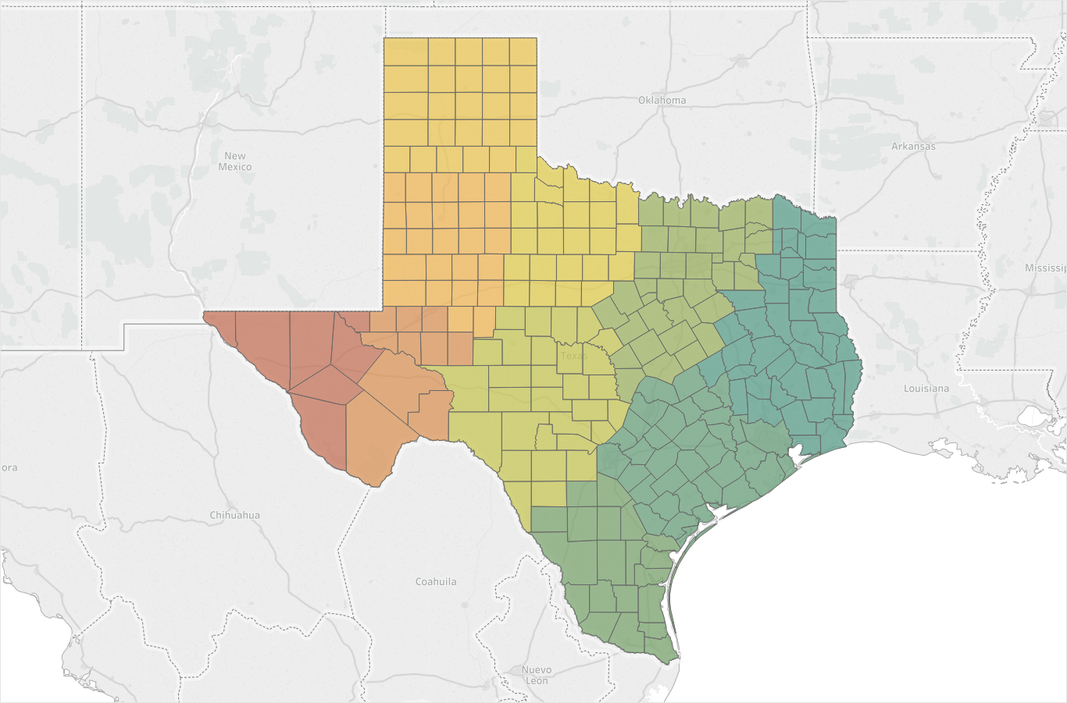
10 Regions

