Slide 1
Market Credit Working Group update to the Wholesale Market Subcommittee
Bill Barnes, NRG, Chair
Josephine Wan, Austin Energy, Vice Chair
6/03/2020

Slide 2
MCWG update to WMS
General Update
May 19 Joint MCWG/CWG WEBEX Meeting
4 NPRRs reviewed for their credit impacts (email vote)
933NPRR Reporting of Demand Response by Retail Electric Providers and Non-Opt-In Entities – No Credit Impact
1000NPRR Elimination of Dynamically Scheduled Resources – No Credit Impact
1021NPRR Adjustments to the Default Uplift Invoice Process – Positive Credit Impact. 1021 will accelerate the default uplift process to address potential cash flow issues for Market Participants if defaults occur.
1022NPRR Submission of Banking Information – No Credit Impact

Slide 3
MCWG update to WMS
Late Payment Enforcement Provisions
The potential conflict with the SFA could be addressed by:
Removing the termination option for Level III Enforcement
Providing graduated penalties for Level III Enforcement
This also eliminates the “do nothing” option for the first late payment.
Late Pmt. | Existing Enforcement Provisions |  |  | Proposed Enforcement Provisions
1 | Review, or | Level I Enforcement | Increase to or provide 110% collateral for min. 60 days | Level I Enforcement | Increase to or provide 110% collateral for min. 60 days
2 | Level I Enforcement, or | Level II Enforcement | 110% collateral in cash or LC for 60 days | Level II Enforcement | 110% collateral in cash or LC for 60 days
3 | Level II Enforcement, or | Level III Enforcement | Warning or terminate SFA | Level III Enforcement | 120% collateral in cash for 90 days
4 | Terminate SFA |  |  | Terminate SFA

Slide 4
MCWG update to WMS
Credit Exposure and Reporting Changes
NPRR887, Monthly Posting of Default Uplift Exposure Information
NPRR907, Revise Definition of M1a to Reflect Actual Calendar Days
NPRR985, Modify Forward Adjustment Factors to Include Pricing for the Current Operating Day
Letter of Credit Concentration Report – will post in PDF/Excel
http://www.ercot.com/content/wcm/key_documents_lists/192858/Item_5_NPRRs_887.907.985.pptx

Slide 5
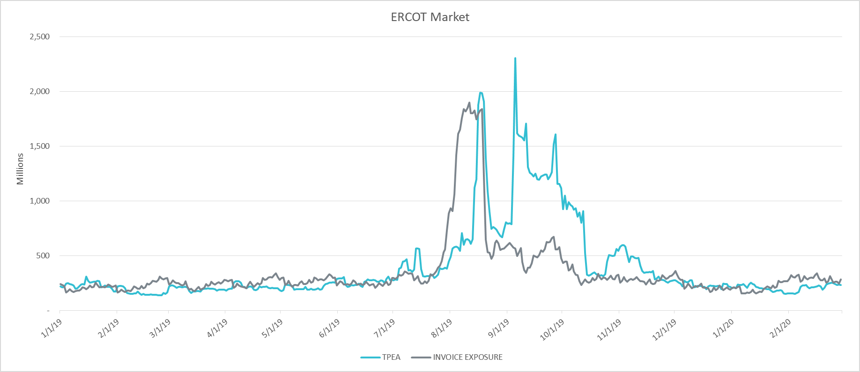
MCWG update to WMS
TPE (Credit Exposure) Coverage of Settlements Jan 2019-Feb 2020

Slide 6
MCWG update to WMS
AMS/IDR Workshop 6/1/20
Settlement Timeline Workshop 6/2/20

