Slide 1
Settlement Timeline Credit Impact
Spoorthy Papudesi
ERCOT Public
May 5, 2020

Slide 2
Modifications to existing Parameters
  For ”x” day reduction in Settlement Timeline,
      RTLCNS included 5-x days of estimates
      M1 value decreased by x
      -Impacts MAXRTLE and DALE
      M2 value decreased by x
      -Impacts MAXURTA

Slide 3
Impact of settlement timeline reduction on TPE
*Base TPE as of 02/13/2020 is considered

Slide 4
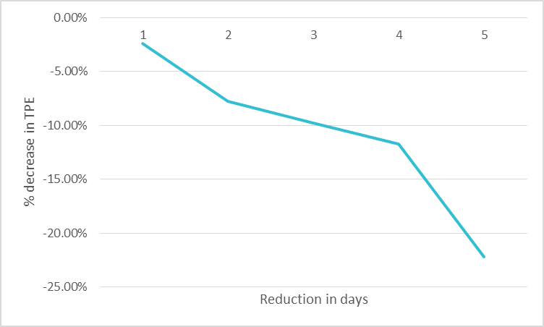
Impact of settlement timeline reduction on TPE
*Base TPE as of 08/13/2019 is considered

Slide 5
Questions

