Slide 1
Distributed Energy Resource (DER) System Impact Analysis to the ERCOT Grid
Dynamic Voltage Stability Assessment and Frequency Response Study Summaries
June 04, 2019

Slide 2
Background
Historically, DERs could be ignored in transmission system studies due to low levels.
With a rapid proliferation of DERs, areas such as Europe, California and Hawaii have learned the importance of having them support grid reliability.
DER ride-through allows distribution-level resources to continue to operate and support the grid during transmission system disturbances.
Note that DER trip requirements for distribution-level issues such as faults or opens take precedence over ride-through requirements.
Two ways that DER ride-through can benefit the ERCOT system are:
Improves voltage and frequency stability
Provides dynamic reactive support by offsetting native load

Slide 3
Background – cont’d
ERCOT is a single Interconnection, and inertia frequency and voltage stability has always been a reliability concern.
As a result, ERCOT began requiring transmission-connected renewables to provide voltage and frequency ride-through.
ERCOT has experienced a decrease in inertia which typically increases the need for frequency ride-through
ERCOT performed these studies as background to consider impacts of new ride-through proposed by IEEE.
This informed ERCOT for the rules proposed in NOGRR212 for DGR/DESR.
Shared results with TDSPs earlier this year for feedback and now bringing to ROS to share results.
Other ISOs and regions are doing similar studies working with NERC SPIDER Working Group and reporting similar benefits to adopting IEEE1547-2018.

Slide 4
Current PUCT Rule for DER Voltage and Frequency

Slide 5
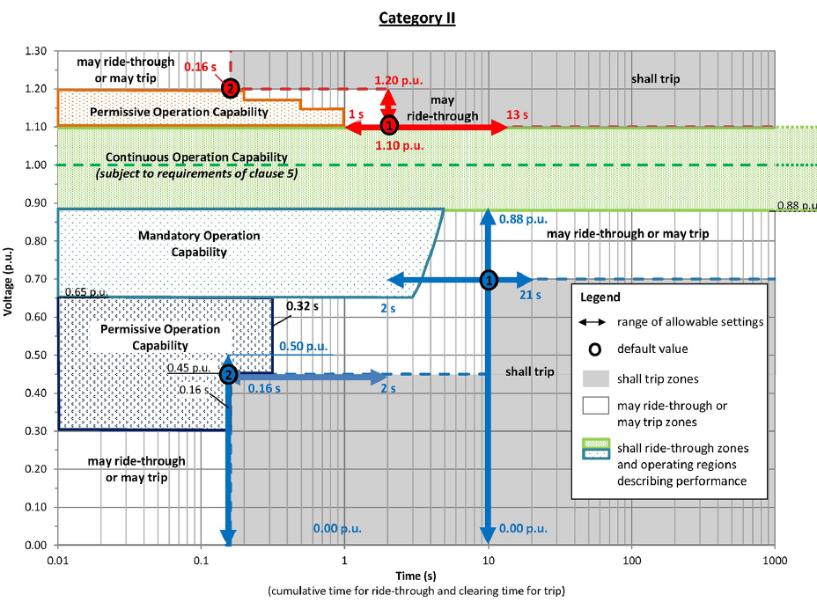
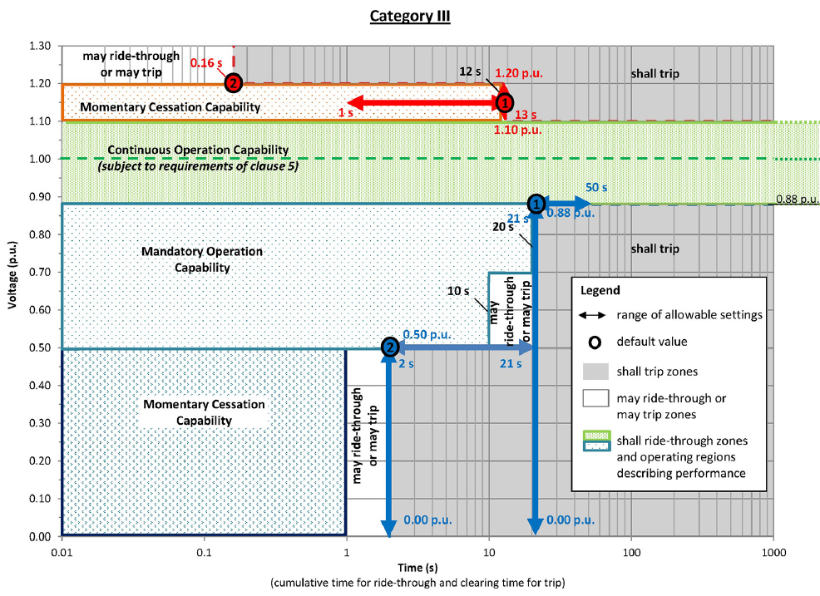
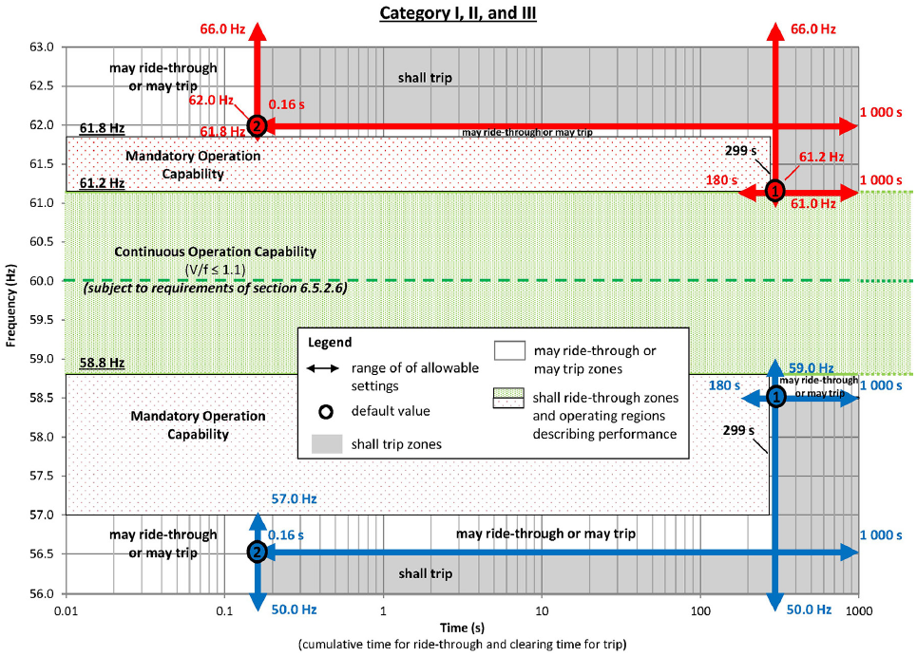
IEEE 1547-2018 Voltage and Frequency Requirements
Longer ride-through for voltage below – 30%
Longer ride-through for voltage below – 30%
Longer ride-through for Frequency below - 0.7 Hz

Slide 6
ERCOT Studies
ERCOT conducted two studies to compare DER system impacts.
Both studies assumed PUCT rule §25.212 as a standard and the IEEE 1547-2018 as a standard.
Study 1 - Analyze transmission impacts for dynamic voltage stability perspective.
Reactive Power: Modern technologies, including inverters for new rooftop solar PV installations, will have the capability to support voltage and ride-through voltage excursions under new IEEE1547-2018.
Study 2 - Analyze system impacts for frequency stability perspective.
Frequency Ride-Through: DERs are not coordinated with the voltage and frequency ride-through requirements of transmission-connected resources. As DERs are added to the system, frequency ride-through capabilities become important due to decreasing inertia.

Slide 7
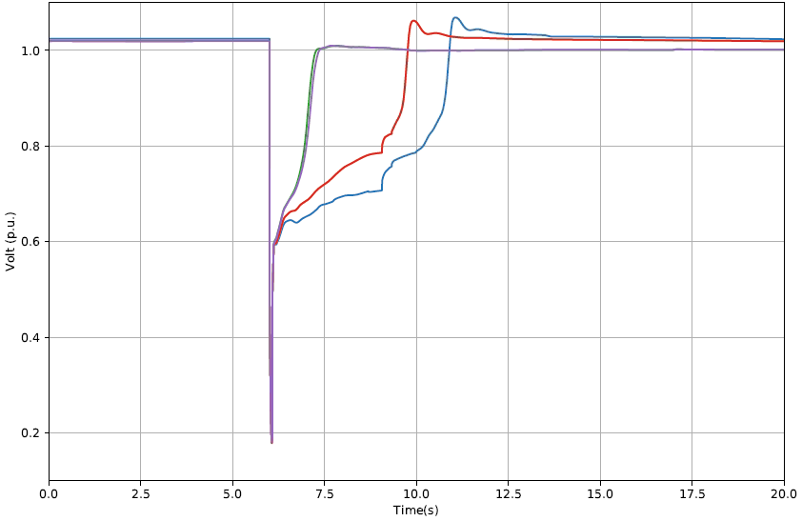
Voltage Recovery for Different DER Categories
5% DER penetration in Rio Grande Valley region
Net load was 3,150 MW, gross load was 3,308 MW
Fault is applied
Existing PUCT VRT Requirements. 229 MW UVLS
IEEE 1547-2018 Cat II or III VRT Requirements with Dynamic Voltage Support . No UVLS
IEEE 1547-2018 Cat II or III VRT Requirements. 194 MW UVLS
Recovery Voltage
Recovery time

Slide 8
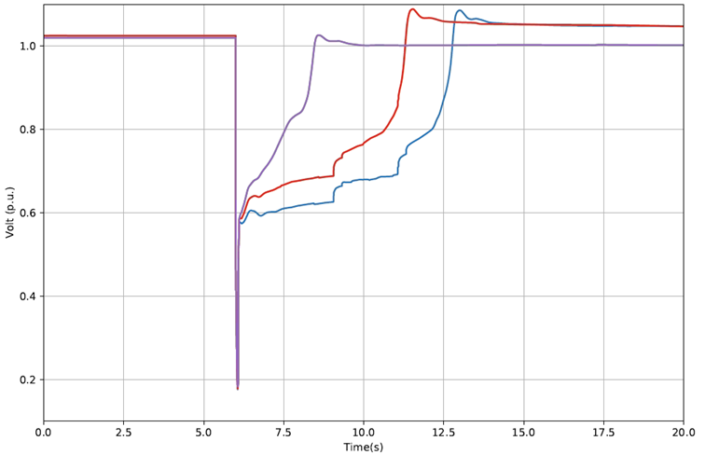
Voltage Recovery for Different DER Categories
10% DER penetration Rio Grande Valley region
Net load was 3,150MW, gross load was 3,465 MW
Fault is applied
Existing PUCT VRT Requirements
525 MW UVLS
IEEE 1547-2018 Cat II or III VRT Requirements with Dynamic Voltage Support. No UVLS
IEEE 1547-2018 Cat II or III VRT Requirements.
375 MW UVLS
Recovery Voltage
Recovery time

Slide 9
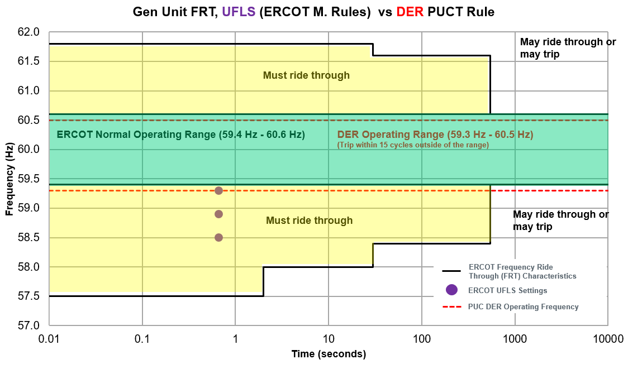
Comparison of Applicable Operating Frequency Rules
Notes:
PUCT DG trip time is at 15 cycles,.
Note the adoption of IEEE-1547 shown in slide 4 would allow DG to ride through frequency well below all 3 stages of UFLS and provide comparable ride-through as the current protocols currently do as shown on this slide. This slide just points out the current issue which the studies ended showing which was that DG tripping can trigger UFLS or reduce its effectiveness.

Slide 10
Frequency Response Studies Under Current Rules
UFLS trip (@59.3 Hz, 5% Load) + 2,500 MW DER trip (@ 59.3Hz) + UFLS trip (@58.9 Hz, 10% Load)
Loss of 3,421 MW generation
UFLS trip (@59.3 Hz, 5% Load) and no DERs tripping at 59.30 Hz
Study Setup:
Inertia: 130 GWs
RRS: 1,150 MW from Generation Resources
1,900 MW Load Resources
UFLS trip (@59.3 Hz, 5% Load) + 1,500 MW DER trip (@ 59.3Hz)
Study 1: Large event - Is ERCOT’s UFLS still effective in recovering frequency as DER penetration increases to 1,500 MW?
Study 2: Large event - What are impacts to ERCOT’s UFLS in recovering frequency as DER penetration increases to 2,500 MW?

Slide 11
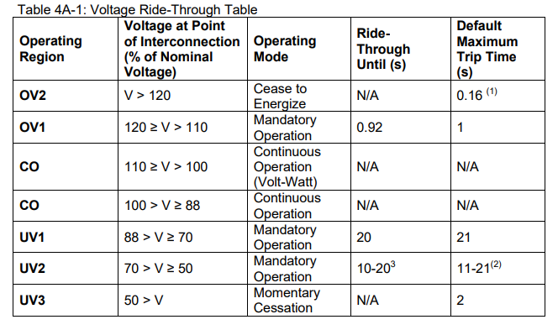
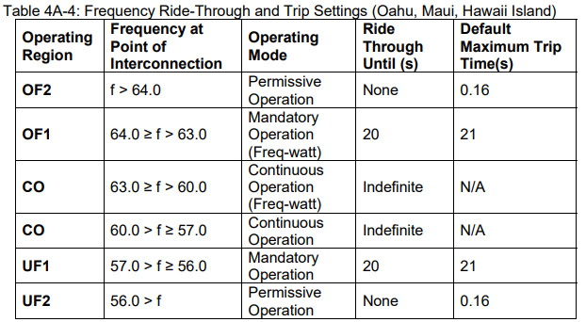
Reference of IEEE-1547 Timeline vs. Hawaii Grid Code for DER
https://www.hawaiianelectric.com/Documents/clean_energy_hawaii/list_of_advanced_legacy_equipment.pdf
Notes:
Hawaii already has grid code for DER which match 1547 ride-through also has list of inverters certified to meet their rule 14 grid code.
IEEE 1547.1-2020 was published today May 21, 2020

Slide 12
Takeaways
DER Voltage and Frequency Ride-Through is needed going forward.
The IEEE 1547-2018 voltage ride-through requirements support voltage stability and increase reliability benefits at higher penetrations of DER.
More improvements can be obtained if DERs also provide dynamic voltage support. This would go beyond currently proposed DGR/DESR requirements. (NPPR1016 requirements).
Inverter-based DERs technically do not have any physical necessity to trip on a low frequency deviation.
The IEEE 1547-2018 requirements provide better alignment with existing generator ride-through.
As DER penetration increases, IEEE 1547-2018 reduces unnecessary DER tripping and avoids negative impact of Under Frequency Load Shed.
ERCOT recommends adopting IEEE1547-2018 along the timeline proposed by IEEE.
Notes:
Note this Dynamic Voltage support may require some coordination and study by TDSPs. Currently ERCOT see improved performance if Dynamic Voltage Support is provided but some detailed studies that look at Distribution voltage management would be needed to understand the degree of this support that could be used without impacting normal DSP voltages. As Dynamic Voltage support is not the same as steady state further studies from DSPs would be beneficial.

