Slide 1
SARA Probabilistic Model, Final
Supply Analysis Working Group
Pete Warnken
Resource Adequacy
May 28, 2020
Notes:
Welcome to

Slide 2
Model Updates

Slide 3
Model Updates Since the Last SAWG Call
New 1980-2019 UL hourly wind profiles with temporal correlations for HE 1:00 pm – 8:00 pm
  Aggregated profiles to account for all operational and planned resources in the Final Summer SARA report
  Accounted for solar SODGs in the profiles by scaling up based on fleet average capacity factors and total SODG nameplate MW
Incorporated probabilistic modeling for certain capacity categories available during EEAs:
  Switchable Generation Resource (SWGRs) units for which SPP is the current “Controlling Party,” but can be requested by ERCOT during an Emergency Condition
  Remaining DC tie capacity above the 850 MW expectation, which is based on the CDR methodology
Updated operational thermal and hydro capacity to match the Final Summer SARA

Slide 4
Model Updates Since the Last SAWG Call
Incorporated probabilistic modeling of utility-scale solar output, using the new UL hourly solar profiles for 1980-2019 and temporal correlations
Included ERS procurement capacity for the June-September 2020 Standard Contract Term, covering TP3-5 (1:00-10:00 pm)
Incremental rooftop solar PV updated based on the “Moderate” penetration scenario reported in the May CDR

Slide 5
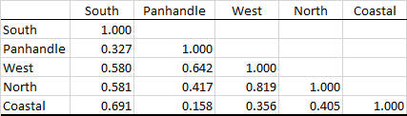
Wind Profile Correlation Coefficients by CDR Zone
Correlations are for summer hours,1:00 pm - 8:00 pm
As expected, correlations are higher between bordering CDR Zones
No strong positive or negative correlations between Panhandle/West and Coastal Zones – no need to model separate wind zones with spatial correlations

Slide 6
Wind Aggregate Distributions for Each Hour
Hour Ending 1:00 pm
Hour Ending 5:00 pm
Hour Ending 2:00 pm
Hour Ending 6:00 pm
Hour Ending 3:00 pm
Hour Ending 7:00 pm
Hour Ending 4:00 pm
Hour Ending 8:00 pm

Slide 7
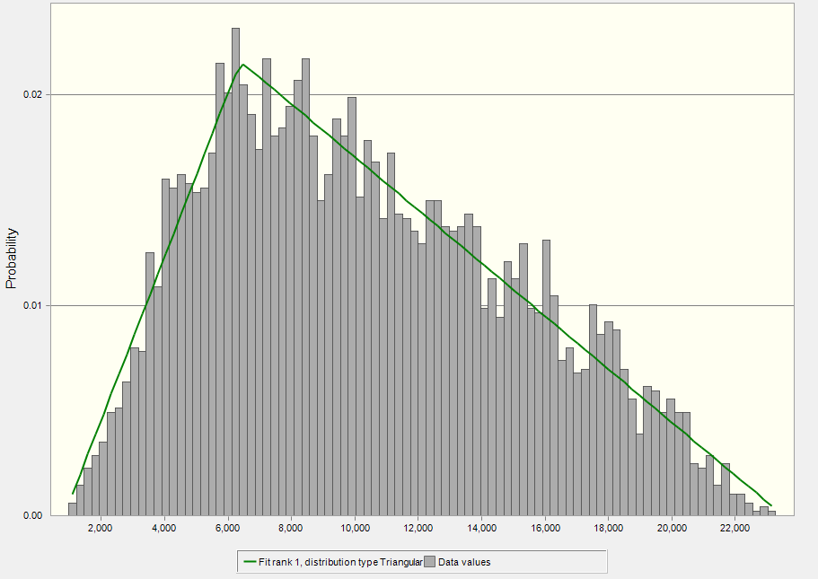
Fitted Distribution for Aggregate Wind Profile, HE 7:00 pm

Slide 8
Solar Aggregate Distributions for Each Hour
Hour Ending 1:00 pm
Hour Ending 5:00 pm
Hour Ending 2:00 pm
Hour Ending 6:00 pm
Hour Ending 7:00 pm
Hour Ending 3:00 pm
Solar output is zero for much of September, HE 7:00 pm, necessitating a custom distribution with many zero values and a long tail
Hour Ending 4:00 pm

Slide 9
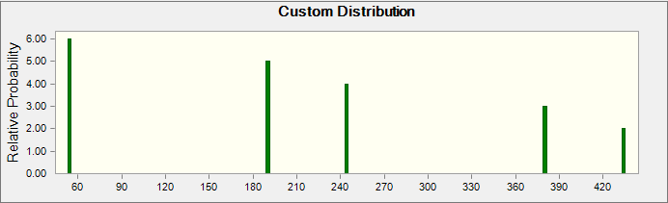
Modeling of Unavailable SWGR Capacity

Slide 10
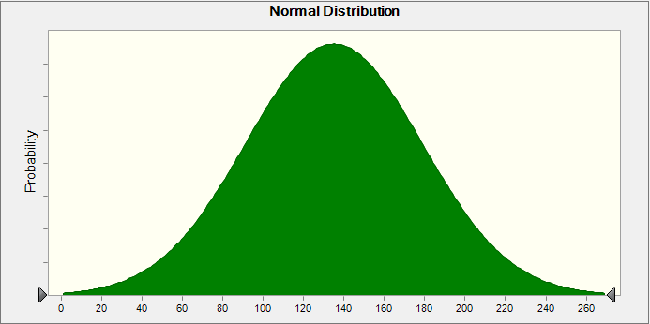
Modeling of Incremental DC Tie Capacity
Summer CDR DC Tie capacity is 850 MW based on actual net imports during summer 2019 EEA events
Maximum amount of incremental DC Tie capacity that could be released under Emergency Conditions: 270 MW
  Accounts for retirement of 30 MW Eagle Pass tie
Assume incremental capacity is normally distributed with a mean of 135 MW; expected value for total available DC tie capacity during EEAs is therefore 985 MW

Slide 11
Simulation Results

Slide 12
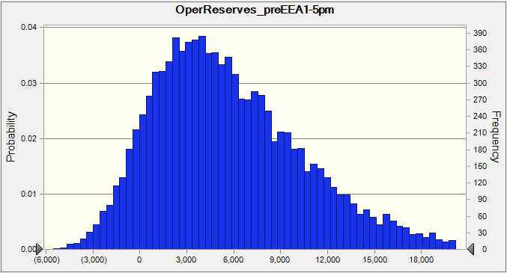
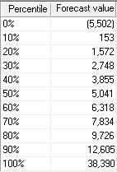
“Capacity for Operating Reserves” Outcome Distribution, HE 5:00 pm – 10,000 Trial Simulation
50th percentile (P50) value is 5,041 MW; Final Summer SARA “Base Case” value is 4,069 MW
Simulation Outcome Range: 38,390 MW to -5,502 MW
SARA Deterministic Scenario Outcome Range: 4,069 MW to -23,374 MW; does not consider favorable scenarios

Slide 13
Hourly Risk Profiles by Load Forecast

Slide 14
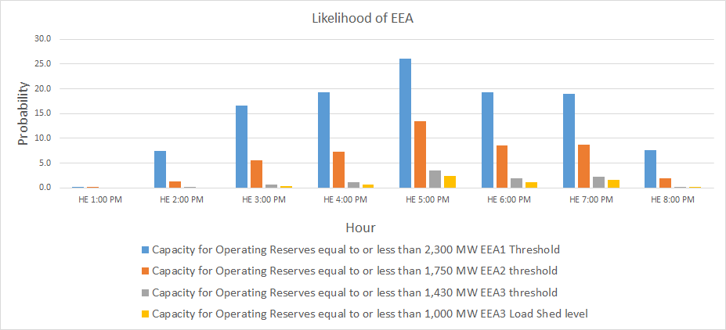
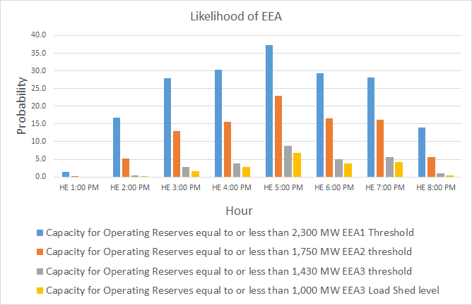
Hourly Risk Profile, COVID-19 Impact Load Forecast
Original Load Forecast

Slide 15
Probabilistic Variable Sensitivity Analysis
The table below provides, for each probabilistic variable, the percentage contribution to the overall variance in simulated “Capacity for Operating Reserves” for HE 5:00 pm
Wind overwhelmingly dominates the variance in a positive direction; forced outages and demand have a small negative impact; the other variables have a negligible impact

Slide 16
Model vs. Final Summer SARA Reconciliation

Slide 17
Findings and Conclusions
Relative to the traditional SARA report, probabilistic modeling demonstrates the impact of considering joint probabilities of risk variables and a full range of capacity reserve outcomes
Wind output, by far, is the most important EEA risk determinant
  While low wind output is the dominant EEA risk factor, it is also common for high wind outcomes to more than compensate for extreme peak load/outage outcomes
EEA risk is roughly symmetrical for hours before and after HE 5:00 pm
~1,500 MW summer peak load reduction, due to COVID-19, reduces the probability of EEA events by 12 percentage points for HE 5:00 pm (38% to 26%)
  EEA risk reduction, on a percentage basis, is greater for other hours
  Probability of an EEA load shed event for HE 5:00 pm drops from 6.9% to 2.4%

