Slide 1
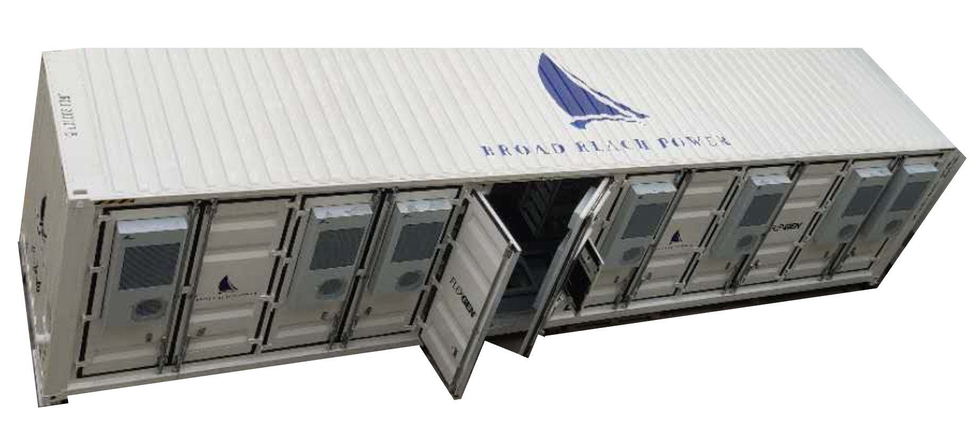
Broad Reach Power
If ERCOT and the PUC agree that certain of Energy Storage System (ESS) loads qualify for Wholesale Storage Load (WSL)
Treatment. Broad Reach request that such treatment be applied equally to all ESS based on the specific functions
and operation under consideration.
Thermal roof & enclosure
sides and doors; meets
IP 66 and NFPA 855
requirements
Flexible architecture: battery
only or integrated battery &
power electronics in single
containerized unit
HVAC/thermal
Control units
Battery/inverter module bays

Slide 2
Broad Reach Power
It is important that ERCOT remain technology and design neutral and focus on the grid operational needs not on a specific technology or product design.
Broad Reach understood that ERCOT required separate metering of all loads and configured its batteries to meet those requirements.
All batteries generate heat during charging and discharging, without thermal management those batteries would be destroyed in hours.
ESS thermal management and control systems are essential to the existence of a battery. Thermal cooling and power electronics exist for the sole purpose of returning power to the grid. As such thermal and power electronic loads are .
Broad Reach fully appreciates and realizes other ESS site specific loads will be Auxiliary Load (site lighting, physical security, etc.) and those loads will pay a retail rate.
Our systems can be re-configured to accept WSL treatment of loads under the one container concept. Others may have a more difficult time reconfiguring their designs.
Broad Reach encourages both ERCOT and Market Participants to focus on operational considerations as they impact the grid and not behind the meter design choices.
Broad Reach, Enel and Able Grid have filed comments on NPRR that extend WSL treatment to the thermal and power electronic loads to all batteries.

