Slide 1
Reactive Study Requirements version 10:
Nodal Protocol 3.15 and
approved NPRR 849
Resource Integration
May 22, 2020

Slide 2
New term in v10 of the Reactive Study Guide
Low Output Point (LOP) =
Low Sustainable Level (LSL) for conventional generators;
10% of maximum real power output (HSL) for Intermittent Renewable Resources;
Low Sustainable Level (maximum charging) for Energy Storage Resources

Slide 3
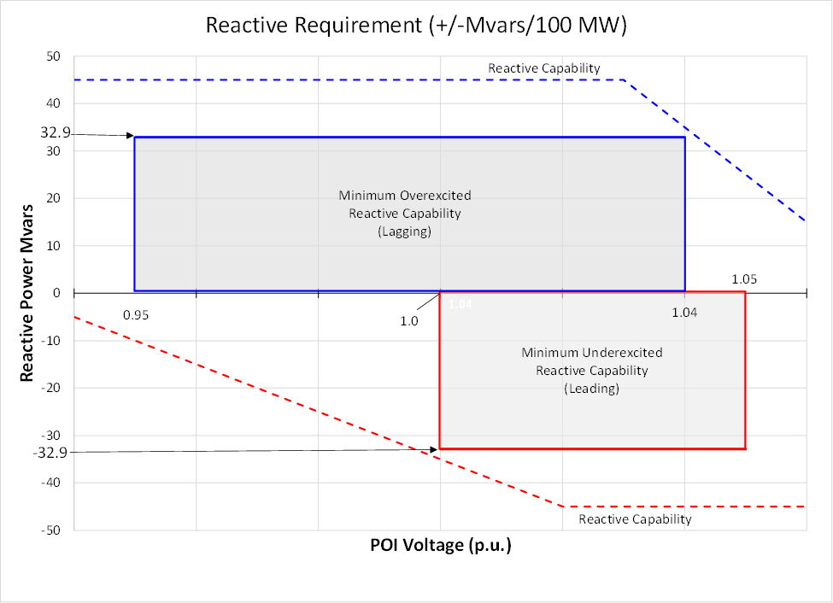
Reactive Requirement at the POI, Mvars per 100 MW

Slide 5
Table 1: Reactive Device Inventory
Generation Resource High Sustained Limit, net power deliverable to POI: _________ MW.
Generation Resource LOP net power deliverable to POI: _________ MW.
Required VAR capability @ POI, calculated as 32.9% of HSL: ± ______MVAr.
Inventory total gross reactive capability (nominal, @ device terminals, excluding losses):
  Generating Units (LOP): _______ MVAr lag / _______ MVAr lead
  Generating Units (HSL): _______ MVAr lag / _______ MVAr lead
  Switchable Shunts: _______ MVAr lag / _______ MVAr lead
  Aux Dynamic Devices (SVC, STATCOM): _______ MVAr lag / _______ MVAr lead
  Grand Total (add #2, 3, 4): _______ MVAr lag / _______ MVAr lead
  Total Dynamic at LOP (add #1, 4): _______ MVAr lag / _______ MVAr lead
  Total Dynamic at HSL (add #2, 4): _______ MVAr lag / _______ MVAr lead
The overload rating of the STATCOM can be used on this line. If so, provide documentation from the manufacturer stating the overload multiplier and how many cycles or seconds that overload can be sustained.

Slide 6
Table 2: Study Results
POI Vol-tage | Dis-patch | Reactive Test | MW Real Power Delivered to POI | Mvar Reactive Power Delivered to POI | Shunts in Service (+Mvar cap, or -Mvar react) | Total Mvars at all turbine or inverter terminals | Lowest voltage at turbine or inverter terminals, pu | Highest voltage at turbine or inverter terminals, pu
0.95 pu | HSL | Max Lagging |  | +
 | LOP | Max Lagging |  | +
1.00 pu | HSL | Max Leading |  | –
 | LOP | Max Leading |  | –
1.04 pu | HSL | Max Lagging |  | +
 | LOP | Max Lagging |  | +
1.05 pu | HSL | Max Leading |  | –
 | LOP | Max Leading |  | –

Slide 7
Required Documentation
  Description of resource that matches RARF, RIOO, and the IA
  Description of the resource connection to ERCOT, including at least:
    POI bus name, nominal voltage
    Length, voltage, and conductor of gen-tie, if any
    Size and impedance of MPT
    Description of MPT load tap changer (LTC) if any, including which side is controlled, and how quickly (seconds) it can change positions
  Manufacturer’s real versus reactive power curve (also known as “D-curve” or “PQ curve”)
  Manufacturer’s reactive power versus terminal voltage curve (“QV curve”)
  Table 1 – Reactive Device Inventory
  Table 2 – Study Results

Slide 8
Operating Points to study
  POI voltage = 0.95 per unit, reactive power = maximum supplying (lagging)
    HSL
    LOP
  POI voltage = 1.0 per unit, reactive power = maximum absorbing (leading)
    HSL
    LOP
  POI voltage = 1.04 per unit, reactive power = maximum supplying (lagging)
    HSL
    LOP
  POI voltage = 1.05 per unit, reactive power = maximum absorbing (leading)
    HSL
    LOP
  Note 1: these four operating points are the extreme corners of Figure 1 and they are required even if a different POI Voltage Profile has been provided.

Slide 9
Check #1, Dynamic Reactive Capability (Gross)
  Use the PQ curve for V = 1.0 pu from the manufacturer: draw one line at P = HSL and another at the LOP. Multiply the results by the number of turbines or inverters of this type. Repeat for each type of inverter or turbine and sum.
  The resulting Q ranges in Mvar should be no less than +/- 0.329*Pmax in MW, where Pmax is the maximum net real power deliverable to the POI. If either Q range is too small, the resource will need dynamic reactive support, such as a STATCOM or SVC.
  If the equipment is sensitive to ambient temperature, use the PQ curve for max design ambient temperature. Design ambient temperature should be no less than 35C.
  Fill out the Reactive Device Inventory Table 1.
  The resulting Q range should not be artificially limited but should reflect the actual equipment capability.

Slide 10
Check #2, Reactive Performance at POI (Net) p1 of 3
  Use a steady-state loadflow program. Model a slack bus with one extremely big generator and matching load at the same bus. The TSP will provide a preliminary short circuit capability of the POI (PGRR076, approval pending). Use this generator to set the POI voltage. Model the transmission line gen-tie, if any, from the slack bus to the high-side of the MPT. Model the MPT. Model the entire collector system including each cable segment and all the transformers and all turbines or inverters. Model all switched capacitor banks and reactors. If a STATCOM or SVC will be part of the resource, then model it.
  Note 1: The model should be detailed down to whatever voltage level is represented by the PQ and QV curves. For wind turbines this may be 690 volts, but for photovoltaic solar resources this may be 34.5kV at the individual skid. The model may include auxiliary or station service loads if they are known but this is not required. If loads are modeled this should be noted in the resource interconnection description.

Slide 11
Check #2, Reactive Performance at POI (Net) p2 of 3
  Use the slack bus generator to set Vpoi to 0.95 per unit, adjust the MPT LTC and other variables to maximize the Mvar provided to the POI. Check individual terminal voltages. If any terminal voltage is outside the permissible operating range then this iteration must be excluded. Adjust variables again (MPT tap, capbank, reactor, transformer taps, generator Vsched, etc) until an iteration is found with maximum Mvars supplied to POI (lagging) while all generator terminal voltages are within range. Record this in the Study Results Table (Table 2).
  Note 2: The resulting Q values should not be limited by anything other than the voltage operating limits at the generator or inverter terminals but should reflect the actual equipment capability.
  Repeat for Vpoi = 1.0 per unit and maximize Mvar absorbed from the POI (leading).

Slide 12
Check #2, Reactive Performance at POI (Net) p3 of 3
  Repeat for Vpoi = 1.04 per unit and maximize Mvar supplied to POI (lagging).
  Repeat for Vpoi = 1.05 per unit and maximize Mvar absorbed from the POI (leading).
These four points are shown as the outside corners of Figure 1 below and are required for ERCOT. The engineer doing the study may wish to evaluate and document other operating conditions for other reasons, including calculations that will be used to complete the RARF or to consider a known Voltage Profile.

Slide 13
Questions?
- Contact Jay Teixeira at jay.teixeira@ercot.com
- or Cathey Carter at cathey.carter@ercot.com

