Slide 1
TPE coverage of settlements
Spoorthy Papudesi
Credit Work Group
ERCOT Public
May 19, 2020

Slide 2
TPE coverage of settlements
TPEA covers Settlement/Invoice exposure and estimated Real-Time and Day- Ahead completed but not settled activity (RTLCNS and UDAA)
The analysis was performed for the period, Jan 2019- Feb 2020
Only Settlement invoices due to ERCOT are considered in the calculation
M1 values as of Feb 2020 were used for the entire period
Example
For business date 2/1/2020, if a Counter-Party has M1 value of 20, then all the charge invoices till 2/21/2020 including RTLCNS and UDAA as of 2/1/2020 is summed up to arrive at “Invoice Exposure”

Slide 3
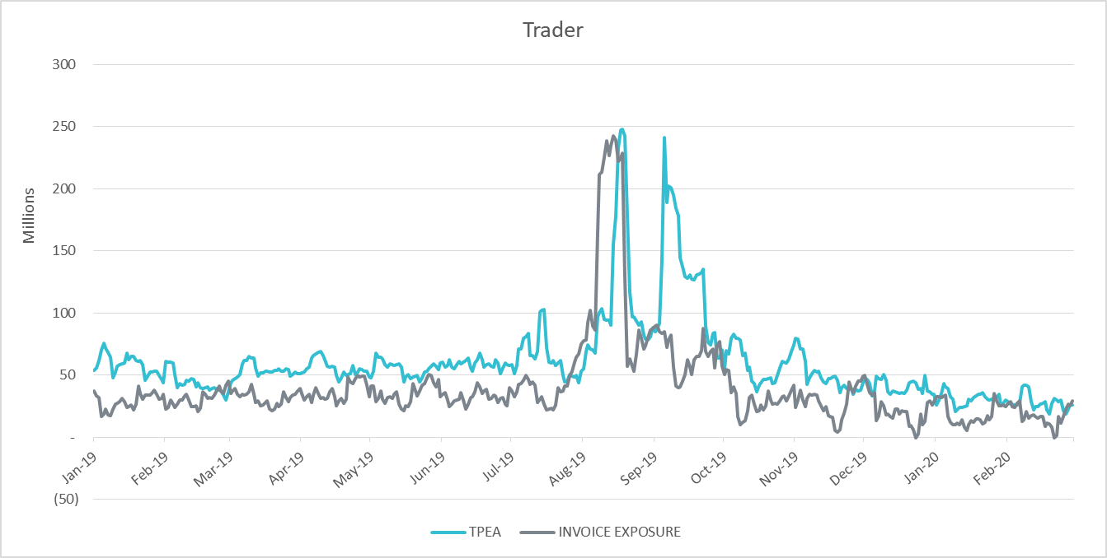
TPE coverage of settlements Jan 2019-Feb 2020
TPEA generally exceeds actual/invoice exposure

Slide 4
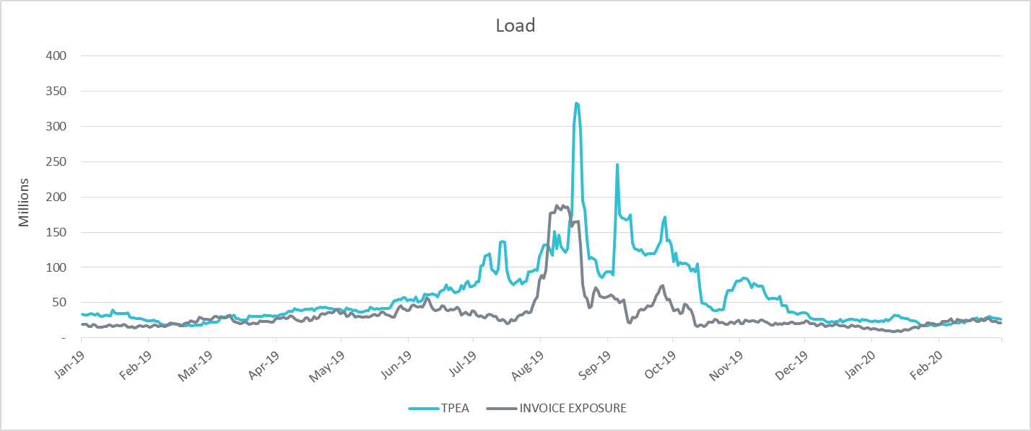
TPE coverage of settlements Jan 2019-Feb 2020
TPEA closely approximates actual/invoice exposure except during summer peak and fall

Slide 5
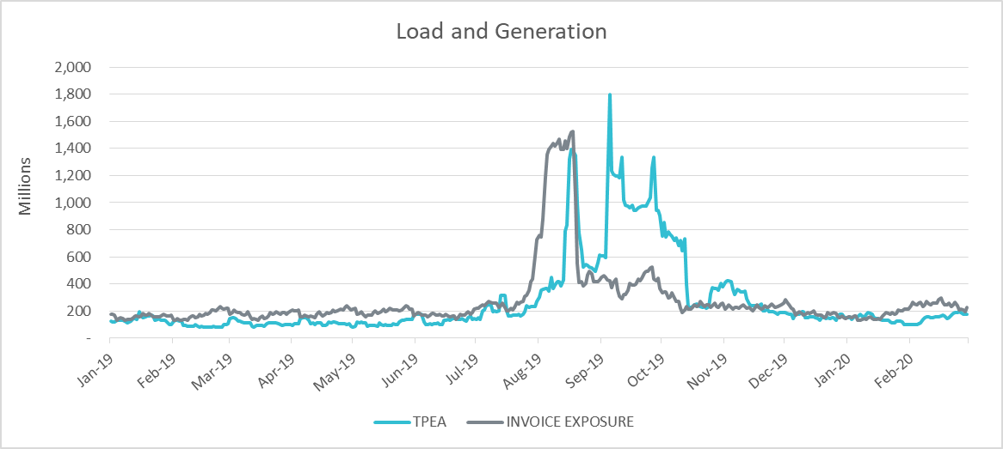
TPE coverage of settlements Jan 2019-Feb 2020
Actual/invoice exposure slightly higher than TPEA except during summer peak and fall

Slide 6
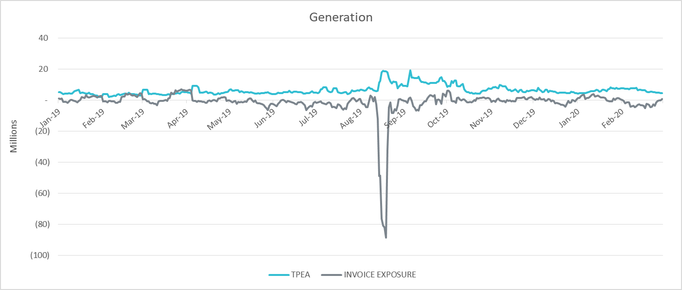
TPE coverage of settlements Jan 2019-Feb 2020
TPEA generally exceeds actual/invoice exposure

Slide 7
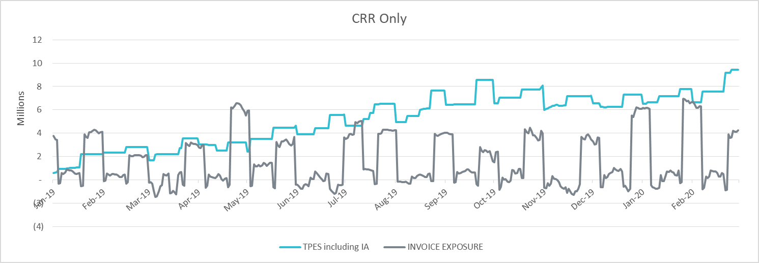
TPE coverage of settlements Jan 2019-Feb 2020
TPES mostly exceeds actual/invoice exposure

Slide 8
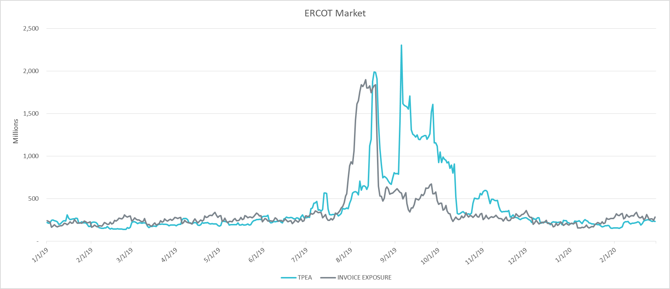
TPE coverage of settlements Jan 2019-Feb 2020
TPEA closely approximates actual/invoice exposure during winter and shoulder months

Slide 9
Questions

