Slide 1
MIS and ERCOT.com User Workshop
May 20, 2020

Slide 2
Agenda
MIS Sandbox Release Notes
Online Card Sort Activity Results
Review MIS Baseline Survey Data
MIS Sandbox Demo
Upcoming UX Research Topics
Next Steps

Slide 3
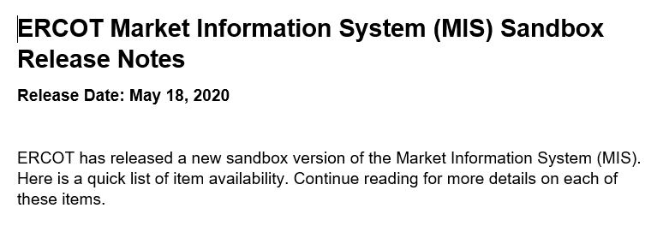
MIS Sandbox Release Notes
Included with 10-Day and Same Day Market Notices
Available on ercot.com/about/redesign
Will also include Before/After Data Mapping Spreadsheet with Same Day Market Notice

Slide 4
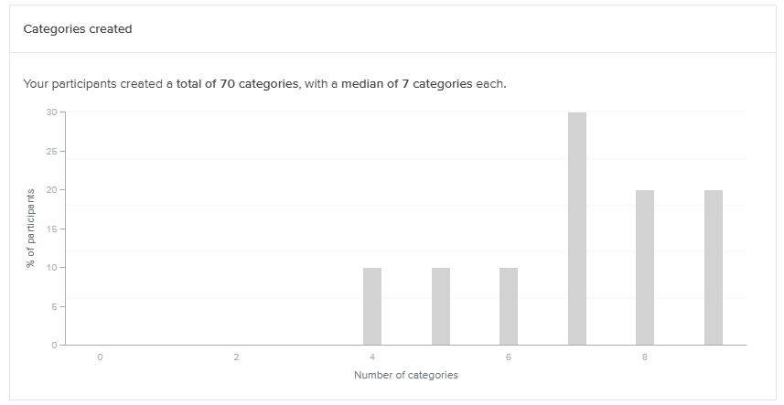
Online Card Sort Activity Results - Markets

Slide 5
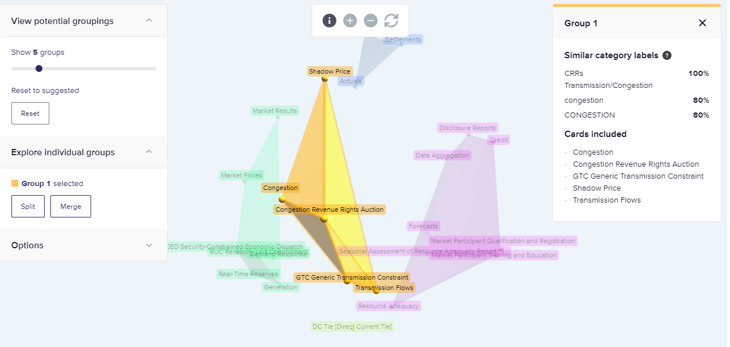
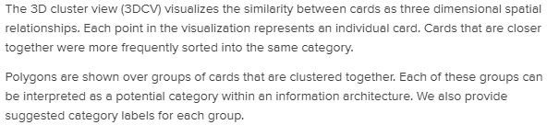
Online Card Sort Activity Results - Markets

Slide 6
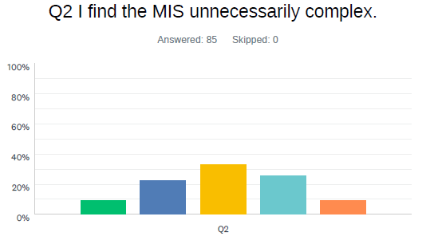
Current MIS Survey Results
Conducted in April based on current MIS
85 responses, >50% use MIS frequently
Used the System Usability Scale
Raw Score = 55.2
Normalized – Marginal, “D”, just functional

Slide 7
MIS Survey Feedback
Multiple certificates
Extracting data is resource intensive
Not easy to find what you’re looking for
Report Index is very slow
Report names could be more intuitive
Outage Scheduler and Market Manager improvements

Slide 8
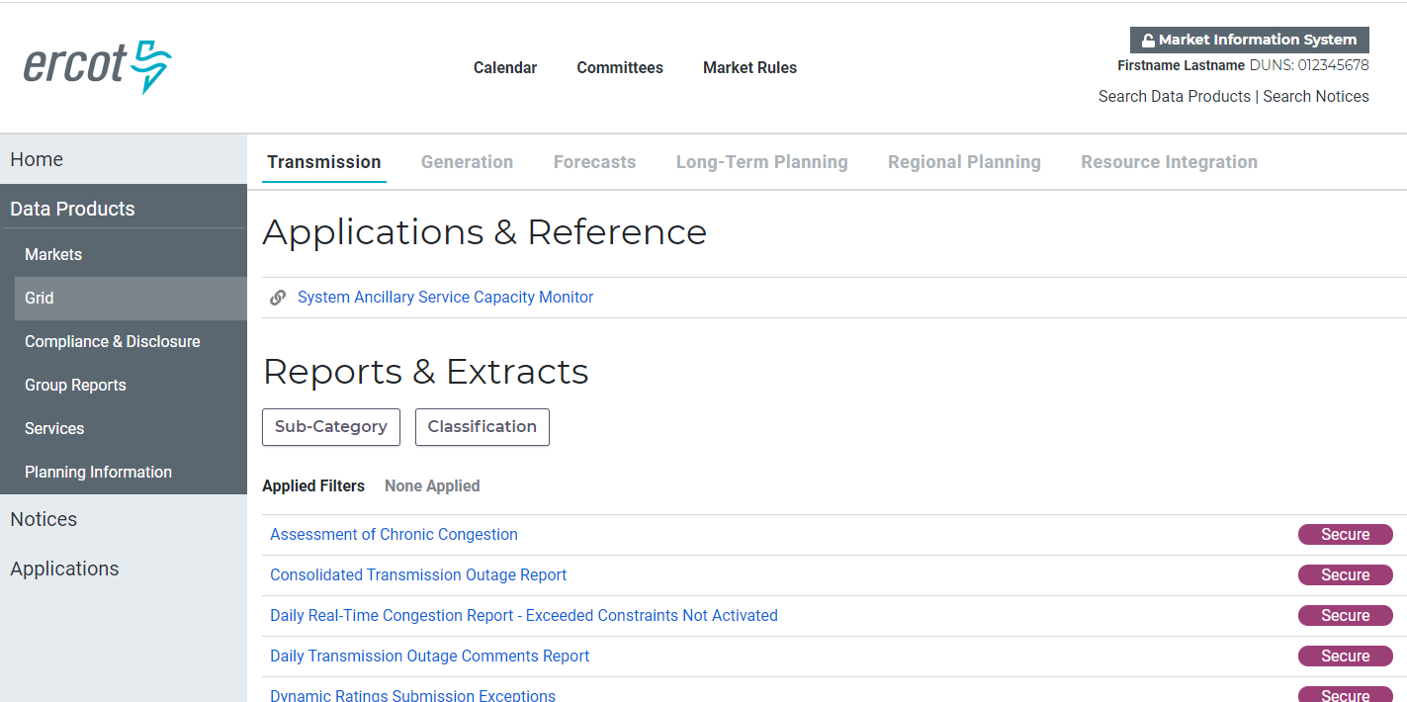
MIS Sandbox Demo

Slide 9
Upcoming User Research Topics
We’ll be seeking information on the following in this meeting, individually and online:
  Home Page: Overall Usage & Dashboards
  MIS login: Handling multiple certificates
  Navigation: Specifically for mobile
  Index Behavior
  Planning Page

Slide 10
What’s Next?
Sandbox MIS Release on May 28.
Sandbox MIS Survey on June 4
Summary of feedback at June 24 MIS & ERCOT.com User Workshop
Production Preview in September and cutover in November
Feedback to webmaster@ercot.com is welcome any time

