Slide 1
Late Payment Enforcement Provisions
CWG / MCWG
ERCOT Public
April 19, 2020

Slide 2
Late Payment Enforcement Provisions
Late Payment # | Current Enforcement Provisions
1 | Review, or | Level I Enforcement | Increase to or provide 110% collateral for min 60 days
2 | Level I Enforcement, or | Level II Enforcement | 110% collateral in cash or LC for 60 days
3 | Level II Enforcement, or | Level III Enforcement | Warning or terminate SFA
4 | Terminate SFA
Note that a third late payment with Level III Enforcement can lead to termination of the Standard Form Agreement. This could conflict with the SFA:
Section 8. Default
Event of Default
(1)..Provided further that if such a material breach, regardless of whether the breaching Party cures the breach within the allotted time after notice of the material breach, occurs more than three (3) times in a 12-month period, the fourth such breach shall constitute a Default.

Slide 3
Late Payment Enforcement Provisions
The potential conflict with the SFA could be addressed by:
Removing the termination option for Level III Enforcement
Providing graduated penalties for Level III Enforcement
This also eliminates the “do nothing” option for the first late payment.
Late Pmt. | Existing Enforcement Provisions |  |  | Proposed Enforcement Provisions
1 | Review, or | Level I Enforcement | Increase to or provide 110% collateral for min. 60 days | Level I Enforcement | Increase to or provide 110% collateral for min. 60 days
2 | Level I Enforcement, or | Level II Enforcement | 110% collateral in cash or LC for 60 days | Level II Enforcement | 110% collateral in cash or LC for 60 days
3 | Level II Enforcement, or | Level III Enforcement | Warning or terminate SFA | Level III Enforcement | 120% collateral in cash for 90 days
4 | Terminate SFA |  |  | Terminate SFA

Slide 4
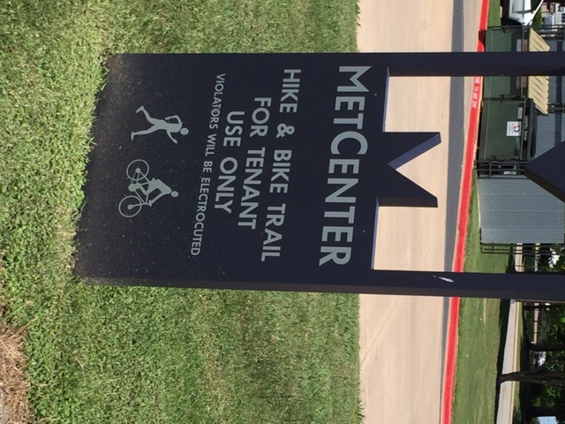
Late Payment Enforcement Provisions
Questions

