Slide 1
Effects of Activating Low Shift Factor Constraints in SCED
Alex Giarratano
Market Analysis & Validation
CMWG
May 11th, 2020

Slide 2
Review Constraint Basics
During Real-Time, Real-Time Contingency Analysis (RTCA) identifies base case and post-contingency overloaded elements and displays them in the Transmission Constraint Manager (TCM)
Constraints are only activated if the following conditions are met:
Above Loading Threshold: loaded at 98% of Emergency Limit
Shift Factors Available: there exists a Resource Shift Factor ≥ 2% (absolute value)
Not Redundant: a similar constraint is not already activated
Constraints for which Constraint Management Plans (CMPs) have been created are activated (sent to SCED) as appropriate

Slide 3
Overview of New Material
The following material is a follow-up to material presented at the February 3rd, 2020 WMWG (link)
Specifically, it is a detailed analysis to understand the potential impact of activating constraints that do not have Resource Shift Factors ≥ 2% (absolute value)
Using EMS data for February, constraints not activated on the basis of not having adequate Shift Factors only were identified for this analysis
This analysis excludes constraints that may be redundant
Constraints loaded at 98% of their Emergency Limit as per EMS were considered

Slide 4
What would happen if constraints with shift factors all less than 2% (absolute value) were activated?
Prices, including both System Lambda and individual LMPs, may be impacted (in either direction)
Resources may be redispatched to accommodate new constraints
Potential for redispatch to create oscillations for Resources that are marginal or flat parts of their EOC, similar to other constraints
Congestion Rent, for the newly activated constraint and already activated constraints, may change
Newly activated constraint is likely to hit Max Shadow Price and to be violated
Impact of constraint with Resource Shift Factors < 2% (absolute value) being activated is dependent on the topology of the system (e.g., radial vs. non-radial, outages) near the constraint and the examples shown here may not be representative of all cases

Slide 5
Three Chosen Examples
The following constraints, of the projected total of 4 constraints that would be newly activated under this change in February ‘20, were considered
They lacked Resource Shift Factors ≥ 2% (absolute value)
Were not redundant
Were greater than 98% of their Emergency Rating
February 4th, 2020 HE15
STHRSIG8: BEEVIL_NORMAN1_1
February 10th, 2020 HE17
DALNBND6: 1610_A
February 12th, 2020 HE13
DLOCRED8: DEERCR_AT1
Some of these constraints ended up not binding in a SCED simulation. For the purpose of this analysis, their limits were set below to their original flow to simulate a binding constraint

Slide 6
Methodology
Analysis performed using an ERCOT internal SCED simulation tool, intended to rerun production SCED cases sequentially
Assumes that Resources follow their Base Points exactly
For each Hour of analysis, a baseline was created by simply rerunning the sequential SCED cases
The new constraints, their limits, and their respective Resource Shift Factor matrices were added to the original SCED constraints
For the test constraints that ended up not binding in the simulation, their limits were reduced to 1 MW below their non-binding flow to force them to bind
SCED results from the baseline case and the modified (w/ additional constraint) case were compared including System Lambda, LMPs, and Base Points

Slide 7
February 4th, 2020 HE15 STHRSIG8:BEEVIL_NORMAN1_1 activated; largest abs(SF) is -1.13%
Constraint
BEEVIL_NORMAN1_1
Contingency STHRSIG8
Corpus Christi

Slide 8
Activating constraint increased System Lambda

Slide 9
Activated constraint was violated with actual limit
Constraint was immediately binding at its maximum shadow price

Slide 10
The addition of constraints shifts Resource LMPs around the system throughout the hour
Shift in data due to varying impact of additional constraint on LMPs from each SCED interval
Positive change in LMPs for Resources w/ + SF’s due to increase in System Lambda and impact of existing binding constraints
STHRSIG8: BEEVIL_NORMAN1_1 binding and being violated created a correlated shift in LMP relative to SF of Resources around the system
61% of Resources-Intervals had a (+) SF on additional constraint. Of those, 80% saw a positive change in LMP

Slide 11
The addition of constraints also shifts Base Points for Online Resources around the system throughout the hour
Resources with (+) SF’s on additional constraint moved up due to the increase in system lambda and impact of existing binding constraints
INGLCOSW_CC1
Increased the BP-weighted LMP* by 5.3%
*BP-weighted LMP = HRS * LMP * BP
SCES_UNIT1_J02
87% of Resources-Intervals (of Online Resources) had a (+) SF on additional constraint. Of those, 8% saw a pos. change in BP, 3.5% saw a neg. change in BP, and 88% saw no change in BP

Slide 12
Addition of constraint causes some Resources to be redispatched to reduce flow on the constraint
INGLCOSW_CC1
SCES_UNIT1_J02
These Resources are, for at least a few SCED intervals during the hour, marginal and thus redispatched to help reduce flow on the constraint

Slide 13
February 10th, 2020 HE17 DALNBND8:1610_A activated; radial constraint w/ most SFs ~ 0.5%
Contingency DALNBND8
Constraint
1610_A
DFW Metro Area

Slide 14
February 10th, 2020 HE17 DALNBND8: 1610_A activated; largest abs(SF) is -1.76%
When activated, DALNBND8: 1610_A was not initially binding despite being loaded > 98% of its Emergency Limit in RTCA
To “force” the constraint to bind, the Limit of the constraint was adjusted to match the “baseline” flow of constraint minus 1 to demonstrate its potential impact

Slide 15
Activating constraint increased System Lambda

Slide 16
Activated constraint was forced to bind and was violated
Constraint was not initially binding, so the Limit was set equal to the Flow – 1 to force the Constraint to bind. This caused the constraint to bind at its maximum shadow price.

Slide 17
The addition of constraint mostly reduces the Resource LMPs around the system since the constraint is radial
84% of Resources-Intervals saw no change to their LMP, while the rest saw a negative change
DALNBND8: 1610 binding and being violated created a correlated shift in LMP relative to SF of Resources around the system

Slide 18
The addition of constraint doesn’t change the BP of any Online Resources throughout the hour
No change in BP of any Resources-Intervals (of Online Resources)
Decreased the BP-weighted LMP* by 1.0%
*BP-weighted LMP = HRS * LMP * BP

Slide 19
February 12th, 2020 HE13 DLOCRED8: DEERCRE_AT1 activated; largest abs(SF) is -1.76%
Bastrop
Contingency DLOCRED8
Constraint
DEERCR_AT1
San Antonio

Slide 20
February 12th, 2020 HE13 DLOCRED8: DEERCRE_AT1 activated; largest abs(SF) is -1.76%
When activated, DLOCRED8: DEERCRE_AT1 was not initially binding despite being loaded >98% of its Emergency Limit in RTCA
To “force” the constraint to bind, the Limit of the constraint was adjusted to match the “baseline” flow of constraint minus 1 to demonstrate its potential impact

Slide 21
Activating constraint increased System Lambda

Slide 22
Activated constraint was forced to bind and was not violated
Constraint was not initially binding, so the Limit was set equal to the Flow – 1 to force the Constraint to bind

Slide 23
The addition of constraints shifts Resource LMPs around the system throughout the hour
83% of Resources-Intervals had a (+) SF on additional constraint. Of those, 66% saw a negative change in LMP
DLOCRED8: DEERCRE_AT1 binding created a correlated shift in LMP relative to SF of Resources around the system

Slide 24
The addition of constraints also shifts Base Points for Online Resources around the system throughout the hour
Decreased BP-weighted LMP* by 0.3%
*BP-weighted LMP = HRS * LMP * BP
VICTORIA_CC1
GUADG_CC1
83% of Resources-Intervals (of Online Resources) had a (+) SF on additional constraint. Of those, 6% saw a pos. change in BP, 6.5% saw a neg. change in BP, and 87% saw no change in BP

Slide 25
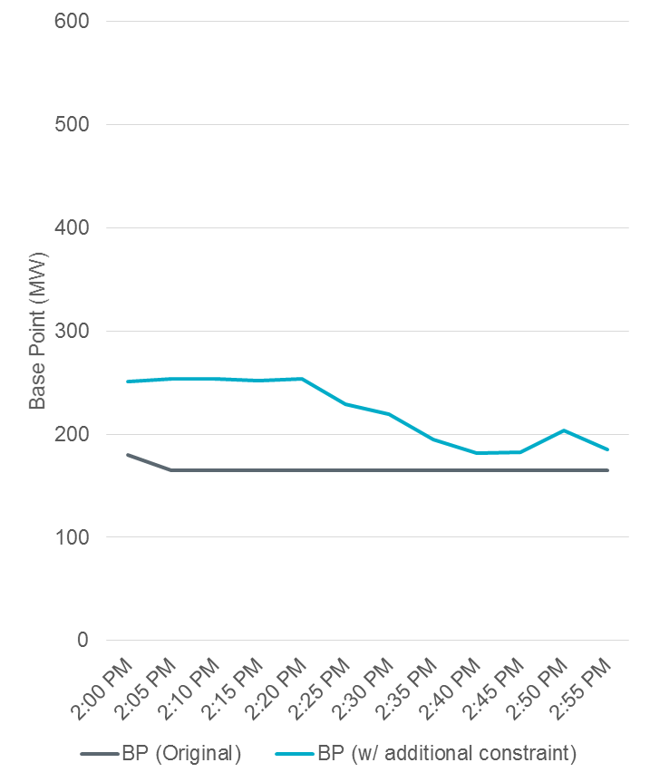
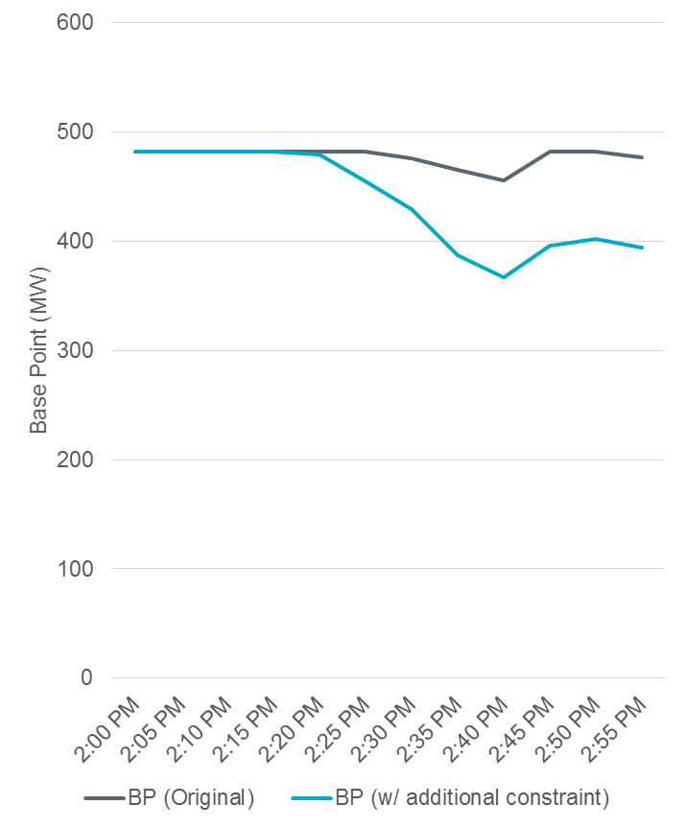
Addition of constraint causes some Resources to be redispatched to reduce flow on the constraint
VICTORIA_CC1
GUADG_CC1
These Resources are, for at least a few SCED intervals during the hour, marginal and thus redispatched to help resolve the constraint

Slide 26
Conclusions
Addition of constraints with only Resource Shift Factors < 2% (absolute value) shifted LMPs and Base Points around the system depending on shift factors, Resource energy offer curves and current system conditions (e.g., other active constraints and their shadow prices, Resource operating points, etc.)
In the three cases studied only one would have been binding. Two were forced to bind by reducing their limits to below their unconstrained flow.
While these constraints have the potential to create conditions that move generators around, this is true for all constraints. No oscillation was observed in these cases.
Impact of constraint with Resource Shift Factors < 2% (absolute value) being activated is dependent on the topology of the system (e.g., radial vs. non-radial, outages) near the constraint and the examples shown here may not be representative of all cases

Slide 27
Questions?
Thank you!

