Slide 1
PDCWG Report to ROS
Chair: Chad Mulholland, NRG
Vice Chair: Jimmy Jackson, CPS
ROS
May 7th, 2020

Slide 2
Report Overview & Notes
Report Overview
Meeting Minutes
BAL-001-TRE-1 FMEs & IMFR
1 FME in the month of March
Frequency Control Report

Slide 3
Meeting Minutes
PDCWG Meeting 4/15/2020
Procedure for Calculating RRS Limits for Individual Resources
FMEs Discussion
3/18/2020 High Frequency Event
Regulation & Frequency Control Reports

Slide 4
Frequency Measurable Events Performance

Slide 5
Frequency Measurable Events
There was 1 FME in March
3/22/2020 08:10:32
Loss of 699 MW
Interconnection Frequency Response: 1013 MW/0.1 Hz
1 of 41 Evaluated Generation Resources had less than 75% of their expected Initial Primary Frequency Response.
2 of 41 Evaluated Generation Resources had less than 75% of their expected Sustained Primary Frequency Response.

Slide 6
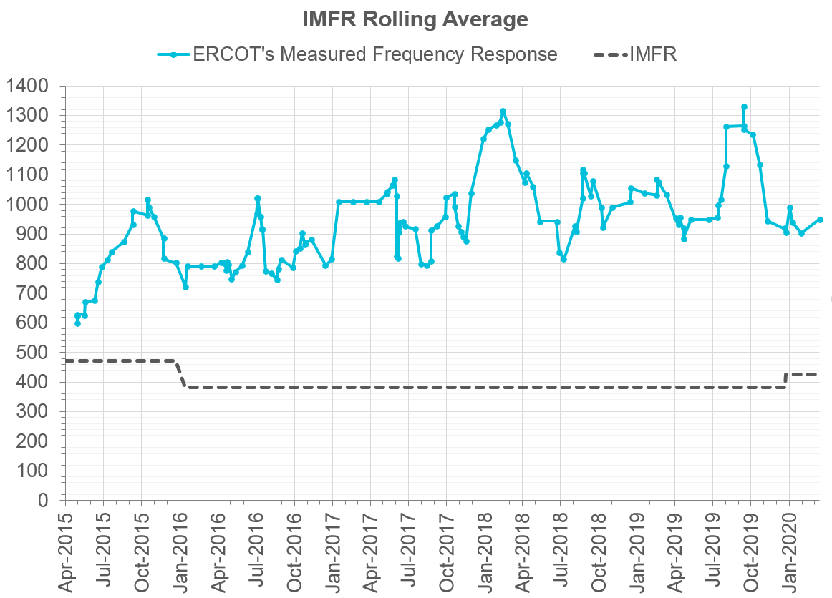
Interconnection Minimum Frequency Response (IMFR) Performance
IMFR Performance currently 950.08 MW/0.1Hz
Frequency Response Obligation (FRO): 425 MW/0.1 Hz

Slide 7
Frequency Control Report
November 2019

Slide 8
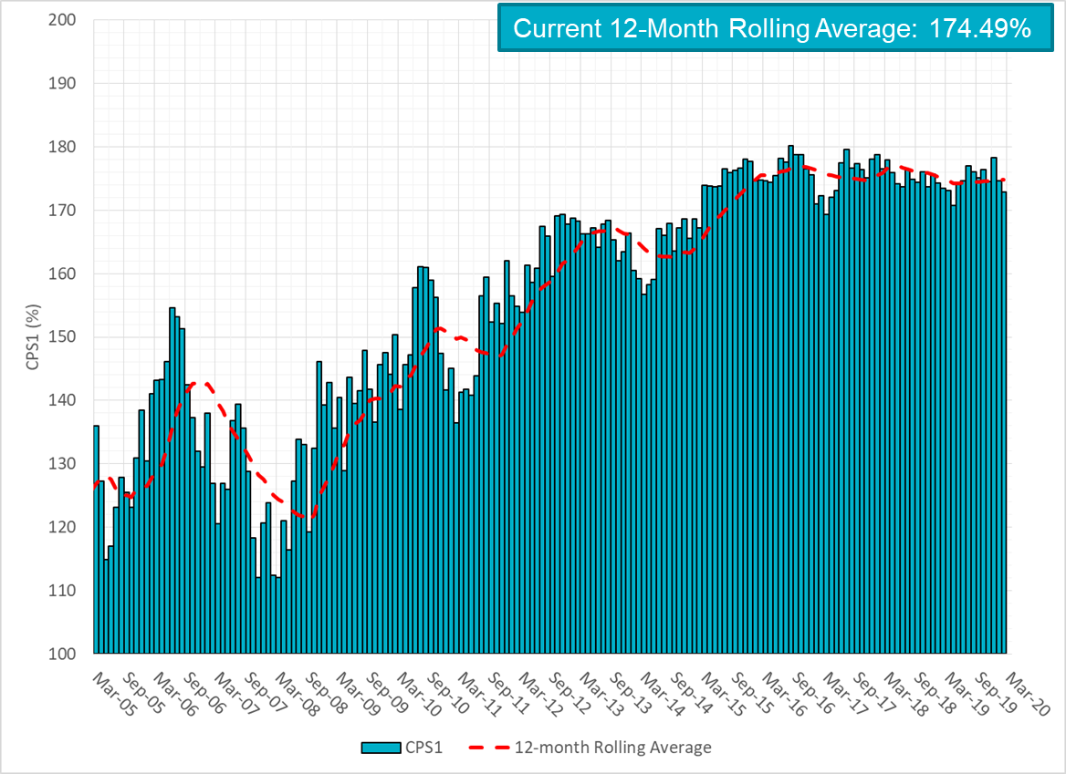
CPS1 Performance

Slide 9
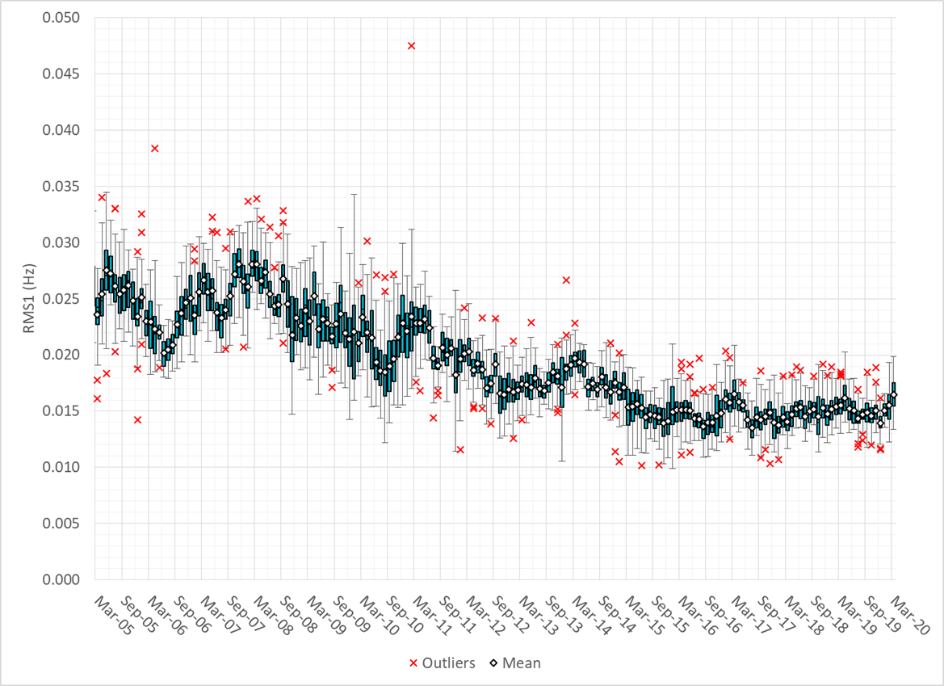
RMS1 Performance of ERCOT Frequency

Slide 10
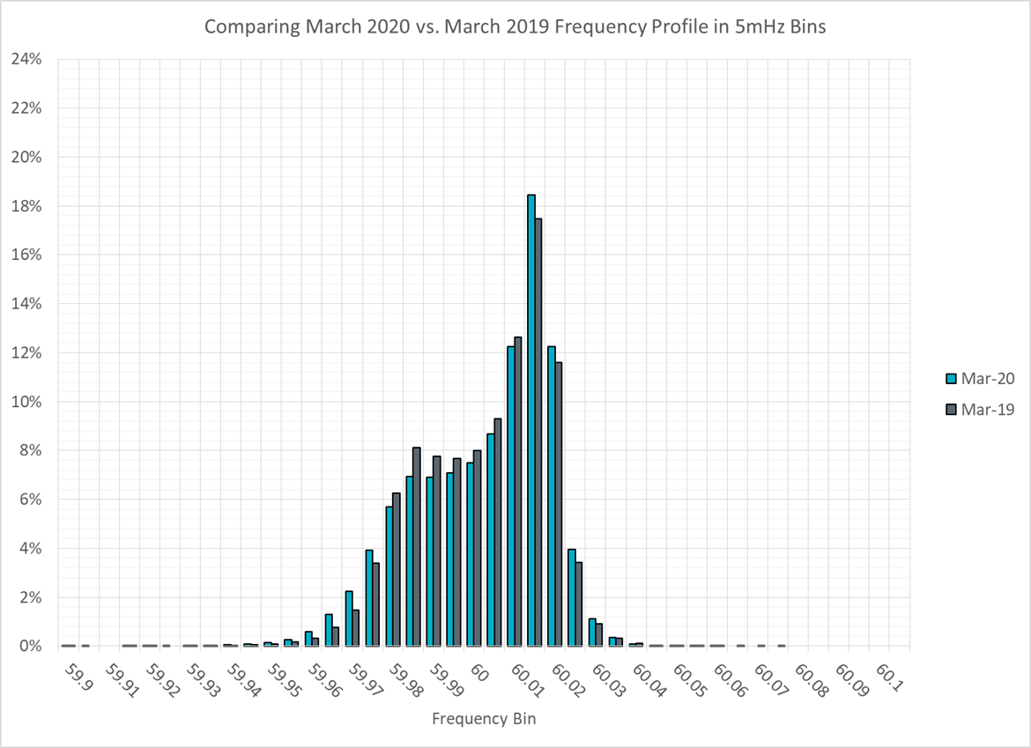
Frequency Profile Analysis

Slide 11
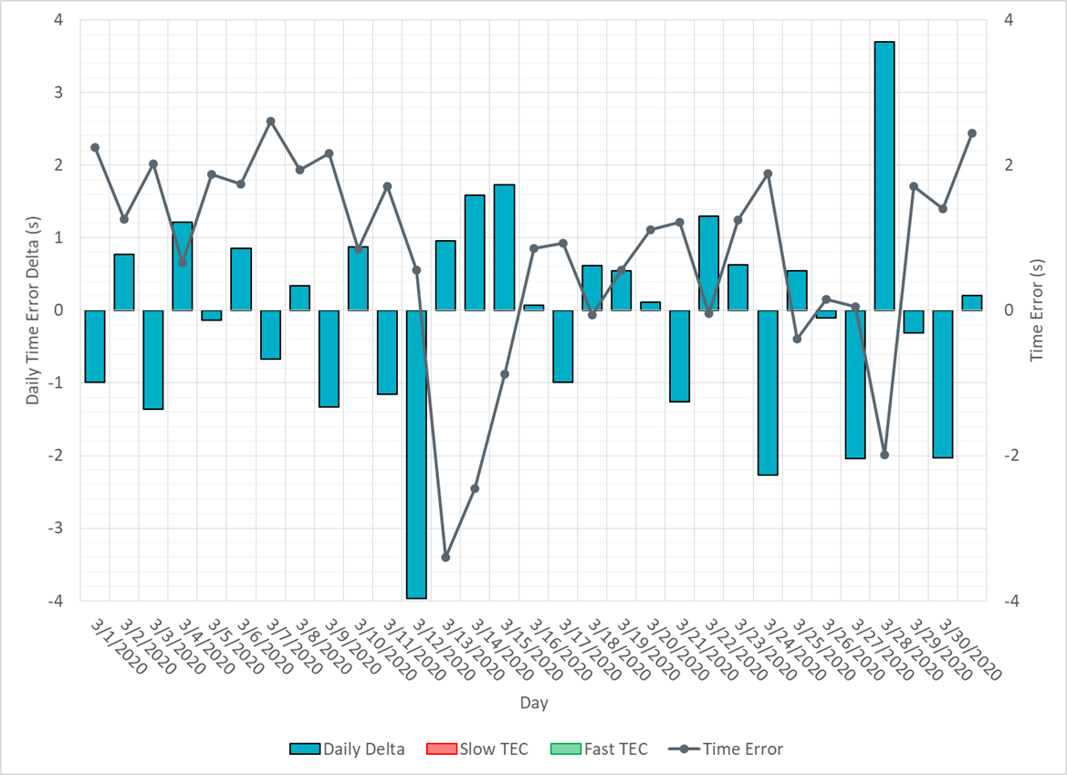
Time Error Corrections

Slide 12
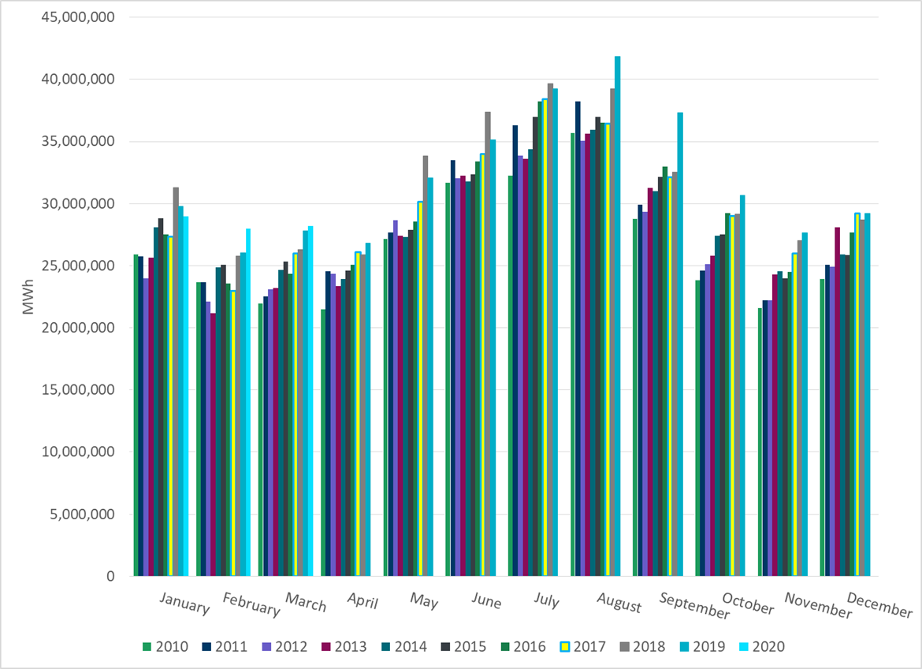
ERCOT Total Energy

Slide 13
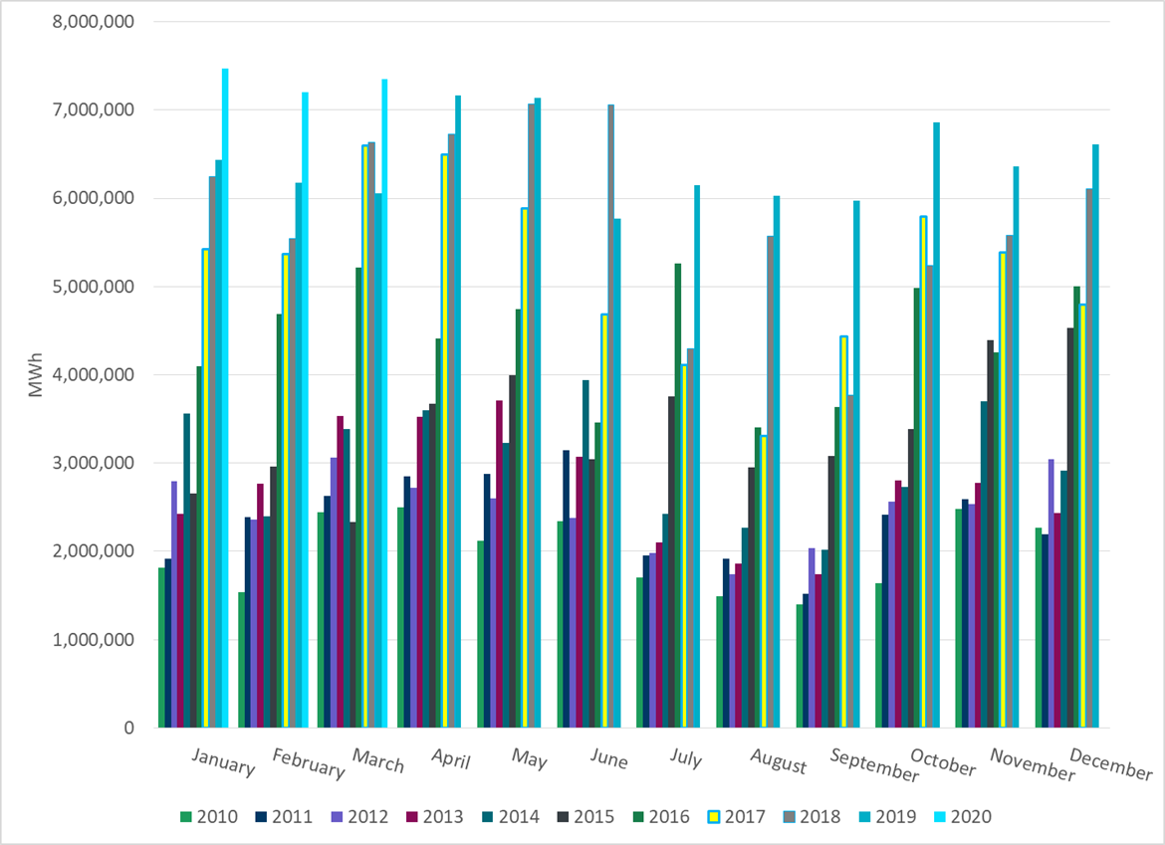
ERCOT Total Energy from Wind Generation

Slide 14
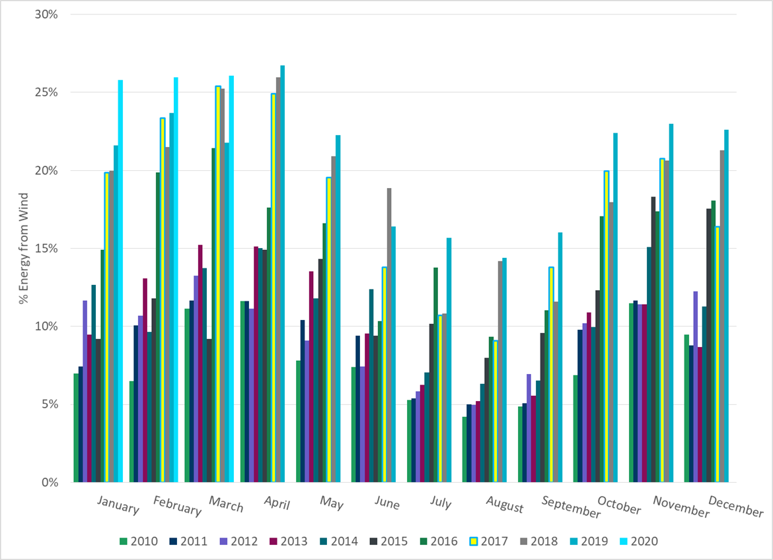
ERCOT % Energy from Wind Generation

Slide 15
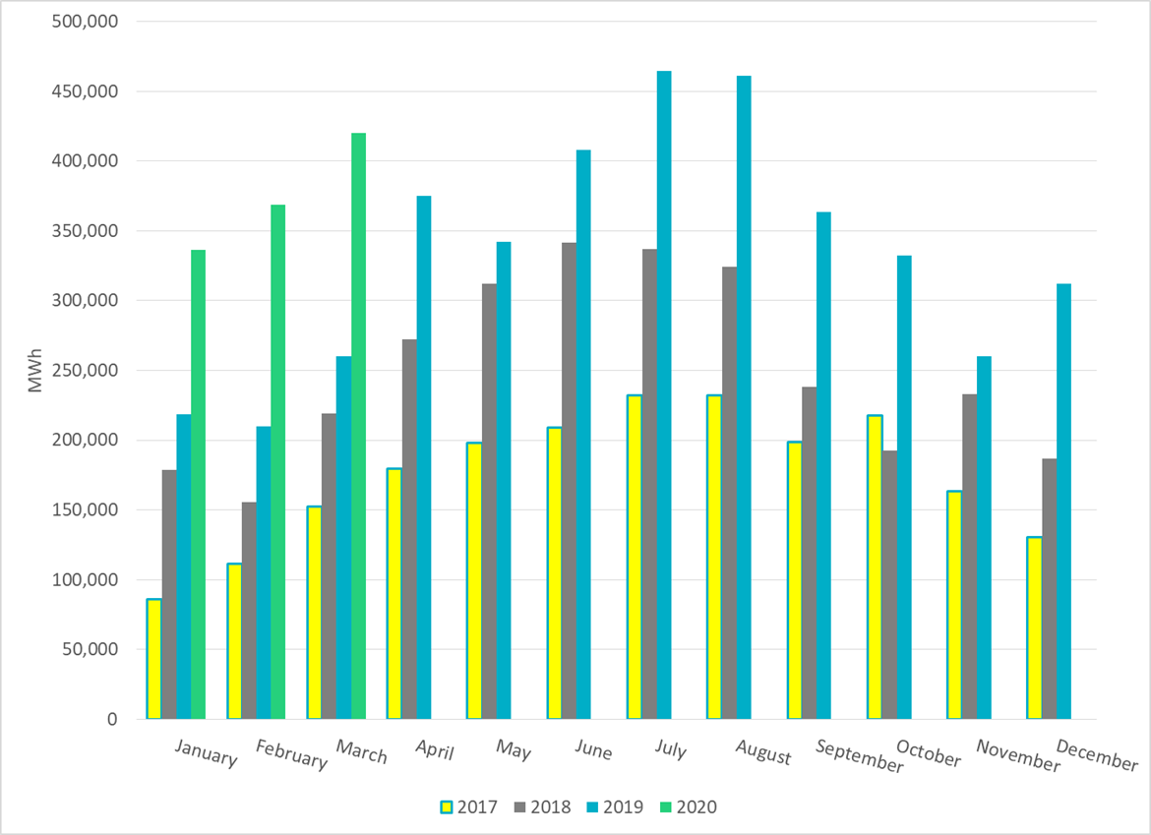
ERCOT Total Energy from Solar Generation

Slide 16
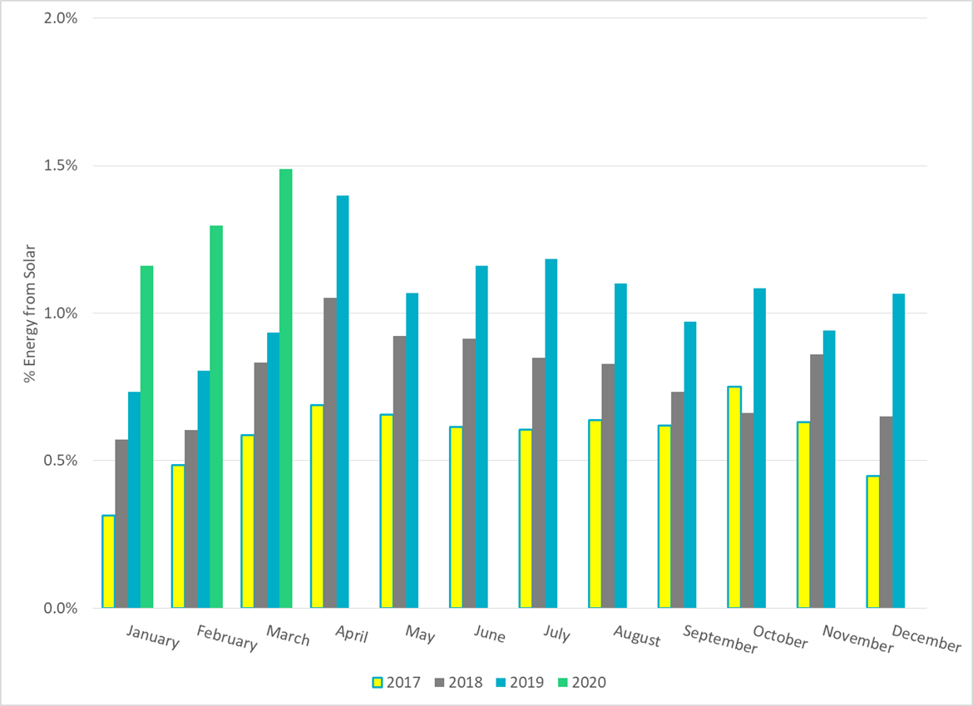
ERCOT % Energy from Solar Generation

Slide 17
Questions?

