Slide 1
System Protection Working Group (SPWG)
Update to ROS
May 07, 2020
Chair: John Karlik, PE
Vice-Chair: Vincent Roberts, PE

Slide 2
SPWG Meeting
Meeting held on March 4, 2020
Topics Discussed:
  Impact of Inverter-Based Resources (IBR) on ERCOT Grid Protection
  2019 Q4 Protection System Misoperations
Next meeting is scheduled July 22-23, 2020

Slide 3
Impact of IBRs on ERCOT Grid Protection

Slide 4
Impact of IBRs on ERCOT Grid Protection
ERCOT provided background information to SPWG members and discussions were held concerning the following:
  Short circuit modeling
  Protection best practices
  Facility interconnection requests
Action Items
  Survey TSPs regarding concerns and issues surrounding IBRs
  Hold an SPWG workshop to discuss survey results and determine if further action is required

Slide 5
2019 Q4 Protection System Misoperations

Slide 6
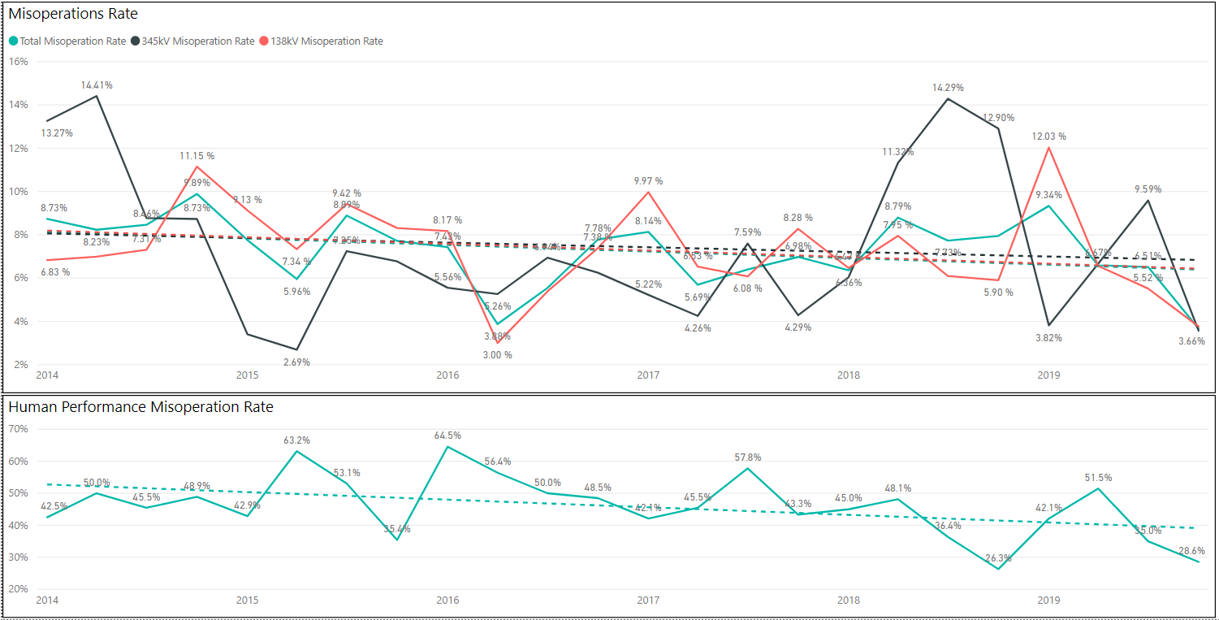
Protection System Misoperations: 2014-2019

Slide 7
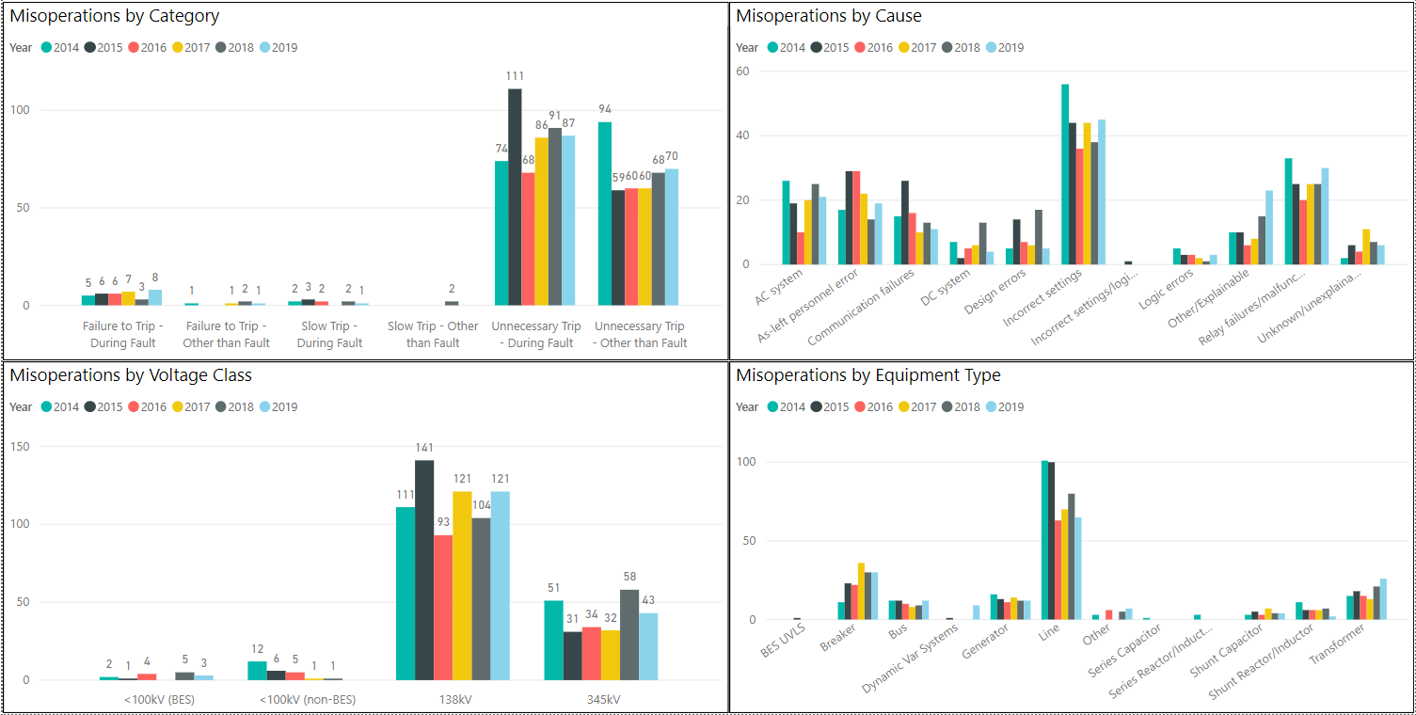
Protection System Misoperations: 2014-2019

Slide 8
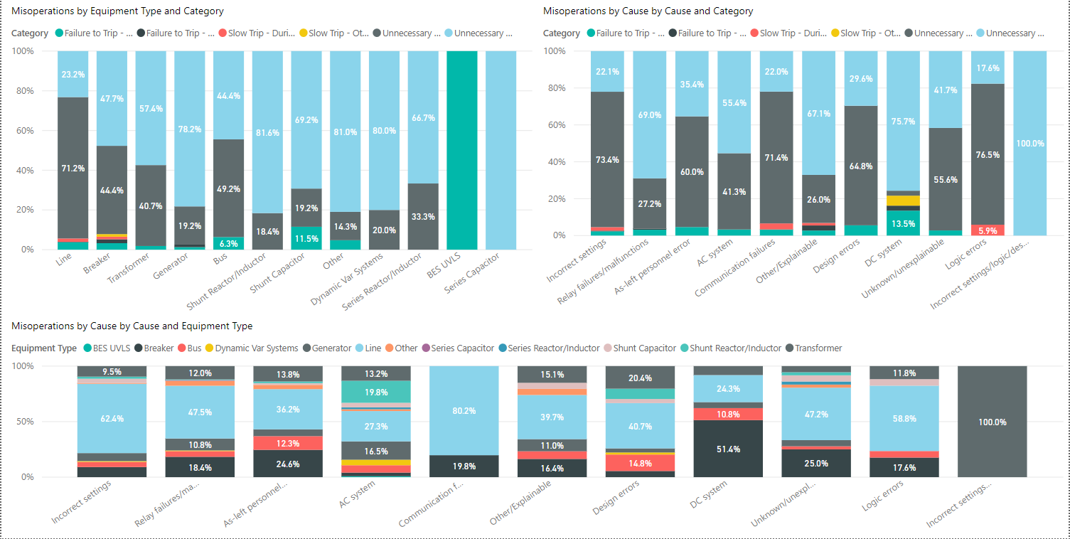
Protection System Misoperations: 2014-2019

Slide 9
Protection System Misoperations – 2019 Q4
 |  | Q4 | 2019
# of Misoperations | Total | 22 | 168
 | 345 kV | 5 | 43
 | 138 kV | 16 | 121
 | < 100 kV | 1 | 4
By Category | Failure to Trip | 2 | 9
 | Slow Trip | 1 | 1
 | Unnecessary Trip during Fault | 13 | 87
 | Unnecessary Trip – Non Fault | 6 | 71
 | SPS | 0 | 0
By Relay System Type | Electromechanical | 2 | 18
 | Solid State | 0 | 1
 | Microprocessor | 16 | 115
 | Other/ N/A | 4 | 34
By Equipment Protected | Line | 11 | 65
 | Transformer | 2 | 26
 | Generator | 0 | 12
 | Shunt/Series Capacitor | 1 | 4
 | Shunt/Series Reactor | 0 | 2
 | Dynamic VAR system | 2 | 9
 | Bus | 1 | 12
 | Breaker | 4 | 31

Slide 10
Regional Misoperation Rate Comparison

Slide 11
Protection System Misoperations 2019 Q4
Summary of Human Performance Issues noted for 2019 Q4:
A 138kV line misoperated during a fault due to out-of-date firmware.
A 138kV line breaker overtripped during a fault due to an unintentionally grounded coaxial cable due to an as-left personnel error.
Failure to Trip/Slow Trip Misoperations in 2019 Q4:
138kV capacitor bank protection failed to trip during a fault due to a block trip function that was inadvertently set too low
A wind plant feeder breaker failed to trip during a fault due to a bad cable

Slide 12
Corrective Action Plan Metrics
Calendar days from date of misoperation to “Corrective Action Complete”

Slide 13
Definitions
Protection System –
  Protective relays which respond to electrical quantities,
  Communications systems necessary for correct operation of protective functions
  Voltage and current sensing devices providing inputs to protective relays,
  Station dc supply associated with protective functions (including station batteries, battery chargers, and non-battery-based dc supply), and
  Control circuitry associated with protective functions through the trip coil(s) of the circuit breakers or other interrupting devices

Slide 14
Definitions
Composite Protection System - The total complement of Protection System(s) that function collectively to protect an Element. Backup protection provided by a different Element’s Protection System(s) is excluded.
Misoperation – The failure a Composite Protection System to operate as intended for protection purposes. Any of the following is a Misoperation:
  Failure to Trip – During Fault – A failure of a Composite Protection system to operate for a Fault condition for which it is designed.
  Failure to Trip – Other than Fault - A failure of a Composite Protection system to operate for a non-Fault condition for which it is designed, such as a power swing, undervoltage, overexcitation, or loss of excitation.

Slide 15
Definitions
Misoperation – The failure a Composite Protection System to operate as intended for protection purposes. Any of the following is a Misoperation:
  Slow Trip – During Fault – A Composite Protection system that is slower than required for a Fault condition if the duration of its operating time resulted in the operation of at least one other Element’s Composite Protection System.
  Slow Trip – Other than Fault - A Composite Protection system that is slower than required for a non-Fault condition, such as a power swing, undervoltage, overexcitation, or loss of excitation, if the duration of its operating time resulted in the operation of at least one other Element’s Composite Protection System.

Slide 16
Definitions
Misoperation – The failure a Composite Protection System to operate as intended for protection purposes. Any of the following is a Misoperation:
  Unnecessary Trip – During Fault – An unnecessary Composite Protection system operation for a Fault condition on another Element.
  Unnecessary Trip – Other than Fault - An unnecessary Composite Protection system operation for a non-Fault condition. A Composite Protection System operation that is caused by personnel during on-site maintenance, testing, inspection, construction, or commissioning activities is not a Misoperation.

