Slide 1
Unregistered Distributed Generation Reports:
2019 Annual Report
2020 Q1 Update
Resource Adequacy
5/6/2020

Slide 2
2019 Annual Unregistered Distributed Generation Report
Load Zone | 2019 Annual Distributed Generation Installed Capacity in MW (AC)
 | SOLAR |  | WIND |  | OTHER RENEWABLE |  | OTHER NON-RENEWABLE |  | TOTAL
 | < 50 kW | ≥ 50 kW | < 50 kW | ≥ 50 kW | < 50 kW | ≥ 50 kW | < 50 kW | ≥ 50 kW | < 50 kW | ≥ 50 kW | Combined
LZ_AEN | 55.19 | 22.59 | - | - | - | - | - | - | 55.19 | 22.59 | 77.78
LZ_CPS | 127.54 | 29.41 | - | - | 0.82 | - | - | 8.06 | 128.36 | 37.47 | 165.83
LZ_HOUSTON | 40.90 | 19.45 | 0.37 | - | - | 0.11 | 0.05 | 4.30 | 41.32 | 23.86 | 65.17
LZ_LCRA | 43.59 | 13.39 | 0.25 | - | - | - | 0.08 | - | 43.92 | 13.39 | 57.31
LZ_NORTH | 172.98 | 34.40 | 2.34 | 1.01 | - | - | - | 7.43 | 175.32 | 42.83 | 218.15
LZ_RAYBN | 7.31 | 1.90 | 0.13 | 0.05 | - | - | - | - | 7.43 | 1.95 | 9.38
LZ_SOUTH | 62.94 | 16.48 | 1.20 | 0.25 | - | - | - | - | 64.15 | 16.73 | 80.88
LZ_WEST | 12.62 | 3.89 | 0.58 | 0.31 | - | - | - | 0.34 | 13.20 | 4.53 | 17.73
TOTAL | 523.06 | 141.50 | 4.87 | 1.61 | 0.82 | 0.11 | 0.13 | 20.12 | 528.89 | 163.34 | 692.23

Slide 3
2020 Q1 Unregistered Distributed Generation Report
Load Zone | 2020 Q1 Distributed Generation Installed Capacity in MW (AC)
 | SOLAR |  | WIND |  | OTHER RENEWABLE |  | OTHER NON-RENEWABLE |  | TOTAL
 | < 50 kW | ≥ 50 kW | < 50 kW | ≥ 50 kW | < 50 kW | ≥ 50 kW | < 50 kW | ≥ 50 kW | < 50 kW | ≥ 50 kW | Combined
LZ_AEN | 57.36 | 23.89 | - | - | - | - | - | - | 57.36 | 23.89 | 81.25
LZ_CPS | 136.96 | 29.25 | 0.01 | - | 0.84 | - | - | 6.22 | 137.81 | 35.47 | 173.28
LZ_HOUSTON | 48.41 | 2.05 | 0.36 | - | - | 0.11 | 0.05 | 3.70 | 49.22 | 5.86 | 55.08
LZ_LCRA | 43.03 | 13.57 | 0.22 | - | - | - | 0.08 | - | 43.33 | 13.57 | 56.90
LZ_NORTH | 179.79 | 22.14 | 1.83 | 1.01 | - | - | - | 0.63 | 181.62 | 23.77 | 205.40
LZ_RAYBN | 9.42 | 1.98 | 0.26 | 0.05 | - | - | - | - | 9.68 | 2.03 | 11.71
LZ_SOUTH | 55.49 | 15.46 | 0.64 | 0.25 | - | - | - | - | 56.13 | 15.71 | 71.84
LZ_WEST | 14.35 | 4.44 | 0.54 | 0.25 | - | - | - | 0.34 | 14.89 | 5.03 | 19.92
TOTAL | 545.21 | 112.79 | 3.86 | 1.56 | 0.84 | 0.11 | 0.13 | 10.88 | 550.04 | 125.33 | 675.37

Slide 4
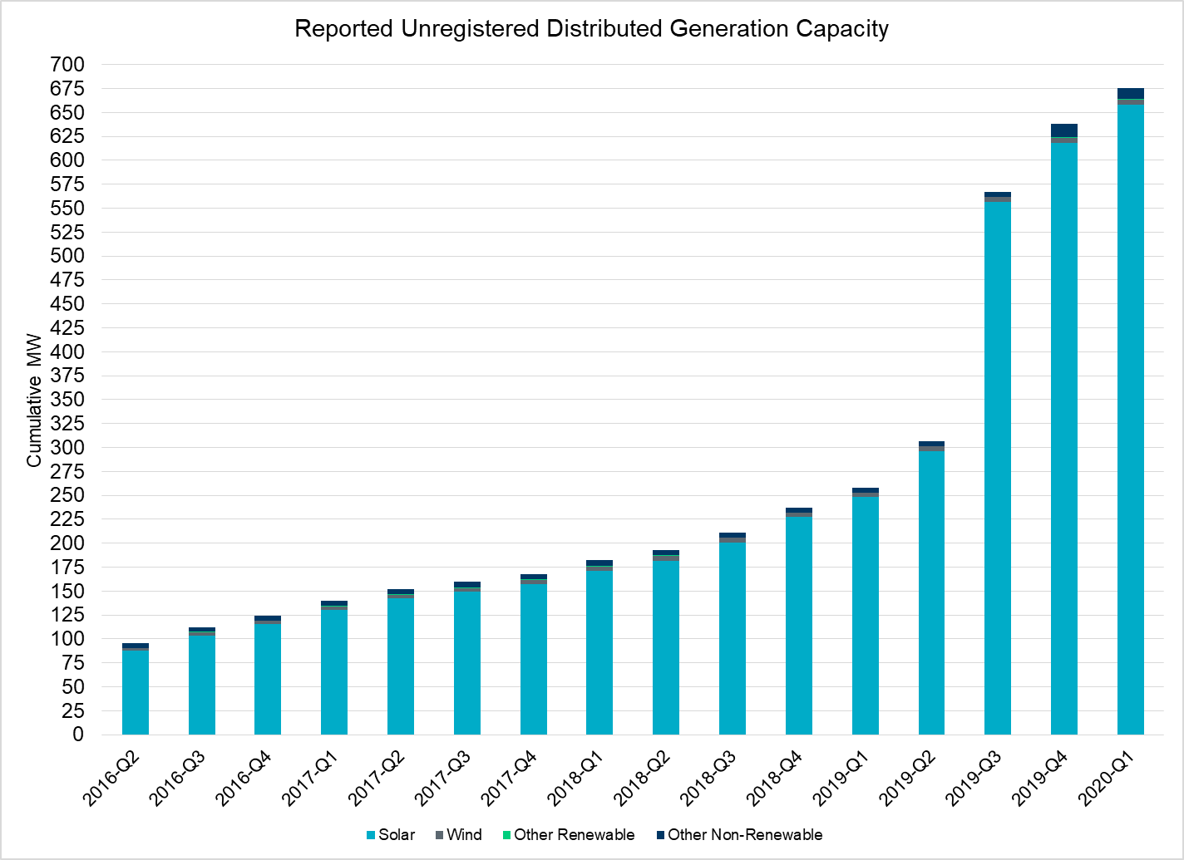
Unregistered DG Growth: 2016-Q2* to 2020-Q1
Large increase due to reporting requirement change**
* 2016-Q2 was the first report published after implementation of report changes per NPRR794/COPMGR044
** 2019-Q3 was the first report published after implementation of report changes per NPRR891

