Slide 1
Real-Time Co-optimization Task Force General Update
Matt Mereness
RTCTF
April 30, 2020

Slide 2
Reminder for today’s WebEx call
If connected to WebEx and dialed-in on a phone PLEASE associate your phone to the WebEx so we see your name. Two ways to do this:
Use “Call me” option for audio and put in your phone number (preferred $)
Use “Call in” option when entering meeting number, also enter Attendee Id assigned on screen
When dialing-in, by default your line will be muted on WebEx
Click microphone icon at bottom of screen or side-panel to mute/unmute
When you want to speak, simply announce your name and company,
Eg “Question from Joe with ElectricCo”
We will NOT be using the Raise Hand feature
We will use the “Chat” feature- send to all Participants
If having difficulties at any time, welcome text Chair or Vice-Chair
Matt Mereness 512.565.8939
Bryan Sams 512.632.4870

Slide 3
Outline of RTCTF General Update
RTC Revision Requests (RTCRRs)
RTCRR Review Details
RTCRR Review Schedule and Process
Next Steps
Appendix
Harmonizing RTC and Battery Energy Storage
Overall RTC Delivery Schedule

Slide 4
RTC Revision Requests (RTCRRs)
Based on Board-approved RTC Key Principles (KPs), ERCOT developed and released the following NPRRs, NOGRR, and OBDRR with a single Impact Analysis (IA).
RTCRRs released March 25, 2020 | Pages 549 total
NPRR1007- RTC NP3- Management Activities for the ERCOT System | 62
NPRR1008- RTC NP4- Day-Ahead Operations | 65
NPRR1009- RTC NP5- Transmission Security Analysis and Reliability Unit Commitment | 39
NPRR1010- RTC NP6- Adjustment Period and Real-Time Operations | 248
NPRR1011- RTC NP8- Performance Monitoring | 49
NPRR1012- RTC NP9- Settlement and Billing | 15
NPRR1013- RTC NP 1, 2, 16, 25- Overview, Definitions/Acronyms, Registration and Qualification of MPs, and Market Suspension and Restart | 24
NOGRR211- RTC Nodal Operating Guides 2 and 9- System Operations and Control Requirements and Monitoring Programs | 21
OBDRR020- RTC - Methodology for Setting Maximum Shadow Prices for Network and Power Balance Constraints | 26

Slide 5
RTCTF Review Details
ERCOT staff has developed a detailed schedule for reviewing the RTCRR language with RTCTF (posted on the RTCTF page).
While each RTCRR section has been assigned a specific series of RTCTF meetings, the language has all been posted and MPs are encouraged to reach out to ERCOT in advance regarding any questions or concerns they have with the language.
Each RTCRR section has been grouped into a category and mapped to a series of RTCTF meetings.
If needed, each section can span across 3 meetings
Reminder that RTCRRs strictly adhere to RTC KPs
Goal: stay on task; only modify language to implement RTC in accordance with Board-endorsed KPs
Avoid restructuring Protocol sections
Avoid “nice-to-have” clarifications

Slide 6
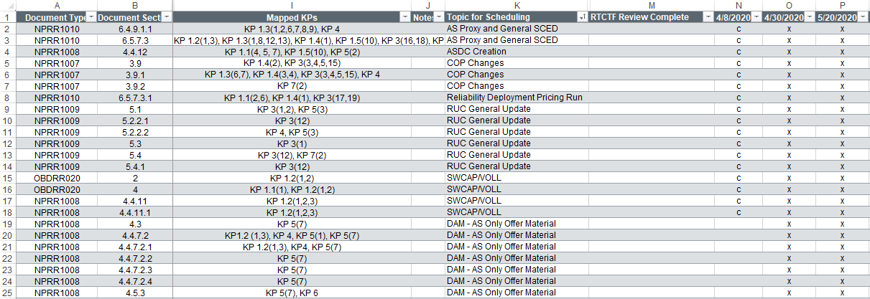
RTCTF Review Details
While RTCTF is designed as the clearinghouse for formally discussing issues using a schedule for each RTCRR/topic, MPs may submit redlines to DMaggio@ercot.com & MMereness@ercot.com at any time or file formal RTCRR comments on any sections at any time. The sooner issues are identified, the better.

Slide 7
RTCRR Review Schedule and Process
Schedule of 2020 meetings for RTCRRs:
Mar. 11 – RTCTF (Plan and logistics for RR review)
Apr. 8 – RTCTF (Review detailed plan, and begin review process)
Apr. 30 – RTCTF
May 20 – RTCTF
Jun. 10 – RTCTF
Jun. 29 – RTCTF
Jul. 22 – RTCTF
Aug. 12 – RTCTF
Sep. 9 – RTCTF
Sep. 28 – RTCTF
Oct. 21 – RTCTF
Nov. 5 – ROS
Nov. 11 – PRS
Nov. 12 – RTCTF (if needed)
Nov. 17 – CWG
Nov. 18 – TAC
Dec. 8 – ERCOT Board

Slide 8
RTCRR Review Schedule and Process
ERCOT will file cumulative RTCRR comments reflecting when consensus on sections achieved. (Also tracked in summary spreadsheet)
Consensus Items Tracked in Spreadsheet as Complete
Resolved Items Tracked in Spreadsheet as Complete
7-days prior #1
ERCOT posts agenda and RTCRRs sections to be reviewed
2-days prior #2
ERCOT responds to MP questions and redlines
7-days prior #3
Non-consensus materials posted for options on language to be considered.
Meeting #1 Meeting #2 Meeting #3
During meeting, MPs discuss any concerns or alternatives
7-days prior #2
MP redlines due and posted to address concerns or alternatives
7-days prior #3
MPs must document concerns and alternative language prior to meeting, and be prepared to discuss.
TAC will be updated monthly. If irresolvable issues occur at RTCTF, the RTCTF Chair can request TAC endorsement to resolve.

Slide 9
Next Steps
Ready to proceed with review today
At the conclusion of the meeting:
MPs encouraged to send Revision Request redlines for RTCTF consideration to DMaggio@ercot.com & MMereness@ercot.com to document and discuss at next meeting (preferred).
You can also submit formal comments through the standard Market Rules RevisionRequest process.
As RTCTF achieves consensus on groups of issues, ERCOT will periodically submit formal comments reflecting the latest consensus/working versions of the NPRRs.
Next RTCTF is May 20th
Any comments or questions?

Slide 10
Today’s Plan
Key Documents for today (cumulative language):
NPRR1007 RTCTF 040820
NPRR1008 Combined 042920
NPRR1009
NPRR1010 Combined 042420
NPRR1013 RJones 042020
OBDRR020

Slide 11
Appendix
Harmonizing RTC and Battery Energy Storage
Overall RTC Delivery Schedule

Slide 12
Harmonizing RTC & Battery Energy Storage
RTC KPs
RTC IA
RTC RRs
RTCTF Meetings
PRS
TAC
BOD
Approval of RTC
RRs and IA
RTC Redline Changes
RTC Redline Changes
RTC Redline Changes
BESTF KTCs
Single Model IA
Single Model NPRR
_____________
For overlapping sections, authors use
RTC Redlines
+
ESR Redlines
BESTF Meetings
PRS
TAC
BOD
Approval of Single Model NPRR & IA
(acknowledging subset of identical RTC redlines to support ESR redlines).
Other BES RRs

Slide 13
Harmonizing RTC & Battery Energy Storage (BES)
RTCTF & BES Task Force (BESTF) meetings are purposefully adjacent or straddling PRS due to inter-relationships of RTC & BES concepts
RTCTF
March 11
April 8
April 30
May 20
June 10
June 29
July 22
August 12
September 9
September 28
October 21
November 12 (if needed)
BESTF
March 13
April 16
May 1
May 21
June 12
June 30
July 23
August 14
September 11
September 29
October 22
November 13 (if needed)
November 5 (ROS)
November 11 (PRS)
November 18 (TAC)
December 8 (Board of Directors)

Slide 14
Overall RTC Delivery Schedule
Draft Timeline
There are several items/policies, beyond 2020 RTCRRs, that must be addressed prior to the implementation of RTC—e.g.:
Proxy Offer Curves;
RUC AS Demand Curves;
Transitional language for RTC go-live (if any);
ORDC/RTC results comparison; and
Target dates for MP detailed requirements (e.g., SCADA changes, XML changes, Market Trials plans).

