Slide 1
ERS QSE Training 201
Baseline & Availability Metrics, Test / Event Analysis, Availability Results and Event Deployment

Slide 2
Outline
Default Baseline Types
ERID Availability and Baseline Metrics
Resource Level Test / Event Metrics
Standard Contract Term (SCT) QSE Level Availability Results
ERS Deployment and Contract Period Renewal Review
ERS Settlement Timeline

Slide 3
Review Default Baseline Types

Slide 4
Review Default Baseline Types
Default Baseline (Drop By) - An estimate of the ERS Load’s level of electric energy usage under “business as usual” conditions
  Default Baseline Types
    Regression (Reg)
    Middle 8-of-10 (M810)
    Matching Day Pair (MDP)
    Nearest 20 (Near20)
    Mid 8 of 10 (Mid8of10)
    Control Group
  QSE specifies:
    Capacity Offer (Curtailable MW)
      For Event/Test the MW amount the Resource will reduce their load by
      For Availability 95% of the hours must be at or above this MW level
Alternate Baseline (Drop To) – Available for all Loads but must be used for Load’s that cannot be accurately baselined
  QSE specifies:
    Maximum Base Load
      For Event/Test – Resource is expected to reduce Load to a level at or below this MW value for the duration of an event/test
      For Availability the Maximum Base Load is subtracted from the Actual Load to determine the Curtailable MW
    Capacity Offer (Curtailable MW)

Slide 5
ERID Availability and Baseline Metrics

Slide 6
Offer parameters are the sole responsibility of the QSE and ERS Resource. The MW capacity of an ERS Load is not required to equal that of the pre-screened capacity (based on historical data) provided as a service to the QSE by ERCOT.

Slide 7
ERID Availability Metrics
Availability_Results tab in ERID – Metrics using historical load
Calculated using previous 12 month usage
Calculated using only specified Standard Contract Terms from the previous year

Slide 8
ERID Availability Metrics
Minimum MW – “min_mw”
Indicates the ERS Resource’s lowest 15-minute interval load level during the summarized period
Related to Alternate Baseline’s Max Base Load

Slide 9
ERID Availability Metrics
Availability_Results tab in ERID – Metrics using historical load
Calculated using previous 12 month usage
Calculated using only specified Standard Contract Terms from the previous year

Slide 10
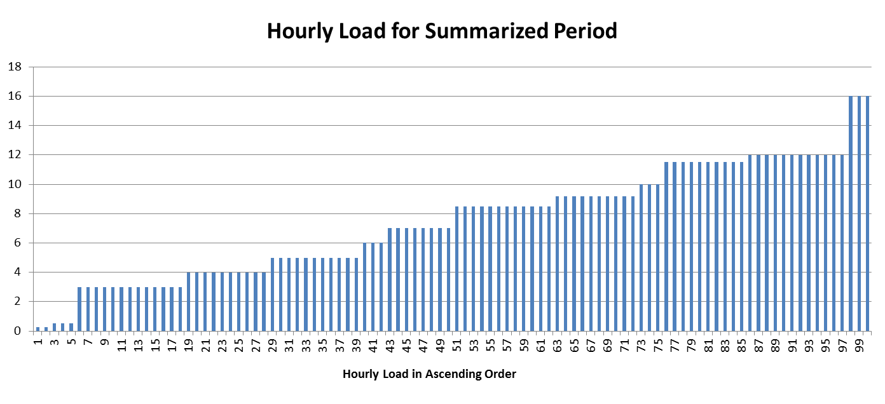
ERID Availability Metrics
1st MW Percentile – “mw_1st_pctile”
  Indicates the ERS Resource’s first percentile load level during the summarized period. The load for this resource was equal to or greater than this number for 99% of the intervals in the Time Period.
  Related to Alternate Baseline’s Maximum Base Load
= 0.25 MW, 99% of all intervals are equal to or greater than this number.
Interval MW for Summarized Period in Ascending Order

Slide 11
ERID Availability Metrics
Availability_Results tab in ERID – Metrics using historical load
Calculated using previous 12 month usage
Calculated using only specified Standard Contract Terms from the previous year

Slide 12
ERID Availability Metrics
5th MW Percentile – “mw_5th_pctile”
Indicates the ERS Resource’s 5th percentile load level during the summarized period. The load for this resource was less than this number for 5% of the intervals in the Time Period, and equal to or greater than this number for 95% of the intervals in the Time Period
Related to Default Baseline’s Offer/Availability Calculation
= 0.50 MW, 95% of all intervals are equal to or greater than this number.
Interval MW for Summarized Period in Ascending Order

Slide 13
ERID Availability Metrics
Availability_Results tab in ERID – Metrics using historical load
Calculated using previous 12 month usage
Calculated using only specified Standard Contract Terms from the previous year

Slide 14
ERID Availability Metrics
Average MW – “avg_mw”
  Represents the average actual Load during the summarized period
  avg_mw calculation excludes intervals where testing, events, or unavailability occurred
  Related to Alternate Baseline’s Offer/Availability Calculation
avg_mw = sum of interval MW in summarized period
_____________________________________________
number of intervals in summarized period
*avg_mw calculation is not necessarily the amount of load that can be offered, i.e., maximum base load is not considered

Slide 15
ERID Availability Metrics
Availability_Results tab in ERID – Metrics using historical load
Calculated using previous 12 month usage
Calculated using only specified Standard Contract Terms from the previous year

Slide 16
ERID Availability Metrics
Minimum Count of ESIIDs – “min_esiid_ct”
  For aggregations, indicates the number of sites used to calculate metrics. Only sites with complete data are included in the calculations, so the number reported may be less than the number of sites submitted in an aggregation.

Slide 17
ERID Baseline Metrics
Baseline_Info Tab in ERID – Metrics for Baselines
How well does a baseline represent the actual load?

Slide 18
ERID Baseline Metrics
Baseline_Info Tab in ERID – Metrics for Baselines

Slide 19
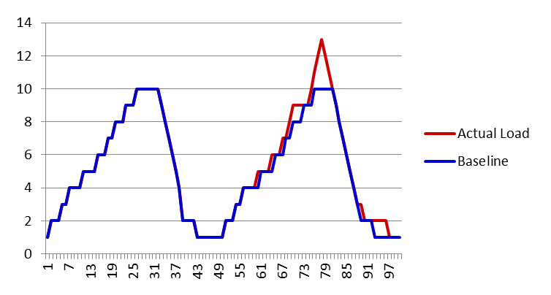
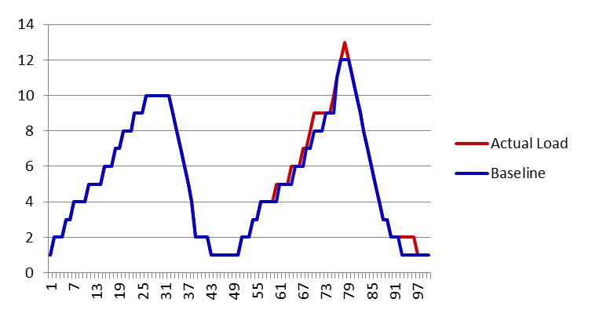
ERID Baseline Metrics
The percent of variation in actual load that is explained by variation in the baseline load is Rsquare.
Baseline 2 follows the variation in the actual load better than Baseline 1, so Baseline 2 will have a higher Rsquare.
Baseline 1
Baseline 2
*An Rsquare of 100% would indicate a perfect baseline

Slide 20
ERID Baseline Metrics
Baseline_Info Tab in ERID – Metrics for Baselines

Slide 21
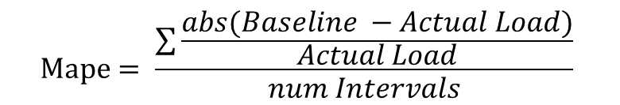
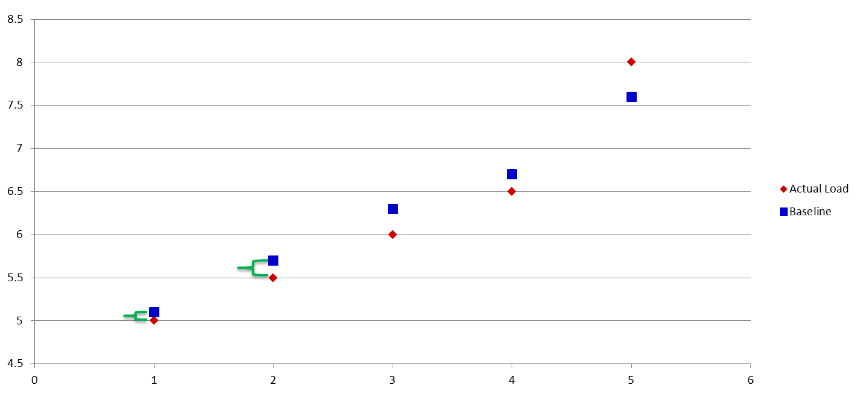
ERID Baseline Metrics
MAPE
  Mean Absolute Percent Error - Average absolute difference between the actual load and the baseline estimate, as a percent of the actual load
Average absolute percent difference using all intervals
Diff₅ = Baseline _{Interval} ₅ – Actual Load _{Interval 5}
Diff₄
Diff₃
Diff₂
Diff₁

Slide 22
ERID Baseline Metrics
It is important to compare MAPE to planned MW reduction
Problem Cases
MW reduction is small in comparison to premise level metering
  Example:
    3.895 Average MW load
    0.35 MW obligation
    6% MAPE
MW reduction is entire premise load
  Example:
    1 MW Average MW load
    1 MW obligation
    6% MAPE

Slide 23
Example: Using ERID Baseline Metrics
Small MW Reduction Example
MAPE = 4.04%
AVG_MW = 3.895
MW_5th_pctile = 3.401
MW_1st_pctile = 2.939
Offer = 0.35
Using the MAPE with the Average MW, we can conclude that there will be an average baseline error equal to,
Average MW Error = MAPE * Average MW = 0.116
With an offer of 0.350 MW, the average baseline error is 33% of the offer. This could lead to test/event performance issues.

Slide 24
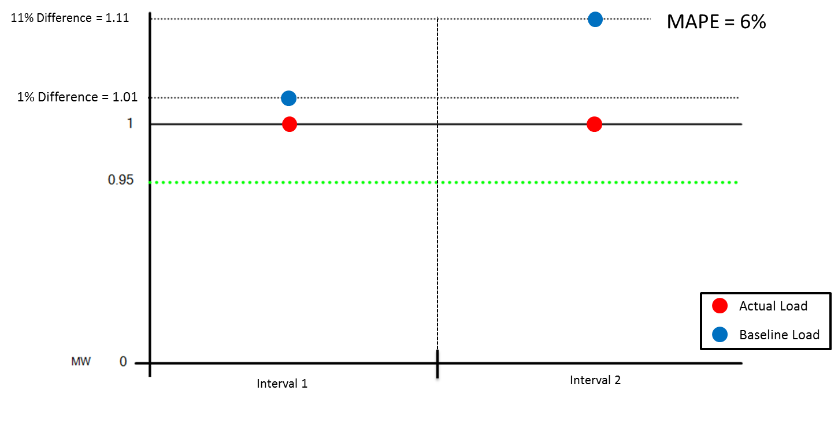
ERID Baseline Metrics
MAPE Scenario 1: Baseline estimates are above actual for all intervals

Slide 25
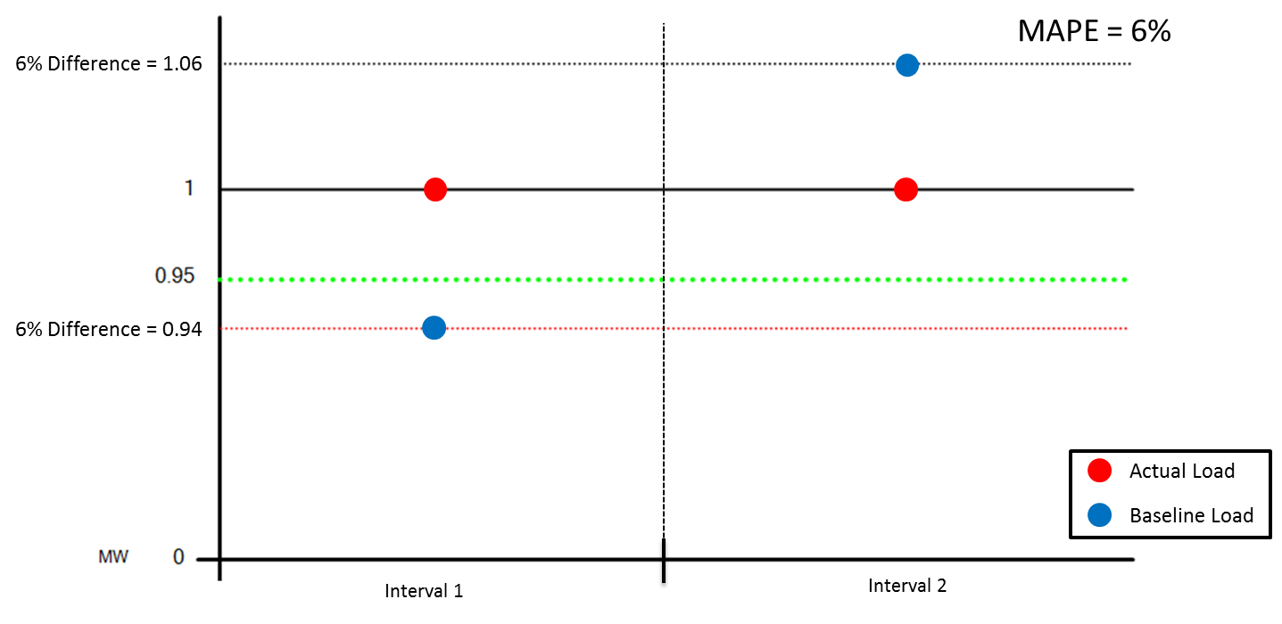
ERID Baseline Metrics
MAPE Scenario 2: Baseline estimates are equally above and below actual with some baseline estimates below 95% of actual.

Slide 26
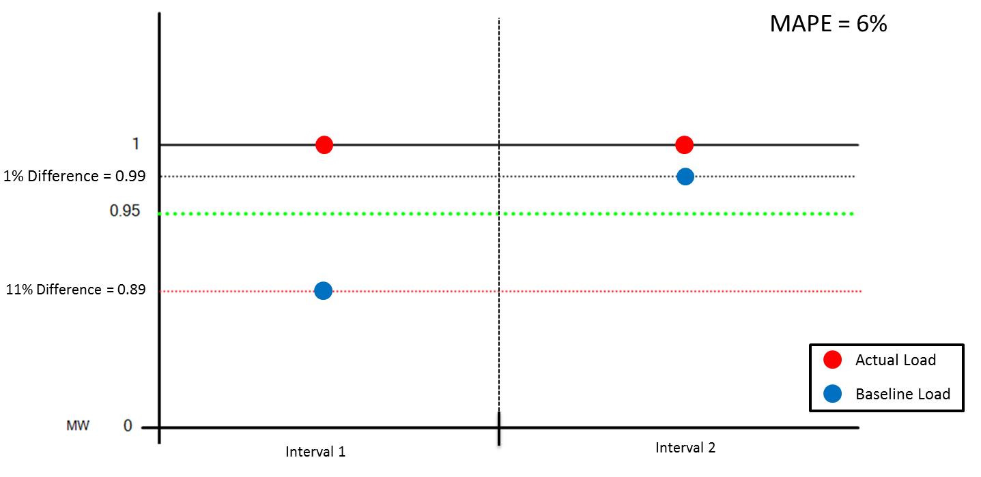
ERID Baseline Metrics
MAPE Scenario 3: Baseline estimates are always below actual with majority of estimates below 95% of actual.

Slide 27
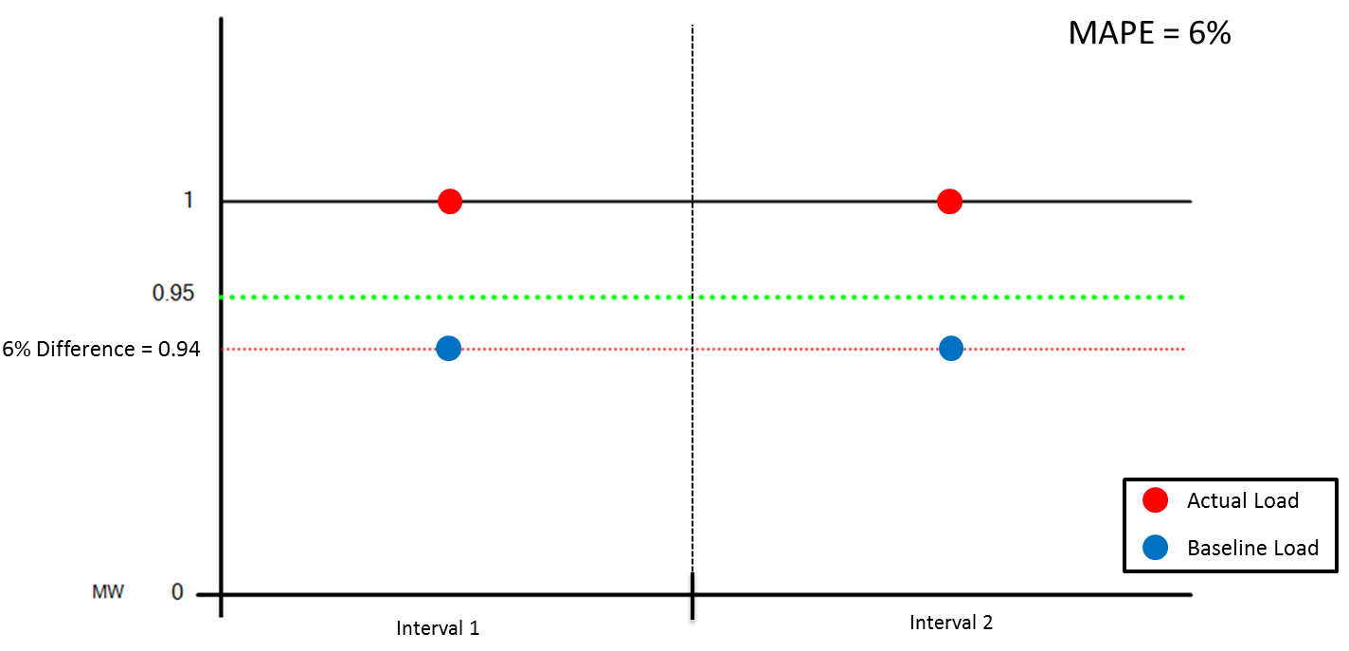
ERID Baseline Metrics
MAPE Scenario 4: Baseline estimates are always below 95% of actual.

Slide 28
ERID Baseline Metrics
Baseline_Info Tab in ERID – Metrics for Baselines

Slide 29
ERID Baseline Metrics
P90_kW_Confidence, P95_kW_Confidence , P99_kW_Confidence
Based on historical data, the kW amount by which a QSE may consider de-rating an offer to achieve a 90%, 95%, or 99% probability of meeting event performance requirements
Note that all baselines should be expected to underestimate and overestimate the actual load in an unpredictable way
*Offer is in MW and Confidence is in kW

Slide 30
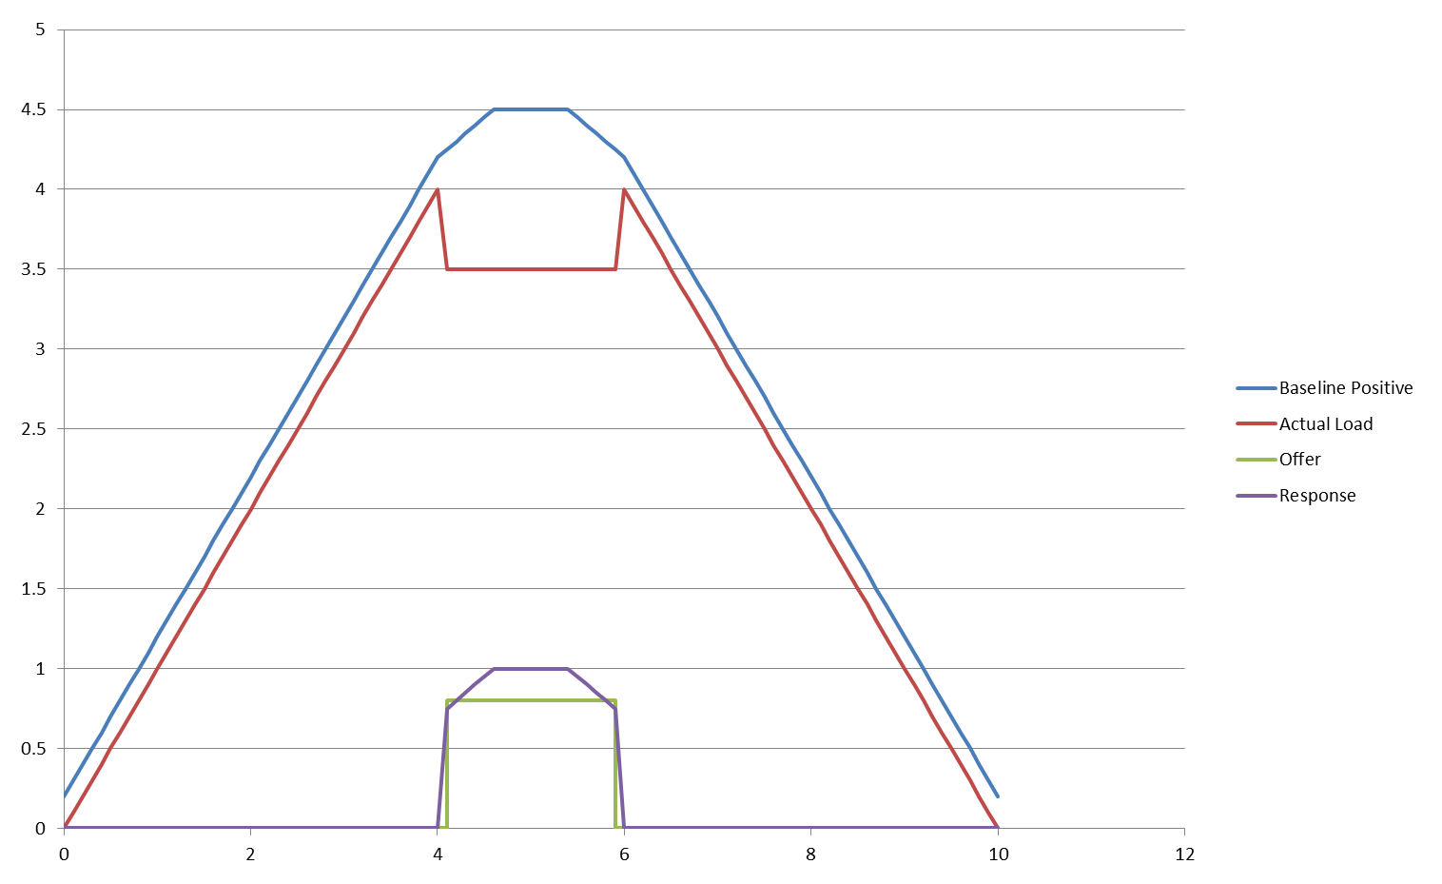
ERID Baseline Metrics
Baseline is estimating above actual load
Response calculated is higher than offer

Slide 31
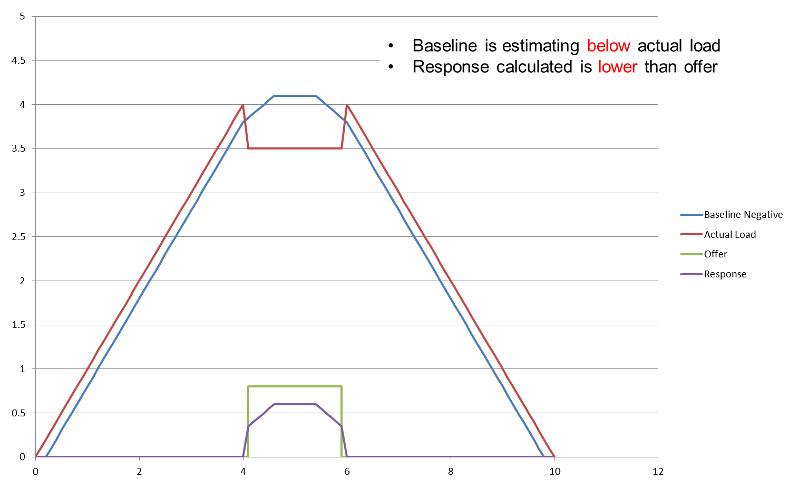
ERID Baseline Metrics

Slide 32
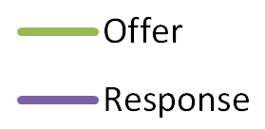
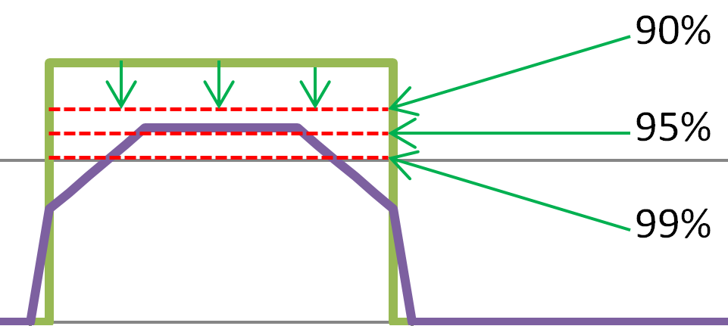
ERID Baseline Metrics
Higher Confidence level requires larger de-rate

Slide 33
Review of Resource
Level Test and Event Metrics

Slide 34
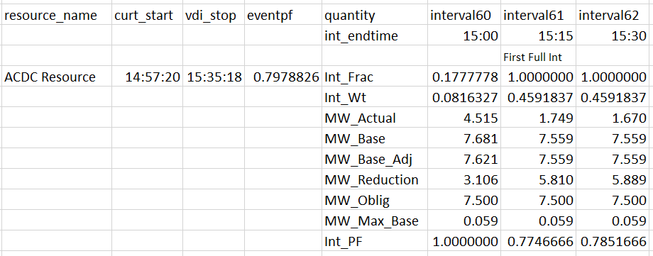
Test / Event Performance Metrics – All Baselines
Example of Resource Test/Event Results
First Full Interval
Int_Frac = (900sec – (12min*60 sec+20sec) ) / 900sec
Successful Test Performance = Resource must pass both eventpf & first full interval with a 0.95 or greater.
(900 – 740) / 900 = 0.1777778
Curt_start = VDI + ramp (10 or 30min)
Eventpf - time weighted average of the interval performance factors
Int_frac - fraction of the interval that is in the test/event
Int_Wt - percent of time in the test/event for the interval
MW_Actual - metered load for the Resource

Slide 35
Review Test Results for
Default Baseline Resources

Slide 36
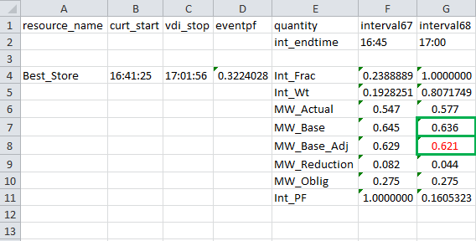
ERS Test Results - Default Baseline
Adjusted Baseline Estimates (MW_Base_Adj )
To improve the accuracy of the baseline an event-day adjustment is applied to the unadjusted baseline estimates. For more information see Default Baseline Methodology.doc posted at https://www.ercot.com/services/programs/load/eils/documents
MW_Base = Unadjusted Baseline estimates
MW_Base * Event-day adjustment(EDA) = MW_Base_Adj
.636 * EDA = 0.621

Slide 37
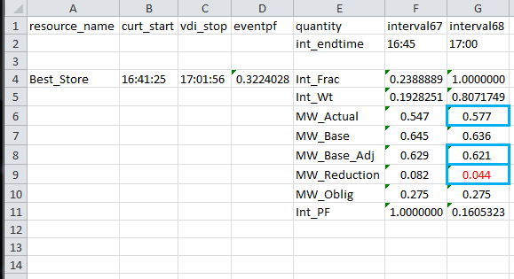
ERS Test Results - Default Baseline
MW Reduction (MW_Reduction)
(MW_Base_Adj - MW_Actual) = MW_Reduction
G8 – G6 = G9
.621 – .577 = .044

Slide 38
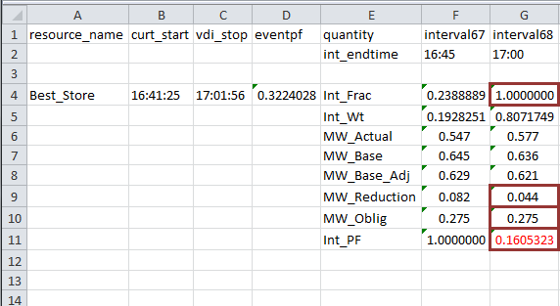
ERS Test Results - Default Baseline
Interval Performance (Int_PF)
MIN(1,MAX(0,MW_Reduction/(Int_Frac*MW_Oblig))) = Int_PF
MIN(1,MAX(0,G9/(G4*G10))) = G11
MIN(1,MAX(0,0.044/(1.0 * 0.275 ))) = 0.1605323

Slide 39
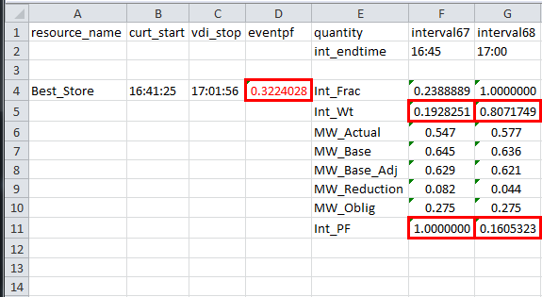
ERS Test Results - Default Baseline
Event Performance (eventpf)
sum(of all (Int_Wt * Int_PF)) = eventPF
F5*F11+G5*G11 = D4
0.1928251* 1.0 + 0.8071749 * 0.1605323 = 0.3224028

Slide 40
Review Test Results for Alternate Baseline Resources

Slide 41
ERS Test Results - Alternate Baseline
Adjusted Baseline Estimates (MW_Base_Adj )
First Partial Interval
MW_Base_Adj = (MW_Oblig + MW_Max_Base)
Alternate baseline - MW_Base_Adj for the first partial interval is determined using one of the default baseline (i.e. Nearest 20 or Mid 8 of 10).
Exception: If the actual load for the first partial interval is less than the maximum base load, the EIPF for that interval shall be set to one.
G10 + G11 = G8
7.500 + 0.059 = 7.559

Slide 42
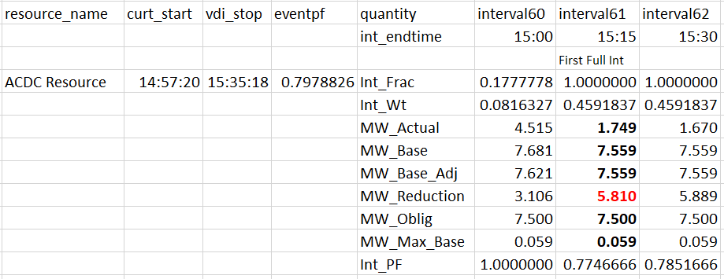
ERS Test Results - Alternate Baseline
MW Reduction (MW_Reduction)
MW_Reduction = (MW_Base_Adj - MW_Actual)
MW_Reduction = G8 – G6 = G9
7.559 – 1.749 = 5.810

Slide 43
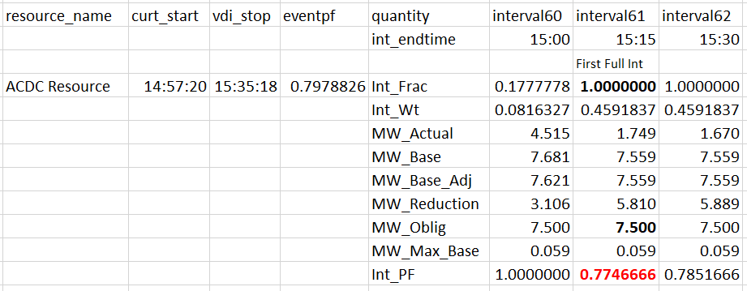
ERS Test Results - Alternate Baseline
Interval Performance (Int_PF)
Int_PF = MIN(1,MAX(0,MW_Reduction/(Int_Frac*MW_Oblig)))
MIN(1,MAX(0,G9/(G4*G10))) = G12
MIN(1,MAX(0,5.810/(1.0 * 7.500 ))) = 0.7746666

Slide 44
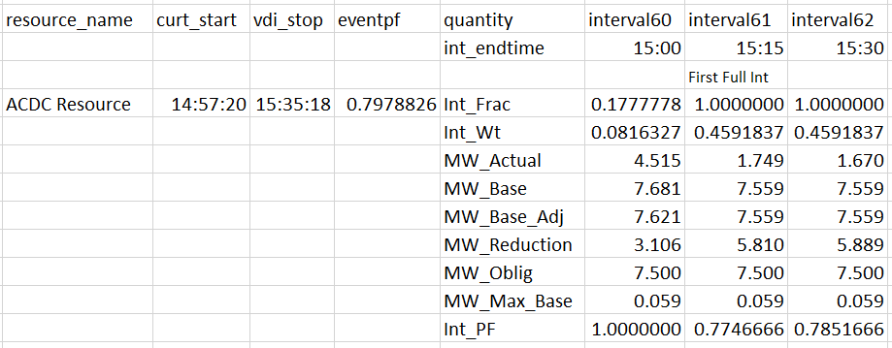
ERS Test Results - Alternate Baseline
Test/Event Performance (eventpf)
EventPF = sum(of all (Int_Wt * Int_PF))
F5*F12+G5*G12+H5*H12 = D4
0.0816327* 1.0 + .04591837 *.7746666 +.04591837 * .0751666 = 0.7978826

Slide 45
ERS Test Performance Factor (ERSTESTPF)
* Testing – ERSTESTPF will be set to 1 if the Resource subsequently passes an event during the SCT
Example1: Standard Contract Term 1
Fail
Fail
Example 2: Standard Contract Term 1 Standard Contract Term 2
Payment Reduction
Fail
Pass
Fail
Fail
No test for one year
Payment Reduction SCT1
Payment Reduction SCT2

Slide 46
QSE Level Event Performance (ERSEPF)

Slide 47
Improving Test/Event Performance
Baseline error is larger than Offer MW amount
Can occur when the premise level load is much larger than the load being curtailed
Options to Improve Accuracy:
  Sub-meter the load being curtailed and offer on an Alternate baseline
  De-rate Offer based on ERID kW confidence amount
Baseline error when entire load is being curtailed
Can occur when a backup generator is being used to offset the entire load
  Options to Improve Accuracy:
  De-rate Offer based on ERID kW confidence amount

Slide 48
Standard Contract Term (SCT) QSE Level Availability Results

Slide 49


QSE Portfolio Level Availability Results
*Combined default and alternate, weighted by time and capacity

Slide 50
QSE Level Availability Factor (ERSAFCOMB)

Slide 51
QSE Level Availability Factor (ERSAFCOMB) Example
Initial Review
QSE
Resource A
Resource B
ERSAFCOMB = 75%
AF = 100%
AF = 50%
< 95% = FAIL
Review Resources AF < 85%
Adjustment Review
QSE
Resource A
Resource B
AF = 100%
AF = (50%)² = 25%
Adjusted ERSAFCOMB = 62.5%
*For this example, both Resource obligations are equal for illustration purposes.

Slide 52
Improving Availability

Slide 53
Substitution vs Supplemental
Substitution
  A method to continue to meet Resources’ ERS commitment during unanticipated periods of unavailability or reduced availability
  1-for-1 Resource replacement
    All or some sites from original can be included
  Specific to a Resource, Baseline Type (Default/Alternate), and Resource Type (Load/Generator)
  Obligation can not be changed
Supplemental
  A method to supplement portfolio-level obligations
  Supplemental load is included in portfolio-level load for availability and event performance
  Zero obligation, therefore no payment for Supplemental Resources
  For event performance, Load reduction equal to the lesser of the capacities specified on its ERS Submission Form or the load reduction provided during the event.
  To receive a portfolio level benefit, the supplemental resource should to match the evaluation type of the resource(s) that are underperforming.
Substitutions and Supplemental Resources can both be provisional or pre-qualified

Slide 54
ERS Settlement Timeline

Slide 55
ERS Settlement Timeline
Availability 45 days following the end of the SCT
RTM Final Settlement 55 days following the operating day
Meter data due 35 days
ERS Settlement 75day (55 + 20)
Last day of the SCT
Payment Reduction for 2 or more test failures sent to QSE for Review
Resolve missing meter data issue
Finalize Availability and Payment Reductions for Test Failures
Activities that begin after day 55
-Settlement team calculates Load Ratio Share for each LSE - need for SPUCL calculation - 2 business days
-ERS team creates settlement workbooks for Resource Level and QSE Level – 4 business days
-Settlement team creates payments and uplift cuts for each QSE and LSE and imports to database – min of 4 days
Note: excluding 6 days for weekends during this period only 14 business days available to complete these activities

Slide 56
ERS Deployment and Contract Period Renewal

Slide 57
Outline
Pre ERS Deployment
Preparation
During ERS Deployment
When to deploy
When to resume normal operations
Post ERS Deployment
Obligation Exhaustion
Contract Renewal

Slide 58
Pre ERS Deployment

Slide 59
Know Thy Resources
Obligated time period(s)
Ramp
Cumulative Deployment Obligation time
  Deployment Obligation Time: The cumulative time during the Sustained Response Period of an event during which an ERS resource has an obligation
Day 1
Day 2
TP1
TP1
Obligation
3.5 hours
2.5 hours
Event 1
Event 2
Event
Deployment Obligation Time = 3 hours
Deployment Obligation Time = 2 hours
Cumulative deployment Obligation time after Event 1 = 3 hours
Cumulative deployment Obligation time after Event 2 = 5 hours
Notes:
Section 3.14.3.3(2)

Slide 60
What to expect?
ERCOT Protocol Sections 6.5.9.4.1 & 6.5.9.4.2
  Deployment
    PRC falls below 3,000 MW and is not projected to recover within 30 minutes
      All ERS Service Types
    EEA level 1
      Un-deployed ERS resources
    EEA Level 2
      Un-deployed ERS resources
  Communication
    Deployment
      XML Message, followed by VDI to all-QSE hotline
      The ramp period shall begin at the completion of the VDI
    Release
      XML Message, followed by VDI to all-QSE hotline
      VDI represents the official notice of the release
Notes:
Section Reference:
6.5.9.4.2(1)(a)
6.5.9.4.2(2)(a)

Slide 61


Whether to deploy
The resource should
Deploy if
  It is contractually committed to provide the ERS service type deployed during the ERS Time Period that includes all or any part of the first interval of the Sustained Response Period, with the following exceptions:
    10-hour-recovery period from a previous deployment
Not deploy if
  It does not have an obligation for any part of the first interval of the Sustained
  Response Period.
Deploy if obligated during any part of the first interval
Notes:
Section Reference:
3.14.3.3 (1)

Slide 62
During ERS Deployment

Slide 63

Knowledge Checkpoint 1

Slide 64
Scenario 1: Should Resource 1 deploy?
Sustained Response Period
Starts
VDI
Starts
VDI
Stops
Obligated
hours
First Interval
Sustained
Response Period
Time
Deploy!
If ERCOT deploys ERS, any ERS Resource that is contractually committed to provide the ERS service type deployed during the ERS Time Period that includes all or any part of the first interval of the Sustained Response Period must deploy.
Notes:
Section Reference:
3.14.3.3 (1)

Slide 65
Scenario 2: Should Resource 2 deploy?
Sustained Response Period
Starts
VDI
Stops
VDI
Starts
Obligated
hours
First Interval
Sustained
Response Period
Time
Deploy!
If ERCOT deploys ERS, any ERS Resource that is contractually committed to provide the ERS service type deployed during the ERS Time Period that includes all or any part of the first interval of the Sustained Response Period must deploy
Notes:
Section Reference:
3.14.3.3 (1)

Slide 66
Scenario 3: Should Resource 3 deploy?
Sustained Response Period
Starts
VDI
Starts
VDI
Stops
Obligated
hours
Obligated
hours
First Interval
Sustained Response
Period
Time
Not required to deploy.
If an ERS Resource does not have an obligation for any part of the first interval of the Sustained Response Period, the ERS Resource is not required to deploy at any time during the Sustained Response Period.
Notes:
Section Reference:
3.14.3.3 (1)

Slide 67
Scenario 4: Should Resource 4 deploy?
Sustained Response Period
Starts
VDI
Starts
VDI
Stops
Obligated
hours
First Interval
Sustained
Response Period
Time
Deploy!
If ERCOT deploys ERS, any ERS Resource that is contractually committed to provide the ERS service type deployed during the ERS Time Period that includes all or any part of the first interval of the Sustained Response Period must deploy.
Notes:
Section Reference:
3.14.3.3 (1)

Slide 68
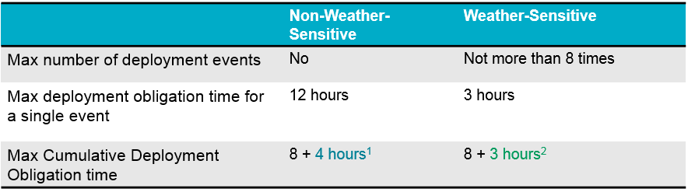
Deployment Obligation
¹ For a Non-Weather-Sensitive ERS Resource, if an ERS deployment is still in effect when the ERS Resource’s cumulative deployment obligation time equals or exceeds eight hours, the ERS Resource must continue to meet its event performance requirements for the next four hours or until ERCOT releases the ERS Resource, whichever comes first.
² If an ERS deployment is still in effect when the Weather-Sensitive ERS Resource’s cumulative deployment obligation time equals or exceeds eight hours, the ERS Resource must continue to meet its event performance requirements until the three-hour maximum deployment obligation time for that event is met or ERCOT releases the ERS Load, whichever comes first.
Notes:
Section Reference:
Non-Weather-Sensitive: Section 3.14.3.3 (3)(a)
Weather-Sensitive: Section 3.14.3.3 (3)(b)

Slide 69
Knowledge Checkpoint 2

Slide 70
During ERS Deployment
Non-Weather-Sensitive (Non-WS)
Scenario 5
Resource 5 (Non-Weather-Sensitive) has a 30 minute ramp, a TP1 (6:00 AM - 8:00 AM) obligation of 10 MW, a TP2 (8:00 AM - 1:00 PM) obligation of 10 MW, a TP3 (1:00 PM - 4:00 PM) obligation of 10 MW and a TP4 (4:00 PM - 7:00 PM) obligation of 10 MW .The deployment instruction is issued at 5:30AM on a weekday. Resource 5 started deploying at 6AM.
(a) At 2PM, the cumulative deployment time reaches 8 hours. Can Resource 5 resume its normal operation after 2PM, if recall was never issued?
(b) If the recall was never issued at 6PM, can Resource 5 resume its normal operation after 6PM?

Slide 71
Scenario 5: Resource 5 (ERS-30)
No event prior to this event
3. Resource 5 has deployed for 8 hours at 2pm
Obligated in all time periods
Question 1:
Can they resume normal operation at 2pm?
No
Question 2:
Can they resume normal operation at 6pm if recall has not yet been issued?
2. Sustained Response Period started at 6am and Resource 5 deployed
1. VDI issued at 5.30am
Yes
Notes:
Scenario 5
Resource 5 (Non-Weather-Sensitive) has a 30 minute ramp, a TP1 (6:00 AM - 8:00 AM) obligation of 10 MW, a TP2 (8:00 AM - 1:00 PM) obligation of 10 MW, a TP3 (1:00 PM - 4:00 PM) obligation of 10 MW and a TP4 (4:00 PM - 7:00 PM) obligation of 10 MW .The deployment instruction is issued at 5:30AM on a weekday. Resource 5 started deploying at 6AM.
(a) At 2PM, the cumulative deployment time reaches 8 hours. Can Resource 5 resume its normal operation after 2PM, if recall was never issued?
(b) If the recall was never issued at 6PM, can Resource 5 resume its normal operation after 6PM?
Reference Section: Section 3.14.3.3 (3)(a)
if an ERS deployment is still in effect when the ERS Resource’s cumulative deployment obligation time equals or exceeds eight hours, the ERS Resource must continue to meet its event performance requirements for the next four hours or until ERCOT releases the ERS Resource, whichever comes first.

Slide 72
During ERS Deployment
Weather-Sensitive
Scenario 6
Resource 6 (Weather Sensitive) has a 30 minute ramp, a TP3 (1:00 PM - 4:00 PM) obligation of 10 MW and a TP4 (4:00 PM - 7:00 PM) obligation of 10 MW. The deployment instruction is issued at 12.30 PM on a weekday. Resource 6 deployed at 1PM. Prior to the event, Resource 6 has a cumulative deployment time of 7 hours.
(a) If the recall was never issued, when can Resource 6 resumes its normal operation without affecting its event performance?

Slide 73
Scenario 6: Resource 6 (ERS-30 WS)
Cumulatively deployed for 7 hours before the event
2. Sustained Response Period started at 1pm and Resource 6 deployed
1. VDI issued at 12.30pm
Obligated in TP3
(1pm-4pm)
and TP4
(4pm -7pm)
3. Cumulative deployment obligation time reached 8 hours at 2pm
Event reached 3 hours at 4pm
Question 3:
When is the earliest time Resource 6 can resume its normal operation if recall has not yet been issued?
4pm
Because the maximum event deployment obligation time for Weather Sensitive
is 3 hours
Notes:
Scenario 6
Resource 6 (Weather Sensitive) has a 30 minute ramp, a TP3 (1:00 PM - 4:00 PM) obligation of 10 MW and a TP4 (4:00 PM - 7:00 PM) obligation of 10 MW. The deployment instruction is issued at 12.30 PM on a weekday. Resource 6 deployed at 1PM. Prior to the event, Resource 6 has a cumulative deployment time of 7 hours.
(a) When is the earliest time Resource 6 can resume its normal operation if recall has not yet been issued?
4pm
Because the maximum event deployment obligation time for Weather Sensitive
is 3 hours
Reference Section: Section 3.14.3.3(3)(b)(iii)
If an ERS deployment is still in effect when the Weather-Sensitive ERS Resource’s cumulative deployment obligation time equals or exceeds eight hours, the ERS Resource must continue to meet its event performance requirements until the three-hour maximum deployment obligation time for that event is met or ERCOT releases the ERS Load, whichever comes first.

Slide 74
Post ERS Deployment

Slide 75
Post ERS deployment
ERCOT will communicate the official VDI times (both deployment and release) for the event.
Keep track on cumulative deployment obligation time for each of your resources
  Use official VDI time for both deployment and release
Determine which resource has exhausted its obligation
  When Cumulative Deployment Obligation time reached 8 hours

Slide 76
Three possible outcomes
None of the resources exhausted its obligation
At least one of the resources exhausted its obligation and ERCOT decided to renew
At least one of the resources exhausted its obligation and ERCOT decided not to renew
Note: if ERS resource(s) migrates to a Must-Run Alternative contract, the contract would be renewed as well.

Slide 77
If none of the resources exhausted its obligation
ERS Contract Period continues
Cumulative Deployment Obligation time is calculated for each resource.
Contract period
Before Event
During event
After Event
Cumulative
Deployment Obligation Time
= 0 hours
Deployed
Cumulative
Deployment Obligation Time
= 5 hours
5 hours
Notes:
Protocol References:
3.14.3.1(16)(a)
3.14.3.1(18)(b)

Slide 78
If at least one of the resources exhausted its obligation and ERCOT decided not to renew
A new Contract Period will begin
All the resources that exhausted their obligation in a previous contract period are no longer obligated in the new Contract Period.
For all resources that did not exhaust their obligation in a previous Contract Period, Cumulative Deployment Obligation time is rolled over from previous Contract Period for each resource.
Exhausted but not renewed
Did not exhaust
Standard Contract Term
Standard Contract Term
1st Contract Period
2nd Contract Period
1st Contract Period
2nd Contract Period
Deployed
No obligation
Deployed
Cumulative
Deployment Obligation Time = 5 hours
8 hours
5 hours
Notes:
Protocol References:
3.14.3.1(16)(b)
3.14.3.1(18)(b)

Slide 79
If at least one of the resources exhausted its obligation and ERCOT decided to renew
A new Contract Period will begin.
For all the resources that exhausted their obligation in a previous Contract Period and opted for renewal, their Cumulative Deployment Obligation time will be reset to zero.
For all resources that did not exhaust their obligation in a previous Contract Period, Cumulative Deployment Obligation time is rolled over from previous Contract Period for each resource.
Exhausted but renewed
Did not exhaust
Standard Contract Term
Standard Contract Term
1st Contract Period
2nd Contract Period
1st Contract Period
2nd Contract Period
Deployed
Cumulative Deployment Obligation Time = 0 hours
Deployed
Cumulative Deployment Obligation Time = 5 hours
8 hours
5 hours
Notes:
Protocol References:
3.14.3.1(16)(c)
3.14.3.1(18)(b)

Slide 80
Contract Period Renewal
Only exhausted resources which opted for renewal will be considered for renewal in the new Contract Period
ERCOT will determine which service-type(s) and time-period(s) to renew
By the end of the 2nd business day of the renewed ERS Contract Period, QSEs may revoke the renewal opt-in status for future Contract Periods
By the end of the 3rd Business Day in any ERS Contract Period (other than the first), ERCOT shall communicate to QSEs a confirmation of the terms of participation for all of their committed resources.
Notes:
Protocol References:
3.14.3.1(18)(c)

