Slide 1
Resource Integration & On-going Operations Resources Services
(RIOO-RS)
Project Update
23 April 2020

Slide 2
Test System Updated March 23
Expand View and Update Capability beyond Dates and Details to include
  REC info
  PUN
  Limits
  Operational Parameters
  Reactive Capability
  SSR
Data reflects February 10th refresh
  User registration information is retained
  All updates and change requests will be deleted
Market notice sent March 26 to all REs
  Signup Guide attached
  All REs should get access to the system now
If you need help, email RIOO-HELP@ercot.com

Slide 3
What to do in the RIOO Test System?
User access will need to be coordinated by the MP with its USA
  Each user need his/her own email to get into the system – not an alias or group email
  Each user needs to have a mobile phone number to received messages from the authentication service
RIOO-RS system is available for training and testing, with more update capability added with each release
What users can do:
  Verify data.
  The “Update Capability” is being made available for the most frequently changed items first.
  Data will be updated and over written with production data on a regular interval.
  Data changed during the training/testing phase will not be stored.
  User registration information is the exception, this will be saved.
Let us know:
  RIOO-HELP@ercot.com

Slide 4
How to get access
The user:
  Gets the role “RIOORS_M_OPERATOR” from his/her USA
  Gets an email
    Clicks on “Verify my account” button
  Types in URL for the system
    Clicks “Don’t remember your password” button
  Gets a change password email
    Clicks on change my password button
  Changes his/her password
  Types in URL for the system, sign with user-id / password
  Setups authentication
    Scans code or enter mobile phone for SMS
    Saves Recovery code
    Confirms authorization method
    (Google Authenticator/ Auth0 guardian/SMS)
  Get an email
  Click on verify my account button
  Access the RIOO-RS, sign with user-id / password

Slide 5
Information/Data issues
ERCOT provided an updated RARF, Delta Report, and Audit Report to the REs in August.
  185 of 212 received and processed
  27 outstanding
Sites may need to be split
  Less than 10

Slide 6
Discussion
or
Questions

Slide 7
Wireframe Review

Slide 8
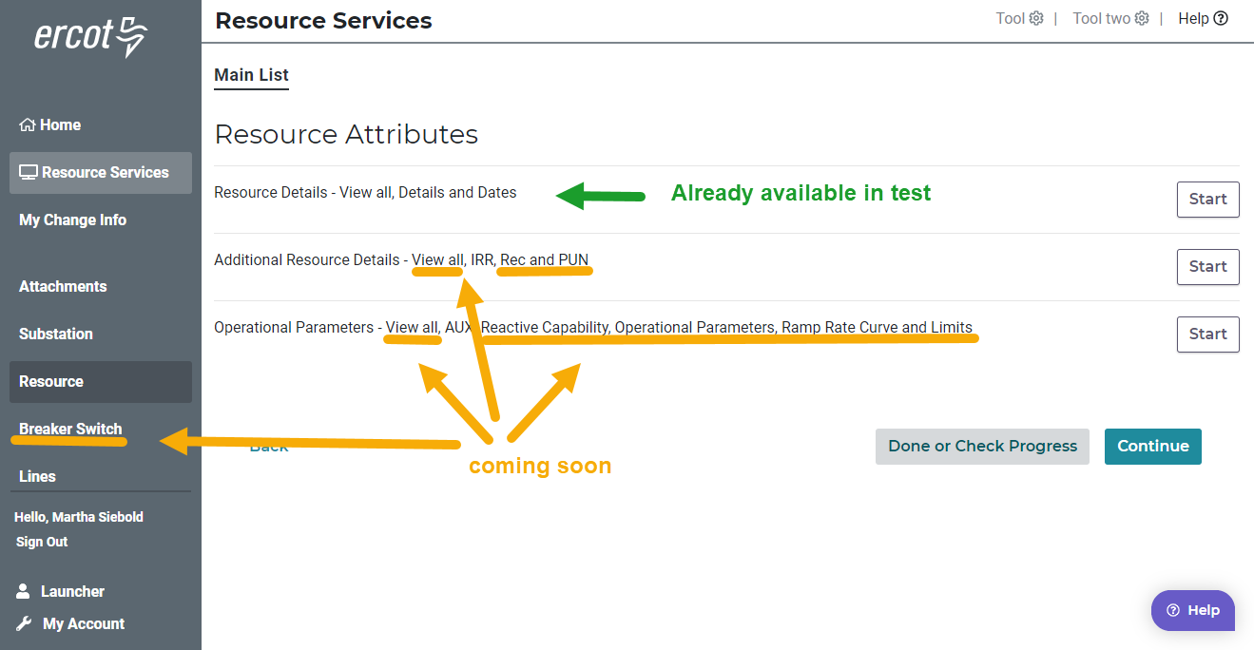
Test Environment

Slide 9
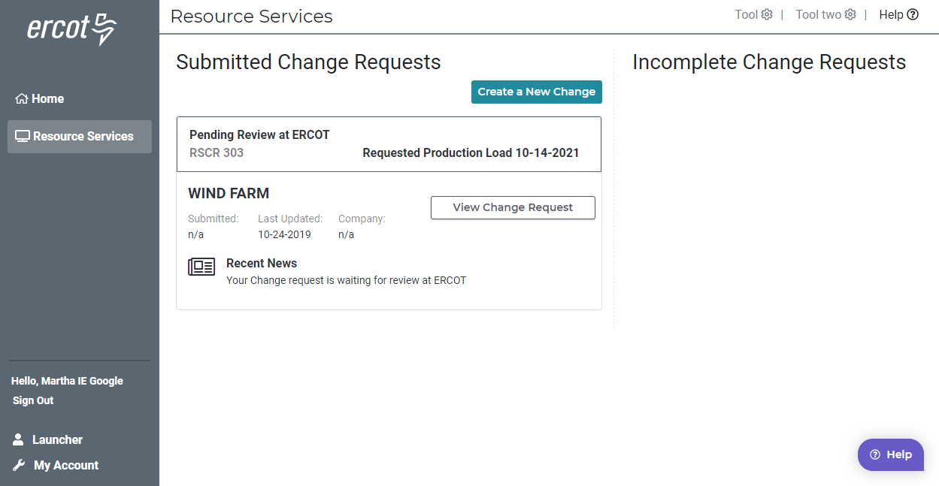
Resource Entity Dashboard

Slide 10
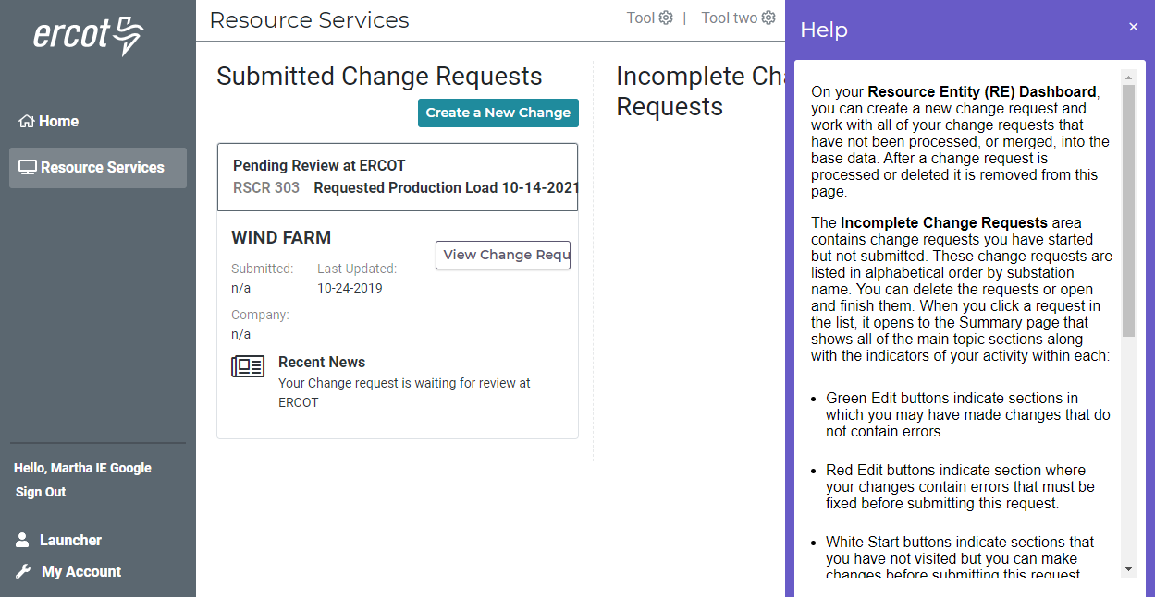
Help – on every page

Slide 11
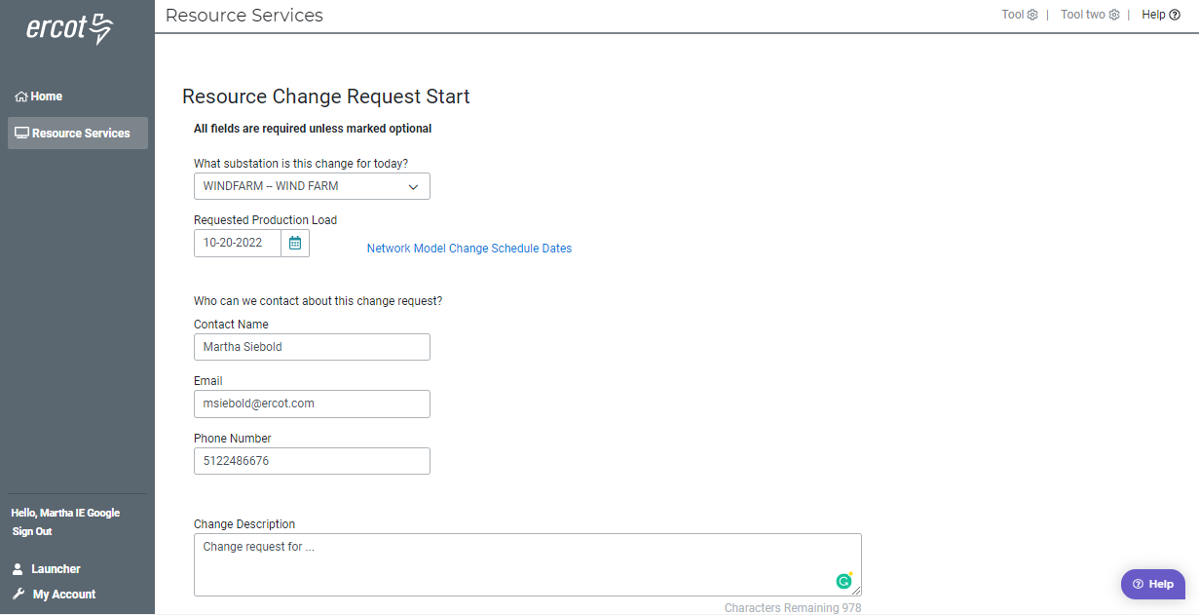
Starting your change request

Slide 12
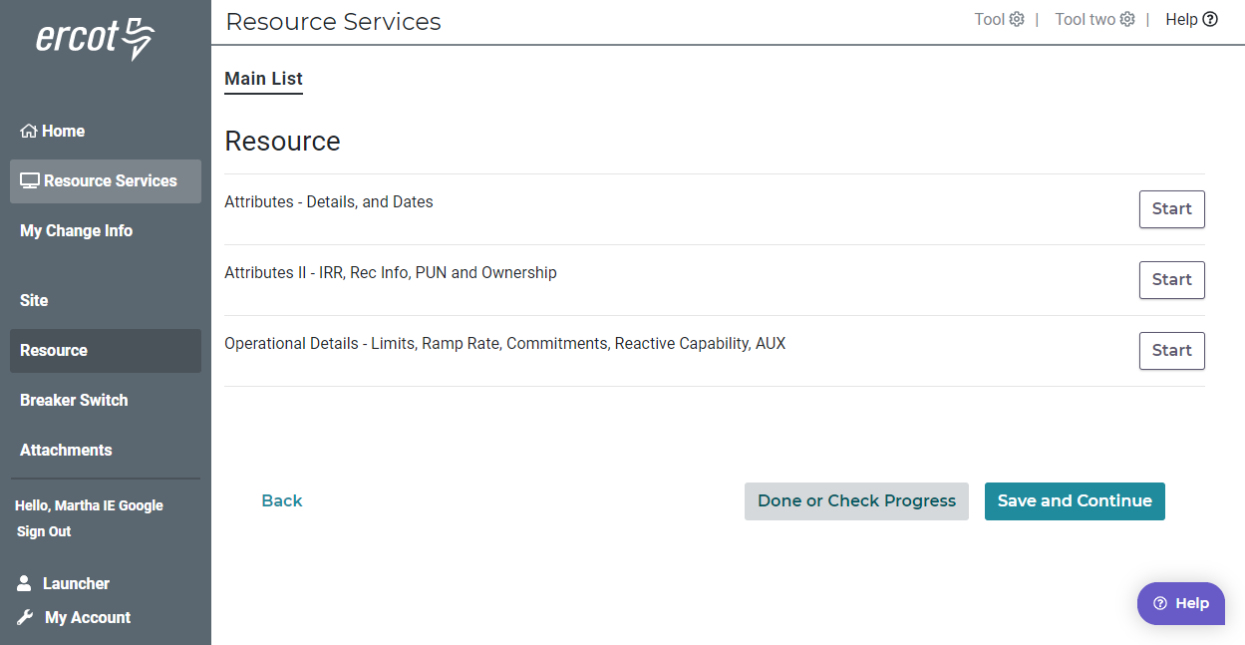
Main List

Slide 13
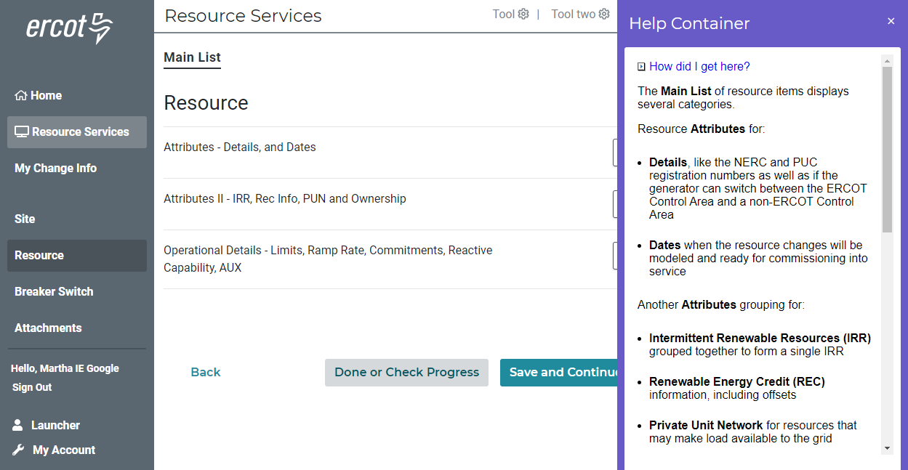
Main Lists – Help – Describes Lists

Slide 14
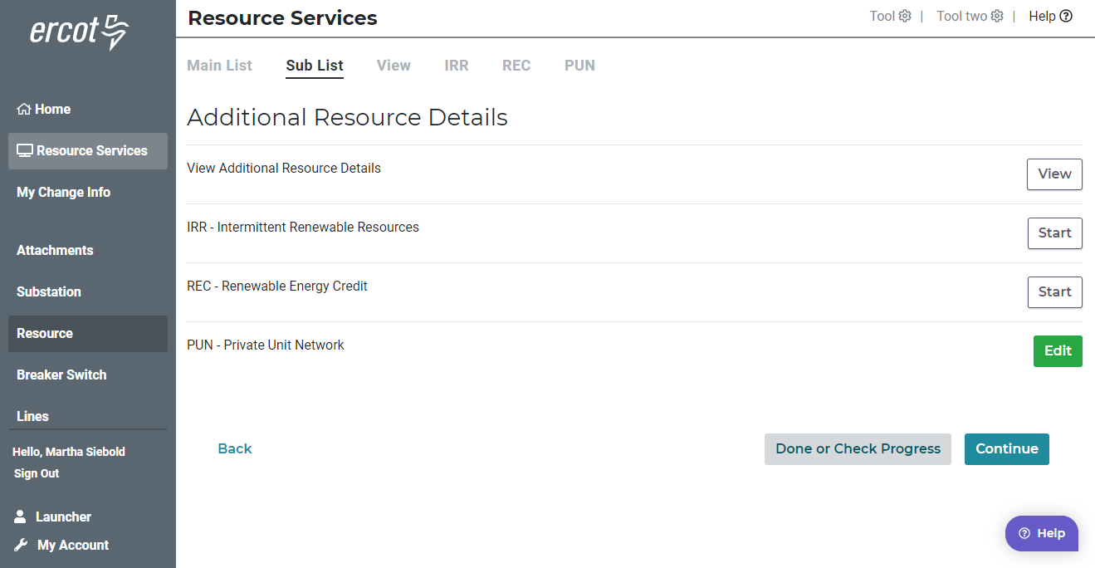
Additional Resource Details – Sub list

Slide 15
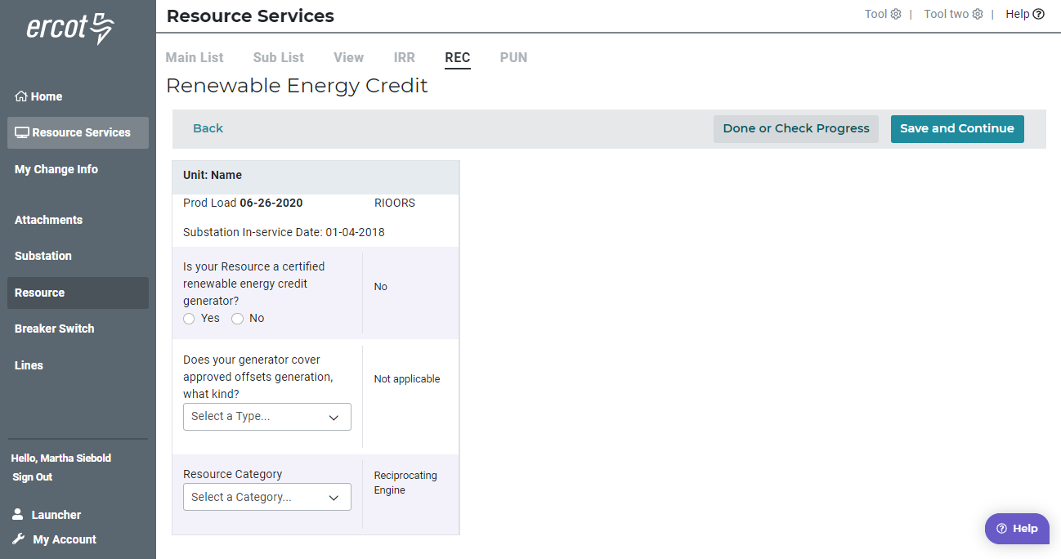
Renewable Energy Credit

Slide 16
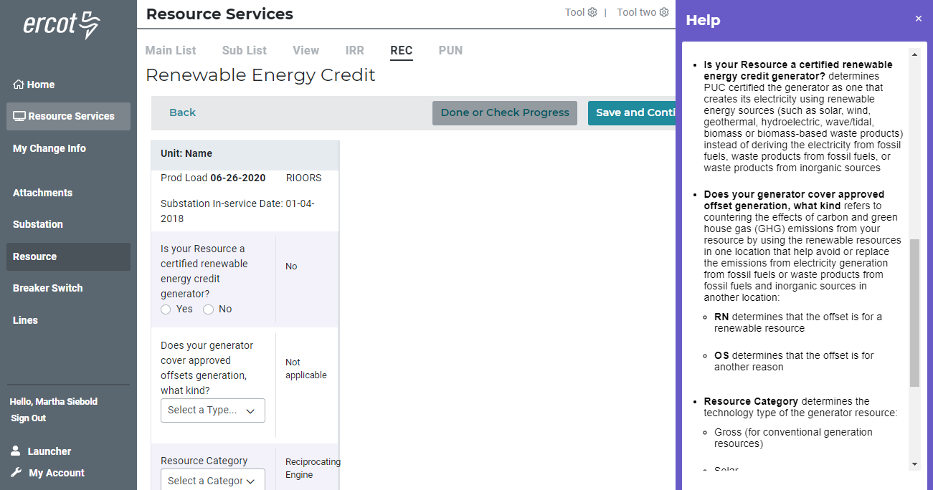
Renewable Energy Credit - Help

Slide 17
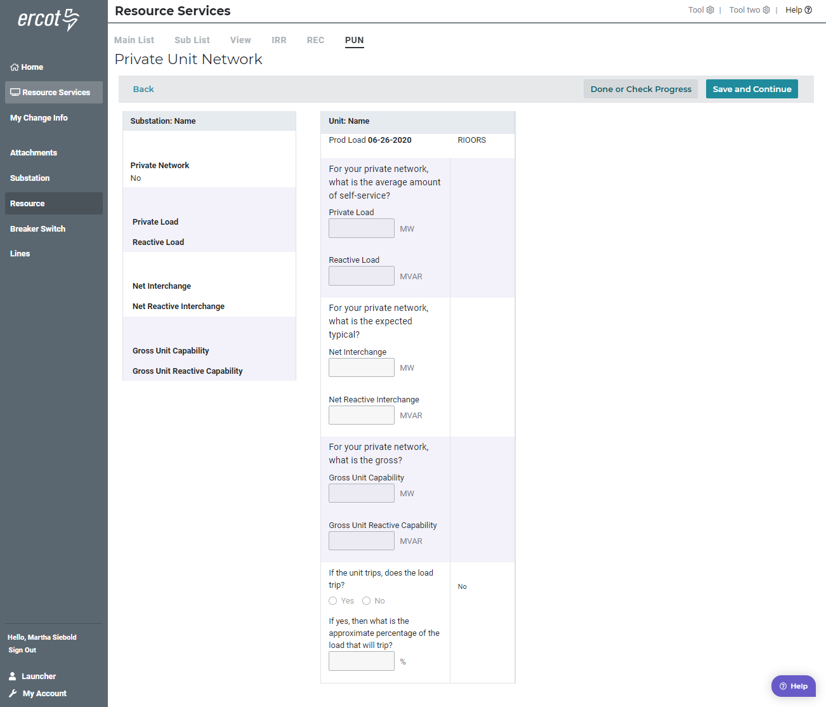
Private Unit Network

Slide 18
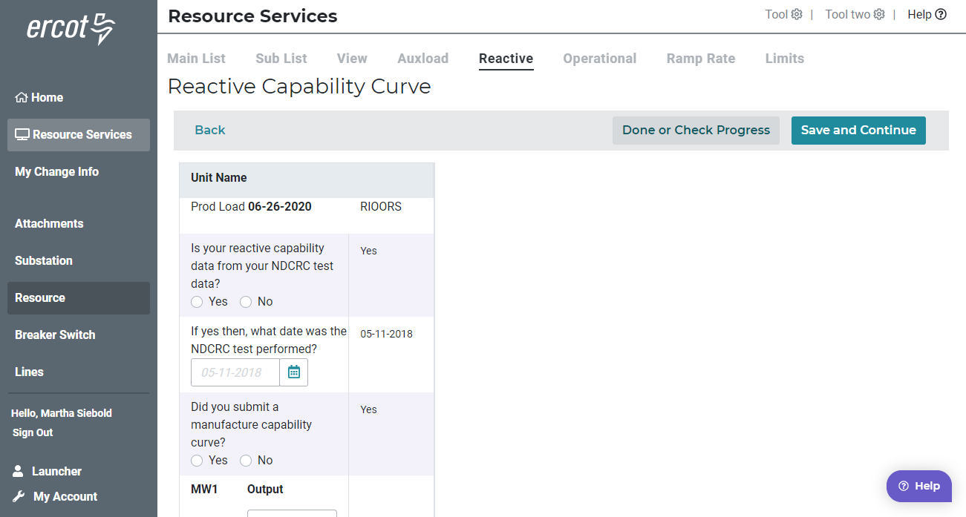
Reactive Capability Curve

Slide 19
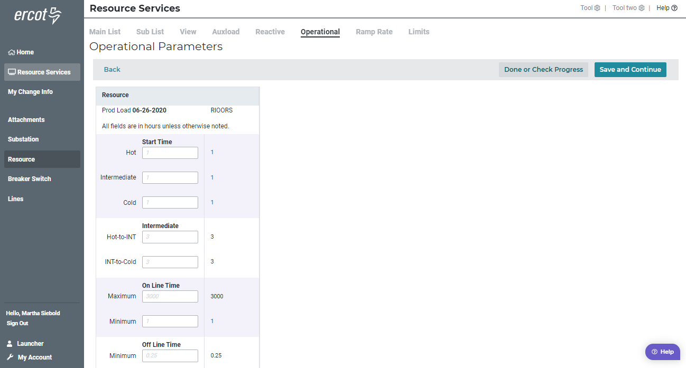
Operational Parameters

Slide 20
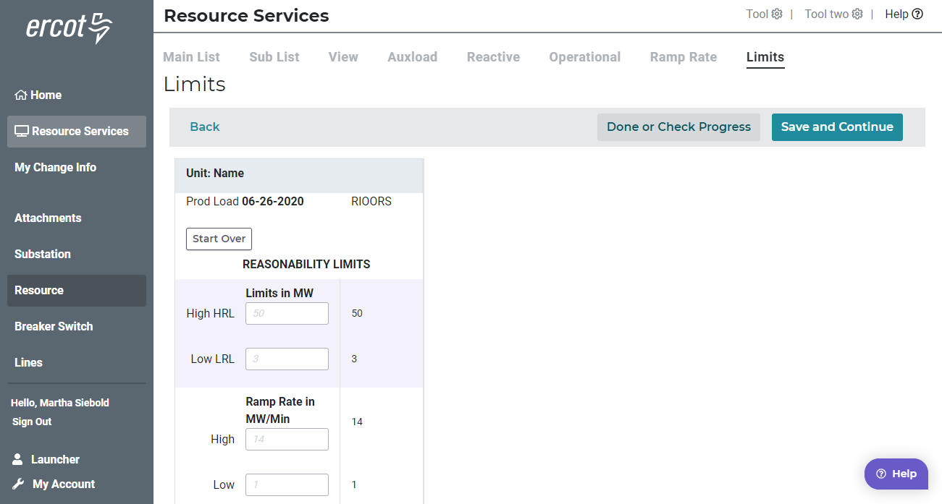
Limits

Slide 21
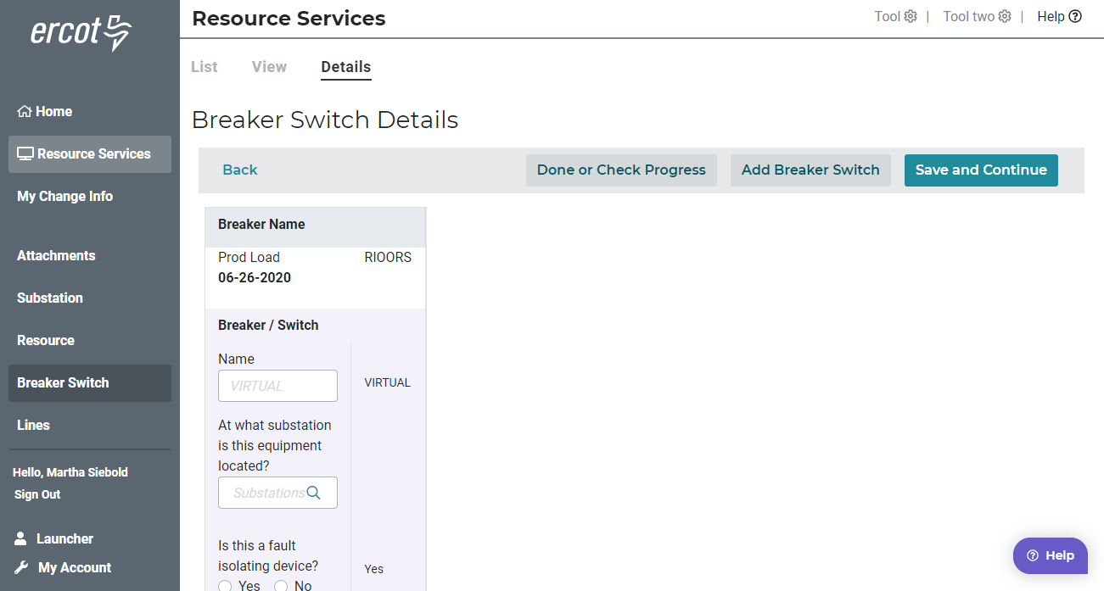
Breaker - Modify

Slide 22
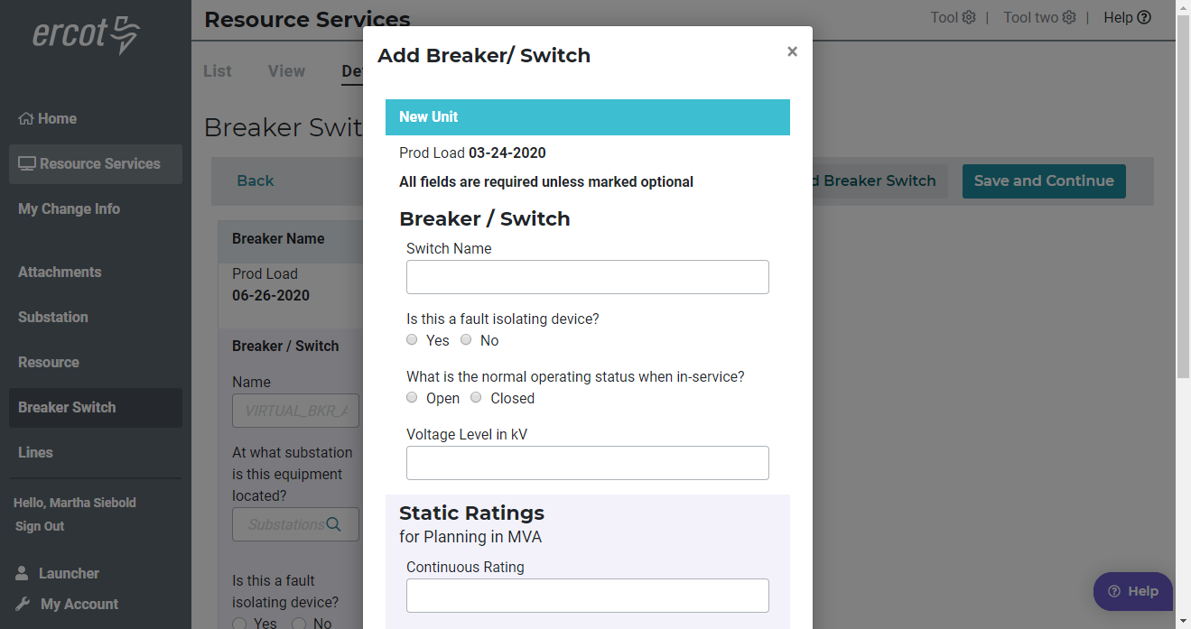
Breaker - Add

Slide 23
Questions?

